Slide 1
Tools and Equipment

Slide 2
What is the name of the tool below?
A
B
TENAN SAW
TENON SAW

Slide 3
What is the name of the tool below?
B
TENON SAW

Slide 4
Reflection
What type of line does a Tenon Saw cut?
A
B
CURVED
STRAIGHT

Slide 5
Reflection
What type of line does a Tenon Saw cut?
B
STRAIGHT

Slide 6
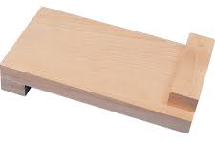
Reflection
What is the piece of equipment below called?
A
B
Wood block
Bench Hook

Slide 7
Reflection
What is the piece of equipment below called?
B
Bench Hook

Slide 8
Reflection
What is the area called below?
A
B
Waste Area
Gap Area

Slide 9
Reflection
What is the area called below?
A
Waste Area

Slide 10
Reflection
What is a deciduous tree?
A
B
Have needle-like leaves all year round
lose their leaves and become dormant during the winter.

Slide 11
Reflection
What is a deciduous tree?
B
lose their leaves and become dormant during the winter.

Slide 12
Reflection
What of the woods below is a Hardwood?
A
B
Pine
Oak

Slide 13
Reflection
What of the woods below is a Hardwood?
B
Oak

Slide 14
Reflection
What of the woods below is a Softwood?
A
B
Beech
Spruce

Slide 15
Reflection
What of the woods below is a Softwood?
B
Spruce

Slide 16
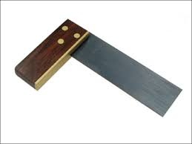
1. What are the following tools called?

Slide 17
1. What are the following tools called?
TRY SQUARE

Slide 18
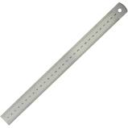
2.What are the following tools called?

Slide 19
2.What are the following tools called?
STEEL RULE

Slide 20
3. What unit of measurement do we use in DT?

Slide 21
3. What unit of measurement do we use in DT?
Millimetres

Slide 22
4. Why do we use this measurement?

Slide 23
4. Why do we use this measurement?
Accuracy

