Slide 1
Formulations

Slide 2
Lesson objectives
Know what a formulation means
Give some examples of products with formulations

Slide 3
Definition
A formulation is a mixture that has been designed as a useful product by mixing the components in carefully measured quantities to ensure that the product has the required properties

Slide 4
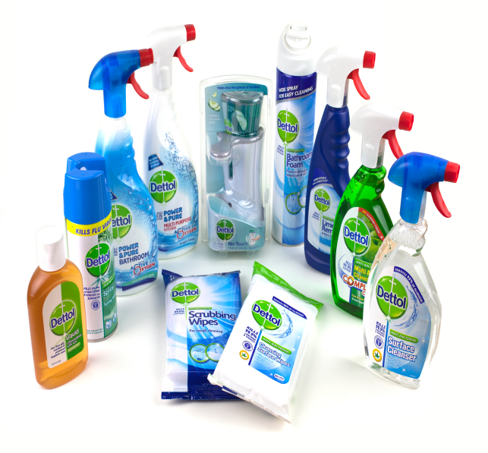
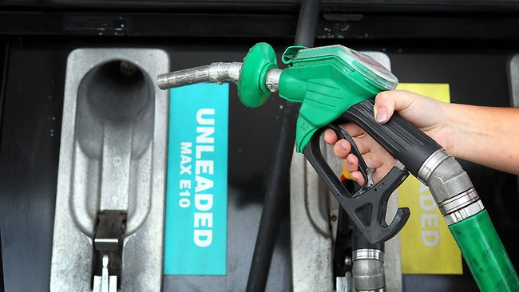
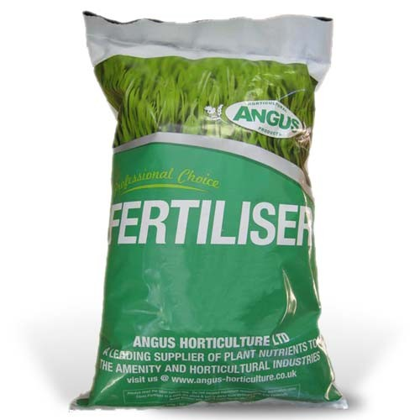
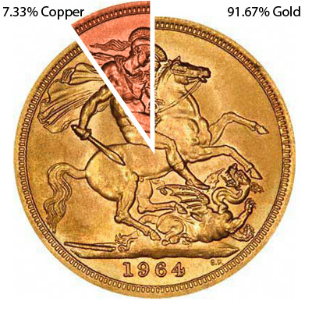
Everyday formulations

Slide 5
Alloys
different properties
harder than pure metals
mixture of metals with other elements
- steel (iron & carbon)
- brass (copper & zinc

Slide 6
Fertilisers
used for different soils
used for different plants
mixtures of different substances
ammonium nitrate
phosphorus oxide
potassium oxide

Slide 7
Fuels
burn well
clean the engine
specific mixtures
petrol
diesel

Slide 8
Medicines
taste better
look better
bind the ingredients
specific mixtures
aspirin (aspirin, cornstarch,)
calpol (paracetamol, sugar, colouring, solvent)

Slide 9
Cleaning products
remove grease
remove stains
kill bacteria
mixtures of different substances
dishwasher tablets (detergent, rinse aid, bleaches, alkalis)
toilet cleaners (detergents, bleach)

Slide 10
Foods
adds flavour
bind ingredients together
specific mixtures
margarine (vegetable oils, water, emulsifiers, salt etc)
tomato ketchup (tomatoes, vinegar, sugar, spices, salt etc)

Slide 11
Paints
holds pigment
in place while
paint dries
gives colour
specific mixtures containing
solvent
pigments
binder

