Slide 1
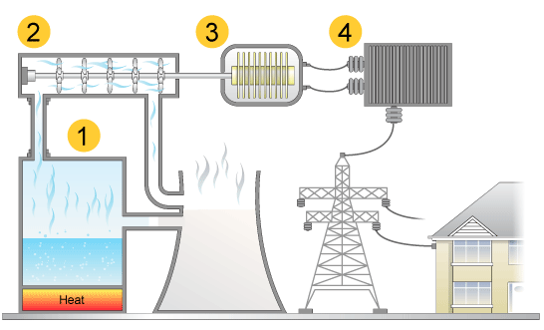
Burning fossil fuels for electricity
generator, turbine, house, boiler
Fuels such as _____, _____ and _____ are burnt to produce ____ energy.
Heat energy makes the water boil to produce _______.
Steam drives the ___________, making it ______.
The spinning turbine turns a ____________ which produces ____________.
The electricity travels through the national grid for use in our ________.
homes, oil, steam, turbine, gas, spin, coal, electricity, heat, generator

