Slide 1
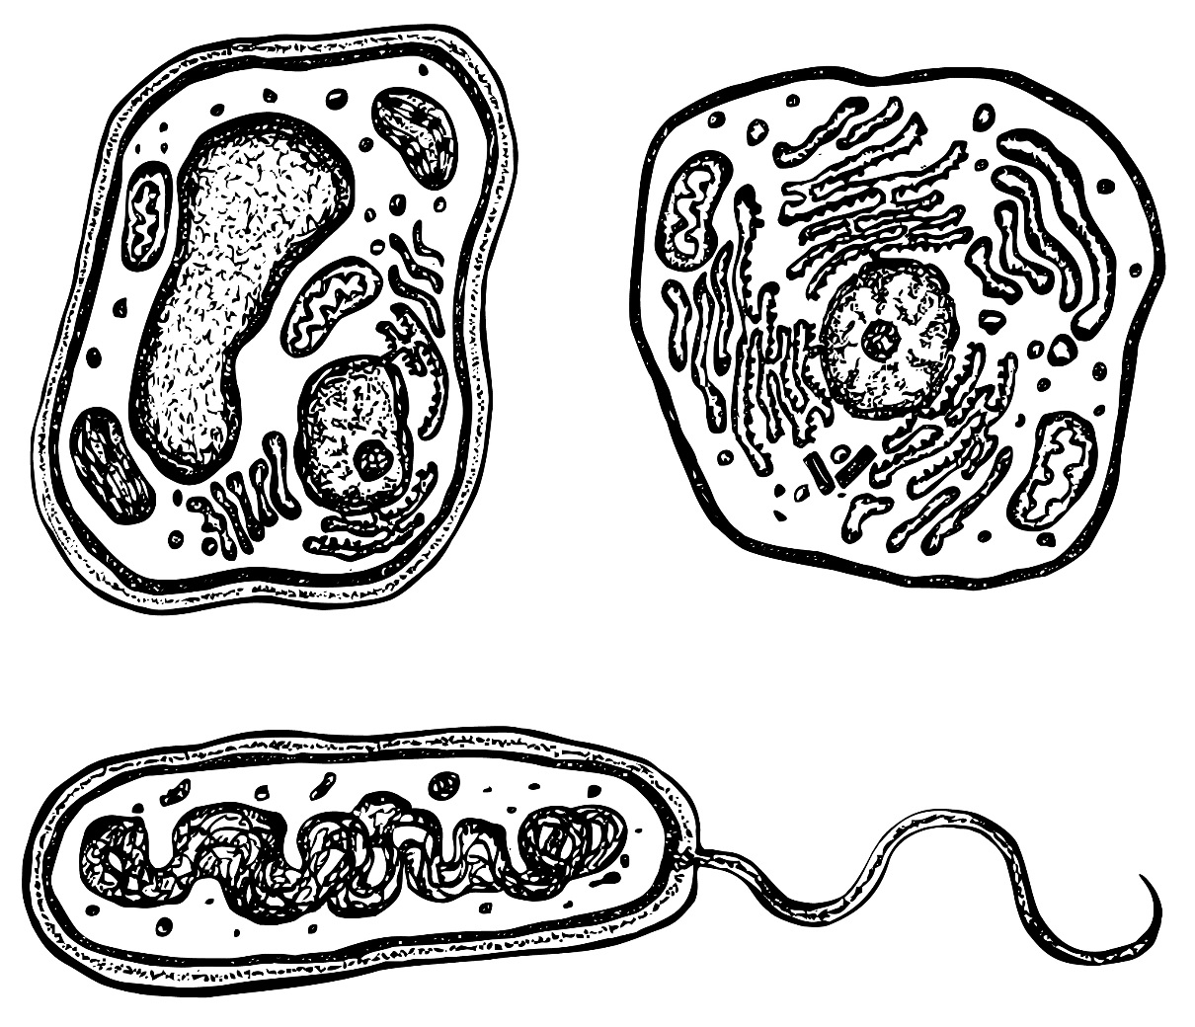
Identify the plant, animal and bacterial cell
What are the main differences between these cells?
Cell 1
Cell 2
Cell 3

Slide 2
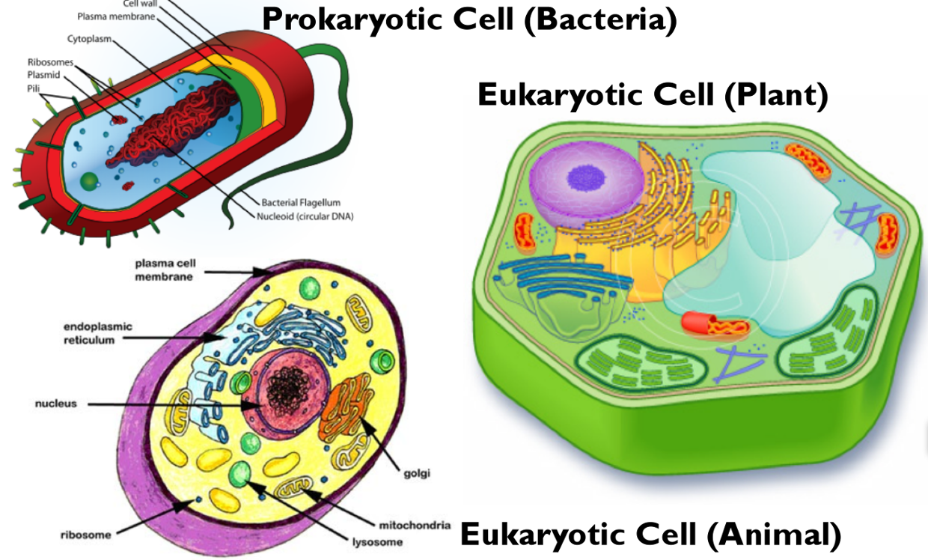

Slide 3
Eukaryotic cells have a true nucleus. (Eukaryotic means ‘good nucleus’). Most living things have eukaryotic cells.
Prokaryotic cells do NOT have a true nucleus. They just have an ‘area’ in the cell where most of the DNA is kept (sometimes called a nucleoid). Bacteria are the only living things with prokaryotic cells.
PROKARYOTE vs EUKARYOTE

Slide 4
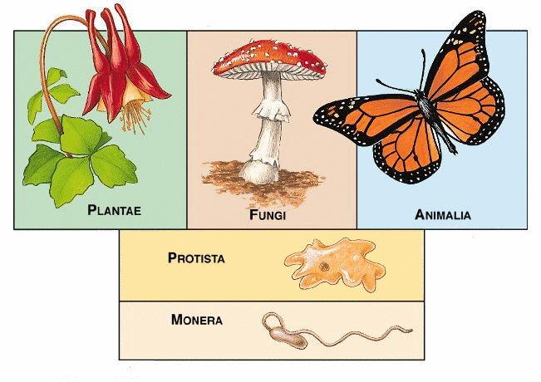
THE ‘OLD’ SYSTEM OF CLASSIFICATION: THE FIVE KINGDOMS OF LIFE

Slide 5
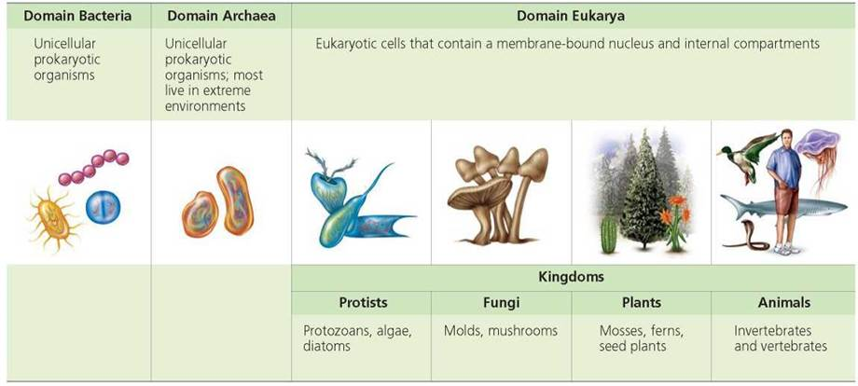
THE DOMAINS OF LIFE
Living things used to be divided into five KINGDOMS based on what their cells are like. The current system uses three DOMAINS, above the level of kingdom. This classification is also based on cell structure.

Slide 6
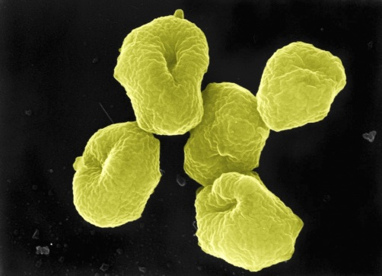
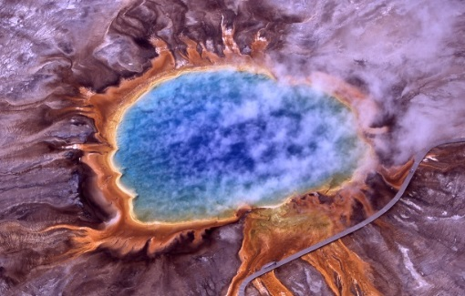
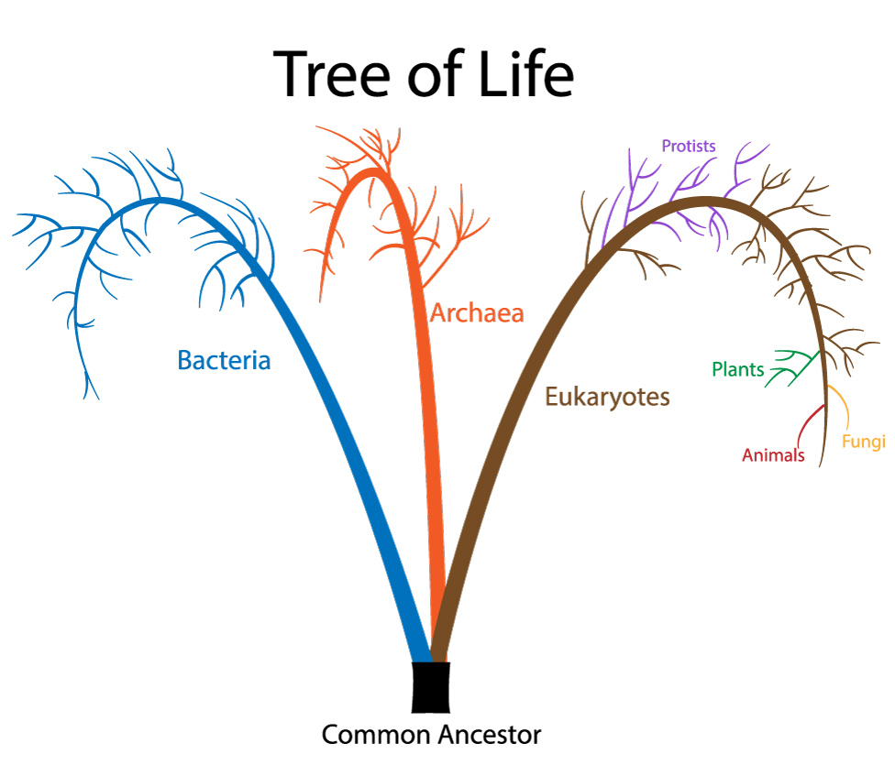
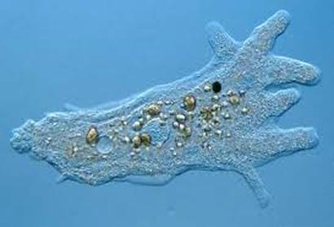
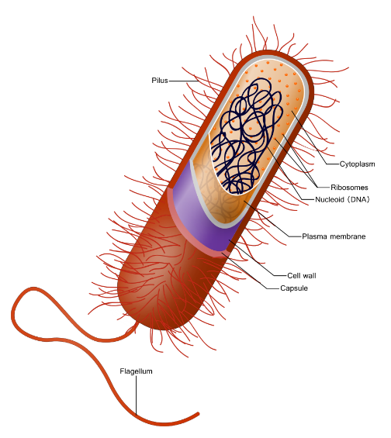
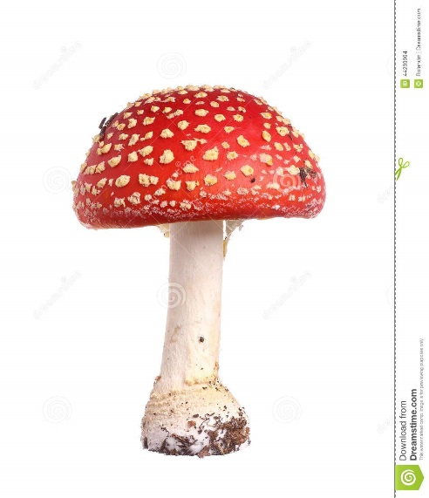
THE NEW SYSTEM OF CLASSIFICATION: THE THREE DOMAINS OF LIFE

Slide 7
Prokaryotic cells
Eukaryotic cells
The most ancient group
Contains kingdoms of Animals, Plants, Fungi and Protists
No true nucleus
FEATURES OF DOMAIN
BACTERIA (PROKARYOTES) | ARCHAEA | EUKARYA
Often live in extreme environments eg high salinity or temperatures
No true membrane-bound organelles.
True nucleus
Always unicellular
May be multicellular
organelles with membranes

Slide 8
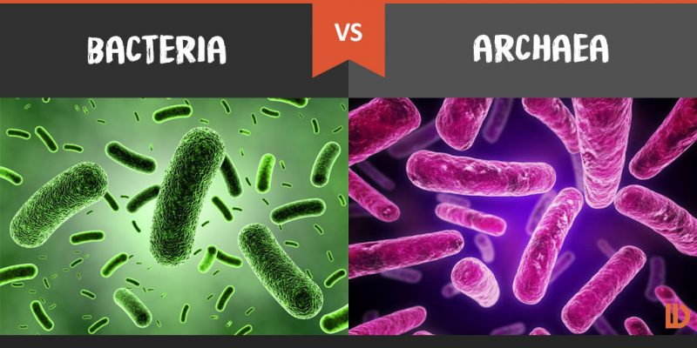
Very similar, but archaea are smaller, simpler and live in extreme environments.
Bacteria and Archaea, Amoeba Sisters 5:09
Extremophiles 2:33
How two microbes changed the world, Evolution of eukaryotes, interesting, HA 7:57

Slide 9
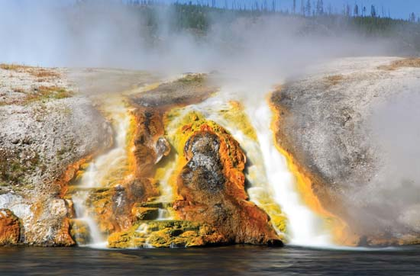
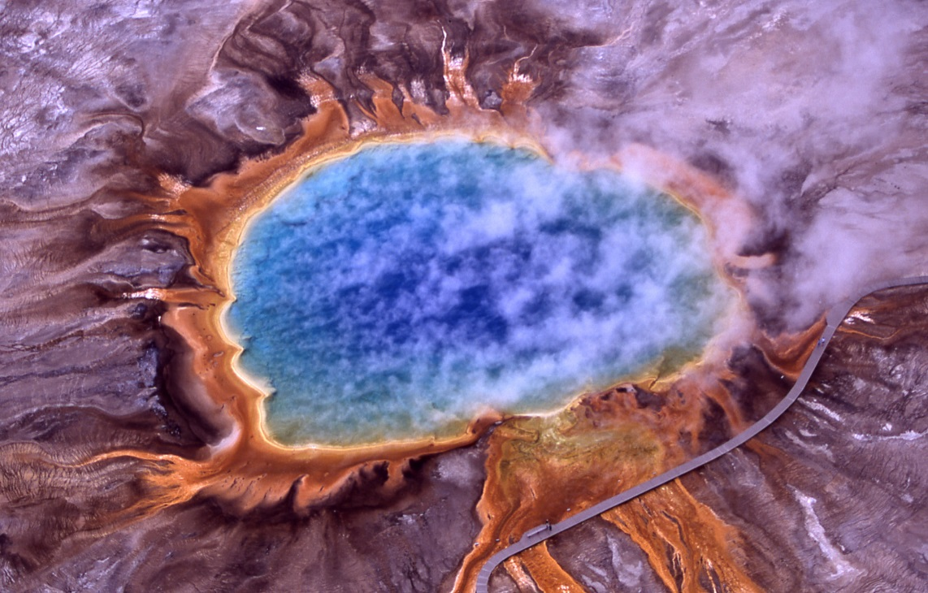
Archaea like it hot and inhospitable (to other organisms). They can live where few other organisms (even bacteria) can, eg boiling hot volcanic springs, or inside freezing cold rocks.

Slide 10
