Slide 1
Trace table
Trace table is used to:
Find the output of programs
Find the changes in the values of variables
Find errors in the program.

Slide 2
1. Complete the trace table.
x | Output
for x in range (1,6):
print(x*2)
Notes:
Teacher demonstration

Slide 3
2. Complete the trace table.
x | x < 3 | Output
for x in range (1,5):
if x < 3:
print("less than 3")
else:
print("3 or above")
Notes:
Teacher demonstration

Slide 4
3. Assume the user enters the following values: “Sam”, “upper”, “Ayo”, “lower”, “Zoe”,”upper”
x | choice | case | Output
for x in range(1,4):
choice = input("Enter a word")
case = input("upper or lower")
if case == "upper":
print(choice.upper () )
else:
print(choice.lower () )
Notes:
Teacher demonstration

Slide 5
4. Complete the trace table.
https://youtu.be/IcX4DMxqAKY
X | Output
for x in range (1,6):
print(x**2)
Notes:
Teacher demonstration

Slide 6
5. Complete the trace table.
https://youtu.be/_9-cXSiAoSw
X | country | Output
for x in range (1,5):
country = "France"
print(country[x])
Notes:
Teacher demonstration

Slide 7
6. Assume the user enters the following values: 0, 3, 2, 5
x | Is x < 3 | num | Output
for x in range (2,7):
if x < 3:
print("it’s Jeff")
else:
num = int(input("Enter a number"))
print(x * num)
https://youtu.be/TNKu5Z96Xrc
Notes:
Teacher demonstration

Slide 8
7. Assume the user enters the following values: “Nick”, “Lukas”, “Lara”, “Tim”
X | name | length | Output
for x in range (1,5):
name= input("Enter a name")
length = len(name)
print(x * length)
https://youtu.be/kT69M2pO9IY
Notes:
Teacher demonstration

Slide 9
8. Assume the user enters the following values: 7, 0, 4, 8
X | country | num | letter | Output
for x in range (1,5):
country = "United States"
num = int(input("Enter a number"))
letter = country[num]
print(country[x] + letter)
https://youtu.be/IleEze5i0YE
Notes:
Teacher demonstration

Slide 10
9. Assume the user enters the following values: 4, *, 3, % ,6, %, 5, *
Hint: % = MOD (finding the remainder)
x | num | operator | Output
for x in range (1,5):
num = int(input("Enter a number"))
operator = input("Enter operator")
if operator == "%":
print(num % x)
else:
print(num*x)
https://youtu.be/VyrDzifn_s4
Notes:
Teacher demonstration

Slide 11
10. Complete the trace table
x | y | Output
for x in range (1,4):
for y in range (1,4):
print( x * y )
https://youtu.be/lEzhzWsoBds
Notes:
Teacher demonstration

Slide 12
11. Complete the trace table.
X | Is x % 2 == 0 | Output
for x in range (1,7):
if x % 2 == 0:
print(x)
https://youtu.be/GPPdK7qyWCA
Notes:
Teacher demonstration

Slide 13
12. Complete the trace table.
x | x < 5 | Output
x = 1
While x < 5:
print(x*2)
x = x + 1
print(" The end ")
Notes:
Teacher demonstration

Slide 14
13. Assume the user enters the following inputs: 12,10,20,9
num | num>=10 | Output
num = int(input("Enter number"))
while num >= 10:
print("Incorrect")
num = int(input("Enter number"))
print("Correct")
Notes:
Teacher demonstration

Slide 15
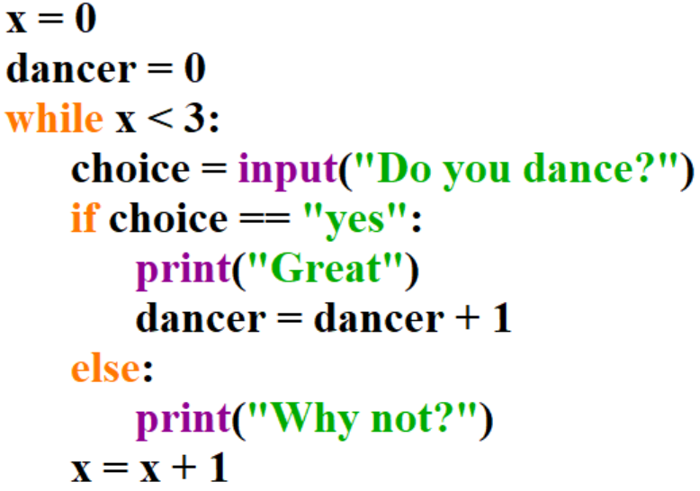
14. Assume the user enters the following values: “yes”, “no”, “chicken”
x | dancer | x < 3 | choice | output
Notes:
Teacher demonstration

Slide 16
15. Complete the trace table. Assume the user enters the following values: “Tom”,”Sarah”,”Andy”,”Ed”
singer | singer != "Ed" | Output

Slide 17
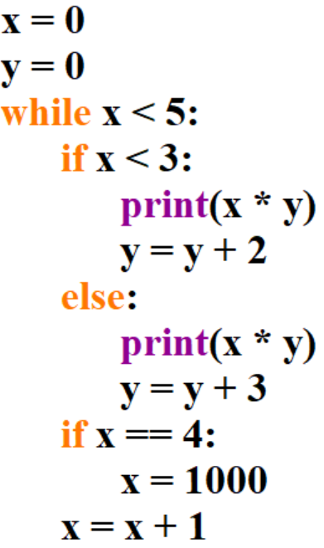
16. Complete the trace table.
x | y | x < 5 | x < 3 | Output

Slide 18
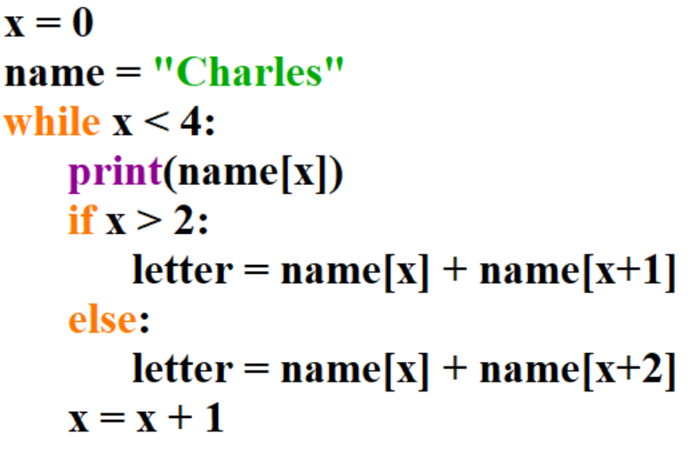
17. Complete the trace table. Then write the final value of letter:
Final value of letter:
x | name | x < 4 | Output | letter

Slide 19
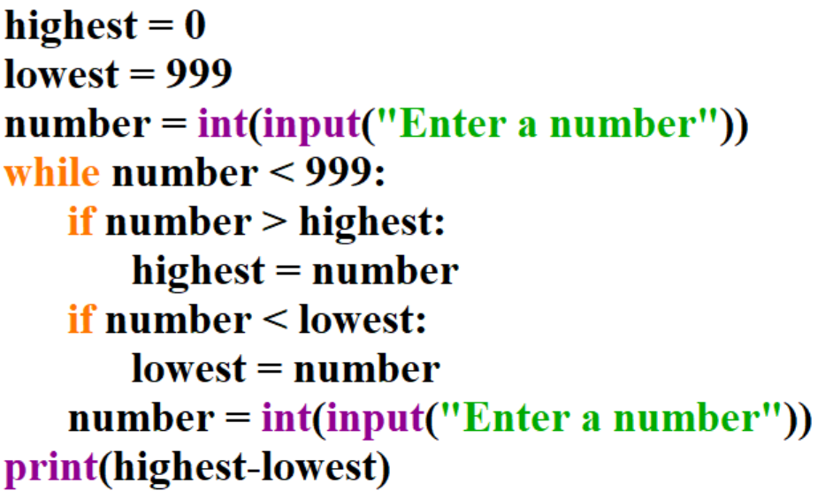
18. Complete the trace table. Assume the user enters the following numbers: 10, 50, 300,5, 1000
Highest | lowest | number | Output

Slide 20
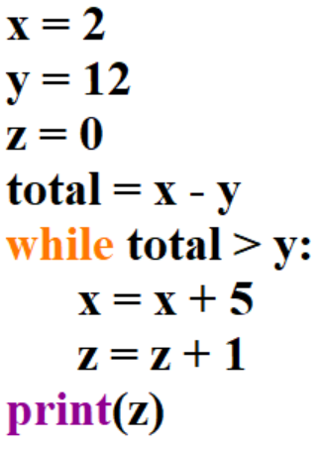
19. Complete the trace table. You may not need all the spaces in the trace table.
Enter the final value of z:
z = 0
x | y | z | total | Output

Slide 21
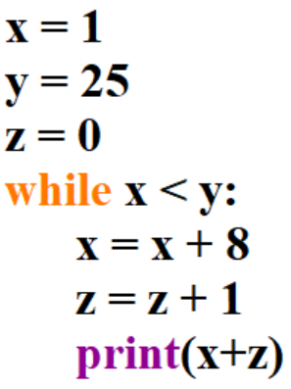
20. Complete the trace table.
x | y | z | Output

Slide 22
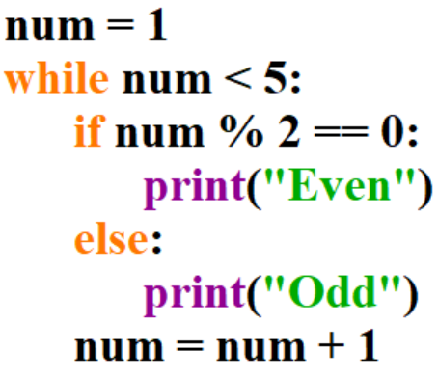
21. Complete the trace table.
num | num < 5 | Output

Slide 23
22. Lets see how it works in a trace table:
x | Output
films = ["Saw", "Sharks", "Lion king"]
for x in range(0,len(films)):
print(films[x])
Notes:
Teacher demonstration

Slide 24
23. Complete the trace table.
x | Output
names = ["Tom", "Mark", "Sam"]
for x in range(0,len(films)):
print(names[x])
Notes:
Teacher demonstration

Slide 25
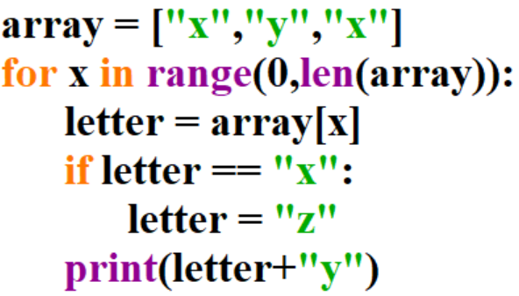
24. Complete the trace table.
x | letter | Output
Notes:
Teacher demonstration

Slide 26
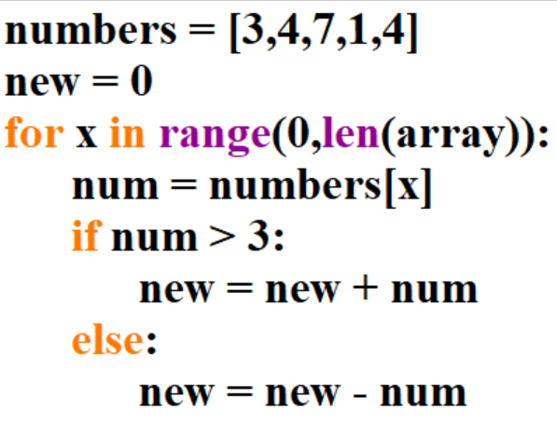
25. Complete the trace table
new | x | num

Slide 27
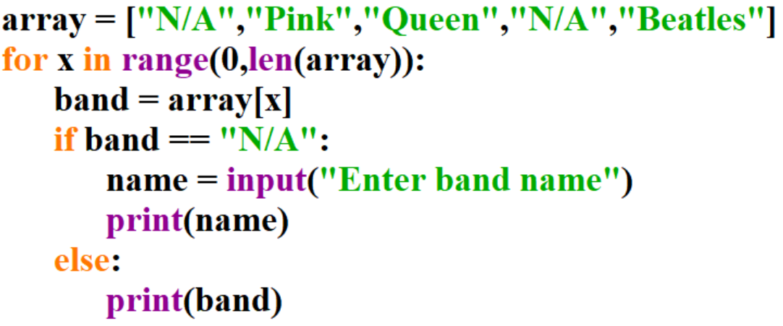
26. Complete the trace table – Assume the user enters the following as inputs: Metallica, Idles
band | name | Output

Slide 28
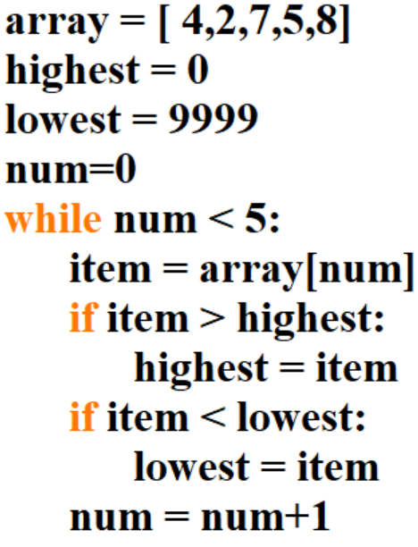
27. Complete the trace table
highest | lowest | num | item

Slide 29
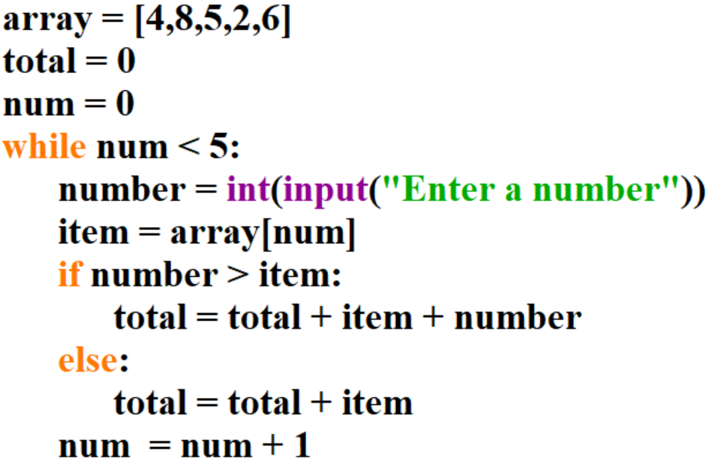
28. Complete the trace table – Assume the user enters 5,2,8,1,4 as inputs
total | num | number | item

Slide 30
29. Complete the trace table
row | column | output

Slide 31
30) Complete the trace table.
row | grades[row][0] | grades[row][1] | Output

Slide 32
31) Complete the trace table. Assume the user enters the following inputs: 15,40,20,7,55,21
x | y | num | numbers[x][y]

Slide 33
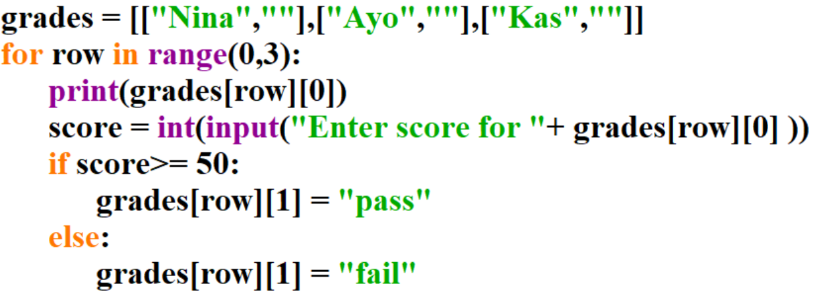
32) Complete the trace table. Assume the user enters the following inputs: 25,90,50
row | Output | score | grades[row][1]

Slide 34
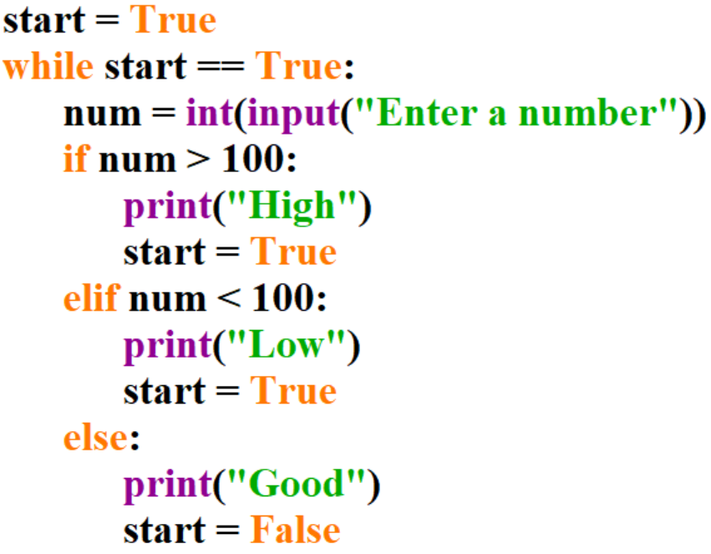
33. Starter: Revisit phase – Complete the trace table Assume the user enters the following values: 5,106,200,100
start | num | output

Slide 35
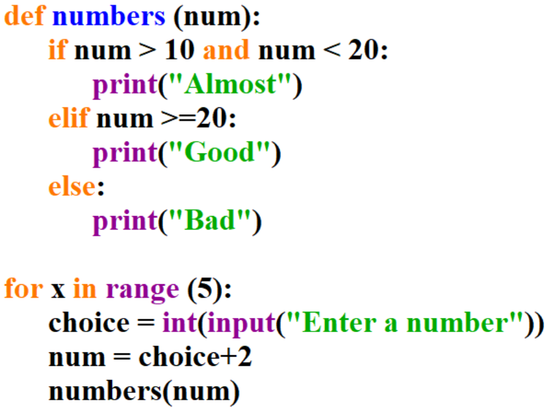
34. Procedure trace table - Assume the user enters the following values: 5,18,15,100,17
choice | num | output

Slide 36
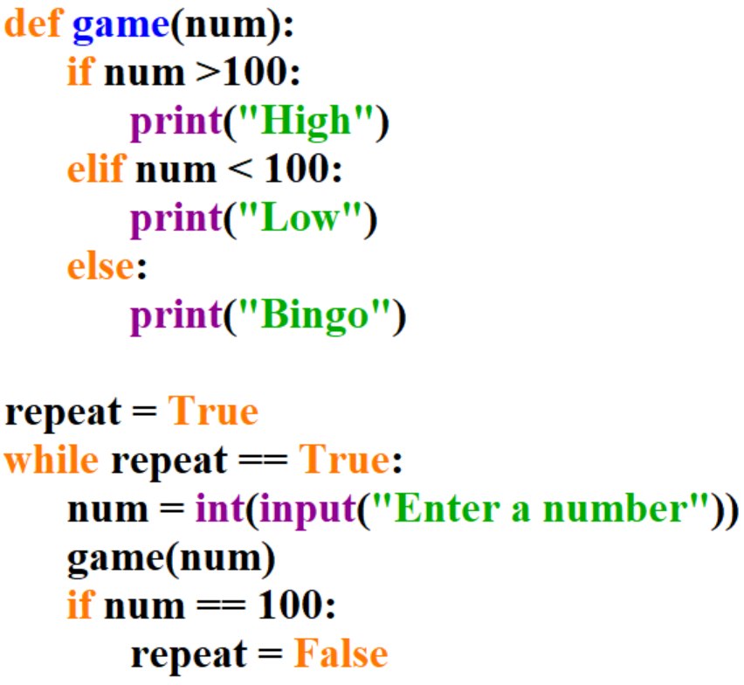
35. Procedure trace table - Assume the user enters the following values: 88,155,15,102,100
Repeat | Repeat == True | num | output | num==100
Notes:
def game(num):
if num >100:
print("High")
elif num < 100:
print("Low")
else:
print("Bingo")
repeat = True
while repeat == True:
num = int(input("Enter a number"))
game(num)
if num == 100:
repeat = False

Slide 37
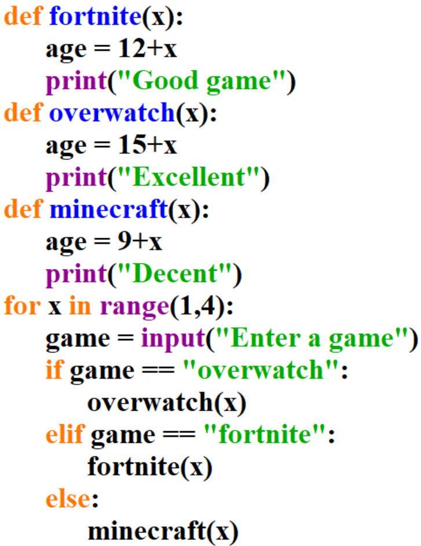
36. Procedure trace table - Assume the user enters the following values: fortnite, minecraft, overwatch
x | game | age | output
Notes:
def fortnite(x):
age = 12+x
print("Good game")
def overwatch(x):
age = 15+x
print("Excellent")
def minecraft(x):
age = 9+x
print("Decent")
for x in range(1,4):
game = input("Enter a game")
if game == "overwatch":
overwatch(x)
elif game == "fortnite":
fortnite(x)
else:
minecraft(x)

