Slide 1
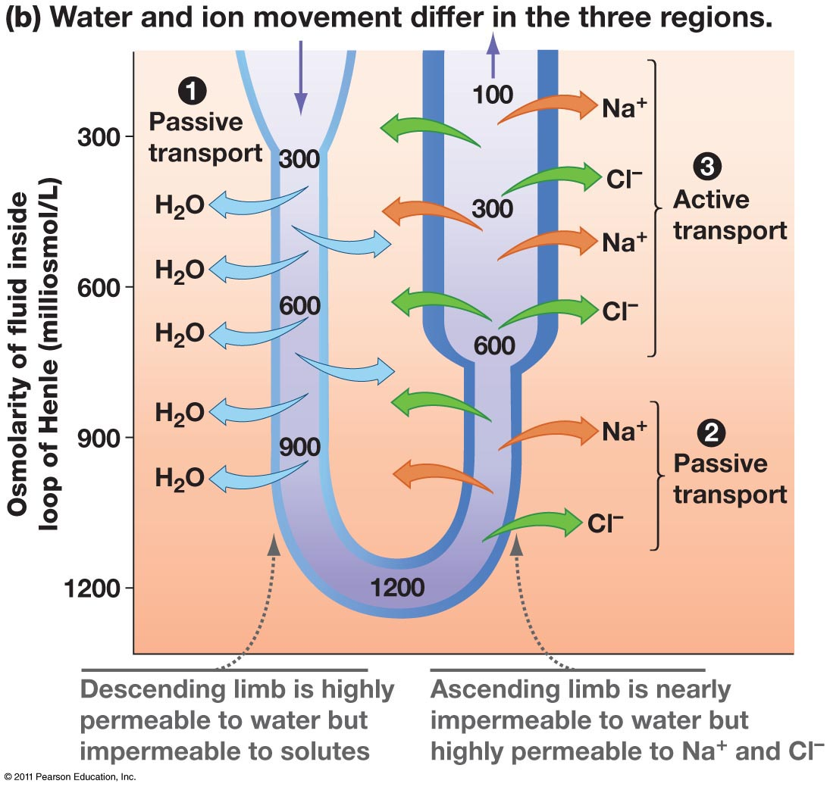
Annotate the features of the loop of Henle and how it works

Slide 2
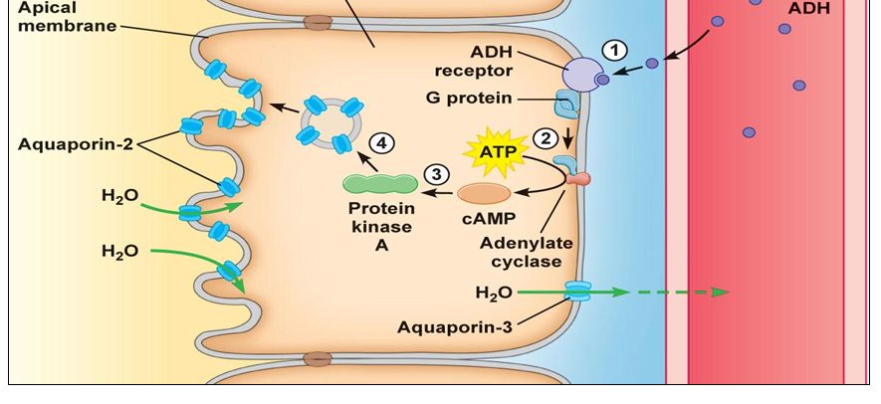
How does ADH altered the permeability of the collecting duct?

