Slide 1
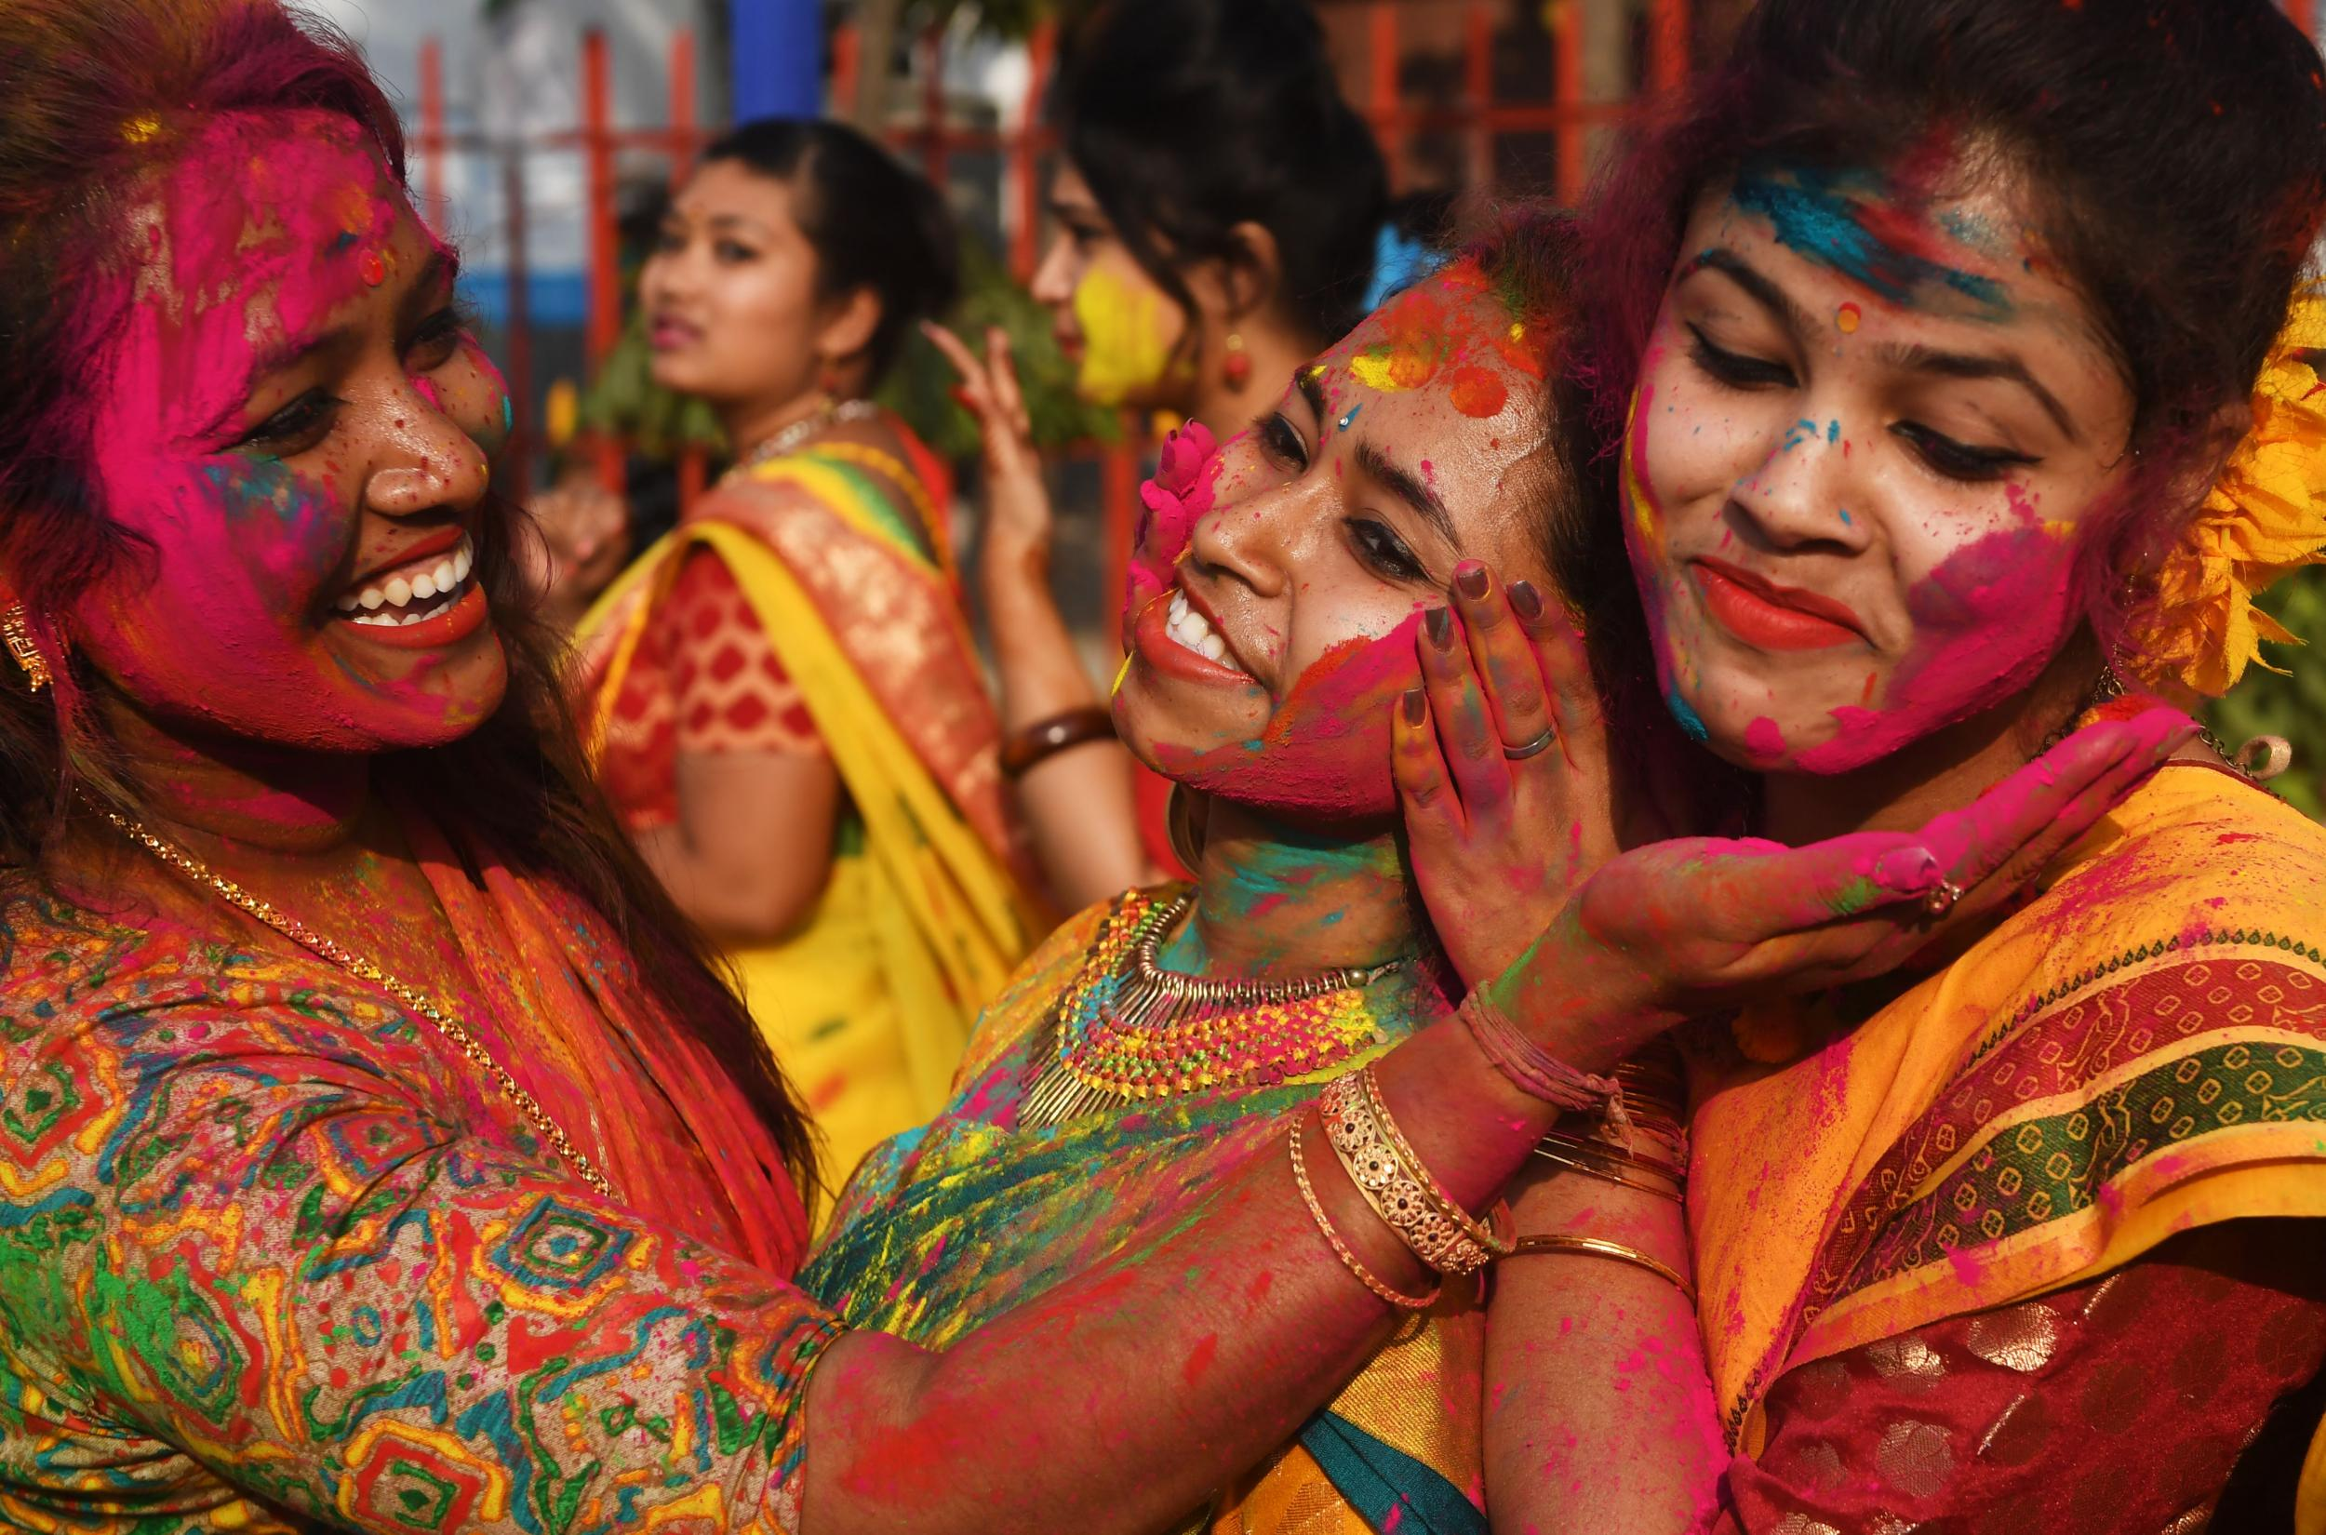
Who was Gandhi and how is his life important today?
Why is the Ramayana important for Hindus?
What is the caste system?
What do Hindus believe happens when we die?
Why is Diwali important for Hindus?
What do Hindus believe about different deities?
Is Hinduism monotheistic or polytheistic?

Slide 2
How many gods are there in Hinduism?

Slide 6
