Slide 1
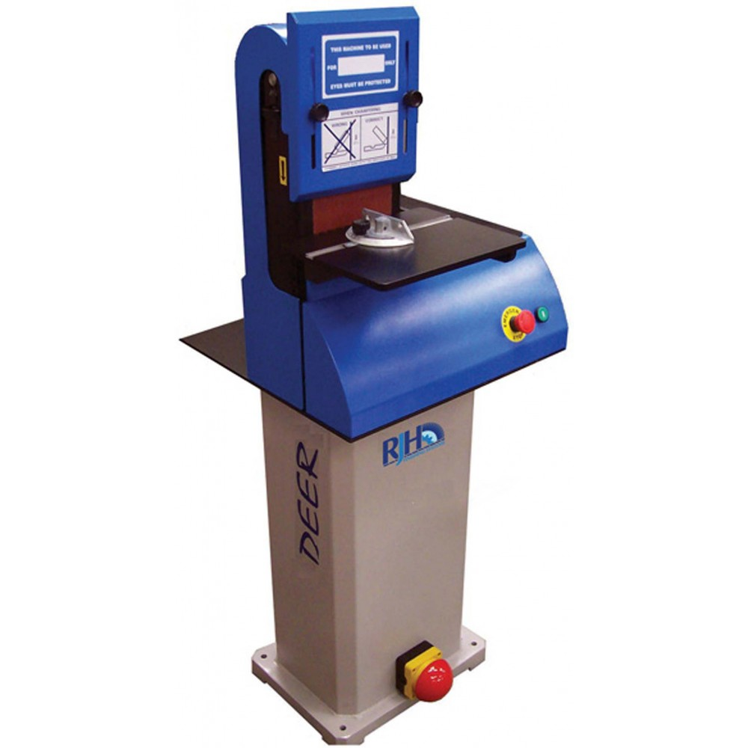
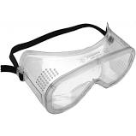
Using the key words in the table below write down the name of each component.
Belt Sander
Goggles
PPE-Protects the eyes from dust and particles.
Start/Stop buttons
The green button starts the machine and red stop. Each button is clearly identified by colour and shape to ensure there is a clear difference between the two buttons (this is useful if you can not see the buttons).
Guard
The guard is adjustable and is moved so that it sits just above the height of the material being sanded. It protects your knuckles and prevents the belt from flipping up if it breaks.
Table
The Table is where you position your material when sanding. It provides a flat surface which can be adjusted if you need to sand an angle.
Abrasive Belt
An abrasive belt rotate around and wastes (sands) the surface material.
Emergency Stop button
Positioned at the base of the Pillar drill so that the user can easily use their foot in the case of emergency.

Slide 2
Using the key words in the table below write down the name of each component.
Belt Sander:
Revision
Start/Stop buttons
Abrasive Belt
Table
Emergency Stop button
Guard
Goggles
Explain what each component is used for.

