Slide 1
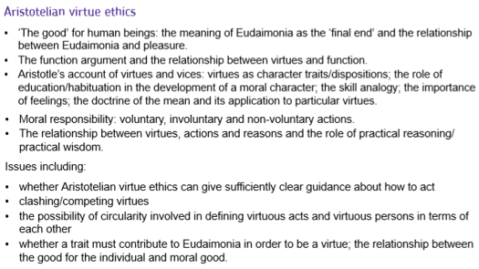
Aristotelian Virtue Ethics

Slide 2
Eudaimonia
Eudaimonia = The good for a human life
‘living well and faring well’ / flourishing
Eudaimonia is not a state of mind, but relates to the activity of living
It is not subjective, but objective
It is not easily changed, but relates to a life as a whole
Final end: an end that we desire for its own sake, not for some further purpose
Some final ends, e.g. pleasure, knowledge, we seek both for their own sake and for the sake of something else, viz. eudaimonia
These other final ends are constituent parts of eudaimonia
But only eudaimonia we seek for its own sake and no other purpose
Not pleasure: animals share in this, but there is more to a human life

Slide 3
The function argument
Key ideas
The argument
P1: The characteristic function (ergon) of a human involves reasoning, since this alone is not shared with other living beings.
P2: A good or excellent example of something does its function well
C1: Therefore: a good or excellent person is one whose activity expresses reason well.
P3: Our virtues will be properties that enable us to do this well.
C2: Therefore, the human good (eudaimonia) consists in activity of the soul which exhibits the virtues by being in accordance with (‘good’ or ‘right’) reason.
C3: Therefore, to live the good life (perform my function well), I should develop my virtues.
Eudaimonia: living well, our final end
Ergon: something’s function or characteristic form of activity (functioning rather than purpose)
An x is a good x when it performs its characteristic activity well (e.g. Good eyes see well; good knives cut well)
Virtue: a quality that aids the fulfilment of a thing’s ergon (e.g. The focus of an eye; the sharpness of a knife)
The good life involves virtue, pleasure and prosperity
Virtue: Central to the account. We must act on virtue, not merely possess it.
Pleasure: People find pleasant whatever it is that they love. A virtuous person loves living virtuously.
Prosperity: In order to live virtuously, we will also need a certain amount of external goods.

Slide 4
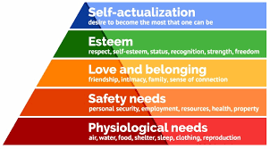
Philosophy and Eudaimonia
Theoretical reason – the contemplation of truth – is the ‘highest’ activity of human beings
Other animals also consider and act on what is best for themselves (practical reason). But they do not contemplate general truths.
Eudaimonia must include excellence in this activity, which is philosophy
This activity is best because:
Theoretical reason is the best thing in us, and what we most are. With it, we contemplate what is best (the greatest, most wonderful and most divine things in the universe)
We are able to undertake this activity more continuously than any other activity, so it leads to the most continuously happy life
Its pleasures are most pure and enduring, unlike pleasures of the body. It is the most self-sufficient activity. Nothing further arises from it (it is knowledge for its own sake), and we need fewer external goods for this than for any other virtuous activity.
The best and most pleasant life is, therefore, a life of reason.
While we should strive to live a life of philosophy, we require more than this:
We have bodies, desires, emotions and live with others
Philosophy is not sufficient for eudaimonia, we also need the virtues
For all this, we require some external goods (health, wealth, good fortune)

Slide 5
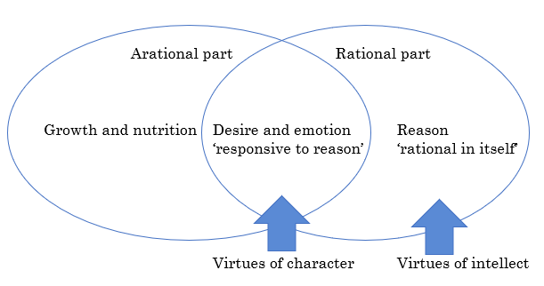
What is a moral virtue?
Aristotle: a moral virtue is a state of character by which you ‘stand well’ in relation to your desires, emotions and choices:
A character trait is a disposition relating to how one feels, thinks, reacts etc. in different situations, e.g. short-tempered, generous
Character traits are more stable and long-lived than mental states like moods and desires. They can change over a lifetime, but are central to being the person one is.
A virtue is a disposition to feel, desire and choose ‘well’

Slide 6
‘Doctrine of the mean’
Virtues and virtuous actions lie between ‘intermediate’ between two vices of ‘too much’ and ‘too little’
Not arithmetical
‘to feel [desires and emotions] at the right times, with reference to the right objects, towards the right people, with the right motive, and in the right way’
This is NOT the same as ‘moderation’ on all occasions. E.g. virtue of anger does not mean only ever being moderately angry, it means being the appropriate level of angry.

Slide 7
Practical wisdom
Practical wisdom – an intellectual virtue – helps us know what the right time, object, person, motive and way is
A virtue, then, ‘a state of character concerned with choice, lying in the mean, i.e. the mean relative to us, this being determined by a rational principle, and by that principle by which the person of practical wisdom would determine it’
So, what is ‘truly’ pleasant is what is pleasant to the virtuous person. It is these pleasures that form part of eudaimonia. People who are not virtuous may get pleasure from other activities, but such pleasure is not good or ‘truly’ pleasant.

Slide 8
Acquiring virtues – Skill analogy
We acquire virtues of character through the habits we form during our upbringing.
Virtues can’t simply be ‘taught’ – there are no moral child prodigies
We are not virtuous ‘by nature’, but become virtuous by practising
Like learning to play a musical instrument
So we become just by doing just acts
We develop virtues like we develop practical skills
Practice, not just theory, is needed
The aim is to learn to think for oneself
The expert has moved from following rules to developing a highly attuned sensitivity to each situation, they know why a particular response is most appropriate in a particular situation (practical wisdom)
So, a fully virtuous action
know what you are doing,
chooses the act for its own sake
choose from a firm and unchangeable character
As we become just, we understand what justice is and choose it because it is just

Slide 9
Voluntary and involuntary actions
Involuntary actions: an action caused by force
Whether an action done from ignorance is involuntary or ‘not voluntary’ depends on regret (e.g. Stepping on someone’s foot and caring or not caring)
Voluntary actions: we know what we are doing and we bring it about ourselves
Actions done from desire or emotion are still voluntary
Everything we choose to do is voluntary, but not everything voluntary is chosen
E.g. the actions of children
Choice: what we decide upon as a result of deliberation
Deliberation: is reasoning about what we can change
Esp. where we need to act not from habit but differently on different occasions
Acting IN ignorance (e.g. drunk) = voluntary
Acting FROM ignorance (not having relevant information) = not voluntary
{
= moral responsibility
{
According to Aristotle

Slide 10
Aristotle: Bad people act voluntarily
Argument 1: What it is in our power to do, it is also in our power not to do. So we can choose to do either good or bad actions. So bad people do bad actions voluntarily.
Arg. 2: We encourage people not to do bad actions, yet we don’t encourage people not to do things that are out of their power. That would be pointless. So bad actions are done voluntarily.
Response: maybe bad people are acting FROM ignorance of what is good, therefore their actions are not voluntary
Arg. 3: Bad people became bad as a result of their choices (opposite of acquiring virtues). Therefore, they are responsible for becoming bad, and thus becoming ignorant of what is good.
Response: bad people are not responsible for what they think is good
Arg. 4:
P1: If the bad person is not responsible for their bad actions, and these are not done voluntarily, then the good person is not responsible for their good actions, and these are not done voluntarily.
P2: what is good cannot force us to act, and that what is involuntary is painful and causes regret.
C1. So good actions are done voluntarily.
C2. Therefore, so are bad actions.

Slide 11
Objection 1: Guidance on how to act
Objection: The doctrine of the mean is no practical help
‘Too much’ and ‘too little’ aren’t quantities on a single scale: the ‘mean’ is meaningless
So how often or how angry should we get?
Response: the doctrine of the mean isn’t an algorithm
Practical wisdom is needed to judge the mean: the mean is where the person with practical wisdom judges it to be; this isn’t a matter of following a rule.
Objection continued: The theory of practical wisdom provides no guidance either
If I have practical wisdom, I know what to do; if I don’t, simply knowing that I should do what the virtuous person would do doesn’t help!
Without virtue, we can’t know what is good – so not everyone knows what is good
Response: Knowledge of what to do comes in degrees, and we can hold most people responsible
People can improve their knowledge of what is good by trying to become better people
Annas: by the time we reflect on right action, we each already have a life
So we have some guidance from our culture, but this will prove inadequate
We are each at different stages of moral development – there is no one right action for everyone

Slide 12
Objection 2: Conflicts between virtues
Objection: What if the virtues conflict?
E.g. justice and mercy? Should we give someone the punishment they deserve or show mercy?
Response: Aristotle denies that this is possible.
With practical wisdom, we can know what virtues the situation demands and avoid the conflict.
If you think that mercy requires injustice, or that justice demands being merciless, then you have misunderstood what justice or mercy actually mean in this situation.
Aristotle rejects that morality involves absolute or universal rules, it’s always a matter of context and judgement
Virtues don’t make demands of their own accord, but provide us with various means to achieve eudaimonia.
Objection continued: Is this always the case though?
Could loyalty to a friend ever require you to be dishonest?

Slide 13
Objection 3: Circularity
Objection:
An act is virtuous if it is an act that would be done by a virtuous person in this situation.
A virtuous person is a person who is disposed to do virtuous acts.
So what is a virtuous person or virtuous act??
(An act is virtuous if it is an act that would be done by a person who is disposed to do virtuous acts in this situation)
(A virtuous person is a person who is disposed to do acts that would be done by a virtuous person)
Possible reply:
This analysis is too simple:
A virtuous person is not defined merely as someone who is disposed to do virtuous actions
A virtuous person has the virtues – concerned with eudaimonia, passions and pleasure

Slide 14
Objection 3: Circularity
Objection continued:
The problem is epistemological:
We can’t tell whether an act is virtuous without knowing whether a virtuous person would do it.
And we can’t tell whether someone is virtuous without seeing whether they do virtuous acts.
Reply:
We can know what a virtuous person is without being able name individuals
‘What the virtuous person would do’ is a standard for judging acts
Other criteria for virtue apart from acts
A different reply:
Annas: the appeal to ‘what the virtuous person do’ is an encouragement for me to think what I should do if I were more virtuous.
Don’t think of the question from the ‘third person’ – ‘what is definition of virtuous action?’ but from the ‘first person’ – what should I do?

Slide 15
Objection 4: Virtue and Eudaimonia
Eudaimonia = The good for a human life. This is what we are aiming at.
BUT, this seems an odd conception of morality
We commonly contrast self-interest and moral duty, and duty can require self-sacrifice
If a morally good life can require self-sacrifice, then eudaimonia and a morally good life are distinct
So is a virtue a trait that contributes to the individual’s eudaimonia? Can there be virtues that are not in someone’s self-interest?
Examples from Swanton:
The tired, ill aid worker
The despairing environmental campaigner
Therefore, according to Swanton, there are values other than eudaimonia. Virtues are dispositions to respond to and pursue these values appropriately.

Slide 16
Objection 4: Virtue and Eudaimonia
Annas’ response
Eudaimonia can’t be understood in terms of (narrow) self-interest
We don’t know what eudaimonia is until we have identified the virtues
Instead, living according to the virtues is what counts as a flourishing life in Aristotle
So aiming at eudaimonia isn’t egoism, e.g. being fair, generous, courageous
These virtues involve a commitment to other’s well-being for its own sake
Being a friend out of self-interest is not being a real friend and misses out on many good things that come from being a real friend
I can’t aim at your eudaimonia – it is a quality of living life, and I can’t live your life
But in pursuing my eudaimonia, I am not privileging my interests above yours
Objection continued
There are some virtuous lives that don’t involve the person flourishing
Reply:
It is better to lead a life of integrity, which the aid worker and environmentalist do
Objection cont.:
True, but integrity isn’t the same as flourishing– their lives could have gone better
So there is no unified final end – virtues can pull in different directions

