Slide 1
GCSE Computer Science (9-1)
Programming
Lesson 2: string handling

Slide 2
Lesson Objectives
Understand and be able to use
Length
Position
Concatenation
Conversion operations

Slide 3
Recap
What is a string?

Slide 4
Strings
Strings are data types used to store sequences of alphanumeric characters and symbols
Strings are denoted through using speech marks “”
For a variable to be a string, it must use ASCII characters (including numbers!)

Slide 5
Hello World!
One of the most well-known programming conventions is to print “Hello World!” in your first program
Let’s relive this now in Python interactive mode! Store the phrase in a variable called string and print it

Slide 6
String manipulation
Essentially strings are lists of characters in an order
In this sense, we can relate strings to arrays
How would you print the first item in a list?
>>> array[0]
Both strings and arrays are mutable – their states can be changed
Now, with your Hello World string, print out the first character using this concept!

Slide 7
Strings are mutable
Strings work just like arrays using the indexing concept
We can call each individual character of a string in the same way we call each individual position in a list
What would String[5] return?
>>> “ ”
Array ← [“Chips”, “Beans”, “Peas”, “Cauliflower”]
String ← “H””e””l””l””o”“ ”“W””o””r””l””d”

Slide 8
Finding position
The concept works back-to-front as well!
We can find the position of a character within a string using the POSITION pseudocode command
For example POSITION(“Hello World”, “r”)
This would return 8
Remember: Indexing starts at 0!

Slide 9
Consider What would be the outputs for this program here?
Num1 ← 3
Num2 ← 4
Str1 ← “3”
Str2 ← “4”
OUTPUT Num1 + Num2
OUTPUT Str1 + Str2

Slide 10
Concatenation
If we were to add two numbers together, we would get the sum of the numbers
However, if we add to ASCII values together, they concatenate
In other words, they join together
“A” + “B” = “AB”

Slide 11
Substrings
What do you think this code would do?
Substrings can be formed using the indexing format
This is done by indexing a string from its start to end point, where : denotes “and onwards” for a string
String ← “Hello World”
Substring ← String[4:]
Substring2 ← String[2,5]

Slide 12
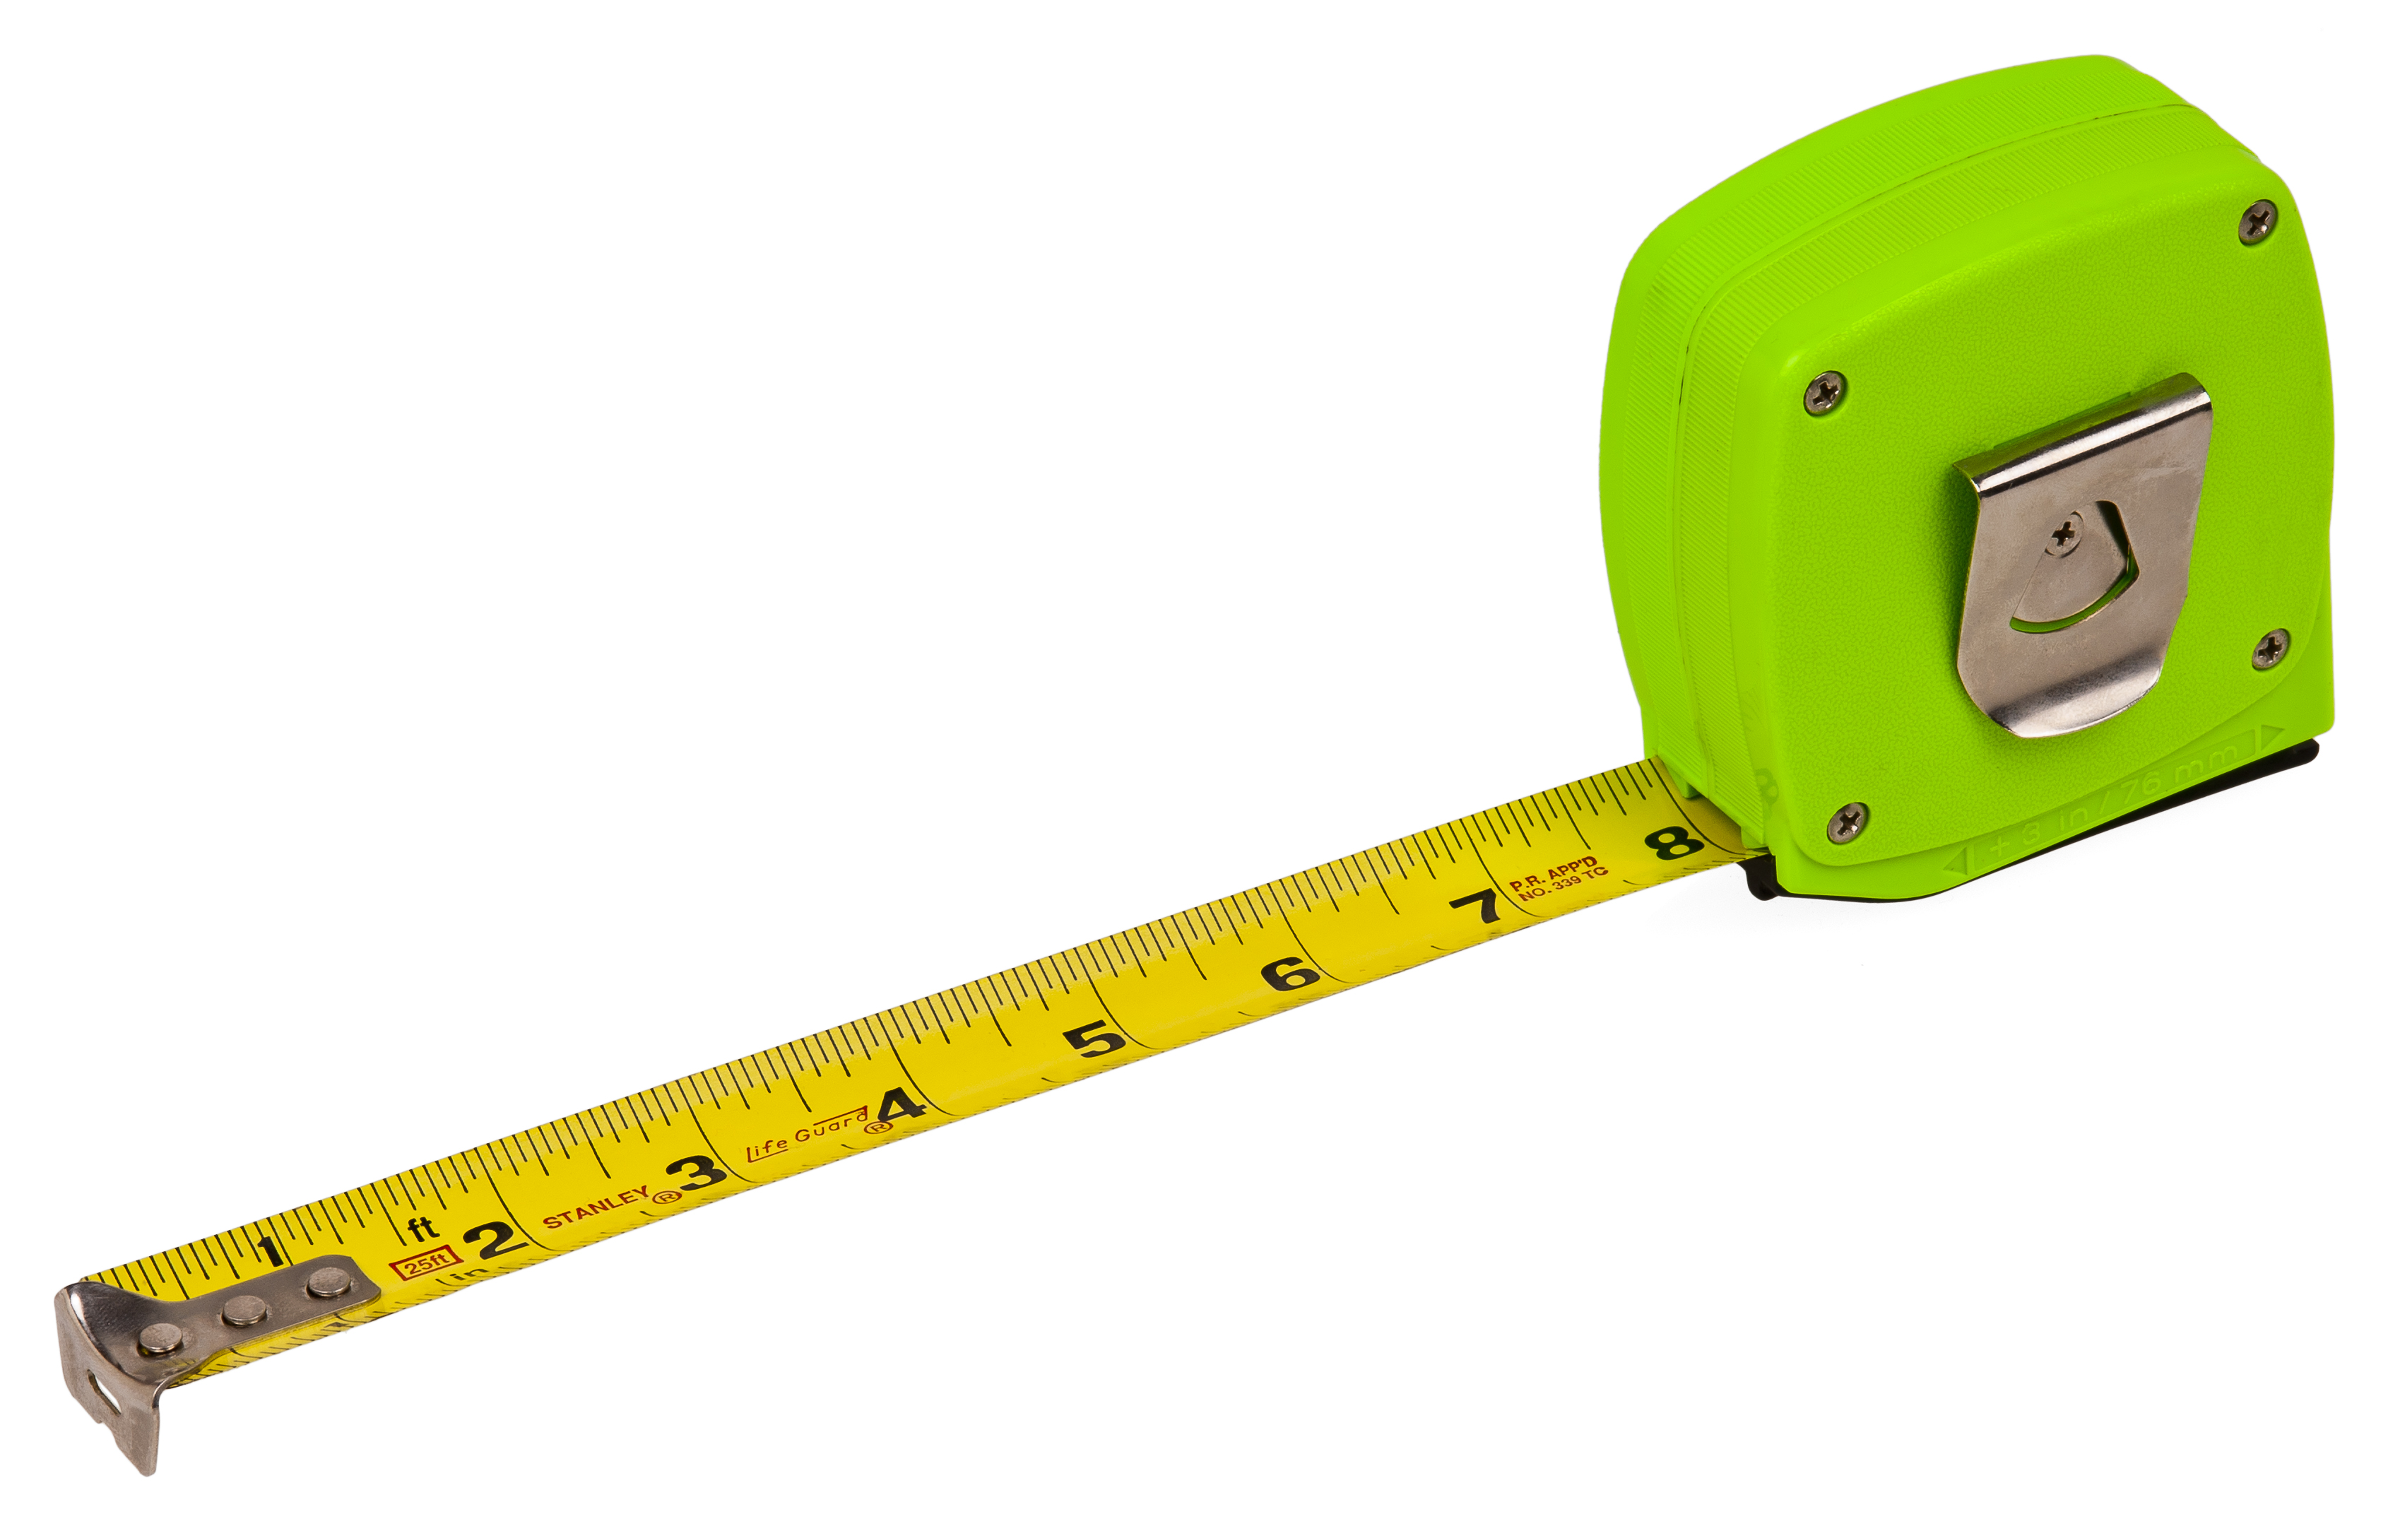
Length
Another method we can use is the Len() method
We can use Len() with any mutable structure
In strings, it returns the length of a string
For example
Len(“Hello world”) >>> 11
What might be some uses of finding the lengths of strings?

Slide 13
Find the error!
Below is an example of a program – where does the program stop working and why?

Slide 14
Casting
In the example, the program fails because it attempts to add a string and an integer together
This is not logically possible!
To resolve this, we need to convert the integers to strings using str()
When we convert data types, this is known as casting

Slide 15
Conversion Operations
Data types can be converted by wrapping str( ), int( ) or float( ) around the data, or the identifier
This converts the data to the relevant type
For example Str(44) → “44”

Slide 16
Worksheet
Complete the worksheet on string handling operations
Homework: Independently, you need to research the uses of random number generation in programming

