Slide 1
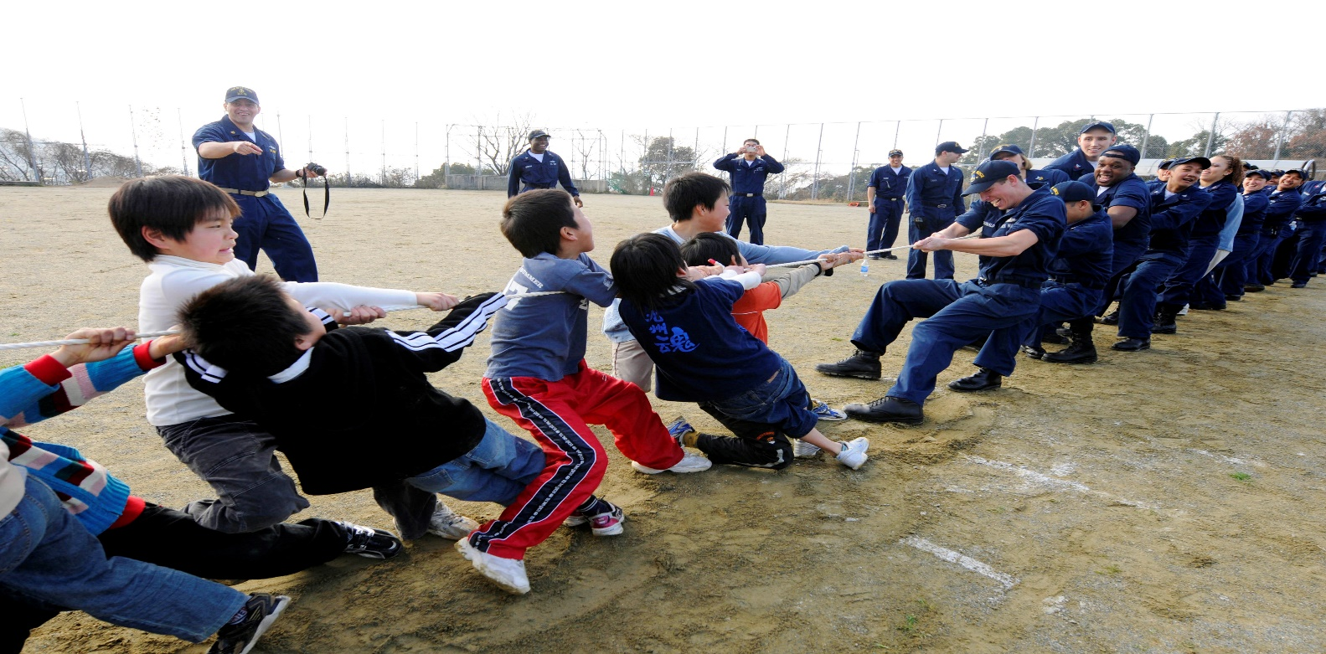
Merton and ‘Strain Theory’
Socially approved goals
Legitimate means
Can you explain how a tension between these two may lead to crime?

Slide 2
‘Socially approved goals’ are the things that a society encourages individuals to achieve – what might these be? Can you explain with reference to the ‘American Dream’?
‘Legitimate means’ are how the institutional structure of society allows people to achieve these goals – for example?

Slide 3
More detail…..
Americans are encouraged to aim for the American Dream which is to achieve success which is largely measured through wealth. Anyone can make it regardless of their background. The accepted ways of achieving this are through education, hard work, drive, determination and ambition.
But sometimes these opportunities are not available to everyone.
This creates a pressure to deviate. Particularly because the greater pressure is to achieve success rather than to stick to the right means.

Slide 4
5 deviant adaptations to strain.
1. Conformity – accept approved goals and get these the right way. Middle class individuals most likely.
2. Innovation – accept goal of money but use ‘new’ creative means. Theft / fraud. Lower end of class structure.
3. Ritualism – give up trying to achieve the goals but know the ligitmate means so keep following the rules with no gain. Lower-middle class office workers in dead-end routine jobs.
4. Retreatism – Reject the goals and the means so become drop outs. Outcasts, psychotics, drug addicts, tramps etc.
5. Rebellion – Reject goals and means but replace with new ones iun a desire to bring about new society. Hippies and radicals.

Slide 5
Subcultural strain theories
These look in more detail at how people may form subcultures to deal with the strains they face.

Slide 6
A. K. Cohen
Moved on from Merton but was more interested in group responses.
Working class boys
Alternative status hierarchy.
Mainstream value upside down.

Slide 7
Evaluation of A. K. Cohen
Accounts for deviance
Explains non-economic crime
Accounts for groups not just individuals.
Do working class boys start of with middle class goals?

Slide 8
Cloward and Ohlin
Also looked at subcultures but took this further and looked at how different subcultures may respond in different ways
Criminal subcultures
Conflict subcultures
Retreatist subcultures.

Slide 9
Evaluation
This theory is a good way to explain what strain may lead to a variety of responses.
Too much focus on working class crime.
Think about the drug trade, this is a mixture of disorganised and professional behaviour so falls into 2 categories.

Slide 10
Miller and Matza
Miller
Matza
Deviance is widespread in the lower class. This is because they are following their OWN goals, not mainstream ones.
Most delinquents are not strongly committed to their subculture but actually drift in and out of delinquency.

Slide 11
Look also at Messner and Rosenfield’s institutional anomie theory
We are living in an anomic cultural environment where people are encouraged to adopt and ‘anything goes’ attitude.

Slide 12
To do
1. topic summary
2. Revision for timed essay.

