Slide 1
LO: find area of a triangle

Slide 2
Remember to find the area of a rectangle we need to know how many squares there are inside
We can do this by multiplying the length by the width
3cm
Area = 3 x 5 = 15 cm²
5cm

Slide 3
Compound Area
Calculate the area of this compound shape:
5cm
7cm
9cm
6cm
Area = (6cm x 7cm) + (5cm x 9cm) =
42cm² + 45cm² =
87cm²

Slide 4
Area of a triangle – think of it as a rectangle and then halve it
Height
= 4cm
Base = 10cm
rectangle area = 4 x 10 = 40cm²
triangle area = ½ rectangle area = ½ x 4 x 10 = 20cm²

Slide 5
Height = 3cm
Base = 6cm
Rectangle area = 6 x 3 = 18cm²
So Triangle area = ½ of 18cm² = ½ x 6 x 3 = 9 cm²

Slide 6
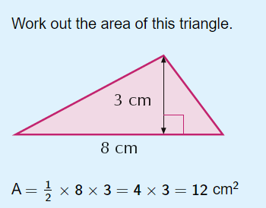

Slide 7
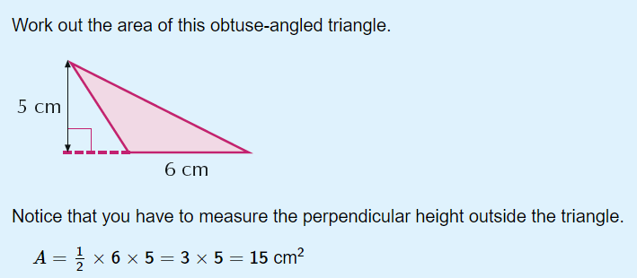

Slide 8
Here are a few to practise with:

Slide 9
Height = 2cm
Base = 8cm
Rectangle area = 8 x 2 = 16cm²

Slide 10
Compound Area
5cm
10cm
5cm
4cm
Area = (4cm x 10cm) + (5cm x 5cm) =
40cm² + 25cm² =
65cm²

Slide 11
Height = 4cm
Base = 5cm
Rectangle area = 5 x 4 = 20cm²
So Triangle area = ½ x 5 x 4 = 10 cm²

Slide 12
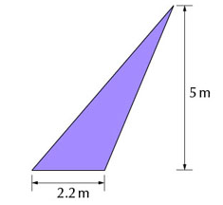
Triangle area = ½ x 2.2 x 5 = 5.5 m²

Slide 13
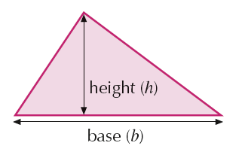
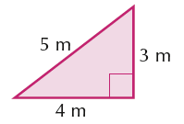
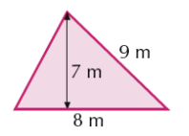
NB the base and height MUST be at right angles to each other (perpendicular)
Ignore other numbers

