Slide 1
CONTACT FORCES
Contact forces occur when object TOUCH each other.
Examples include friction, drag, air resistance, upthrust, reaction force

Slide 2
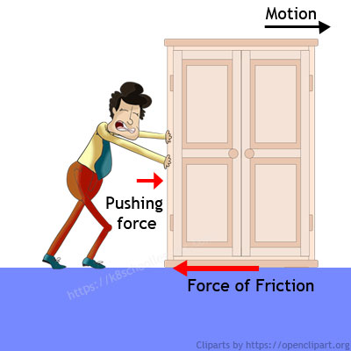
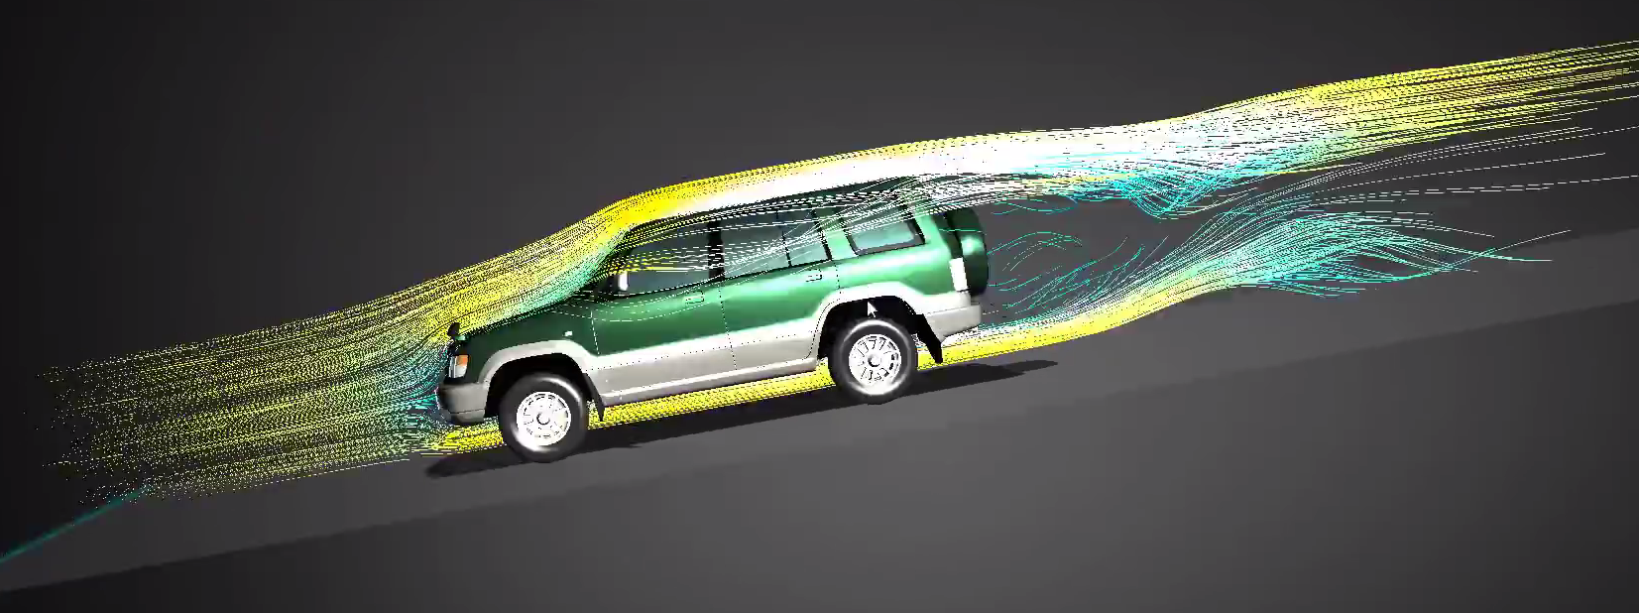
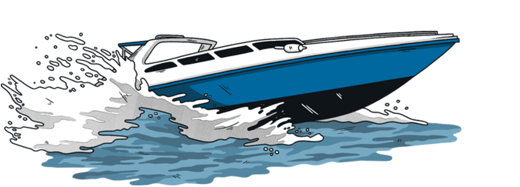
Friction is the force that happens when two surfaces rub together.
Air resistance is similar – it is caused by particles of air rubbing against an object as it moves.
Water resistance is caused by water rubbing against an object as it moves.
Air resistance and water resistance can also be called drag.

Slide 3
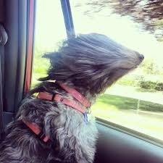
Air resistance at work….

Slide 4
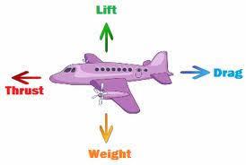
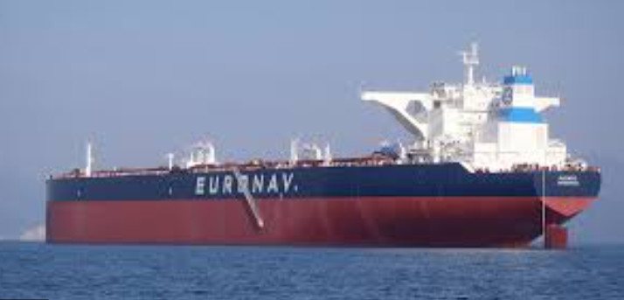
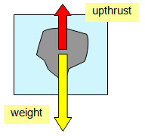
The tanker has a lot of WEIGHT pulling it downwards, but it doesn’t sink because the water pushes back on it with a force called UPTHRUST. This is also called buoyancy or lift (in a plane)
UPTHRUST
WEIGHT

Slide 5
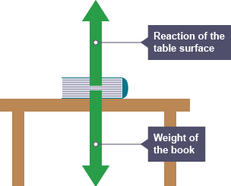
Another contact force is the reaction force that ‘supports’ an object on a surface.

Slide 6
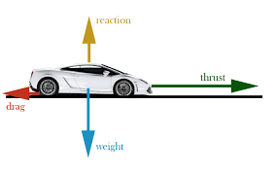
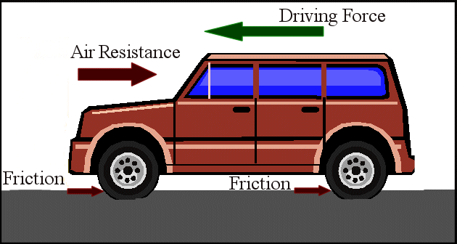
Another contact force is THRUST or DRIVING FORCE.

