Slide 1
Sound (KS3)
Multiple choice

Slide 2
Question 1
Sound is caused by ___________.
A | cold objects contracting
B | objects vibrating
C | hot objects expanding
D | metallic objects only

Slide 3
Question 2
Sound will pass through a ___________.
1 | vacuum
2 | concrete wall
3 | thick steel door
1 and 2 only
1 and 3 only
2 and 3 only
1, 2 and 3

Slide 4
Question 3
Identify the key that is correct about the speed of sound as it travels through solids, liquids and gases.
 | Solids | Liquids | Gases
A | Fastest | Medium speed | Slowest
B | Cannot pass | Medium speed | Fastest
C | Slowest | Medium speed | Fastest
D | Same speed | Same speed | Same speed

Slide 5
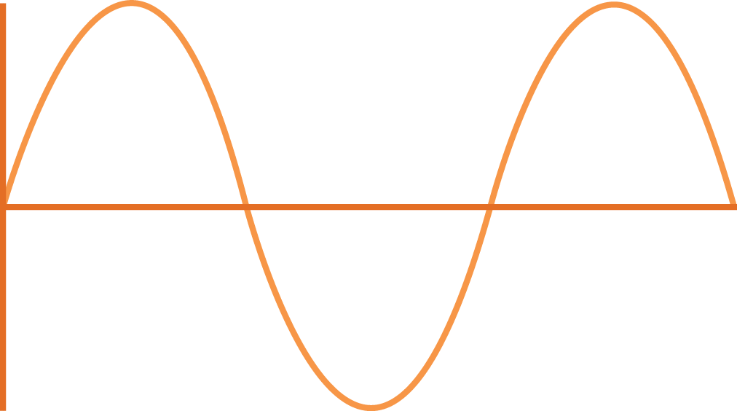
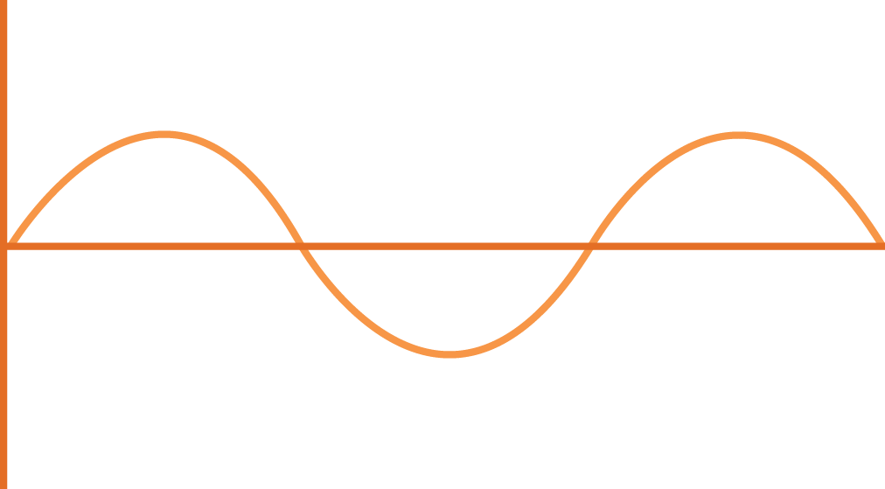
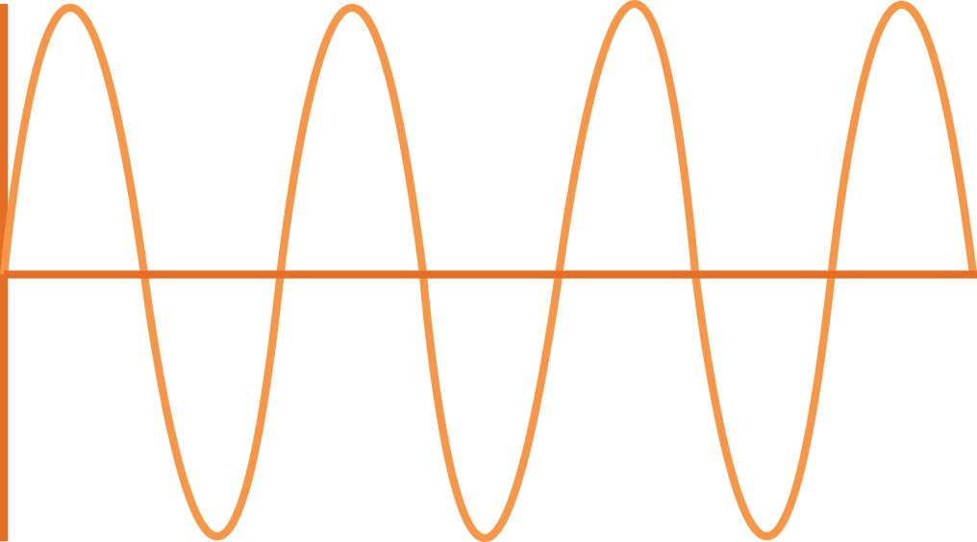
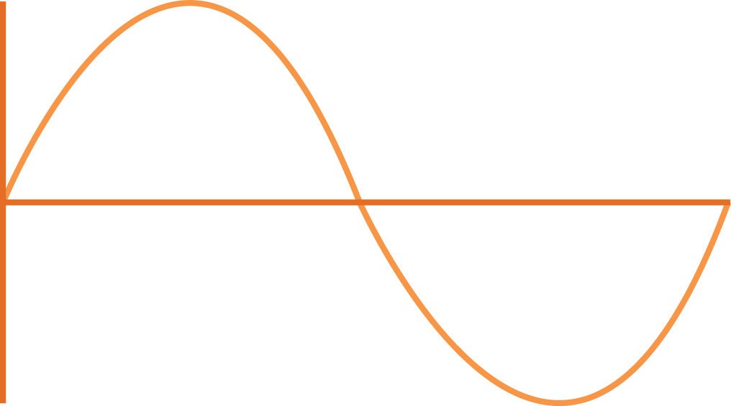
Question 4
Which of these sound waves has the highest frequency?
Displacement
Displacement
A
Time
B
Time
Displacement
Displacement
C
Time
D
Time

Slide 6
Question 5
Which of these sound frequencies has the highest pitch?
A | 0.025 MHz
B | 2.5 kHz
C | 250 Hz
D | 2500 Hz

Slide 7
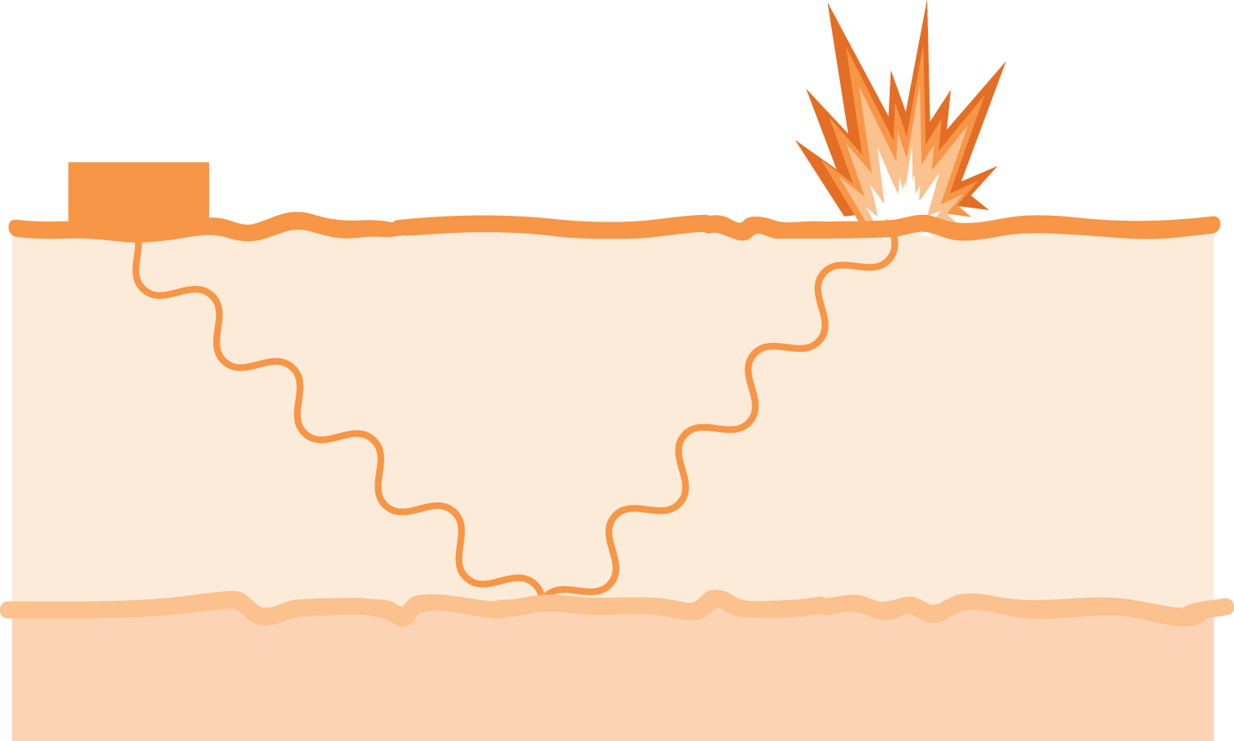
Question 6
A geologist can investigate the position of oil-bearing rock by a ‘seismic survey’. This involves making a small explosion on the surface and then timing the reflected echo of the sound from the oil bearing rock.
timer
explosion
surface
oil bearing rock

Slide 8
Question 6 (continued)
In such a survey the geologist found that the time interval was
4 seconds. Assuming the speed of the sound through the ground was
1600 m/s, how far down is the oil bearing rock?
A | 400 metres
B | 800 metres
C | 1 600 metres
D | 3 200 metres

Slide 9
Question 7
Which of these sounds described in the table would be the quietest?
 | Frequency | Amplitude
A | High | Low
B | Low | Medium
C | Medium | High
D | Low | Medium

Slide 10
Question 8
A woman’s voice is normally higher pitched than a man’s because _____________________.
A | men have larger lungs
B | women have vocal cords that vibrate faster
C | men have a larger voice box
D | women have longer vocal cords

Slide 11
Question 9
The loudness of a sound is measured in ________________.
A | millimetres (mm)
B | joules (J)
C | watts (W)
D | decibels (dB)

Slide 12
Question 10
When a band is heard from a distance, the music from the high pitched flute and the low pitched tuba are not out of step with each other. The sound from each instrument reaches the audience at the same time.
This is because ___________.
A | the wavelength of both notes is the same
B | both notes travel at the same speed
C | the amplitude of both notes is the same
D | they are both wind instruments

Slide 13
Question 11
Which of these waves shows the lowest note?
Displacement
Displacement
A
Time
B
Time
Displacement
Displacement
C
Time
D
Time

Slide 14
Question 12
The range of human hearing is 20 to 20 000 Hz.
Which of these animal sounds can be heard by the human ear?
1 | The piercing hoot of an owl (10 kHz)
2 | The low-pitched trumpet sound of an elephant (5 Hz)
3 | The shrill call of a bat (30 kHz)
1 and 2 only
1 and 3 only
2 and 3 only
1, 2 and 3

Slide 15
Answers
B | C | A | C | A
D | A | B | D | B
D | A

