Slide 1
Functionalism

Slide 2
Overview
Durkheim was the main theorist in 19th century but Parsons is also very important. We have met functionalist in crime, religion, family and education.
This is a MACRO theory (focussing on the needs of the whole society)
It is a STRUCTURAL theory (focussing on the needs of structures within society.
It is a CONSENSUS theory (based on agreement)

Slide 3
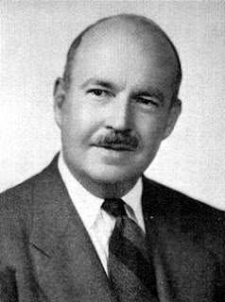
Key Concepts PARSONS
Value consensus – everyone agrees on shared norms and values.
Social order – everyone agrees so there is order not chaos.

Slide 4
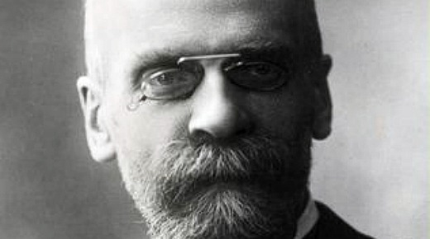
Durkheim Anomie etc
Traditional society was based on ‘mechanical solidarity’ with little division of labour. Industrial society brings division of labour, movement and a variety of norms. Social solidarity is weakened which leads to ‘anomie’ or normlessness.
Durkheim thinks society exists over and above its members.

Slide 5
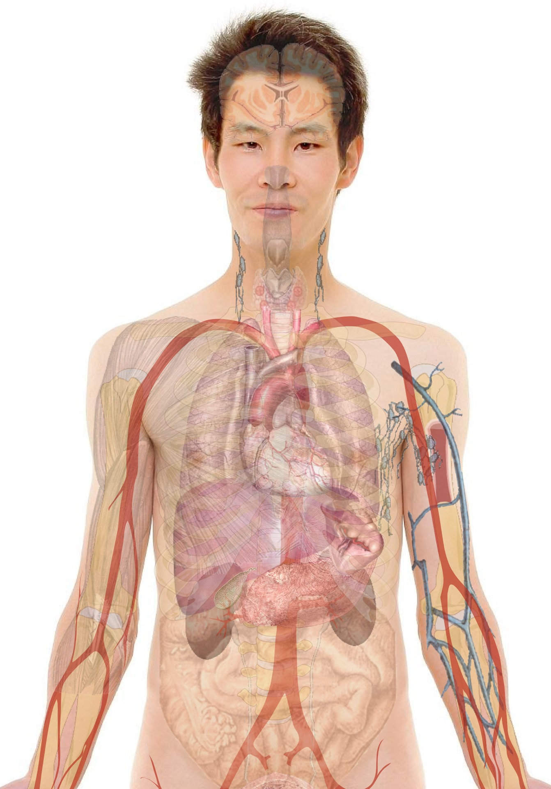
Organic analogy
PARSONS claimed that society is like a biological organism.
System – parts fit together like bits of the human body.
System needs – the needs must be met or an organism will die – same for society. Functionalism sees society as having basic needs which must be met to survive.
Functions – the function of any part of a system is the contribution it makes to meeting needs. Eg the circulation system in the body carried oxygen. The economy in society meets the needs for food and shelter.

Slide 6
Socialisation and social control
Individuals need to be integrated into the social system.
PARSONS says this is done by
Primary and secondary socialisation (family, media, religion, education)
Social control positive sanctions to reward conformity. Negative ones to punish deviance.

Slide 7
PARSONS a building block approach to describing society with the following bricks……
For Parsons, society is a system with its own needs. Which are AGIL…adaptation (members needs are met through economic sub-system) goal attainment (goals are set and resources allocated trough political sub-system) Integration (different parts must fit together – helped by religion, education and the media), latency (society is maintained over time but socialising individuals)

Slide 8
For Parsons – 2 types of society
– traditional and modern. Modern society has norms of self interest and people are judged by universalistic standards. Societies slowly evolve from one type to another. In a modern society the functions of kinship are replaced by political parties, schools churches etc

Slide 9
Parsons assumes that parts of society are indispensable in their current form but Merton suggests more flexibility. For example socialisation does not have to take place in the nuclear family, could be within single parent family.
Are all parts of society really so tightly fitted together? Complex modern societies have many parts which may be only distantly related to each other. Some actually have functional autonomy from each other so do not rely on anything else.
Parsons assumes that everythin has a positive function but this may not be the case.
Overall Merton points out that we can’t assume that society is always smooth running and well integrated.

Slide 10
Difference between manifest and latent functions.
Merton thinks we should divide things up into two types of function. ‘Manifest’ and ‘latent’
A manifest function is an intended one. Eg Hopi Indians who perform a rain dance to magically produce rain. This may not be scientific but their function has an intention.
Other functions may be latent this mean they may be more hidden or unintended for example if something promotes solidarity in a time of hardship when individuals may have been tempted to look after themselves at the expense of others.

Slide 11
External critiques of functionalism
Conflict perspective criticism – theorists such as Marxists criticism Functionalism as it is unable to explain conflict and change. Organic analogy is not a good one as organisms are stable and harmonious but society is not a harmonious whole according to Marxists. It is based on exploitation and divided into classes. If we are not critical of society we legitimize the privileged position of powerful groups.
Action perspective criticism – Dennis Wrong criticises the deterministic view of the individual. In functionalism individuals have no free will or choice, they are just puppets whose strings are pulled by the social system. The action perspective thinks that individuals create society by their interactions. Action perspective sees individuals as constructing society by giving meaning to their worlds rather than society existing above individuals as Functionalism suggests.
Postmodernist criticisms functionalism assumes society is stable and orderly but postmodernists claim there is a lot of diversity and instability in society. An overall theory is not possible as society is increasingly fragmented.

Slide 12
Summary
This is a structural perspective, looks at the structures within society and that order is based on value consensus.
Parsons develops this and sees society as a system of interdependent parts.
Merton introduces the idea of dysfunction and manifest and latent functions.
Critics think functionalism neglects conflict so is too positive and has an over-socialised view of individuals.

