Slide 1
Sex and Gender
SEX
GENDER
DISTINGUISHING POINT:

Slide 2
Bem’s Sex Role Inventory
1. What was Bem aiming to investigate? a. Masculinity in males b. Femininity in females c. Androgyny in males and females d. Androgyny in males | 2. What research method did Bem use? a. Inventory b. Questionnaire c. Interview d. Experiment | 3. What is meant by the term androgyny? a. How feminine a woman is b. How masculine a woman is c. How feminine a man is d. The balance between masculine and feminine traits in a person
4. How many traits were chosen to be included for the scale? a. 20 masculine and 20 feminine b. 50 masculine and 50 feminine c. 75 masculine and 75 feminine d. 100 masculine and 100 feminine | 5. An example of a feminine trait on the scale is: a. Ambition b. Compassion c. Self-sufficiency d. Aggression | 6. An example of a masculine trait on the scale is: a. Warmth b. Sympathy c. Analytical d. Gullibility
7. What was the name given to Bem’s scale? a. Bem Sex Role Inventory b. Bem Androgyny Scale c. Bem Sex Characteristics Scale d. Bem Androgyny Inventory | 8. Between what scores did people have to rate themselves on the scale? a. 1-5 b. 1-7 c. 1-9 d. 1-10 | 9. How many participants were used to test Bem’s scale? a. 50 b. 100 c. 500 d. 1000
10. What type of participants did Bem use in her study? a. 40-60 year olds b. 10-12 year olds c. Students d. 30-40 year olds | 11. How did Bem prove that her test was reliable? a. Used two judges to score the results b. Students also did a different version of the test c. Performed statistical analysis d. Small sample of students repeated the test a month later | 12. How did Bem prove the validity of the test? a. Results were checked against the sample’s own description of their gender identity b. Students repeated the test a month later c. The test was completed in natural conditions d. Used two judges to score the results
13. Which groups of people were found to be more psychologically healthy at the end? a. Males b. Females c. Androgynous people d. Those who scored low on androgyny | 14. What was a problem with Bem’s inventory? a. Lacked generalisability b. Relies on people having insight into their personality and behaviour c. People may give socially desirable responses d. All of the above e. None of the above | 15. What was a strength of Bem’s work? a. Generalisability b. Confidentiality c. Ecological validity d. Low reliability

Slide 3
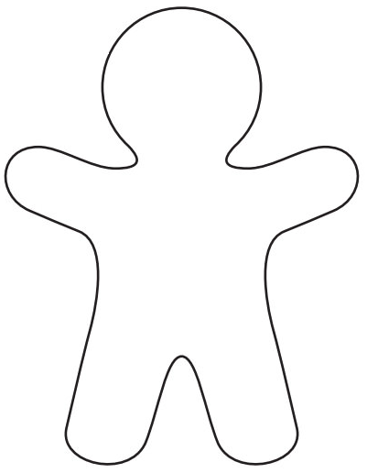
Female stereotypes
Male stereotypes

Slide 4
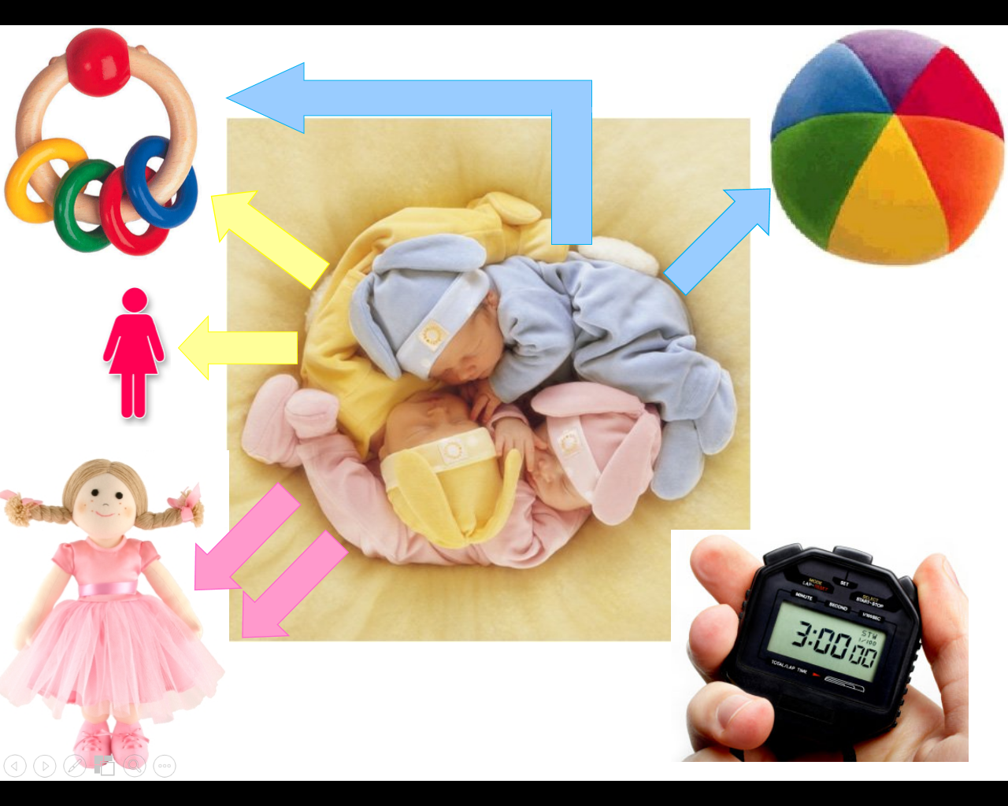
A study into gender stereotypes (Seavey et al.)

Slide 5
What is meant by the term sex in relation to gender studies? | Define the term gender | Distinguish between sex and gender
What are gender stereotypes? | What is androgyny? | How is androgyny investigated?
Who investigated androgyny? | What are the three ways in which gender stereotypes may be reinforced in children? | How would you test somebody’s sex?
What term is given to somebody who desires to be a member of the opposite sex? | Give an example of a gender stereotype. | What is the sex chromosome pattern of a male?
What is the sex chromosome pattern of a female? | What does it mean if a person has a high androgyny score? | What is gender dysphoria?

Slide 6
Cross-cultural research true or false
Cross-cultural research involves studying different cultures. If behaviour is found to be similar then this leads us to the view that differences are biologically based, regardless of external factors.
Cross-cultural research has been criticised as it isn’t useful for investigating the nature/nurture debate in relation to gender differences.
Researchers are unable to provide any insight into different cultural systems, beliefs and practices as we can only ever experience one culture.
Comparison to western cultures allows for a greater understanding of cultural diversity
Mead (1935) conducted a cross-cultural study of 4 societies to investigate whether there were differences in gender roles which would suggest that gender was a product of environment rather than culture. She visited 4 tribal communities on the island of New Guinea for a period of 6 months.
One tribal group showed personalities and behaviours similar to those found in Western societies, although they were more interested in the community than pursuing individual goals. One tribe were described as fierce and cannibalistic; both males and females displaying traits described as masculine. The third tribe had distinctive gender roles but the reverse of those in Western societies; men were more artistic and women held the social and economic power.
Mead’s study shows that there is no inevitable relationship between biological sex and gender role. Culture is the major socialising and conditioning agent, particularly in the early years
Mead’s work therefore provides empirical evidence in support of the nature view of gender
Cross-cultural research may raise issues such as invasion of privacy
The researcher may not understand the language or may misinterpret an action.
Cultural biases produce expectations of gender roles which alter what the researchers ‘observe’.
The observations from a sample may not be typical of the whole culture being studied - gender differences within a culture can vary as well as between cultures.
Variables under investigation are always culturally comparable.
Problems with cultural bias cannot be overcome.

Slide 7
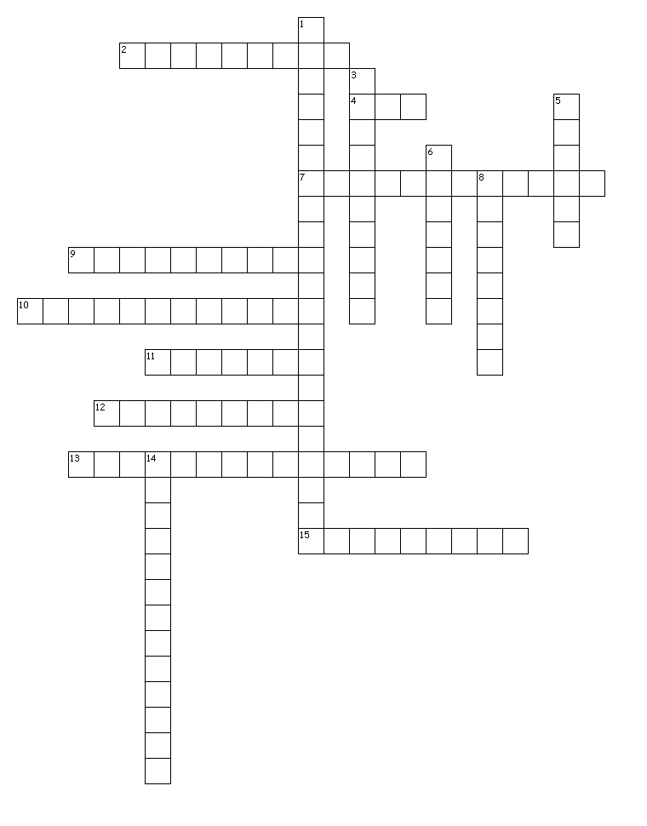
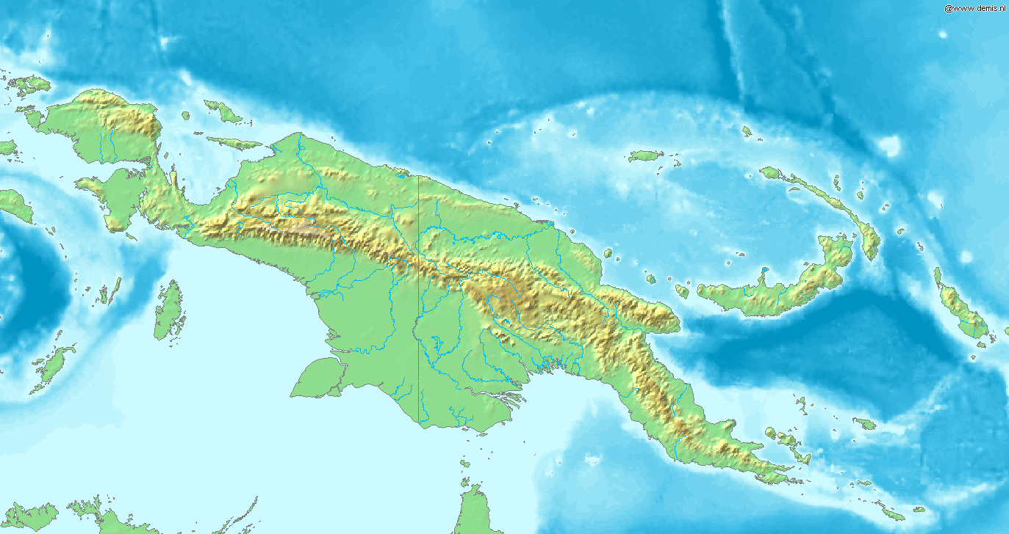
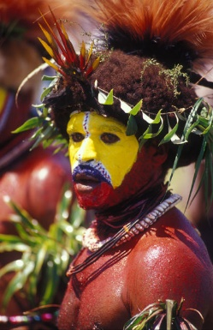
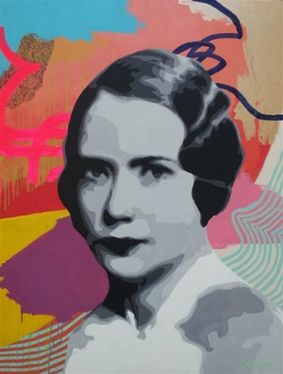
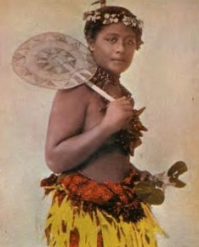
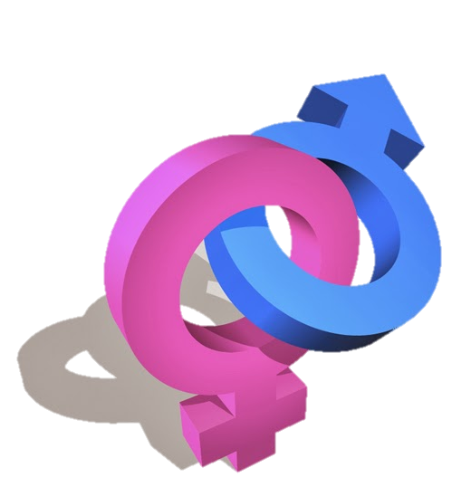
Mead crossword
Across
2. Mead’s study can be considered ecologically valid because the observation took place in the tribes’ natural setting of…
4. Mead was criticised for lacking in life experience when conducting her research due to this factor.
7. This criticism stems from the fact that Mead was a Westerner who may not have understood the behaviours being observed in a different culture.
9. The tribe where both sexes were masculine e.g. assertive, aggressive and fierce.
10. The type of study that Mead completed
11. The fact that Mead found that gender is not universal means that gender development must incorporate aspects of this.
12. The tribe where gender roles were reversed compared with Western gender roles.
13. Some have argued that Mead displayed observer bias because she may have imposed these upon the data.
15. The duration that Mead spent with the tribes which some have argued doesn’t allow sufficient time for a full appreciation of gender roles and behaviours to be acquired.
Down
1. The presence of Mead may have changed the behaviours of the tribes being studied which would produce these.
3. Due to the limited sample of tribes people with whom Mead spent time, it doesn’t allow for variations within a culture as well as variations across cultures. This criticism is known as…
5. Mead’s sex
6. The tribe that had both sexes in a more feminine role e.g. caring, expressive and co-operative.
8. Mead may have been misinformed by or misunderstood the informants from the tribe due to differences in this factor.
14. A type of research involving investigations carried out across more than one society.

Slide 8
Gender mix and match
1 This term refers to our biological status as either male or female | 2 The Sex Role Inventory to investigate androgyny was devised by… | 3 Fagot concluded this | 4 This term describes the balance between masculine and feminine traits
5 Gender schema theory states that children have a representation of the world specific to their own gender and was developed by… | 6 This researcher conducted a lot of cross-cultural research in gender | 7 Criticisms of cross-cultural research include… | 8 A strength of Bem’s work
9 Any combination of chromosomes that is not the usual pattern for males and females is known as… | 10 Gender identity, stability and constancy were developed by this psychologist | 11 A psychosocial term that refers to notions about the expected roles, behaviours and attitudes of males and females | 12 This study showed the importance of biology as child rearing did not alter sex
13 A distinguishing point between gender and sex is that gender is… | 14 This study concluded that hormones affect behaviours as testosterone was linked to aggression in violent prisoners | 15 Evaluative comments of SLT gender theory | 16 Gender studies have examined the role of biology and the environment. This debate is known as…
17 Evaluative comments of cognitive theories of gender | 18 The chromosome pattern for males | 19 These hormones have been shown to affect males and females differently suggesting biology impacts upon gender | 20 This XO pattern is found in some females and causes lower than average spatial awareness and difficulty in social adjustment
21 Imperato and McGinley established the importance of biology in gender development in this study | 22 This chromosome pattern is XXY and is found in males. It results in poor language skills and infertility | 23 Damon’s study into cognitive development concluded this | 24 Psychoanalytic theory argues gender is acquired in the phallic stage via these processes
A Nature-nurture | B Androgyny | C Kohlberg | D XY
E Testosterone (males) and oestrogen (females) | F Mead | G Oedipus and Electra Complexes | H Socially constructed
I Turner’s Syndrome | J Good test-retest reliability | K Sex | L Batista Boys
M Parents respond differently to males and females and encourage them to act in gender appropriate ways | N Children’s understanding of gender appropriate behaviour changes with age and reflects their cognitive development | O Martin and Halverson | P Unscientific, researcher bias, alternative findings
Q Money and Erhardt | R Klinefelter’s Syndrome | S Dabbs | T Bem
U Gender | V Doesn’t explain more fixed views of males than females or why children choose same-sex playmates; describes but doesn’t explain. However, explains why children model gender appropriate behaviours | W Cross-cultural support, Bandura’s empirical evidence, doesn’t account for developmental changes with age, unrealistic, artificial conditions | X Atypical
1 = | 2 = | 3 = | 4 = | 5 = | 6 = | 7 = | 8 =
9 = | 10 = | 11 = | 12 = | 13 = | 14 = | 15 = | 16 =
17 = | 18 = | 19 = | 20 = | 21 = | 22 = | 23 = | 24 =

Slide 9
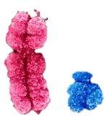
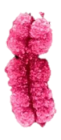
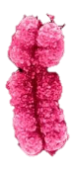
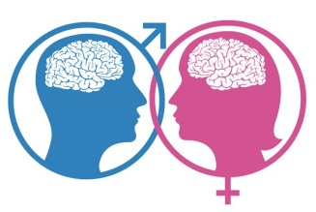
Biological explanations for gender
Genetics
Oestrogen and Oxytocin
Testosterone

Slide 10
What is the typical chromosome pattern for a male?
What is the typical chromosome pattern for a female?
Give an example of an atypical chromosome pattern for a male including its name and chromosome structure.
Give an example of an atypical chromosome pattern for a female including its name and chromosome structure.
Why do people investigate atypical chromosome patterns?
Genetics are responsible for the difference in sex organs. What is the correct name for sex organs?
At what age do gonads begin to develop?
Name the male and female gonads.

Slide 11
What name is given to the group of female hormones?
Which hormone besides oestrogen and progesterone is produced in greater quantities in females than males?
What two things does oestrogen control?
What does oxytocin stimulate and why is this important?
What behaviours can be an effect of high levels of oestrogen during the menstrual cycle?
Which stress hormone is oxytocin said to reduce which increases the likelihood of bonding?
What are PMT and PMS?
Give two occasions when oxytocin would most likely be produced.

Slide 12
What do the letters CAH stand for?
What name is given to the group of male hormones?
Give an example of a female hormone.
Give an example of a male hormone.
Females with CAH are exposed to what in the womb?
What would be a likely outcome for a girl with CAH?
Name one type of behaviour that males with high levels of testosterone are likely to display.
Name one study that has investigated the effects of hormones on gender related behaviours.

Slide 13
Biological explanations of gender development
Clues
The typical chromosome pattern for a male……………………………………………………………………………
The typical chromosome pattern for a female………………………………………………………………………..
The name given to males with an XXY chromosome pattern; ___ Syndrome …………………………
The name given to females with an XO chromosome pattern; ___ Syndrome ……………………….
People who do not share the typical chromosome patterns are said to have ___ chromosome patterns. …………………………………………………………………………………………………………..
The correct name for sex organs. ……………………………………………………………………………………………
The age at which gonads begin to develop. ……………………………………………………………………………
The name given to male gonads. ……………………………………………………………………………………………
The name given to female gonads. …………………………………………………………………………………………
The factor that affects the development of the brain before birth. ……………………………………….
The name given to the female hormone that determines female sexual characteristics. ……………………………………………………………….
The name given to the group of male hormones. …………………………………………………………………..
A hormone that is produced by both males and females but particularly females, especially as a result of having given birth. …………………………………………………………………………………………….
An example of a male hormone. …………………………………………………………………………………………….
Females with this have been exposed to excessive amounts of androgens in the womb. ……………………………………………………………………………………………………………………………………………….
The type of behaviour that males with high levels of testosterone are likely to display. ……………………………………………………………………………………………………………………………………………….
A limitation of the biological approach meaning that it breaks things down into smaller components. ………………………………………………………………………………………………………………………….
A limitation of the biological approach meaning that it concentrates on biological factors only and doesn’t account for processes such as socialisation. ………………………………………………..
E | N | O | R | E | T | S | O | T | S | E | T | S | H | O | T | F | I | A | S
T | L | X | X | Z | J | K | L | I | N | E | F | E | L | T | E | R | S | G | N
O | V | A | R | I | E | S | Q | G | S | A | I | H | G | C | S | H | R | G | E
G | N | E | G | O | R | T | S | E | O | I | Q | R | A | H | T | O | E | R | G
C | M | B | U | X | Y | B | J | I | X | N | X | H | I | J | E | R | N | E | O
N | I | C | O | T | Y | X | O | H | U | V | A | W | U | O | S | M | R | S | R
R | E | D | U | C | T | I | O | N | I | S | T | D | E | J | Y | O | U | S | D
Z | A | T | Y | P | I | C | A | L | G | W | X | X | S | E | T | N | T | I | N
H | D | A | K | L | M | R | M | J | N | P | V | H | W | H | K | E | Y | V | A
S | V | Z | C | I | T | S | I | N | I | M | R | E | T | E | D | S | F | E | B

Slide 14
Biological studies colour sort
The study was conducted using female rats that were injected with testosterone prior to birth to see the impacts upon their physical appearance and behaviour. | Although initially, it appeared that socialisation was possible, later revelations proved the reassignment to be unsuccessful and the child went on to lead a life as a male, thus proving the importance of biological factors. | A problem is that the study is correlational as we do not know whether the prisoners’ violent behaviour was the result of high levels of testosterone or whether acting violently increases a person’s testosterone levels.
The study concluded that testosterone can increase levels of aggression and therefore, hormones help to explain behavioural differences between males and females. | The study showed that male-to-female transsexuals showed decreases in aggression and visual-spatial skills but increases in verbal fluency. Female-to-male showed the opposite. | The case study involved 18 males living in the Dominican Republic who had been born with a hormone deficiency which meant that their genitals appeared female so they were raised as girls.
A problem with the study is that it involves animals and therefore we do not know whether we can generalise the results from this study to humans. | The study was conducted using male prisoners who had committed violent offences such as rape and murder | A problem with this study is that it was not a controlled experiment and therefore, other factors may have contributed to the results such as the transsexuals’ own expectations.
A problem is that it was a case study which investigated just one child so generalisation from such a limited sample is not possible. He was also not socialised from birth so the initial 2 years where he was raised as a boy may have impacted upon the success of the reassignment. | There were several problems with this study. The fact that it was a case study prevents generalisation, males were viewed as favourable which may have contributed to their acceptance of their new sex and the accounts were retrospective which affects reliability. | The study showed that increased levels of testosterone led to physiological and behavioural differences as the rats had masculinised genitals (e.g. an enlarged clitoris) and showed masculine behaviour (e.g. trying to mount other females).
The study investigated the effects of sex hormones on adult behaviour in transsexuals of both sexes undergoing hormone treatment. | The study involved a child whose sex had been reassigned following the accidental loss of his penis during a routine circumcision at age 2 years to see if he could successfully be socialised as a female. | Following biological transformation, the boys assumed their new male identity and began to display male characteristics such as aggression. This showed that biological factors explain gender development.
Dabbs
Money & Erhardt
Gorski
VanGoozen
Batista Boys

Slide 15
Atypical gender development
Key facts
Key facts
Physical differences
Physical differences
Klinefelters Syndrome
Turners Syndrome
Psychological differences
Psychological differences

Slide 16
Learning theories of gender
Modelling
Identification
Imitation
Reinforcement
Acquisition of behaviour
Performance of behaviour

Slide 17
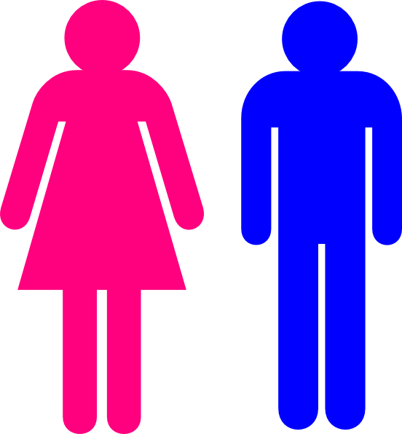
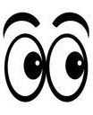
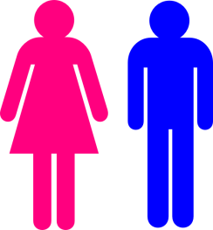
Perry and Bussey (1979)

Slide 18
When an individual has a reason for displaying that behaviour
Positive consequences which strengthen a behaviour, making it more likely to happen again
Modelling and identification together make up this.
Imitation and reinforcement together make up this.
A negative consequence which is likely to prevent the behaviour from occurring again.
Indirect reinforcement i.e. seeing somebody else being reinforced.
Where behaviours become an integrated part of an individual’s identity.
An abstract concept that is capable of change with different societal views.

Slide 19
People that we admire and whose behaviour we will imitate
A type of model that is a person with whom the individual has contact such as a parent or friend
A type of model that the person doesn’t have direct contact with e.g. a celebrity or a character from a film or book
Observing someone else carrying out a behaviour
Storing observed behaviours so that they can be retrieved at a later date
The process by which an individual associates with the qualities, characteristics and views of another person.
Where an individual consciously copies or reproduces an action or behaviour.
The individual’s belief that they have the capacity to imitate the behaviour that they have observed.

Slide 20
SLT does not account for changes in the development of gender understanding with age. It assumes there is no process of gradual development in understanding
Evaluating SLT
Cross-cultural studies support the view gender is learned
Neglects the role of biological factors in gender development
Many studies of modelling are unrealistic; they use adult models playing with toys or pretending in one context or another
If behaviour always arises as a result of imitation, it does not easily explain the emergence of new trends in gender-related behaviour, e.g. ‘the new man’, who is happy to change nappies and make dinner
Does not easily explain gender differences which exist between same-sex siblings.
Ample evidence that boys and girls are reinforced differently and that children do model the behaviour of others
Does not explain why children at a certain age (about 4-5 yrs) often have more rigid views about sex-typed behaviour than their parents
Emphasises the role of cognitive factors in learning so bridges traditional learning theory and cognitive theory
Stella: expand on why these are strengths/limitations of the theory

Slide 21
Kohlberg’s Cognitive Theory of Gender Development
Gender identity
Gender stability
Gender constancy

Slide 22
Lexie, 8, and Mark, 4, were playing together. Lexie had dressed them both up. Mark was in an orange satin dress and a pair of his mother’s heels. On seeing himself in a mirror he stopped and stared at his reflection.
“Ooooh – look! I’m a girl!”
He seemed a bit surprised about this and possibly a little upset.
“It’s only pretend, Mark”, his sister reassured him, “you’re still a boy really, and when you grow up you’ll be a man like dad.”
A man with long hair, silver earrings and a beard was working in a shop. A woman came into the shop with her daughter in tow. The girl looked to be about three or four years old. She gave the man a good long look whilst her mum examined some shoes. The girl tugged on her mum’s sleeve.
“Mummy?”
“Yes, dear?”
“Mummy, why has that lady got a BEARD?”
Jackson, aged 3 was watching his mum put on lipstick before going out. “What are you doing, mum?” he asked.
“I’m putting on lipstick”, she replied.
“Can I put on lipstick?”
“No, silly, lipstick’s only for girls!” she said.
Jackson went quiet for a bit and kept watching.
“Mum,” he said eventually, “when I’m a girl, will I be able to put on lipstick then?”
Meredith and Christina were playing with Meredith’s Barbie dolls. Christina put Barbie in a pair of black trousers and pulled her hair back so that it looked really short.
“Look Meredith! Barbie’s a boy” said Christina.
“Just kidding”, she laughed, “she’ll always be a girl”.
Alex and Izzy were getting dressed up for Halloween. Their dad came downstairs dressed as a wicked witch with a black dress, green face and a wart on the end of his nose.
Alex began to cry and said “why have you turned into a woman daddy? I want you to be a boy just like me.”
Derek was playing with his sister’s dolls and had just set up a tea party for them all. Derek’s friend Owen saw him playing with the dolls and said “you must be a girl now because you play with dolls”.
Stella: Make up your own scenarios to demonstrate Kohlberg’s three stages of gender development.
Kohlberg’s gender stages

Slide 23
KOHLBERG
The age at which gender constancy develops
Children understand that their own sex cannot change
The age at which gender identity develops
SLABY AND FREY
The age at which gender stability develops
4-7 YEARS
The psychologist who developed a gender concept interview and used a male doll wearing a dress
GENDER STABILITY
2-3 YEARS
Kohlberg matching pairs
GEORGE
Children are able to label their own sex and that of others
DAMON
The psychologist who developed a cognitive theory of gender
The psychologist who tested Kohlberg’s theory using a story about a boy who liked to play with dolls
3-4 YEARS
GENDER IDENTITY
The name of the boy character used in Damon’s study
Children are aware that everyone’s sex stays the same forever
GENDER CONSTANCY

Slide 24
Comparing Kohlberg and Gender Schema Theory
KOHLBERG
GENDER SCHEMA THEORY

Slide 25
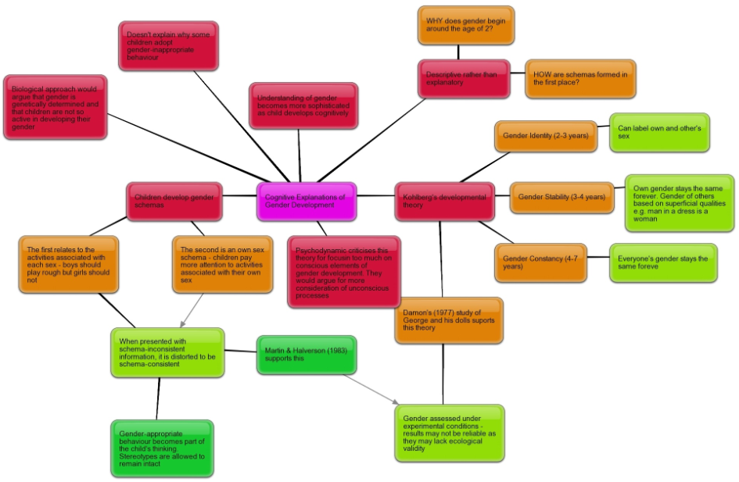

Slide 26
Exam technique
Describe gender schema explanations of gender development. (6 marks)
…………………………………………………………………………………………………………………………………………………………………………………………………………………………………………………………………………………………………………………………………………………………………………………………………………………………………………………………………………………………………………………………………………………………………………………………………………………………………………………………………………………………………………………………………………………………………………………………………………………………………………………………………………………………………………………………………………………….
……………………………………………………………………………………………………………………………………………………………………………………………………………………………………………………………………………………………………………………………………………………………………………………………………………………………………………………………………………………………………………………………………………………………………………………………………………………………………………………………………………………………………………….
WORD BANK
Cognitive
Martin and Halverson
Gender identity
Two years
Schemas
Active exploration
In-group
Out-group
Gender stereotypes
Gender scripts
Stages
8-10 years
Today my work was marked by ____________
and they awarded me a score of _____/6.
Comments:
Target:

Slide 27
Psychodynamic Explanations of Gender Development
PSYCHODYNAMIC EXPLANATIONS OF GENDER DEVELOPMENT KEYWORDS
FREUD’S CASE STUDY OF LITTLE HANS
Freud carried out a case study to investigate the gender development of a boy known as “Little Hans”
AIM: To investigate Little Hans’ phobia
METHOD: Han’s father wrote to Freud to tell him about Hans development. At the age of four Hans developed a phobia of horses. He was frightened that a horse might bite him or fall down. He was particularly afraid of large white horses with black around the mouth.
RESULTS: Freud claimed that Hans was experiencing the Oedipus complex. He unconsciously sexually desired his mother and saw his father as a rival and feared castration. He displaced the fear of his father on to horses. The white horse with black around the mouth represented his father who had a dark beard. His fear of being bitten by a horse represented his fear of castration and his fear of horses falling down was his unconscious desire to see his father dead
CONCLUSION: This supports Freud’s ideas about the Oedipus Complex
REKERS CASE STUDY OF CARL
Rekers (1974) described the case of Carl who was 8 years old and had a gender identity problem
Carl had a feminine voice and liked to talk about dresses, cosmetics and delivering babies.
He preferred to play with girls and played house with his sister.
He also pretended to be ill or injured rather than playing with boys.
Carl lived with his mother and did not have a stable father figure in his life.
This supported Freud’s theory about lone-parent households. Freud suggested that if a child is brought up in a single-parent household they would have a poorly developed gender identity. This is because the child does not experience and resolve the Oedipus/Electra Complex.
If a boy is raised without a father, he will not develop a masculine gender identity as he did not have a father to identify with during the phallic stage of development. Freud suggested that a boy in this position would become homosexual.
REKERS AND MORAY (1990)
AIM: To investigate whether there is a relationship between gender disturbance and family background
METHOD: Researchers rated 46 boys with gender disturbance for gender behaviour and gender identity. Their family background was also investigated.
RESULTS: 75% of the most severely gender-disturbed boys had neither their biological father nor a father substitute living with them
CONCLUSION: Boys who do not have a father figure present during their childhood are more likely to develop a problem with their gender identity.
EVALUATION
☹ Based upon the unconscious which is unfalsifiable – we don’t know that identification with the same sex occurs in the manner described in Freud’s psychoanalytic theory
☹ Identification does not necessarily only occur with parents. SLT shows that parents play a role in gender development but so too do peers, siblings and teachers.
☹ Changing society now means a greater number of single parent families but these don’t necessarily show an increase for homosexuality.
☹ The theory would predict that gender identity arises at approximately 4 or 5 years of age, following the Oedipus or Electra complex but most evidence suggests that children have some understanding of gender identity long before this and that gender identity develops gradually (compare with Kohlberg’s cognitive theory)
☹ The Oedipus and Electra complexes are very controversial; many people find the notion of childhood sexuality difficult to accept and the Electra complex is considered to be particularly weak in its explanations of female gender identity and is considered to be based upon androcentric views.
☹ Generalisability from case studies such as Little Hans is poor.
☹ There is actually little evidence to support Freud’s theory

Slide 28
Psychosexual development: the phallic stage
Oedipus Complex
Electra Complex

Slide 29
The Oedipus and Electra Complexes
A ____________ experiences the Oedipus conflict during the ____________ stage because of his _______________ desire for his ______________ and fear his ___________ will castrate him. In order to resolve this conflict (reduce ____________ _________) the boy ____________ with his father meaning that he adopts his father’s norms, ___________ , beliefs and attitudes. The boy feels that his father is less likely to harm him, and behaving like his father will bring the boy __________ to his mother. The boy internalises male _________________ through _____________ with his father (also known as identification with the ____________) and starts to behave as a male.
At the ages of ________ during the phallic stage, girls experience the ________ Complex. Here, the girl has unconscious ______________ for her ____________. As she thinks she has already been _____________ by her mother, she is not fearful of her as a boy is of his father (and therefore identification is not as strong). Instead, the girl’s conflict with her mother is due to feelings of having already been castrated. In addition, girls experience ______________ though after realising that they can never have a penis, they substitute this desire with a desire for a baby (to be fathered by their own father). The girl’s ______________ with her mother follows fear of a loss of her mother’s love and to reduce the conflict that she is feeling. The girl therefore still identifies with the characteristics, behaviours, attitudes and beliefs of her mother and so her female ___________________ develops.
FATHER
PHALLIC
THREE-FIVE
CLOSER
CASTRATION ANXIETY
CHARACTERISTICS
GENDER IDENTITY
IDENTIFICATION
AGGRESSOR
CASTRATED
DESIRES
BEHAVIOURS
MOTHER
BOY
IDENTIFIES
UNCONSCIOUS
PENIS ENVY
IDENTIFICATION
ELECTRA
FATHER

Slide 30
THE ROLE OF THE MEDIA ON GENDER DEVELOPMENT

Slide 31
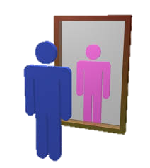
Gender dysphoria is…
Signs
1
Evaluation including reference to biosocial explanations
Biological
5
Symptoms
2
Cognitive
4
3
Psychoanalytic

