Slide 1
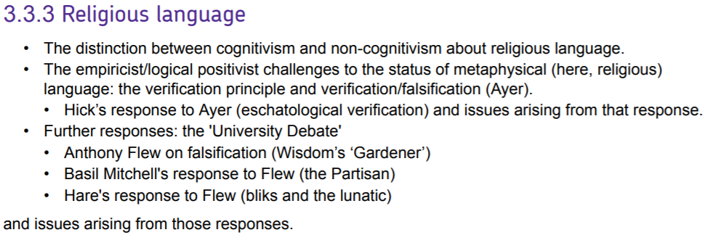

Slide 2
Cognitivism v non-cognitivism
What are we doing when we are talking about God?
Cognitivism: religious claims, e.g. ‘God exists’
Aim to describe how the world is
Can be true or false
Express beliefs that the claim is true
Arguments concerning the existence of God typically assume that cognitivism is true
‘God exists’ is true or false, a statement of fact.
The belief that God exists can be supported or rejected on the basis of reasoning.
God is a being that exists independently of (and prior to) human beings and our beliefs.

Slide 3
Cognitivism v non-cognitivism
What are we doing when we are talking about God?
Non-cognitivism: religious claims
Do not aim to describe the world
Cannot be true or false
Express attitudes towards the world
People don’t normally acquire religious beliefs by argument or testing evidence
When someone converts to a religion, what changes isn’t so much intellectual beliefs, but their will, values, way of living
Attitudes towards other people, nature, oneself, human history
Therefore, ‘God exists’ doesn’t state a factual belief, but expresses a non-cognitive attitude

Slide 4
Objections to non-cognitivist view of religious language
1. Religious belief cannot be criticized by facts and ‘evidence’
It cannot be true or false, probable or improbable
But what about the argument from design or problem of evil?
Religious belief is not cut off from reason
Reply: religious belief still needs to ‘make sense’ of human experience
But what does this mean, given that it doesn’t say anything cognitive?
2. Non-cognitivism contradicts what most religious believers believe they believe!
Believers use religious language to state truths
They have disagreed and argued over truths that don’t have an obvious practical implication
Solution: Religious language is both factual and expressive
It has a cognitive meaning, but is also used to express attitudes and values.

Slide 5
The verification principle – A.J. Ayer
‘A statement only has meaning if it is either analytic or empirically verifiable’
Analytic: A statement is analytic if it is true or false just in virtue of the meanings of the words.
Empirically verifiable: A statement is empirically verifiable if empirical evidence would go towards establishing that the statement is true or false.
We don’t have to be able to acquire the evidence in practice, but in principle
We don’t need to prove the statement, only raise or reduce its probability
Verificationism on God
‘God exists’ is not analytic
Nor can it be deduced from a priori claims
‘God exists’ is not empirically verifiable
‘God exists’ makes no predictions about our empirical experience
No experiences count towards establishing or refuting the claim
Therefore, ‘God exists’ is meaningless.
It lacks cognitive meaning, so it lacks meaning.

Slide 6
Hick: Eschatological verification
Verification: removing rational doubt, ignorance or uncertainty through experience
Claims involve predictions about experience under conditions
‘God exists’ makes no predictions about our experience in this life, but does make predictions about our experience in life after death
This is eschatalogical verification
Issues
What does it mean to talk of an afterlife?
For it to be meaningful, at least the concept of personal existence after death must be coherent
What could an experience of God be?
Hick: experience of personal fulfilment and relation to God?

Slide 7
Rejecting the verification principle
According the verification principle, the principle itself is meaningless.
‘a statement only has meaning if it is analytic or can be verified empirically’ is not analytic
and cannot be verified empirically.
If the principle is meaningless, it is not true.
If it is not true, it cannot show that religious language is meaningless.
Ayer’s Response
The principle is intended as a definition
Whether it is the right definition of ‘meaning’ is established by arguments about its implications
Objection: If we are not convinced by the implications, we will not accept it as a definition
The principle provides no independent support for thinking that religious language is meaningless

Slide 8
Falsification Principle
A claim is only meaningful if it is falsifiable
Falsifiable: logically incompatible with some (set of) empirical observations.
Claims must rule out certain experiences in order to be asserting anything
Advantage: generalizations
‘All swans are white’ is not verifiable, but it is falsifiable (one black swan)
Objections
Many claims are verifiable but not falsifiable
‘there are three successive 7s in the decimal determination of π’
Claims about what exists (we cannot search everywhere at once)
Claims about probability (the future can overturn probabilities)
If we weaken falsifiable from ‘logically incompatible’ to ‘evidence against’, then there is no distinction from verification, which defines empirical verification in terms of raising or lowering the probability of a claim

Slide 9
University Debate: Flew’s challenge
The two explorers in the jungle
How is an undetectable ‘gardener’ different from no gardener at all?
For a claim to be meaningful, there must be something it is denying
There must be some way of establishing that it is false
Under what circumstances are we prepared to withdraw the claim?
What experiences would lead a religious believer to accept that ‘God exists’ is false?
If there are no such experiences, the claim has no meaning
Flew is a cognitivist about religious language

Slide 10
University Debate: Flew’s challenge
For a truth claim to be meaningful, there must be some possible state of affairs it denies or rules out.
Therefore, to meaningfully assert a claim, someone must accept that it rules out some possible state of affairs.
The occurrence of a state of affairs that a claim rules out demonstrates that the claim is false.
Therefore, to meaningfully assert a claim, someone must be willing to withdraw it if the state of affairs it rules out were to occur.
Religious believers refuse to specify which state of affairs would lead them to withdraw the claim that ‘God exists’.
Therefore, when religious believers say ‘God exists’, they do not rule out any state of affairs.
Therefore, the claim that ‘God exists’, when made by religious believers, is meaningless.

Slide 11
University Debate: Mitchell’s Response
Flew is right that we must allow experiences to count against a claim, if the claim is to be meaningful
But this doesn’t mean that we have to withdraw it
The story of the trusting partisan
When does counter-evidence become so strong that a belief becomes irrational?
There is no abstract answer
Religious beliefs aren’t provisional hypotheses, but involve commitments
We must count evidence against them, but aren’t required to withdraw them
Flew accepts this qualification, but appeals to the problem of evil to argue that belief in God should be withdrawn
And if it is not withdrawn, it becomes irrational
But this is no longer about the meaning of religious language, but the rationality of religious belief

Slide 12
Hare’s ‘bliks’
Religious beliefs are not like ordinary assertions, but part of someone’s ‘blik’, an attitude or view of the world
Differences in bliks can’t be shown to be true or false by empirical experience
Examples of bliks
An incorrigible view that university lecturers want to murder you
Trust in the properties of steel v. not
Believing that everything happens by chance v laws of nature
The difference between holding these bliks is meaningful and make a difference to our lives
To hold that God exists (or not) is a blik

Slide 13
Hare’s ‘bliks’
Issues
Are bliks cognitive or non-cognitive?
Cognitive: bliks can be true or false (independent of what you hold)
Non-cognitive: bliks can’t be falsified and work like attitudes
But: any normal cognitive belief could be a blik
It depends how the person thinks about it
When someone holds a blik when we hold beliefs, we think they are irrational
Does Hare’s view entail that religious belief is irrational?
Flew: Hare’s view contradicts what religious believers actually think about their beliefs

