Slide 1
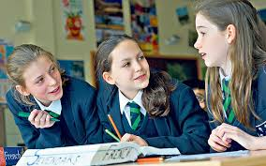
This topic is all about….
The relationships that exist between pupils and between teachers and pupils and the impact these may have on pupil progress.
Starter - what relationships in school does this pupil have with other pupils and staff? Is there a way you can categorise or colour code them?

Slide 2
The subcultures.
Look back at the examples at the beginning of the booklet and consider which are anti and pro school.
This Photo by Unknown Author is licensed under CC BY-SA

Slide 4
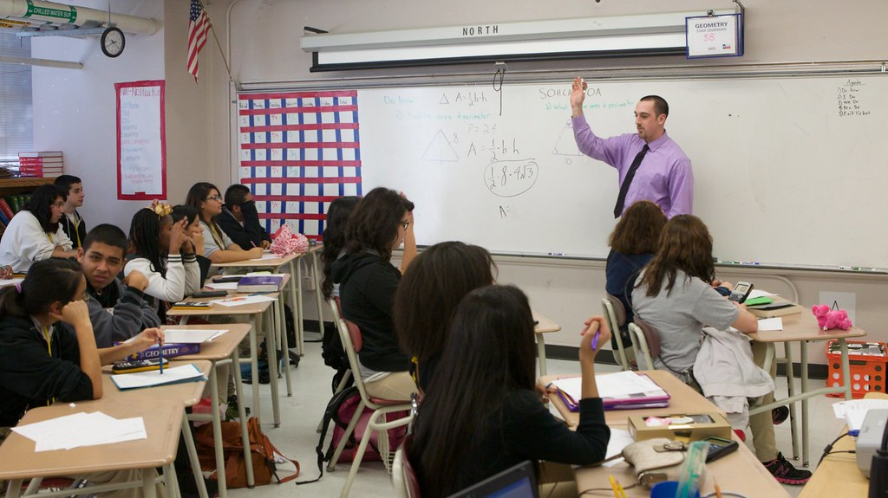
Relationships within school.
This Photo by Unknown Author is licensed under CC BY

Slide 5
Describe a perfect pupil…..
How will a teacher treat her……? What is the impact of this…….?

Slide 6
Key terms today
Labelling theory
Halo Effect
Self-fulfilling prophecy.

Slide 7
Remember this topic is about processes within school
So think about teacher – pupil relationships.
Teacher-student interactions can create positive or negative pupil identities. Teachers are actively judging, classifying and forming impressions of pupils, e.g. bright or slow learners, troublemakers or the ideal pupil. This process of labelling by teachers can contribute to the moulding of student identities, and has been shown to affect their educational performance.
To label someone is to attach a meaning or definition to them. For example?
Teachers often don’t attach labels based on ability or attitude, what do they base their labels on?

Slide 8
Howard Becker
Howard Becker (1971) interviewed 60 high school teachers from Chicago and showed that teachers perceive the ‘ideal pupil’ to be one who conforms to middle-class standards of behaviour. Lower class pupils were seen as the opposite.
The pupils’ social class influenced how they were assessed.
This Photo by Unknown Author is licensed under CC BY-ND

Slide 9
Gillborn and Youdell (2001)
researched in London between 1995 and 1997 and decided that teachers have a ‘common sense understanding of ability’.
Working class pupils seen as disruptive and lacking in motivation and having little parental support so are discriminated against.
They have to work harder to convince teachers they have ability so often end up in lower sets.
This Photo by Unknown Author is licensed under CC BY-SA
This Photo by Unknown Author is licensed under CC BY-SA

Slide 10
Labels are sticky……
The stereotype held by teachers (good/bad) can produce a halo effect. This means that a teacher who has formed a good impression of a student in one way, for example, seeing them as helpful, may see that student more favourably in other unrelated ways too - for example, being bright and hardworking.
On the other hand, labelling can often have bad effects for the student. Although teachers believe they are teaching all students in the same way, those who are taught in higher ‘sets’ or ‘streams’ are often provided with abstract, high status knowledge whilst the les able students are given common sense, low status knowledge that can affect their achievement.
This Photo by Unknown Author is licensed under CC BY

Slide 11
Is this a good theory?

Slide 12
Self-fulfilling prophecy
For example:
A teacher might label a pupil as intelligent and so predict (make a prophecy) that they will make good academic progress.
The teacher may then change the way they interact with the pupil, for example by giving them more attention and expecting a higher standard of work.
The pupil then internalises the teacher’s expectation as it becomes part of their self-concept, consequently they gain confidence, try harder and make good academic progress – fulfilling the prophecy. The teacher prediction has come true.

Slide 13
Mac an Ghaill
study above. Here the Macho lads were seen as being low ability. Teachers considered them to be trouble makers so spent their time policing them. Macho Lads saw teachers and controlling and hostile.
How would this relationship create a self-fulfilling prophecy?

Slide 14
Organisation of teaching and learning

Slide 15
Quick 6
1. What is a subculture?
2. What is the Halo Effect?
3. Explain labelling?
4. Why are labels sticky?
5. What is ‘self-fulfilling prophecy’?
6. Give an example of self-fulfilling prophecy in school?

Slide 16
Should pupils be in different sets?
What is a set?
What is a stream?

Slide 17
Arguments for setting?
Arguments against setting
Different teaching
Different speeds / ways / levels of learning
Different types of tasks
Different exams.
Social benefits
Ability is not fixed
Setting affects attainment
Discriminates against some pupils
Behaviour rather than ability.

Slide 18
Key Study: Ball's (1981) Beachside Comprehensive
Ball found that top-streamed students were 'warmed up' by encouragement to achieve highly and to follow academic courses of study. On the other hand, lower-stream students were 'cooled down' and encouraged to follow low status vocational and practical courses, and consequently achieved lower levels of academic success, frequently leaving school at the earliest opportunity.
Working class pupils are often allocated to lower streams how might this lead to a self-fulfilling prophecy?
This Photo by Unknown Author is licensed under CC BY-SA

Slide 19
Keddie
found that teachers who taught in higher streams had greater expectations of the students to behave better and do more work, and teachers gave them more, and different types of, educational knowledge, which gave them greater opportunities for educational success. Teachers from lower stream working-class pupils might therefore underachieve partly because they have not been given access to the knowledge required for educational success.

Slide 20
Gillbourn and Youdell

Slide 21
How might teachers’ behaviour lead to subcultures?

Slide 22
Think about….
Does school create subcultures through how pupils are treated and taught?
Tony Sewell believes that it is more complex than this. Pupils may come into school already part of a subculture or get their attitudes from outside school.

Slide 24
Evaluation

Slide 25
Another topic finished
Create a revision mind map for this.
Include subcultures and examples including whether they are pro-school or anti-school, labelling, halo effect, self fulfilling prophecy.
Key theorists Willis, Ward, Jackson, Allen, Shain, Mac an Ghaill, Becker, Gillbourn and Youdell, Ball, Keddie, Sewel, Lacey, Fuller.

