Slide 1
Corrie ten Boom
By Sophie, Corinne and Lucy
Notes:
Corinne: Hello and welcome to our presentation!
Lucy: Today we are going to be talking about Corrie Ten Boom.
Sophie: And how religion influenced her life.

Slide 2
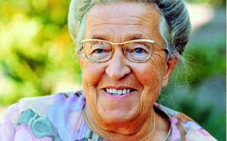
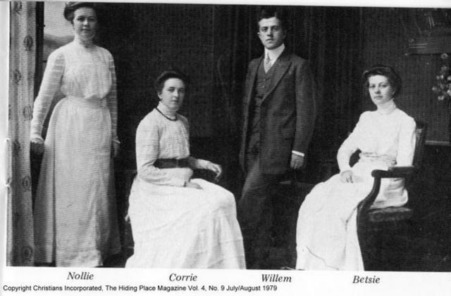
Introduction
Corrie ten Boom was born on the 15th of April 1892 in Amsterdam, the Netherlands.
She was named after her mother Cornelia and was given the name Cornelia Arnolda Johanna ten Boom.
Corrie lived with her parents – Casper and Cornelia as well as her 3 older siblings - Betsie, Willem and Arnolda.
Notes:
Corinne: An Introduction.
Lucy: Corrie Ten Boom was born on the 15th of April 1892 in Amsterdam, the Netherlands.
Sophie: She was named after her mother Cornelia and was given the name Cornelia Arnolda Johanna ten Boom.
Corinne: However, she was known as Corrie for the majority of her life.
Lucy: Throughout her childhood, she lived with her parents – Casper and Cornelia ten Boom as well as her 3 older siblings – Betsie, Willem and Arnolda ten Boom.
Sophie: Corrie died on the 15th of April 1983 at the age of 91. This just so happened to be her 91st birthday.

Slide 3
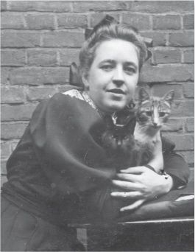
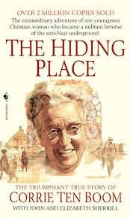
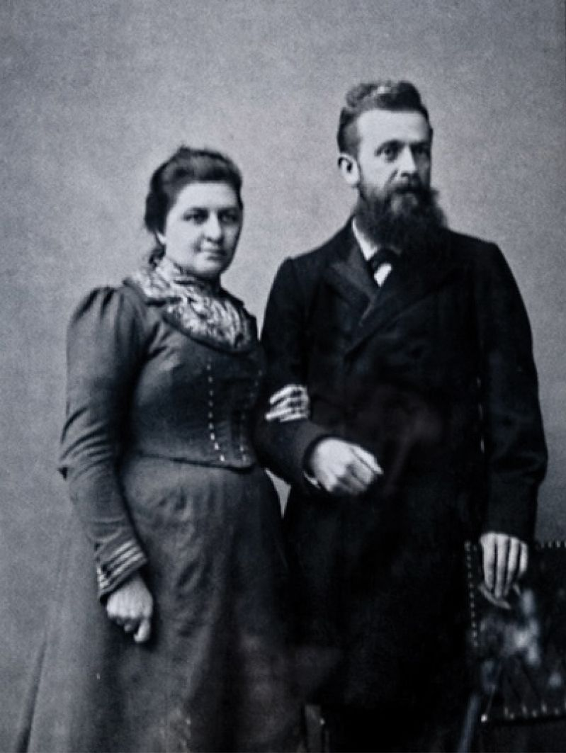
What did she do?
In 1922, Corrie trained herself to become a watchmaker, inspired by her parents former career.
She was the 1st woman to be licensed as a watchmaker in the Netherlands.
Later in her life, after the 2nd World War, Corrie decided to become a writer and called her only published book The Hiding Place.
Notes:
Corinne: What did she do?
Lucy: Casper Ten Boom (Corrie’s father) owned a jeweller’s and watchmakers shop, which is where Corrie chose to work.
Sophie: In 1922, Corrie trained herself to become a watchmaker, inspired by her parents former career.
Corinne: She was the 1st woman to be licensed as a watchmaker in the Netherlands.
Lucy: She established a youth club for teenage girls which provided religious instruction and classes involving performing arts and sewing.
Sophie: Later in her life, after the 2nd World War, Corrie decided to become a writer and called her only published book, The Hiding Place. This was soon turned into a movie.

Slide 4
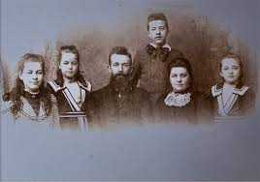
During the Holocaust
During the Holocaust, Corrie and her family took the decision to hide endangered Jews in their family home in Haarlem, the Netherlands in order to protect them from the Nazi’s.
This led to their imprisonment in a concentration camp, where Corrie suffered the loss of family members who died from severe maltreatment whilst in German Custody.
The whole family was sent to a prison camp but only 2 were released. Corrie, her sister Betsie and her father Casper remained imprisoned.
Notes:
Corinne: During the Holocaust.
Lucy: During the Holocaust, Corrie and her family took the decision to hide endangered Jews in their family home in Haarlem, the Netherlands in order to protect them from the Nazi’s.
Sophie: This led to their imprisonment in a concentration camp, where Corrie suffered from the loss of her family members who died from severe maltreatment whilst in German Custody.
Corinne: After being sent to the concentration camp, only 2 of her family members were released.
Lucy: Corrie, her sister Betsie and her father Casper remained imprisoned.
Sophie: 10 days after being imprisoned, Casper ten Boom became sick whilst in prison and soon died in a hospital corridor.
Corinne: However, the 2 sisters remained together until Betsie’s tragic death in December.

Slide 5
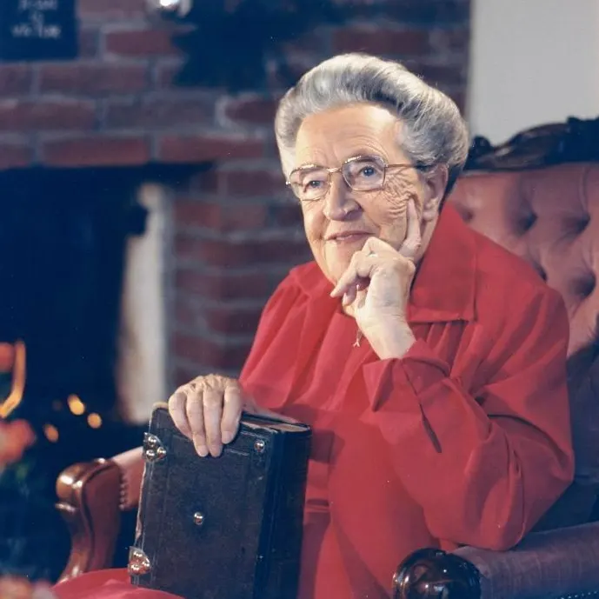
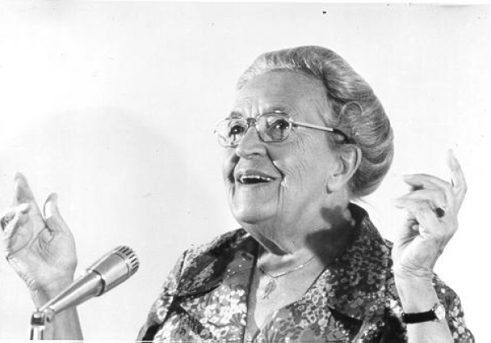
After the Holocaust
After the War, Corrie spoke her views on how people could overcome their psychological scars left by the Nazi’s.
Corrie later travelled the world as an evangelist (preacher), a motivational speaker and a social critic referring to her experiences during the Holocaust as she offered peace to her fellow prisoners.
She set up a Rehabilitation Centre for concentration camp survivors as well as people who cooperated with the Germans.
Notes:
Lucy: After the Holocaust
Sophie: After the War, Corrie spoke about her views on how people could overcome their psychological scars left by the Nazi’s. Her and her family saved around 800 Jews.
Corinne: Corrie later travelled the world as and evangelist (preacher), a motivational speaker and a social critic.
Lucy: This referred to her experiences during the Holocaust as she offered peace to her fellow prisoners.
Sophie: She then set up a Rehabilitation Centre for concentration camp survivors as well as people who cooperated with the Germans.

Slide 6
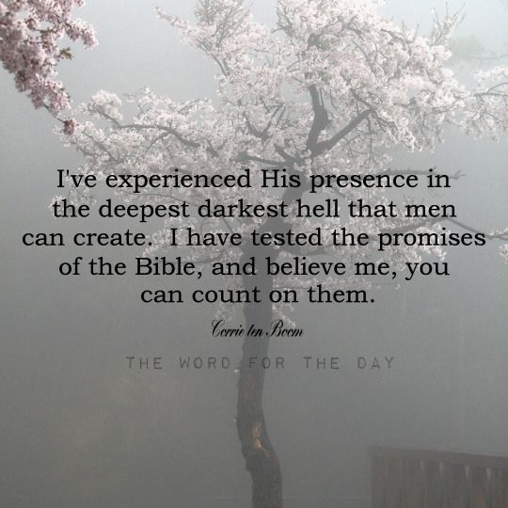
How did religion influence her life?
Religion influenced Corrie’s life when she was setting up a teenage girls youth club which helped and allowed them to grow up religiously.
Corrie also helped the Jewish people in the Holocaust because God told her too.
Her faith inspired her to serve society, offering shelter, food and money to those in need.
Notes:
Corinne: How did religion influence her life?
Lucy: Religion influenced Corrie’s life when she was setting up a teenage girls youth club which helped them to grow up religiously.
Sophie: Corrie also helped people that were part of the Jewish community during the Holocaust because God had told her too.
Corinne: Her faith inspired her to serve society, offering shelter, food and money to those in need.

Slide 7
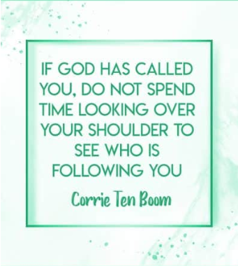
Quotes
Notes:
Lucy: Quotes
Sophie: In the words of Corrie ten Boom, Never be afraid to trust an unknown future to a known God.
Corinne: If God has called you, do not spend time looking over your shoulder to see who is following you.
Lucy: There is no pit so deep that God's love is not deeper still.

Slide 8
Thank you for listening!
Notes:
Sophie: Thank you for listening!

