Slide 1
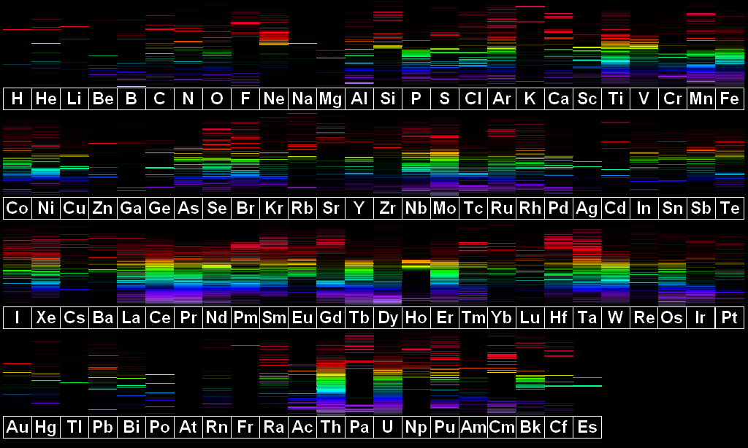
Flame emission spectroscopy

Slide 2
Lesson objectives
State the advantages of instrumental methods of analysis
Describe the process of flame emission spectroscopy
Interpret flame emission data to identify an element

Slide 3
Identify these metals?
calcium
sodium

Slide 4
Identify these metals?

Slide 5
Flame emission spectroscopy
SAMPLE
SPECTROSCOPE
LINE SPECTRUM
FLAME

Slide 6
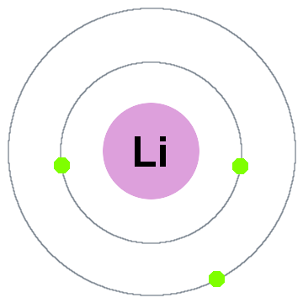
Scientific principles
Higher energy level – further from nucleus
energy in
heat
energy out
light
colour emission
spectrum
Lower energy level – closer to nucleus

Slide 7
Line spectra

Slide 8
Numerical data
Sample | Emission line wavelengths / nm
Mixture | 420, 560, 580, 630, 680
Ion X | 420, 630, 680
Ion Y | 560, 580

Slide 9
Uses

Slide 10
Instrumental analysis Rather than chemical tests
Advantages
Disadvantages
Sensitive
Accurate
Rapid
Low concentrations detected
Expensive
Specialist training

