Slide 1
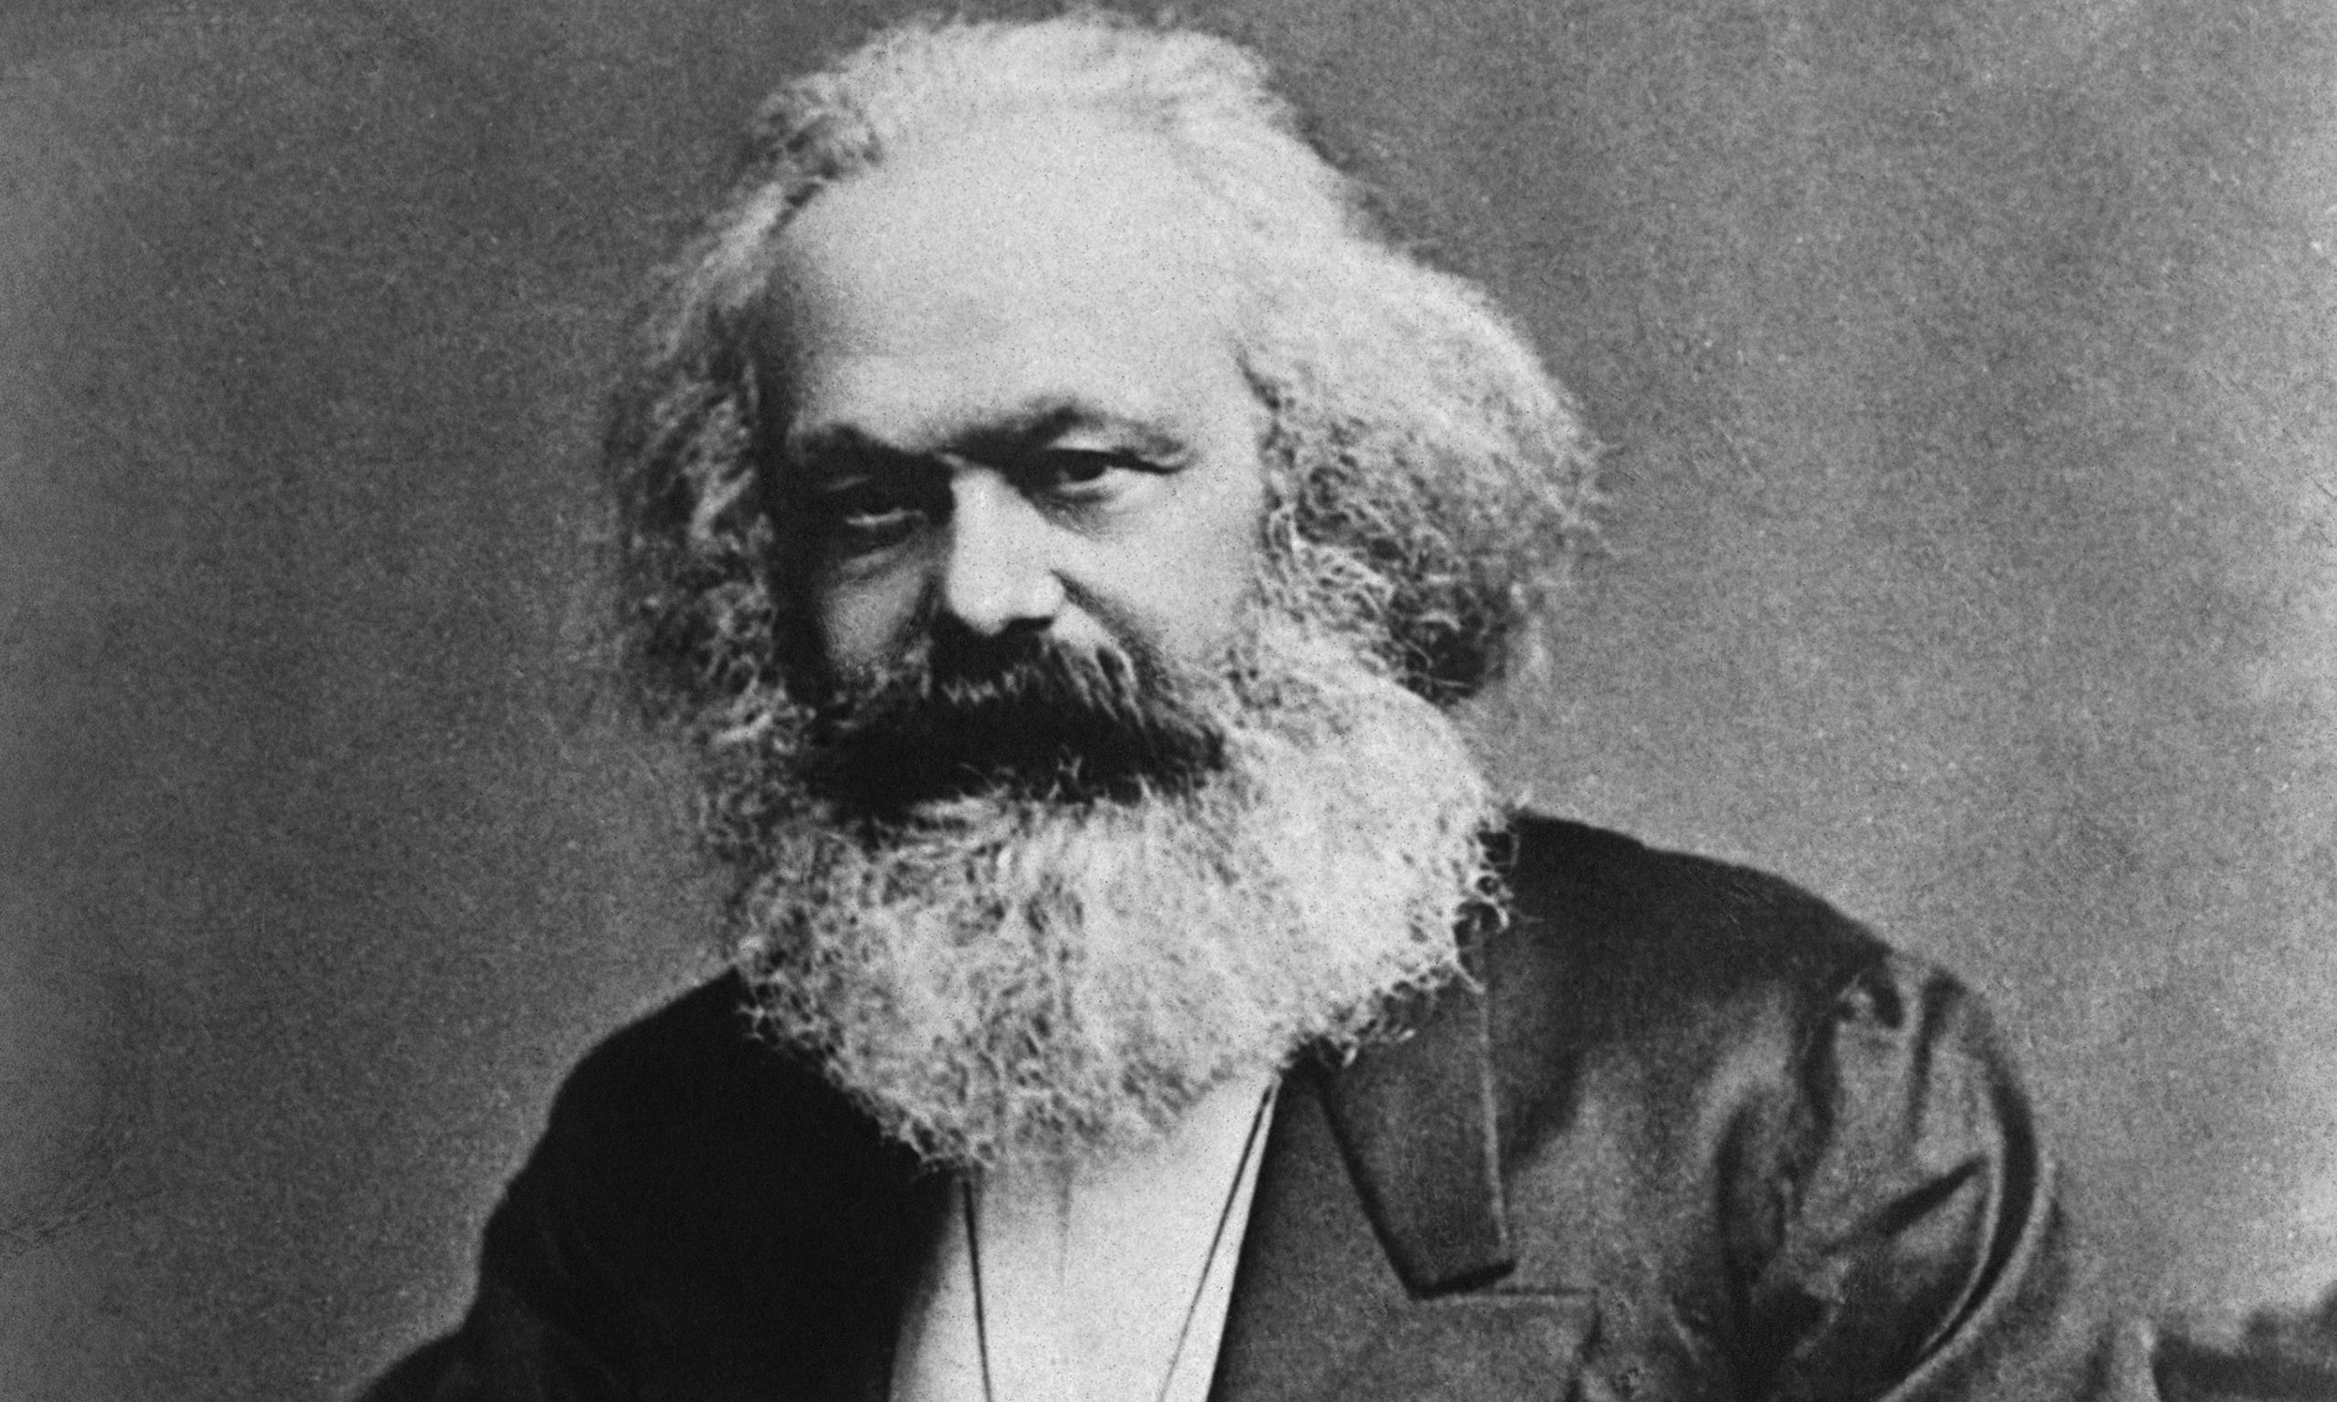
Conflict theories - Marxism
This Photo by Unknown Author is licensed under CC BY-SA-NC

Slide 2
What can you remember?
Mode of production
Economic base
Superstructure
How capitalism works through class consciousness, alienation and ideology.
Links to communism.
Criticisms of Marx

Slide 3
Comparison to Functionalism
Comparison to Functionalism
Similar to Durkheim - both could see harm caused my modern Industrial Society. Both believed that you could understand society scientifically.
Different because Marx did not see progress as smooth and gradual. Saw historical change as a process where capitalism would increase human misery before giving may to a classless society where humans would be free.

Slide 4
Materialism = idea that humans are beings with needs
How are these met?
Through history….unaided human labour, then tools, machines, human co-operation and social relations of production.
This creates - 1. A class who owns means of production
2. A class of labourers
.

Slide 5
Useful terms
Mode of production (forces and relations of production)
Economic base of society – this determines all other features of society.
Superstructures all the bits of society that come from this base

Slide 6
Important concepts.
At the beginning of human history, no classes, no private ownership so no exploitation. Everyone works and everything is share. As soon as someone owns production then there is exploitation. Ancient society has slaves. Feudal society has serfs tied to the land. Capitalist society has free wage labourers.
Capitalism has a division between proletariat (who are legally free) and bourgeoisie. Proletariat are not really free as have to sell their labour power to the bourgeoisie and they do not receive the profits they raise. Competition forces low wages to raise profits.
The classes are polarised. Members of the proletariat become conscious of how bad their lives are, this is called ‘class consciousness’ as they become aware of need to overthrow capitalism.
Ideology – bourgeoisie aim to control the ideas of the proletariat. Ideas in society are those of the dominant class. This can create a false consciousness.
Alienation – this comes from loss of control and then separation from our true nature.,
Revolution and communism – the state exists to protect the interests of the ruling class. Marx thinks that the proletariat will overthrow the bourgeoisie and become the first majority to overthrow a minority. The state and class will disappear, private ownership and exploitation will disappear.

Slide 7
Evaluation – problems with Marx’s view of class
It is too simplistic. He sees class as the only important division. Weber suggests a more complication approach where sources of inequality such as wealth can exist outside of class. For example a ‘power elite’ can exist without actually owning the means of production. Feminists argue that gender is more important than class.
The two class model is too simplistic.
Rather than two classes the middle class ahs grown and the industrial working class has shrunk.

Slide 8
Evaluation problems with determinism and predictions.
Marx is criticised for being too deterministic. Economic factors do not cause everything in society. Humans have free will
Revolution has not occurred as Marx predicted. This has only happened in economically backward countries such as Russia and not in America and Western Europe as predicted.

Slide 9
2 types of Marxism
Since Marx’s death two types of Marxism have emerged.
1. Humanist Marxism – in this theory humans have free-will and are active agents in history so are central in changing the world.
2. Structuralist Marxism – this looks at Marxism as a science. Structural factors determine the cause of history not humans.

Slide 10
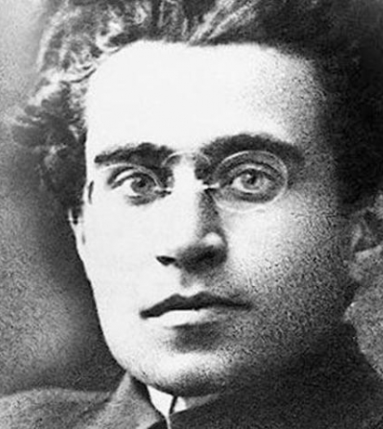
Gramsci and hegemony humanistic Marxism
Hegemony means ideological or moral leadership. This idea is used to explain how the ruling class keep their position. They use coercion (force) and hegemony - ideas and values to trick the weaker class into thinking their stronger class should be in power. The working class can only win the battle by producing their own intellectuals who would put together a different vision of how society should work. This would be called the ‘counter hegemony’ it would be based on socialist rather than capitalist values.
He is what is called a ‘Humanist Marxist’

Slide 11
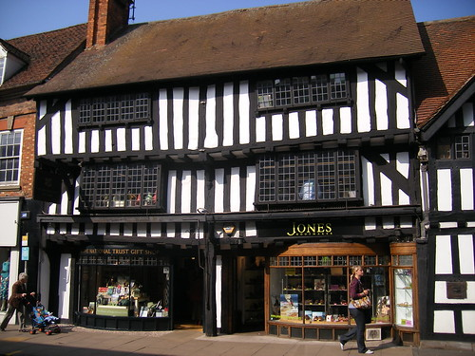
Evaluation of Gramsci
Althusser’s structuralist Marxism
Humanist Marxists believe that humans can change the course of history. Structuralist Marxists believe that social structures shape history and these could be studied scientifically. Althusser is the most important structural Marxist. He sees society as having 3 structures or Levels, draw these below. Draw Craib’s analogy next to it and explain.
Read box 3.11 on page 213 and draw the 3 storey building described.
economic level
political level
ideological level
What can you remember about RSAs and ISAs?
Repressive state apparatuses and ideological state apparatuses.
How does Althusser criticise humanist Marxism?
Althusser believes we are not free agents and we do not possess free will. We are products of social structures which determine everything around us and fit us into the structures of capitalism. This is in contrast to Marx who believed that humans could bring change.
This Photo by Unknown Author is licensed under CC BY
This Photo by Unknown Author is licensed under CC BY-SA

Slide 12
Evaluation of Althusser
Althusser criticises humanism and determinism but he is particularly critical of humanism.
He replaces it with structural determinism which is more complex.
Some Marxists criticise this scientific approach as it puts people off activism as it suggests that humans can’t make a difference.

Slide 13
Summary
Marxism as a structural perspective based on conflict.
Bourgeoisie exploit the proletariat. This is through repressive state apparatus and through ideology.
Marx believed that society would eventually become classless.
Critics find this too deterministic, ignores other forms of inequality and assumes a 2 class system which is not what we see in modern society. Different views are put forwards by Gramsci who puts forward more of a humanist approach and Althusser who looks are ‘structural determinism.

