Slide 1
Education and Ethnic Group

Slide 2
What exam board want you to know (this is your minimum by the end of today
Different sociological explanations of ethnic differences in educational achievement in relation to external factors, eg cultural deprivation, material deprivation and racism in wider society.
Bereiter & Engelmann, Evans, Lupton
Also Internal factors: racist labelling, self-fulfilling prophecy, pupil subcultural responses, ethnic identities, institutional racism, ethnocentric curriculum

Slide 3
cultural deprivation, material deprivation and racism?
Internal factors: racist labelling, self-fulfilling prophecy, pupil subcultural responses, ethnic identities, institutional racism, ethnocentric curriculum
And what do the statistics show?
This Photo by Unknown Author is licensed under CC BY-NC-ND

Slide 5
Language
Official statistics (2013) have found that 18% of pupils in primary, and 13% of pupils in secondary schools (with much higher proportions in some areas) did not have English as their first language or the main language used in their homes.
Impact of this?
This Photo by Unknown Author is licensed under CC BY-SA

Slide 6
Bereiter and Engelmann
consider language spoken by low income Black American families as not complicated enough for success in education. The see it as ‘umgrammatical, disjointed and incapable of expressing abstract ideas’.
This Photo by Unknown Author is licensed under CC BY-SA

Slide 7
BUT how might we criticise this?
BUT / HOWEVER / ON THE OTHER HAND
There has been the concern that students who don't speak English at home may be held back educationally. However, official statistics (2010) have found that pupils with English as a first language were only 3.2 points ahead of those without English as a first language (55.2% to 52.0%) when gaining 5 GCSE A*-C.
Similarly, the Swann Report (1985) found that while language factors might hold back some children, for the majority it was not a major factor in underachievement, while David Gillborn and Heidi Safia Mirza (2000) note that Indian pupils do very well despite often not having English as their home language.
Also, evidence from the Department for Education (2013) showed that pupils with English as a second language, who speak another language in their homes, outperformed in the EBacc their classmates who had English as their first language.
What does this tell us about intellectual and linguistic skills as an explanations for ethnic groups differences in achievement?

Slide 8
2. Family life and parental support Sociologists suggest that some minority groups offer more support for education at home than others.
This Photo by Unknown Author is licensed under CC BY-ND

Slide 9
Family life?
African-Caribbean families
Moynihan (1965) argues that many African-Caribbean families are headed by a single mother
New Right sociologist Murray (1989) argues that black one-parent families are part of an ‘underclass’ that is not committed to mainstream values and does not value education
cultural deprivation theorists argue, some black children are socialised into a subculture that instils a fatalistic, 'live for today' attitude that does not value education and leaves them unequipped for success.

Slide 10
Supported by?
Sewell?
Pryce?

Slide 11
Asian families?
Driver and Ballard (1981)
Ruth Lupton (2004)

Slide 12
White working class?
Lupton (2004) studied 4 mainly working class schools 2 mainly white, one serving a largely Pakistani community and the fourth very mixed. She found the poorest levels of behaviour and discipline in the white working-class schools and blamed this on lower levels of parental support and the negative attitudes that white working-class parents had towards education. These parents had fairly indifferent or negative attitude towards learning and toward school, and low aspirations for their children.
This Photo by Unknown Author is licensed under CC BY-SA

Slide 13
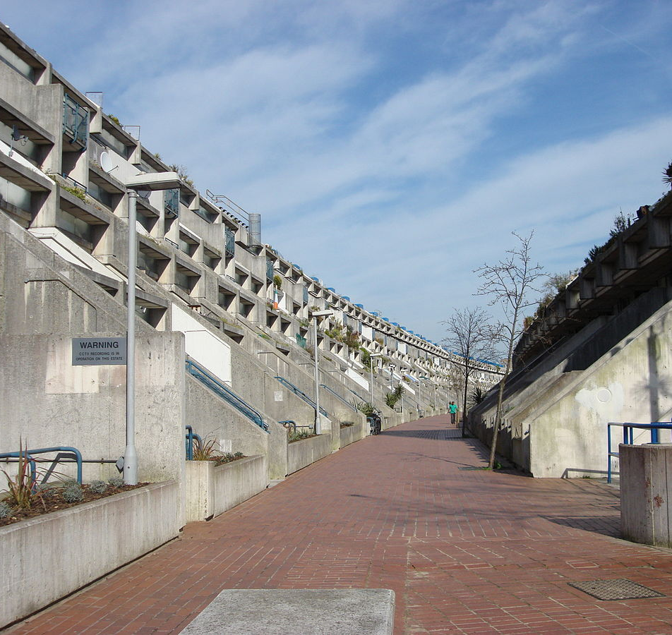
What does Evans (2006) state is another reason for white working-class underachievement?
Street culture
White working class areas are brutal (p39 of red book)
This Photo by Unknown Author is licensed under CC BY-SA

Slide 14
An interaction of home and school factors?
Bhatti (1999) found a relationship between home and school for Pakistani, Bangladeshi and Indian Asian pupils. They found that parents are very supportive and had a high level of interest in their child's education, though they didn't know much about the daily processes and organisation of schools, and their children's experience of schooling. Many didn't know how to approach the school or teachers, so avoided doing so unless it was essential. Many of those who did visit found school unwelcoming. Their own level of education meant they were sometimes unable to help their children with schoolwork as much as they would have liked to.
Similarly, Vincent (2011) found that black middle-class parents were concerned and actively involved in their children's schooling e.g. enrolling them in extra-curricular activities and extra tutoring. However, they found teachers treated them as if they knew less about their children's education than white middle-class parents, despite having similar qualifications, and expected them to be far less interested in education than their white peers.

Slide 15
How are material deprivation and ethnicity linked?
Material deprivation explanations see educational failure as resulting from factors such as substandard housing and low income. Ethnic minorities are more likely to face these problems. For example, according to Flaherty (2004):
Give me examples…..

Slide 16
Why is this picture complicated? See p 40 about Indian and Chinese pupils who are materially deprived and still do better than most?

Slide 17
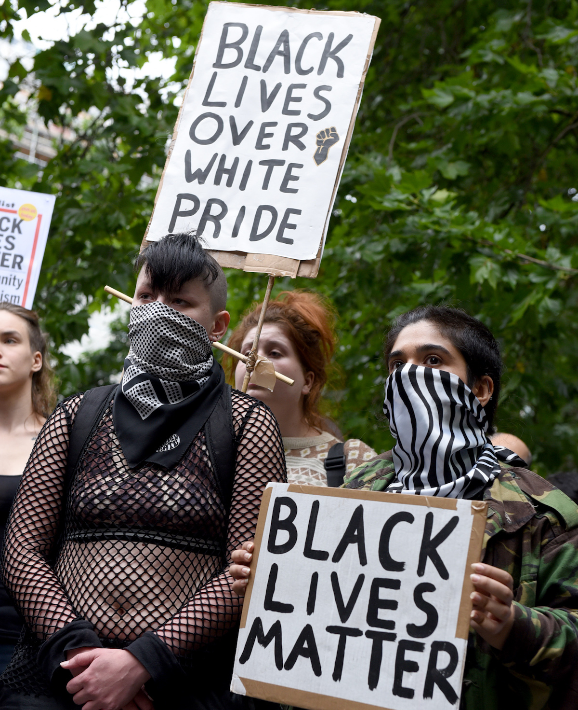
3. Racism in wider society
Chine et al (2002) found racism is common in schools and while travelling to and from school. Traveller / Gypsy children faced the worst. This is likely to make their experience of school more stressful.
This Photo by Unknown Author is licensed under CC BY-SA-NC

Slide 18
Teachers and labelling?
Gillborn and Mirza (2000) have found that in one local education authority, black children were the highest achievers on entry to primary school (20% above the local average), but by GCSE, they had the worst results of any ethnic group – 21 points below the local average.
What does this suggest?

Slide 19
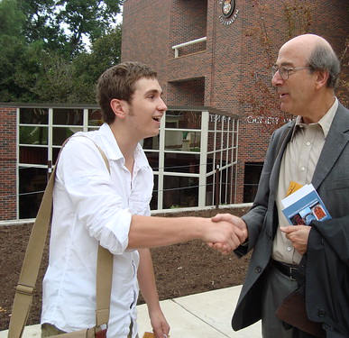
Labelling?
When looking at ethnic differences in achievement, interactionists focus on the different labels teachers give to children from different ethnic backgrounds. Their studies show that teachers often see black and Asian pupils as being far from the ‘ideal pupil’. For example, black pupils are often seen as disruptive and Asians as passive.
This Photo by Unknown Author is licensed under CC BY

Slide 20
Teachers may not be consciously racist but the Swann report found that many are unintentionally racist so may favour pupils or give more time to some or give individual praise for example more often to white pupils than to black Caribbean girls and boys.
Wright and Connolly looked at stereotypes in inner-city schools and found these stereotypes – positive impressions of Asian girls and Asians in general. Black Caribbean pupils were seen as having low potential and being disruptive. This means these pupils were reacted to more quickly creating conflict.
This Photo by Unknown Author is licensed under CC BY-ND

Slide 21
Archer 3 pupil identities constructed by pupils
Ideal pupil
Pathologised pupil identity (seen as abnormal)
Demonised pupil
How do teachers respond when group 2 achieve success?

Slide 22
Subcultures?

Slide 23
Sewell: the variety of boys’ responses:
Sewell studied underachievement of black boys, and found that pupils’ responses to schooling, including racist stereotyping by teachers, can affect their achievement. He identifies four such responses:

Slide 25
Institutional racism and the ethnocentric curriculum:
Can you remember what critical race theory is?

Slide 26
Marketisation and segregation:
Key study: Moore and Davenport (1990)
Moore and Davenport show how selection procedures lead to ethnic segregation, with minority pupils failing to get into better secondary schools due to discrimination
This Photo by Unknown Author is licensed under CC BY-SA
This Photo by Unknown Author is licensed under CC BY-SA-NC

Slide 27
The ethnocentric curriculum?

Slide 28
Different sociological explanations of ethnic differences in educational achievement in relation to external factors, eg cultural deprivation, material deprivation and racism in wider society.
Bereiter & Engelmann, Evans, Lupton
Also Internal factors: racist labelling, self-fulfilling prophecy, pupil subcultural responses, ethnic identities, institutional racism, ethnocentric curriculum

Slide 29
Topic Summary to be completed and put on Firefly
Can do a revision clock if you prefer.
Use this powerpoint and your booklet.
Optional past questions too…..

