Slide 1
1.
x | Output
for x in range (1,6):
print(x*2)
1
2
2
4
3
6
4
8
5
10
Notes:
Teacher demonstration

Slide 2
2.
x | x < 3 | Output
for x in range (1,5):
if x < 3:
print("less than 3")
else:
print("3 or above")
1
True
Less than 3
2
True
Less than 3
3
False
3 or above
4
False
3 or above
Notes:
Teacher demonstration

Slide 3
3. Assume the user enters the following values: “Sam”, “upper”, “Ayo”, “lower”, “Zoe”,”upper”
x | choice | case | Output
for x in range(1,4):
choice = input("Enter a word")
case = input("upper or lower")
if case == "upper":
print(choice.upper () )
else:
print(choice.lower () )
1
Sam
upper
SAM
2
Ayo
lower
ayo
3
Zoe
upper
ZOE
Notes:
Teacher demonstration

Slide 4
4. Complete the trace table.
https://youtu.be/IcX4DMxqAKY
X | Output
for x in range (1,6):
print(x**2)
1
1
2
4
3
9
4
16
5
25
Notes:
Teacher demonstration

Slide 5
5. Complete the trace table.
https://youtu.be/_9-cXSiAoSw
X | country | Output
1 | France | r
2 | France | a
3 | France | n
4 | France | c
for x in range (1,5):
country = "France"
print(country[x])
Notes:
Teacher demonstration

Slide 6
6. Assume the user enters the following values: 0, 3, 2, 5
x | Is x < 3 | num | Output
2 | True |  | it’s Jeff
3 | False | 0 | 0
4 | False | 3 | 12
5 | False | 2 | 10
6 | False | 5 | 30
for x in range (2,7):
if x < 3:
print("it’s Jeff")
else:
num = int(input("Enter a number"))
print(x * num)
https://youtu.be/TNKu5Z96Xrc
Notes:
Teacher demonstration

Slide 7
7. Assume the user enters the following values: “Nick”, “Lukas”, “Lara”, “Tim”
X | name | length | Output
1 | Nick | 4 | 4
2 | Lukas | 5 | 10
3 | Lara | 4 | 12
4 | Tim | 3 | 12
for x in range (1,5):
name= input("Enter a name")
length = len(name)
print(x * length)
https://youtu.be/kT69M2pO9IY
Notes:
Teacher demonstration

Slide 8
8. Assume the user enters the following values: 7, 0, 4, 8
X | country | num | letter | Output
1 | United States | 7 | S | nS
2 | United States | 0 | U | iU
3 | United States | 4 | e | te
4 | United States | 8 | t | et
for x in range (1,5):
country = "United States"
num = int(input("Enter a number"))
letter = country[num]
print(country[x] + letter)
https://youtu.be/IleEze5i0YE
Notes:
Teacher demonstration

Slide 9
9. Assume the user enters the following values: 4, *, 3, % ,6, %, 5, *
Hint: % = MOD (finding the remainder)
x | num | operator | Output
1 | 4 | * | 4
2 | 3 | % | 1
3 | 6 | % | 0
4 | 5 | * | 20
for x in range (1,5):
num = int(input("Enter a number"))
operator = input("Enter operator")
if operator == "%":
print(num % x)
else:
print(num*x)
https://youtu.be/VyrDzifn_s4
Notes:
Teacher demonstration

Slide 10
10. Complete the trace table
x | y | Output
1 | 1 | 1
1 | 2 | 2
1 | 3 | 3
2 | 1 | 2
2 | 2 | 4
2 | 3 | 6
3 | 1 | 3
3 | 2 | 6
3 | 3 | 9
for x in range (1,4):
for y in range (1,4):
print( x * y )
https://youtu.be/lEzhzWsoBds
Notes:
Teacher demonstration

Slide 11
11. Complete the trace table.
X | Is x % 2 == 0 | Output
1 | False
2 | True | 2
3 | False
4 | True | 4
5 | False
6 | True | 6
for x in range (1,7):
if x % 2 == 0:
print(x)
https://youtu.be/GPPdK7qyWCA
Notes:
Teacher demonstration

Slide 12
12.
x | x < 5 | Output
x = 1
While x < 5:
print(x*2)
x = x + 1
print(" The end ")
1
True
2
2
True
4
3
True
6
4
True
8
5
False
The end
Notes:
Teacher demonstration

Slide 13
13. Assume the user enters the following inputs: 12,10,20,9
num | Num>=10 | Output
num = int(input("Enter number"))
while num >= 10:
print("Incorrect")
num = int(input("Enter number"))
print("Correct")
12
True
Incorrect
10
True
Incorrect
20
True
Incorrect
9
False
correct
Notes:
Teacher demonstration

Slide 14
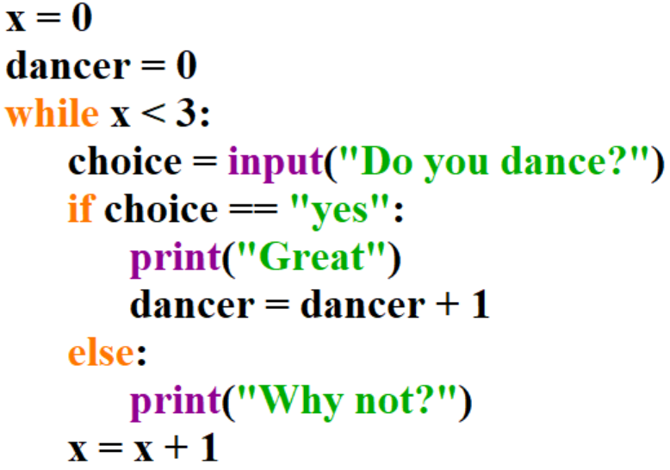
14. Assume the user enters the following values: “yes”, “no”, “chicken”
x | dancer | x < 3 | choice | output
0
0
True
yes
great
1
1
True
no
Why not?
2
1
Why not?
True
Chicken
3
Notes:
Teacher demonstration

Slide 15
15. Complete the trace table. Assume the user enters the following values: “Tom”,”Sarah”,”Andy”,”Ed”
singer | singer != "Ed" | Output
Tom | True | Incorrect
Sarah | True | Incorrect
Andy | True | Incorrect
Ed | False | Correct
https://youtu.be/PKkP-fY8M5c

Slide 16
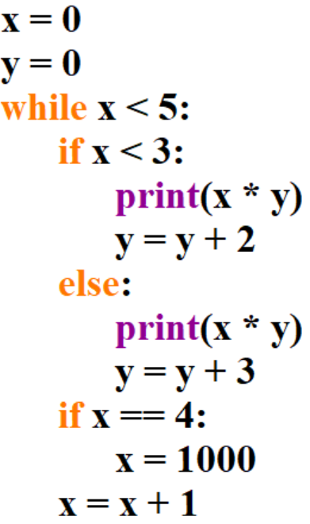
16. Complete the trace table.
x | y | x < 5 | x < 3 | Output
0 | 0 | True | True | 0
1 | 2 | True | True | 2
2 | 4 | True | True | 8
3 | 6 | True | False | 18
4 | 9 | True | False | 36
1000 | 12
1001 |  | False
https://youtu.be/vIsF88GPOu4

Slide 17
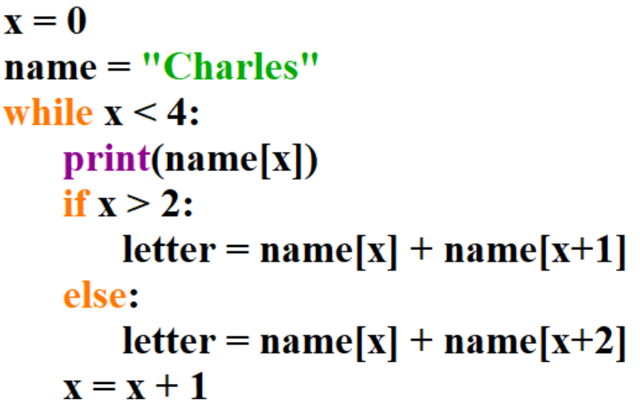
17. Complete the trace table. Then write the final value of letter:
Final value of letter: rl
x | name | x < 4 | Output | letter
0 | Charles | True | C | Ca
1 | Charles | True | h | hr
2 | Charles | True | a | al
3 | Charles | True | r | rl
4 | Charles | False
https://youtu.be/dcSONzbHWBE

Slide 18
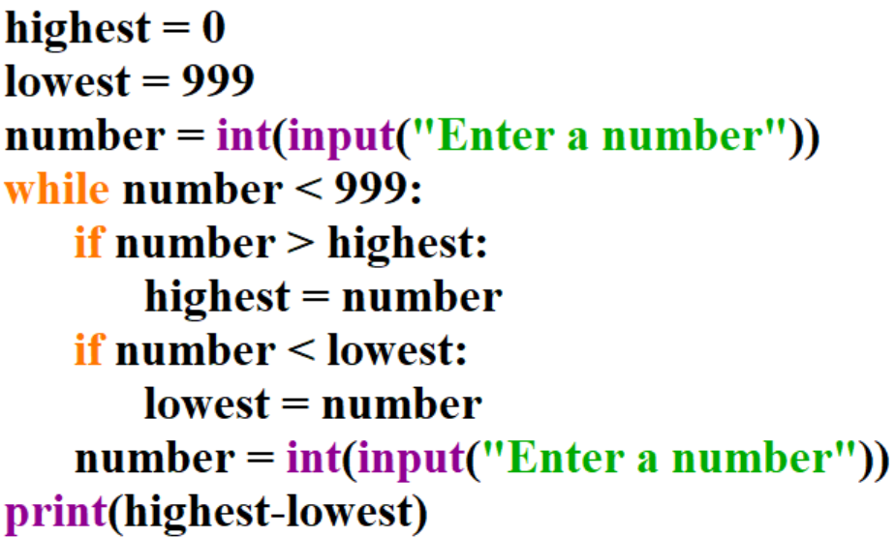
18. Complete the trace table. Assume the user enters the following numbers: 10, 50, 300,5, 1000
Highest | lowest | number | Output
0 | 999 | 10
10 | 10 | 50
50 | 10 | 300
300 | 10 | 5
300 | 5 | 1000 | 295
https://youtu.be/uYylwr_P_ok

Slide 19
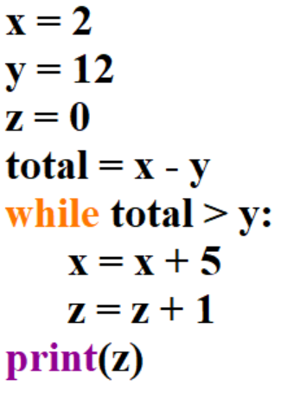
19. Complete the trace table. You may not need all the spaces in the trace table.
Enter the final value of z:
z = 0
x | y | z | total | Output
2 | 12 | 0 | -10 | 0
https://youtu.be/6TsVTkLdlKY

Slide 20
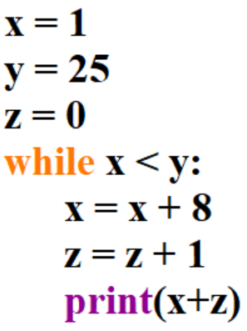
20. Complete the trace table.
x | y | z | Output
1 | 25 | 0
9 | 25 | 1 | 10
17 | 25 | 2 | 19
25 | 25 | 3 | 28
https://youtu.be/HBg2TM2SI2A

Slide 21
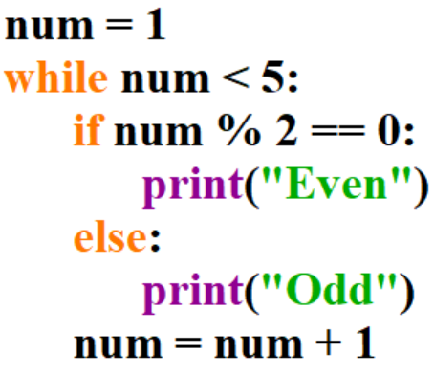
21. Complete the trace table.
num | num < 5 | Output
1 | True | Odd
2 | True | Even
3 | True | Odd
4 | True | Even
5 | False
https://youtu.be/-zVIYOjO62c

Slide 22
22. Lets see how it works in a trace table:
x | Output
films = ["Saw", "Sharks", "Lion king"]
for x in range(0,len(films)):
print(films[x])
0
Saw
1
Sharks
2
Lion King
Notes:
Teacher demonstration

Slide 23
23.
x | Output
names = ["Tom", "Mark", "Sam"]
for x in range(0,len(films)):
print(names[x])
0
Tom
1
Mark
2
Sam
Notes:
Teacher demonstration

Slide 24
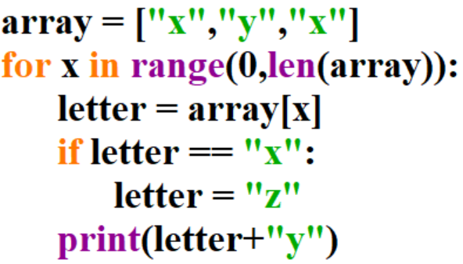
24.
x | letter | Output
0
x
0
z
zy
1
y
yy
2
x
2
z
zy
Notes:
Teacher demonstration

Slide 25
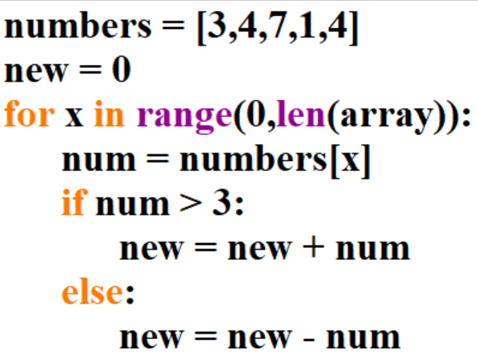
25. Complete the trace table
new | x | num
0 | 0 | 3
-3 | 1 | 4
1 | 2 | 7
8 | 3 | 1
7 | 4 | 4
11
https://youtu.be/Gf05FF6jwoE

Slide 26
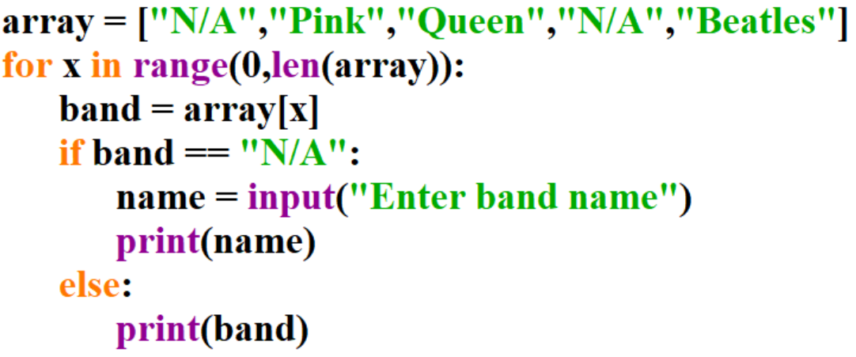
26. Complete the trace table – Assume the user enters the following as inputs: Metallica, Idles
band | name | Output
N/A | Metallica | Metallica
Pink | Metallica | Pink
Queen | Metallica | Queen
N/A | Idles | Idles
Beatles | Idles | Beatles
https://youtu.be/JQA1Sdj0tP0

Slide 27
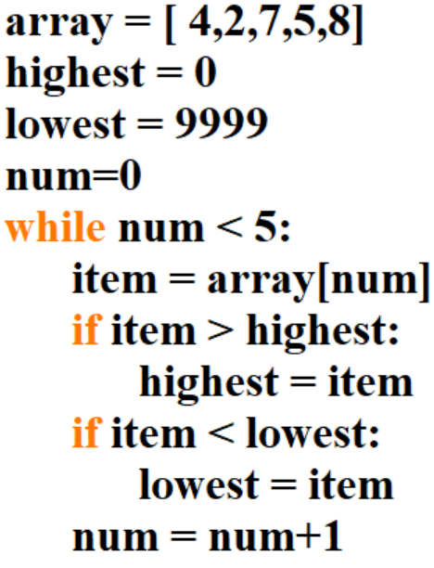
27. Complete the trace table
highest | lowest | num | item
0 | 9999 | 0 | 4
4 | 4 | 1 | 2
4 | 2 | 2 | 7
7 | 2 | 3 | 5
7 | 2 | 4 | 8
8 | 2 | 5
https://youtu.be/VjwJk1by91c

Slide 28
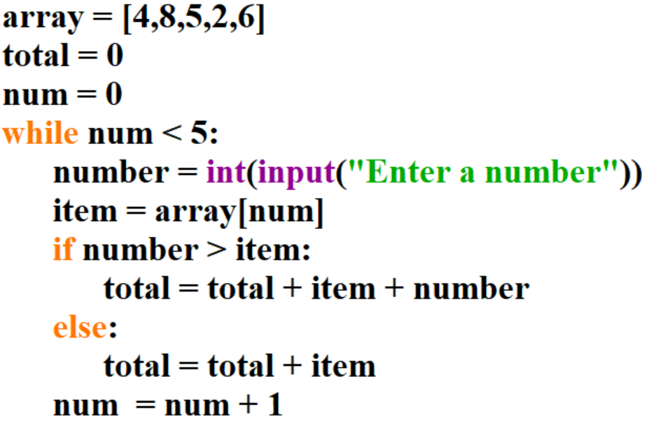
28. Complete the trace table – Assume the user enters 5,2,8,1,4 as inputs
total | num | number | item
0 | 0 | 5 | 4
9 | 1 | 2 | 8
17 | 2 | 8 | 5
30 | 3 | 1 | 2
32 | 4 | 4 | 6
38 | 5
https://youtu.be/JQi4Iqb5rao

Slide 29
29. Complete the trace table.
row | column | output
0
0
A
0
1
B
0
2
C
1
0
G
1
1
S
1
2
T

Slide 30
30. Complete the trace table.
row | grades[row][0] | grades[row][1] | Output
0 | Tom | x | fail
1 | Kim | C | pass
2 | Sam | x | fail
https://youtu.be/qsjmhxfq5-o

Slide 31
31. Complete the trace table. Assume the user enters the following inputs: 15,40,20,7,55,21
x | y | num | numbers[x][y]
0 | 0 | 15 | 20
0 | 1 | 40 | 45
1 | 0 | 20 | 25
1 | 1 | 7 | 12
2 | 0 | 55 | 60
2 | 1 | 21 | 26
https://youtu.be/xCP2-_Ihw2Y

Slide 32
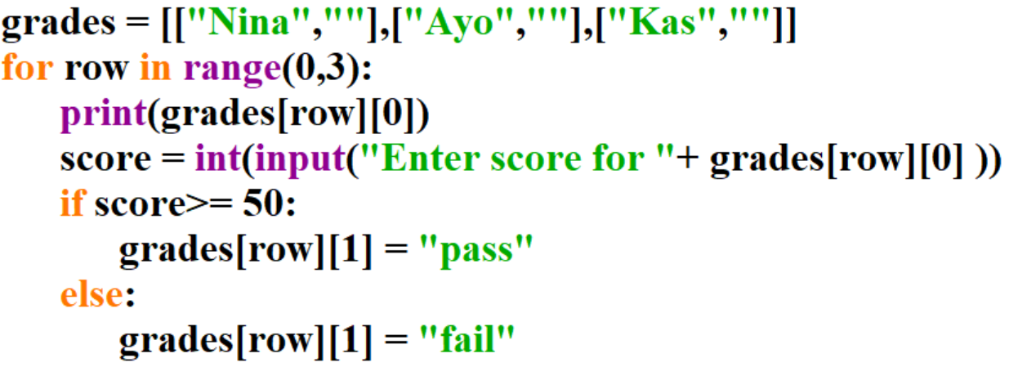
32. Complete the trace table. Assume the user enters the following inputs: 25,90,50
row | Output | score | grades[row][1]
0 | Nina | 25 | fail
1 | Ayo | 90 | pass
2 | Kas | 50 | pass
https://youtu.be/qqGddNS1_k4

Slide 33
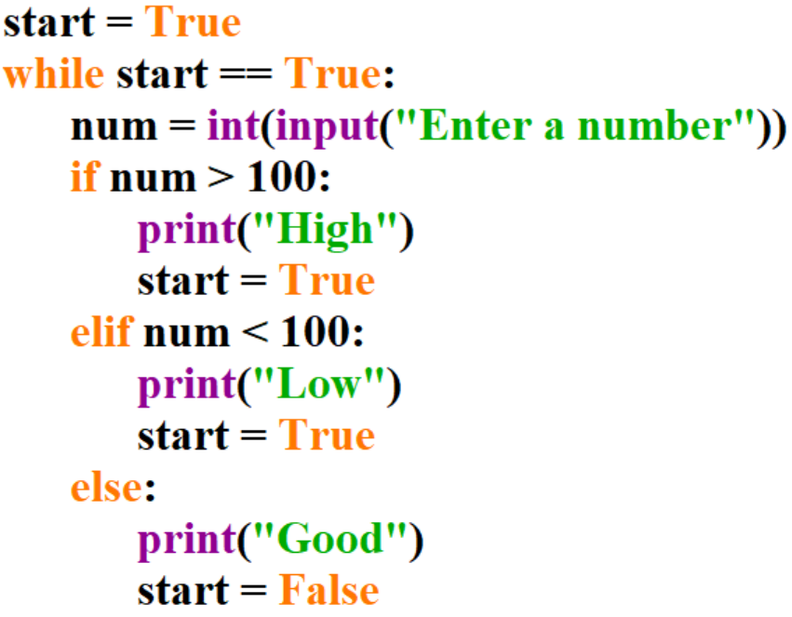
33. Starter: Revisit phase – Complete the trace table Assume the user enters the following values: 5,106,200,100
start | num | output
True | 5 | Low
True | 106 | High
True | 200 | High
True | 100 | Good
False
https://youtu.be/SSSC7FGixus

Slide 34
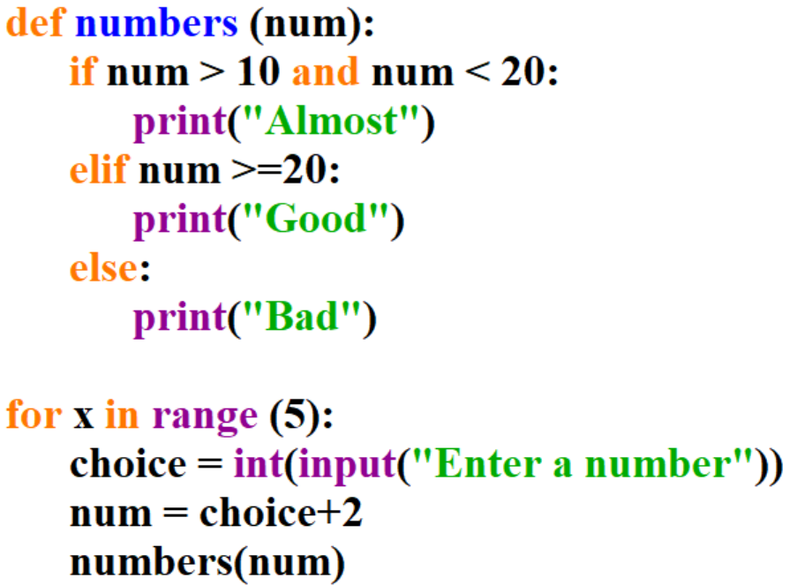
34. Procedure trace table - Assume the user enters the following values: 5,18,15,100,17
choice | num | output
5
7
Bad
18
20
Good
15
17
Almost
100
102
Good
17
19
Almost

Slide 35
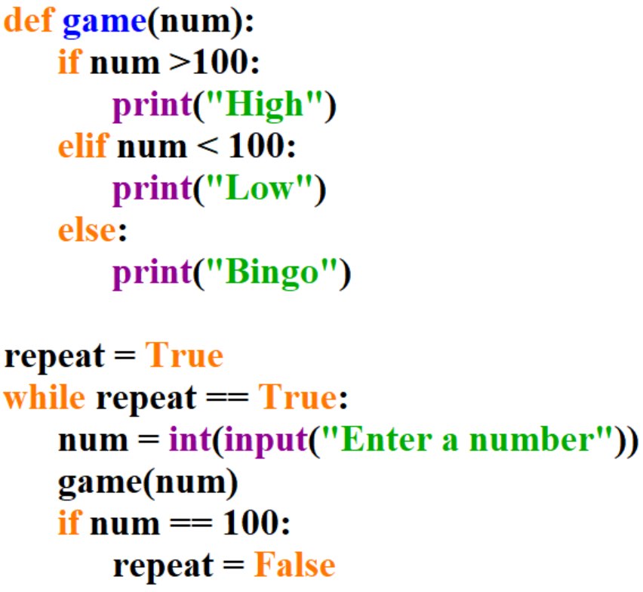
35. Procedure trace table - Assume the user enters the following values: 88,155,15,102,100
Repeat | Repeat == True | num | output | num==100
True | True | 88 | Low | False
True | True | 155 | High | False
True | True | 15 | Low | False
True | True | 102 | High | False
True | True | 100 | Bingo | True
False | False
https://youtu.be/4gS_QudghtU
Notes:
def game(num):
if num >100:
print("High")
elif num < 100:
print("Low")
else:
print("Bingo")
repeat = True
while repeat == True:
num = int(input("Enter a number"))
game(num)
if num == 100:
repeat = False

Slide 36
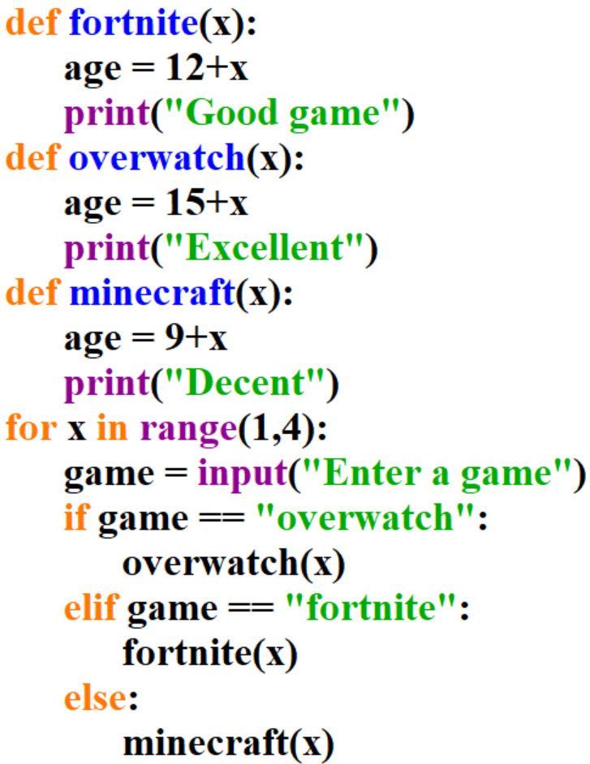
36. Procedure trace table - Assume the user enters the following values: fortnite, minecraft, overwatch
x | game | age | output
1 | fortnite | 13 | Good game
2 | minecraft | 11 | Decent
3 | overwatch | 18 | Excellent
4
https://youtu.be/Iv088BB_ABs
Notes:
def fortnite(x):
age = 12+x
print("Good game")
def overwatch(x):
age = 15+x
print("Excellent")
def minecraft(x):
age = 9+x
print("Decent")
for x in range(1,4):
game = input("Enter a game")
if game == "overwatch":
overwatch(x)
elif game == "fortnite":
fortnite(x)
else:
minecraft(x)

