Slide 1
Pure substances

Slide 2
Lesson objectives
Define a pure substance
Understand that pure substances melt and boil at specific temperatures
Identify pure substances from mixtures using melting point and boiling point data

Slide 3
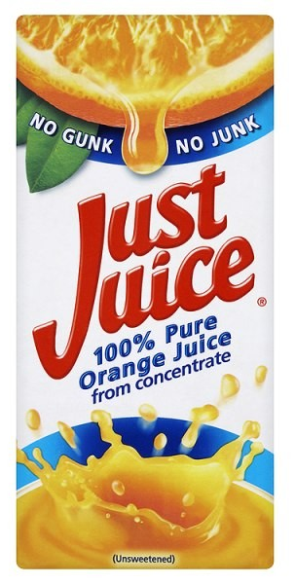
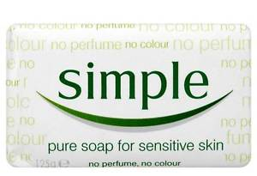
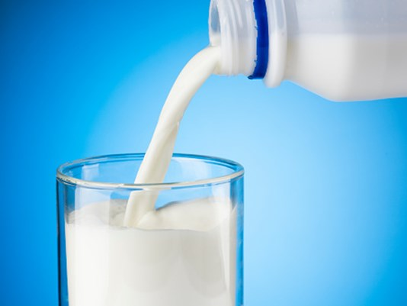
Pure substances?
Notes:
Everyday language – pure is thought to be a natural substance that has not had anything added to it.
Pure orange juice – nothing else added
Pure soap – no perfumes or colour added
Milk – taken straight from the cow and nothing else is added
Mineral water – bottled straight form the water source
Scientist would not consider these things pure because they contain more than one type of substance.

Slide 4
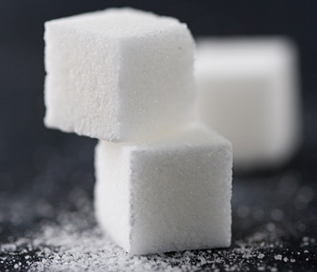
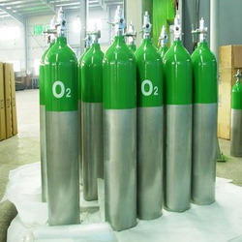
Definition
A pure substance is a single element or compound, not mixed with any other substance.
Diamond
Element: carbon
Glucose
Compound: C₆H₁₂O₆
Oxygen
Element: O₂

Slide 5
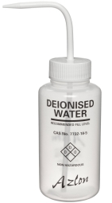
Testing pure substances
Pure: melt & boil
at precise temperature
0^{O}C
100^{O}C
Mixtures: melt & boil over a range
temperatures
-5 to -10^{O}C
101 - 103^{O}C

Slide 6
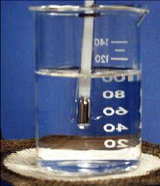
Determining melting points Melting point apparatus
Small amount solid
melts instantly
thermometer
Heat slowly near melting point
Liquid must have boiling point above melting point of substance

Slide 7
Melting point range
Temperature / ºC
A
B
C
D
E
Notes:
Pure substances melt and boil at very precise temperatures.
Mixtures will melt and boil over a range of temperatures.

Slide 8
Pure or mixture?
Substance | Melting point / ^{O}C | Boiling point / ^{O}C | Pure or Mixture?
De-ionised water | 0 | 100
Salt water | -3 to -5 | 101-103
Ethanol | -114 | 78
Antifreeze | -13 to -40 | -
Petrol | - | 60-100
Carbon dioxide | -57 | -78
Butter | 32–35 | -
pure
mixture
pure
mixture
mixture
pure
mixture
Notes:
Pure substances melt and boil at very precise temperatures.
Mixtures will melt and boil over a range of temperatures.

