Slide 1
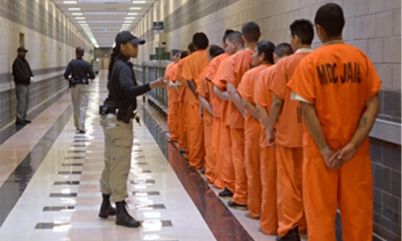
Ethnicity and crime

Slide 2
What the exam board want you to know
Social distribution of crime by ethnicity, including recent patterns and trends and different explanations for these.
Ethnicity and criminality
Racism and the criminal justice system
Victimisation
Bowling and Phillips, Gilroy, Hall.

Slide 3
Reminder…..
What do the statistics show?

Slide 4
Our main debate and space for evaluation…
Lies in the discussions around crime figures and the possible causes of these.
Are ethnic minorities committing more crimes?
Are there other reasons why there are more convictions?

Slide 5
3 main explanations for these
We might take a Marxist approach like Hall – society needs to scapegoat certain groups through elective reporting. Supported by Gilroy (Neo- Marxist)
Maybe police are racist? Bowling and Phillips suggest this.
Ethnic minorities have more deprivation so are likely to turn to crime. This is a ‘New Left’ approach held by Lea and Young

Slide 6
Your task
Using the booklet and textbook pages 114-120 create detailed notes and a summary of each of the 3 perspectives on the previous slide.
Answer all of the 4 and 6 marks questions for ethnicity and gender and start to think about the longer ones which we will plan next week.

