Slide 1
Going Loopy
Computer Science

Slide 2
Iteration
Start
This flow diagram contains a loop.
This is where the code loops back round to re-join the previous code.
This is also known as iteration.
count = 0
count == 10
Yes
count == 10
No
OUTPUT count
OUTPUT count
OUTPUT “You have reached 10”
count = count + 1
count = count + 1
Stop
2

Slide 3
How much do you remember?
Create these programs to recap what you have learnt.

Slide 4
How much do you remember?
Create these programs to recap what you have learnt.

Slide 5
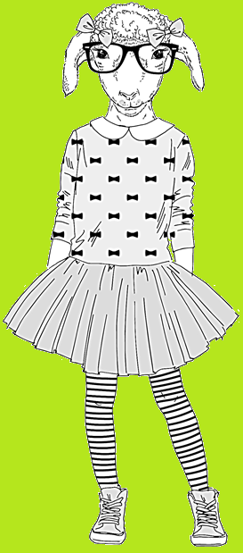
Pop Quiz
What is meant by the phrase “iteration”?
What shape, in a flow diagram, is used for a terminator?
What shape, in a flow diagram, is used for an input or output?
What shape, in a flow diagram, is used to represent a calculation?
What shape, in a flow diagram, is used to represent a decision?
What is the difference between a condition controlled loop and a count controlled loop?

