Slide 1
LO: find area for different shapes

Slide 2
Remember to find the area of a rectangle we need to know how many squares there are inside
We can do this by multiplying the length by the width
3cm
Area = 3 x 5 = 15 cm²
5cm

Slide 3
Area of a Parallelogram

height
Area = base x height
base
The area of a parallelogram
= the area of a rectangle on the same base.
height
Area = base x height
base

Slide 4
Height = 3cm
Base = 6cm
Area = 6 x 3 = 18cm²

Slide 5
Height = 4cm
Base = 6cm
Parallelogram area = 6 x 4 = 24cm²

Slide 6
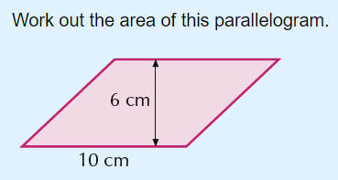

Slide 7
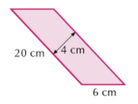
NB As with triangles, the base and height must be perpendicular (at right angles)
Ignore other numbers

Slide 8
Height = 2cm
Base = 4cm

