Slide 1
Chemistry
Pressure - R

Slide 2
Lesson objectives
Understand how gases and liquids cause pressure
Understand how to change the pressure in a gas

Slide 3
Pressure in gases
Gas particles move around and the force
of the particles hitting the inside causes pressure.
Remember the air outside the balloon is also causing pressure. Which is the greater? Why?

Slide 4
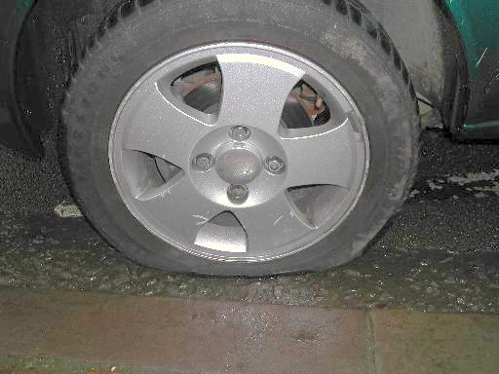
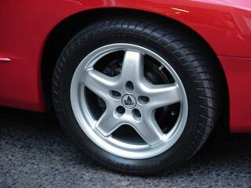
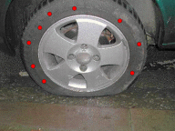
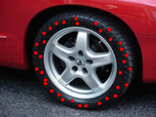
Pressure car tyres
fewer gas particles
lower pressure
more gas particles
higher pressure

Slide 5
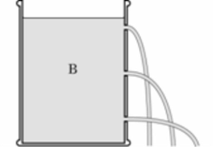
Pressure in liquids
spouting can
Lower pressure
Higher pressure
Why is the bottom spout under the highest pressure?

Slide 6
Pressure
Fill in the gaps in these sentences, using words from the box. You may need to use some words more than once or not at all.
The _______ in a gas and liquid are moving around all the time. The particles ____ into the sides of their container. The _____ of the particles hitting the sides causes ______ . If you put more particles into a container, there will be ____ particles to collide with the walls, and the pressure will ________.
bump decrease force less increase more particles pressure

Slide 7
Pressure - answers
Fill in the gaps in these sentences, using words from the box. You may need to use some words more than once or not at all.
The particles in a gas and liquid are moving around all the time. The particles bump into the sides of their container. The force of the particles hitting the sides causes pressure . If you put more particles into a container, there will be more particles to collide with the walls, and the pressure will increase.
bump decrease force less increase more particles pressure

Slide 8
Compressing a gas
FeL
To compress means to squash
A
B
Draw 5 gas particles in each syringe.
In which syringe is the gas pressure highest? Why?
As the pressure increases what happens to the size of each particle?
What would happen if you kept squashing the particles closer together?

