Slide 1
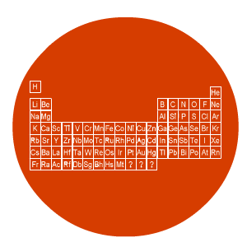
Chemistry
Chemical properties metals &
non-metals

Slide 2
Lesson objectives
State the chemical properties of metals & non-metals

Slide 3
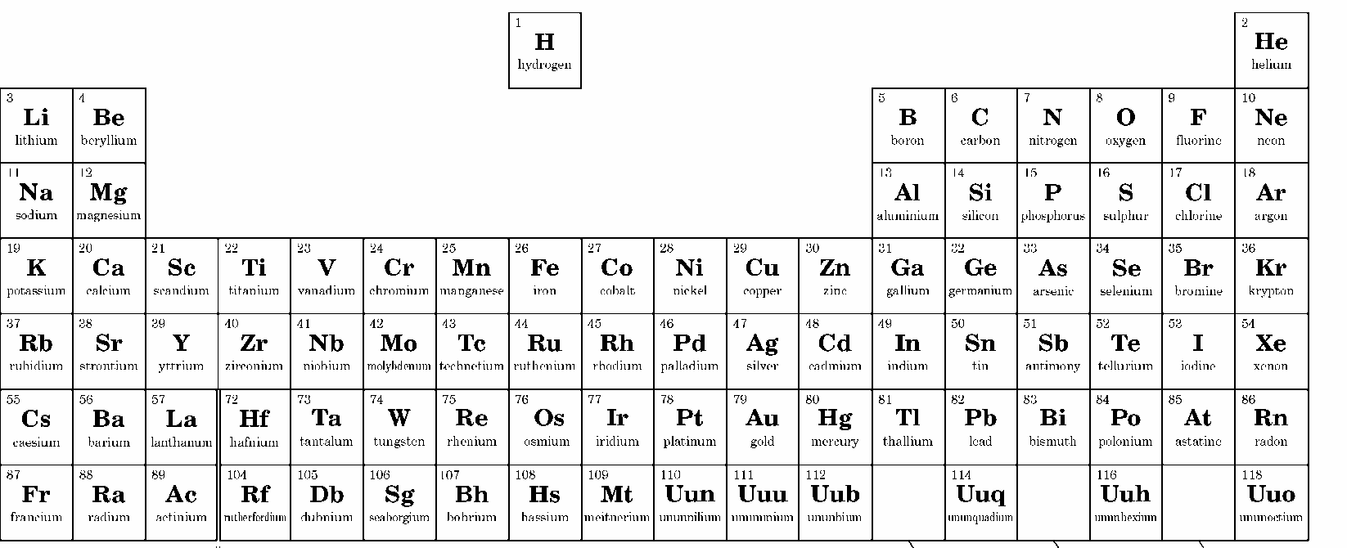
Metal & non-metals
What is the difference in their chemical properties?
8
1
1
2
3
4
5
6
7
2
3
4
5
6
7
KEY:
Metals Non-metals

Slide 4
Chemical properties of metals & non-metals
Metals
Non-metals
React with oxygen
Make metal oxide
Test with universal indicator
React with oxygen
Make metal oxide
Test with universal indicator
YouTube: https://www.youtube.com/watch?v=yMkfNVjwvXM
YouTube: https://www.youtube.com/watch?v=-z6FuDFxRPs

Slide 5
Demonstration
Do matches contain a metal or non-metal element?

