Slide 1
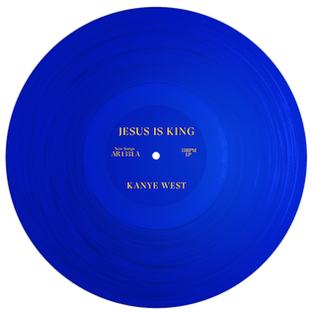
Kanye West
And what religion means to him
By Natasha, Faith and Cherise

Slide 2
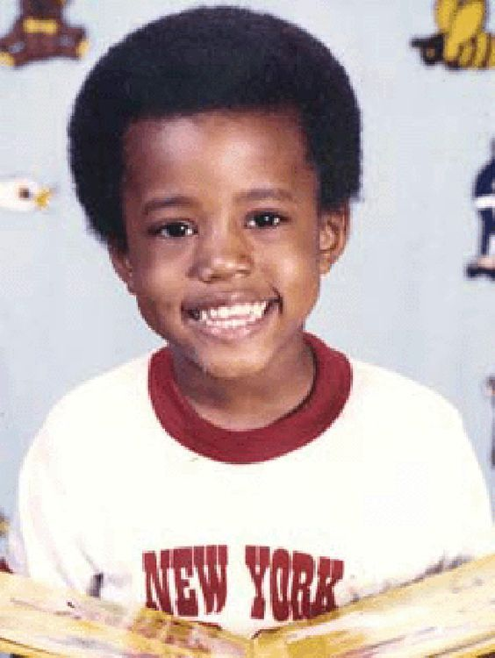
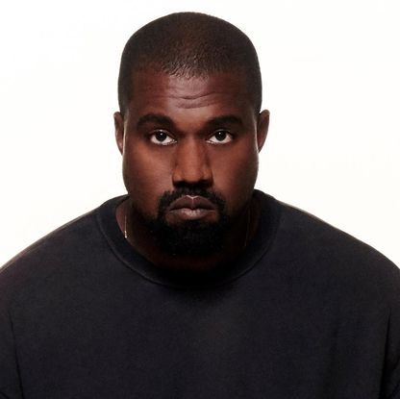
Life of Kanye
After returning from China, after spending a year there he began to find himself drawn to the hip-hop culture and soon became an amateur DJ.
Kanye Omari West is an American rapper, singer, and producer.
After graduating from high school, Kanye was given a scholarship at Chicago’s American Academy of art.
He was born on the 8th June 1977 (age 42) in Atlanta, Georgia into a religious family.
He later dropped out of collage all-together to pursue a career in music.
His mum Donda West was a teacher
His father was a Christian counsellor.
After his parents divorced when he was three years old, he moved with his mum to Chicago, Illinois.
Kanye was raised in a middle-class background, attending Polaris high school

Slide 3
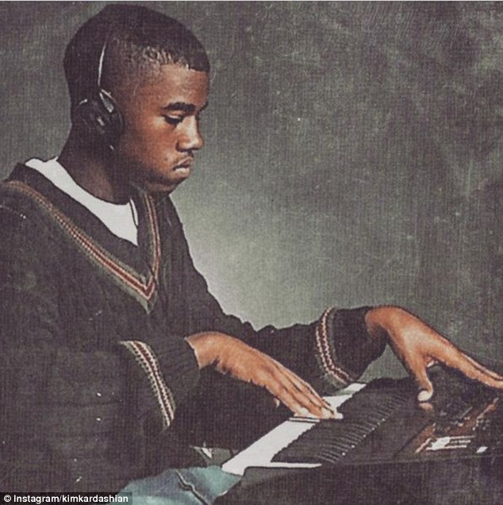
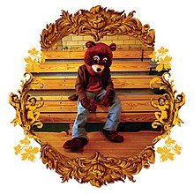
Beginning of his career
Between 1996-2002 he worked at Roc-A-Fella records
After dropping out of collage to peruse music he moved to Brooklyn New York
His albums over the years include:
Late Registration – 2005
Graduation – 2007
VH1 no storytellers - 2010
Watch the throne - 2011
Yeezus – 2013
The life of Pablo – 2016
Ye - 2018
Jesus is king- 2019
A year after he moved to Brooklyn, in 2004 he released his first album ‘The college dropout’.
His first song was called ‘through the wire’ and he released it when he was 27.

Slide 4
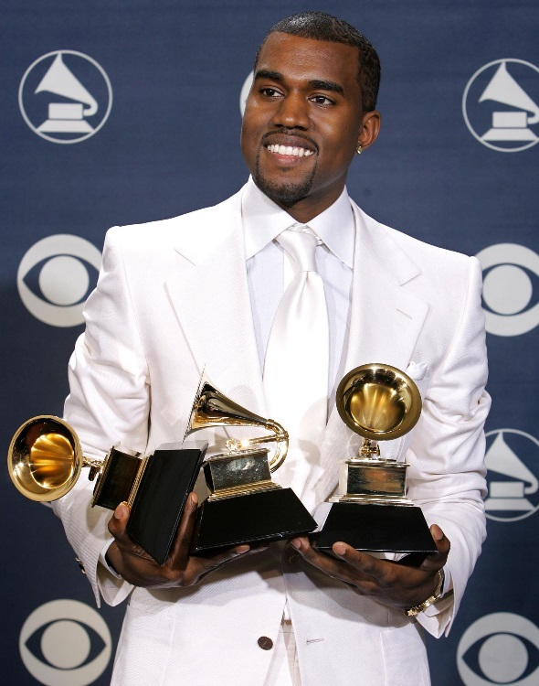
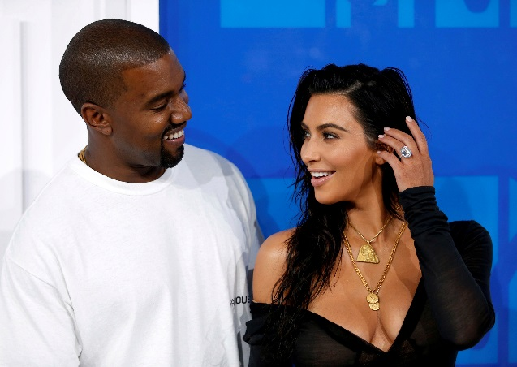
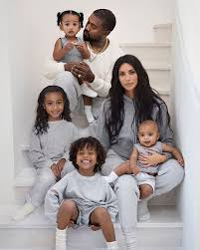
Present day
He has won a total of 21 Grammy awards, making him one of the worlds most awarded artist.
On the 24th may 2014 Kanye married reality TV star Kim Kardashian
West is one of the world’s best-selling music artists with over 100 million records sold world-wide.
He has released over 27 albums
They have four kids, North, Saint, Psalm and Chicago West.
He has done six world tours

Slide 5
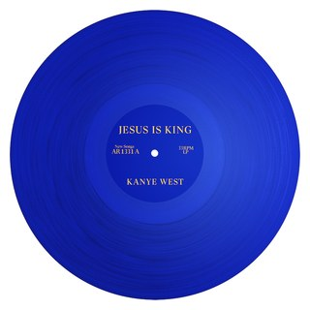
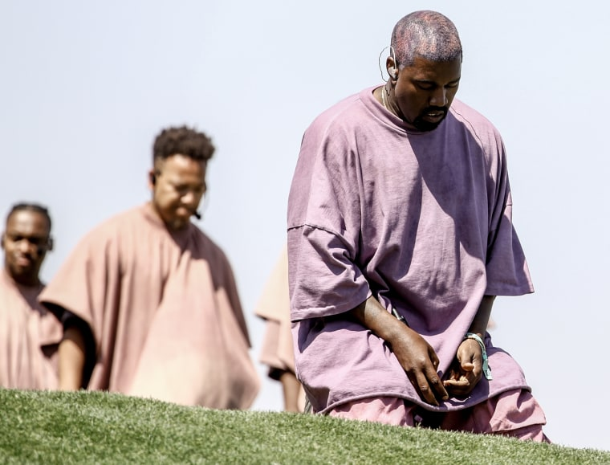
Religion and what it means to him
While he struggled he found hope in God and when he returned to his music he released the album ‘Jesus is king’
Kanye is a Christian and has his own Sunday service.
Over the past few years Kanye has battled with mental health problems meaning he had to take a break from his music career.
He now goes around America and the world sharing his love of God and holding his Sunday Service.
Kanye’s service involves the mix of hip hop and spiritual forum.
We will now show a clip of his service
Two of his kids are names Saint, and Psalm both out of the bible.

Slide 6
Kanye’s Service
https://www.youtube.com/watch?v=Dp78WR467xs
https://www.youtube.com/watch?v=nD0F31hzPeM

Slide 7
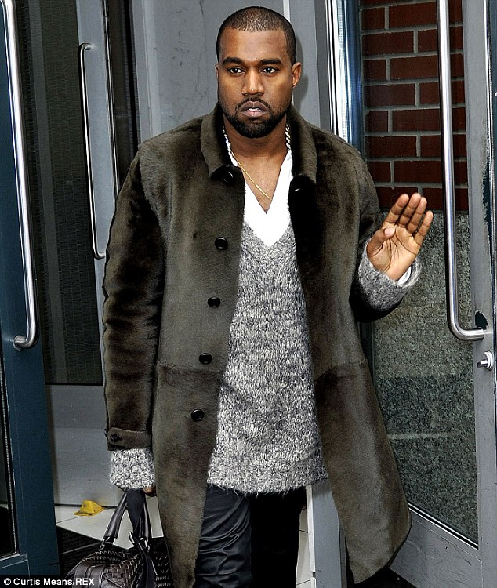
Thank you for listening
Any Questions?

