Slide 1
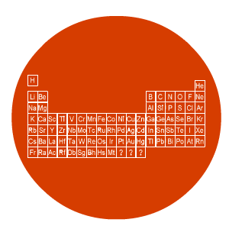
Chemistry
Naming compounds

Slide 2
Lesson objectives
Work out the name of some compounds from the names of the elements it contains

Slide 3
Naming compounds
Simple compounds containing 2 elements:
1st – metal same as element
2nd - non-metal changes ending to “-ide”
E.g. oxygen becomes oxide
Multiples of oxides: mon (1) e.g. carbon monoxide
di (2) e.g. carbon dioxide
tri (3) e.g. sulphur trioxide

Slide 4
Naming compounds – non-metals
element name
compound name
oxygen
oxide
sulphur
sulphide / sulfide
chlorine
chloride
bromine
bromide
iodine
iodide

Slide 5
Naming compounds - examples
metal
non-metal
compound
sodium + oxygen
sodium oxide
calcium + chlorine
calcium chloride

Slide 6
Naming compounds
Compounds containing more than 2 elements.
1st – metal same as element
2nd - non-metal plus oxygen ending is “-ate”
E.g. sulphur with oxygen becomes sulphate
sulfate

Slide 7
Naming compounds
element names
compound name
sulphur plus oxygen
sulphate / sulfate
nitrogen plus oxygen
nitrate
carbon plus oxygen
carbonate

Slide 8
Naming compounds - examples
metal
non-metals
compound
sodium + sulphur + oxygen
sodium sulphate
calcium + carbon + oxygen
calcium carbonate
lithium + nitrogen + oxygen
lithium nitrate

