Slide 1
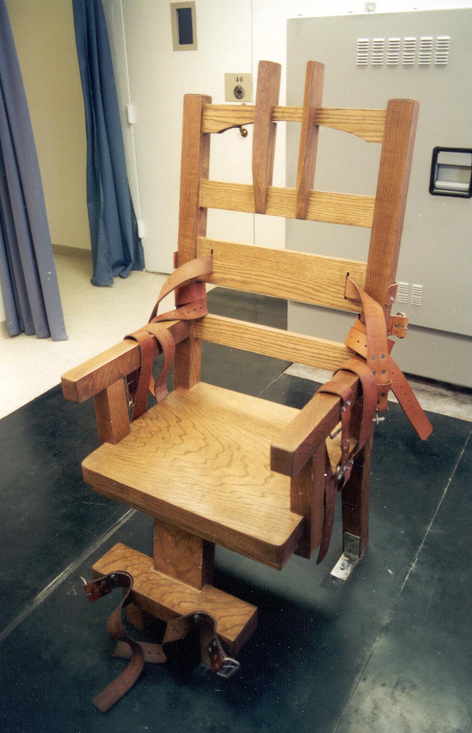
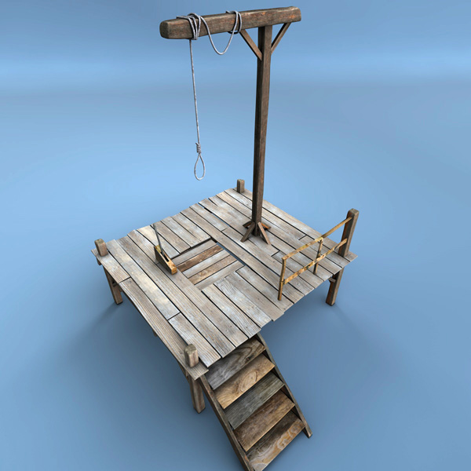
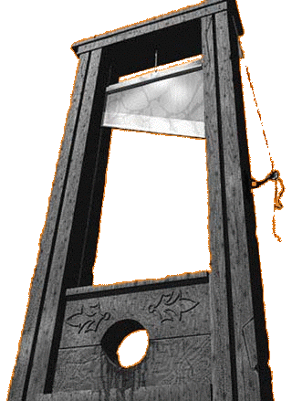
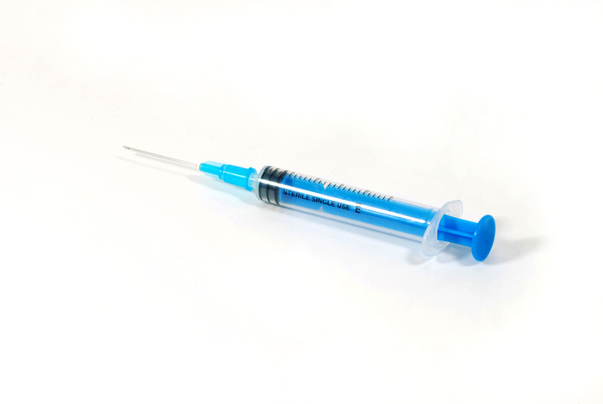
What’s the link?
Notes:
They are all methods of execution. Raise the students’ awareness that it is odd to have a method of killing as the symbol of a religion

Slide 2
Title: The Crucifixion of Jesus Lesson Outcomes
How and why was Jesus crucified?
(DESCRIBE the events leading up to Jesus’ crucifixion)
What is atonement?
(EXPLAIN the Christian idea of atonement)
Is the Christian belief of atonement fair?
(ASSESS different viewpoints on healing and evil spirits)

Slide 3
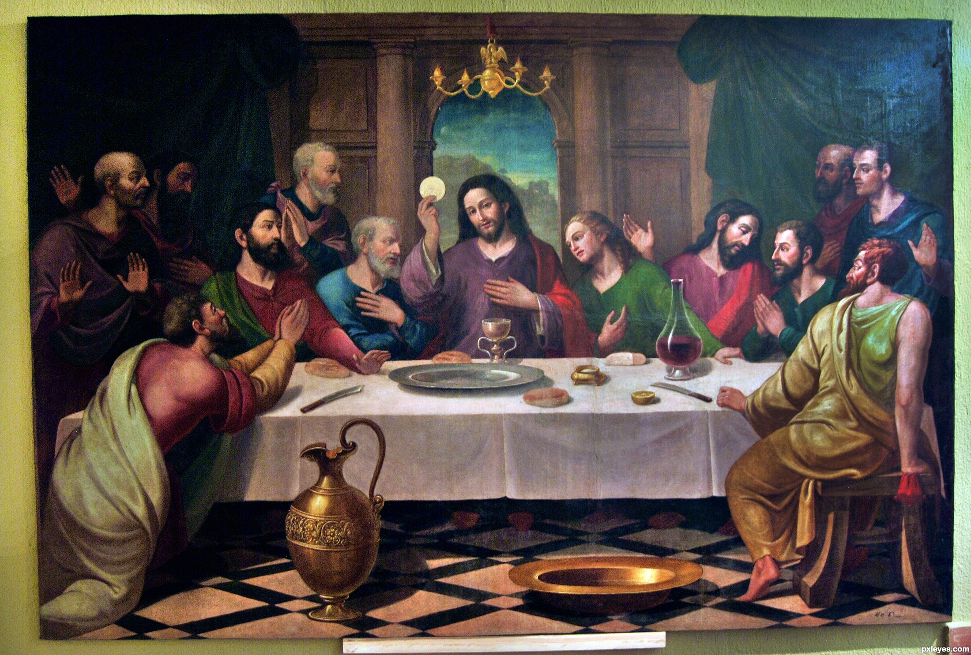
What happened here?
Notes:
Last Supper – Important points are Jesus prediction of his betrayal & death, washing the disciples feet and first communion

Slide 4
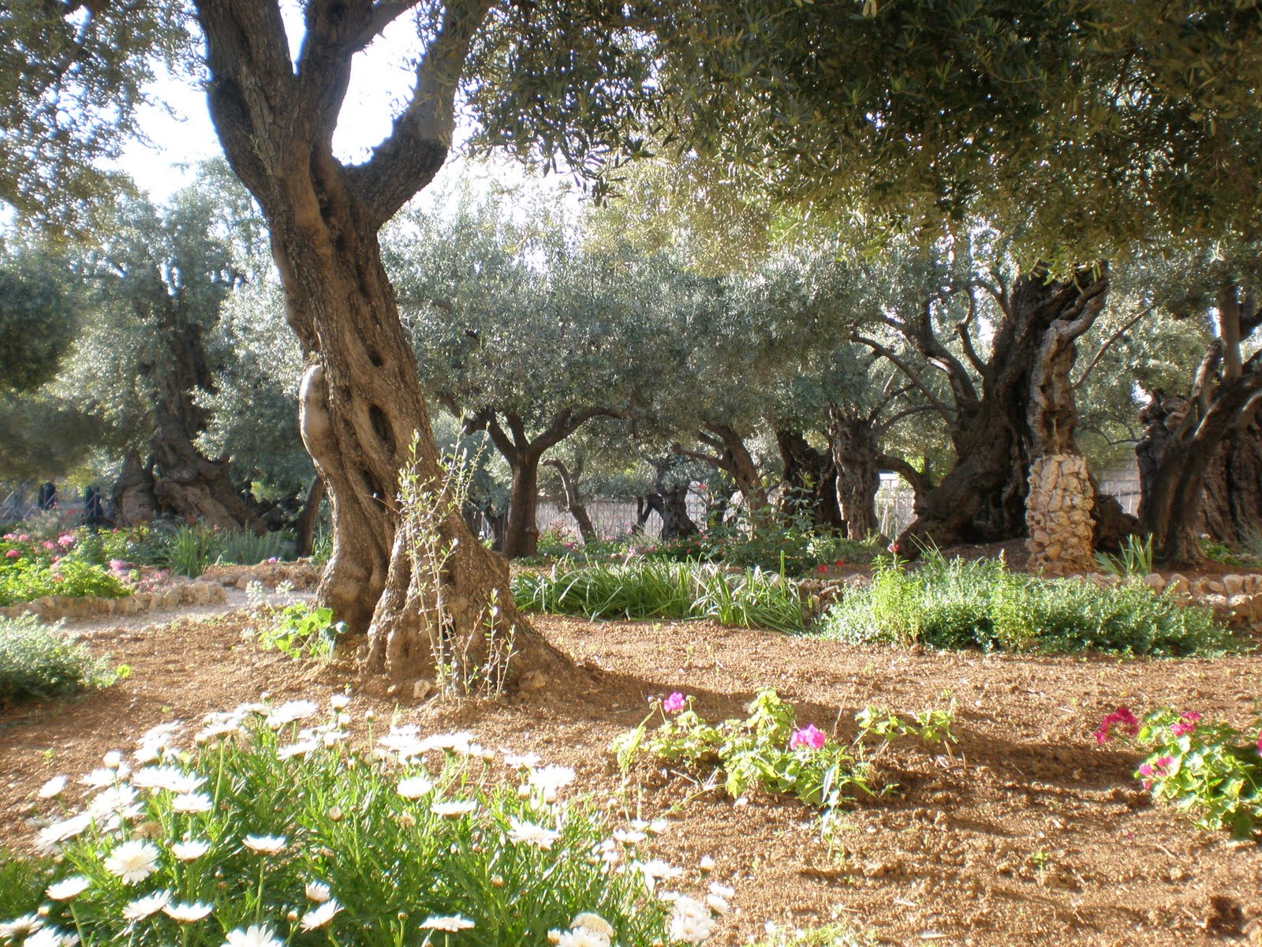
What happened here?
Notes:
This is a modern day picture of the Garden of Gethsemane. Important points are Jesus praying and Jesus being arrested

Slide 5
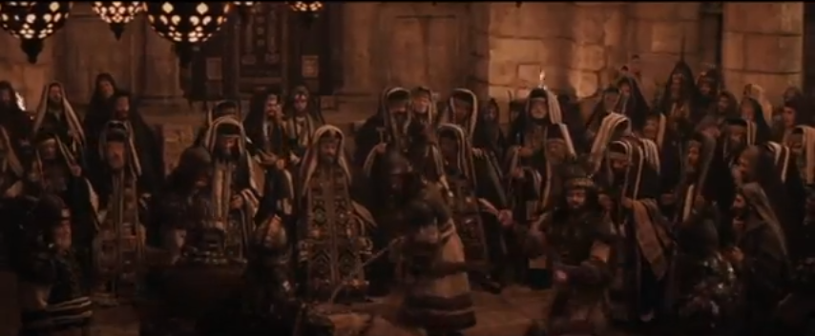
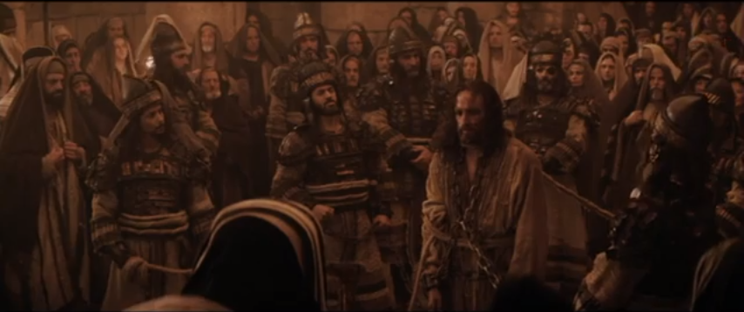
What happened here?
Notes:
Trial before the Sanhedrin – Jesus was convicted of blasphemy after he said he was the Messiah, the Son of God.

Slide 6
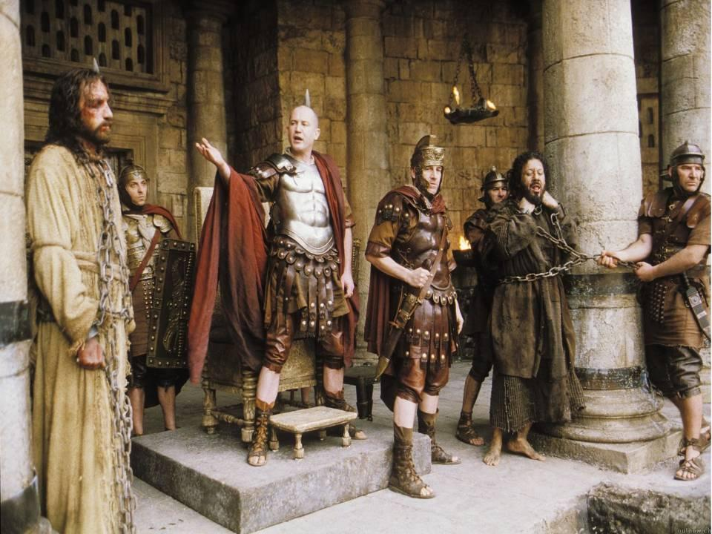
What happened here?
Notes:
Trial before Pilate. Found not guilty by Pilate and tortured but the crowd call for his execution anyway. Pilate offers to release either Jesus or Barabbas – the crowd call for Barrabas and Jesus is sentenced to death

Slide 7
Notes:
This button will play a cartoon version of the crucifixion.

Slide 8
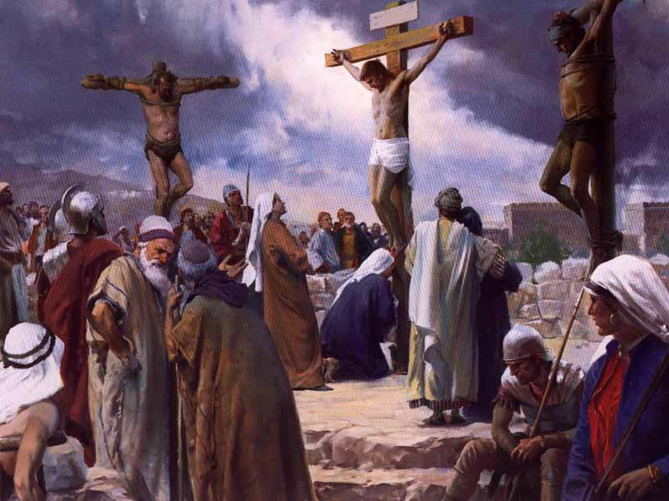
What happened here?
Notes:
Jesus is crucified between two criminals. The guards mock him etc.

Slide 9
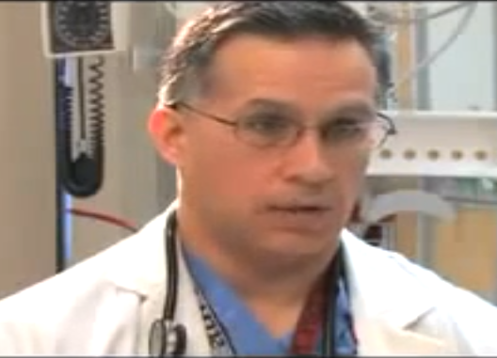
This is Dr. David Acuna. He is a trauma surgeon who is going to give a medical perspective on what Jesus went through during the events we’ve just looked.
How and why was Jesus crucified?
(DESCRIBE the events leading up to Jesus’ crucifixion)
Notes:
Click on the picture for the video. After watching this slide, talk through what was said to show students just how horrific crucifixion is. (WARNING: SOME STUDENTS CAN FIND THIS UPSETTING, USE YOUR JUDGEMENT TO DECIDE WHETHER OR NOT TO SHOW IT)
Then ask them to remember the first activity (the symbol of Christianity is a cross) and the fact that this day is now known as Good Friday. Ask them if this seems strange and then explain that we will now find out why this is.

Slide 10
What is atonement?
(EXPLAIN the Christian idea of atonement)
“If we say that we have no sin, we deceive ourselves, and the truth is not in us.” 1 John 1:8
Do you agree?
Notes:
Give students a few mins to discuss this question.

Slide 11
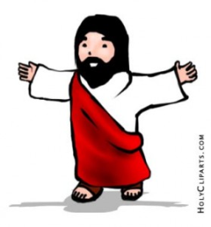
Christians believe that heaven is a perfect place
They also believe, as we have seen in John’s gospel, that no-one is perfect.
Therefore, no-one is fit for heaven.
Humanity
Heaven
Death

Slide 12
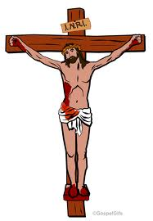
Christians believe God is fair and so this means that all people deserve to be punished for what they have done wrong.
However, because God loves humanity, he takes the punishment for humanity’s sins on himself in the form of Jesus by going through a hard life and a horrific death on a cross.
Jesus didn’t deserve this punishment because he never did anything wrong but this means now that we are forgiven by God because our punishment has been taken for us.
Humanity
Heaven
Death

Slide 13
What is atonement?
(EXPLAIN the Christian idea of atonement)
Why do you think this idea is called atonement?
At-one-ment
Jesus
Humanity
God

Slide 14
So how do people go to heaven?
This can perhaps best be explained by Indiana Jones. In this clip, Indiana Jones is faced with a similar situation to the man on the previous slide. He is one side and wants to get to the other but there is a big gap! Watch how he gets across.
Notes:
Click on the picture for a hyperlink to the clip.

Slide 15
Why do Christians call Jesus’ death ‘Good’ Friday?
(EXPLAIN why Christians believe Jesus came to die)
Draw this diagram in your books
and underneath, explain how it
shows atonement
Jesus
Humanity
God

Slide 16
Yes
No
Is the Christian belief of atonement fair?
(ASSESS different viewpoints on healing and evil spirits)
Notes:
Either ask them to stand on whichever side of the room, write their answer on a post-it and stick it on the board, washing line, fill in the two columns in their book

Slide 17
Notes:
Link back to this and ask them to add to their own personal mind map.

