Slide 1
Python
Lesson 2

Slide 2
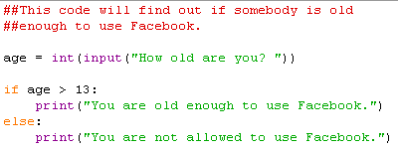
If Statements
What will this code do?

Slide 3
If Statements
What will this code do?

Slide 4
If Statements
## is used to create comments which are ignored by Python but make the code easier to understand.
What will this code do?
if is used to decide if an action is going to be followed. It ends with a : symbol.
Indents are very important as this tells Python where the different sections start and end.
else is used to describe what will happen if the first condition has not been met.

Slide 5
More If Statements
if condition:
Statement
elif condition:
Statement
else:
Statement
if is used to decide if an action is going to be followed.
elif stands for “else if” where you can test another condition.
else is used to tell Python what to do if it hasn’t met any other conditions.

