Slide 1
GCSE Computer Science (9-1)
FUNDAMENTALS OF DATA REPRESENTATION
LESSON 1: NUMBER BASES

Slide 2
Lesson Objectives
Understand the following number bases
Decimal
Binary
Hexadecimal
Understand that all computers use binary to represent instructions
Explain why hexadecimal is often used in computer science
Understand how binary can be used to represent whole numbers
Understand how hexadecimal can be used to represent whole numbers

Slide 3
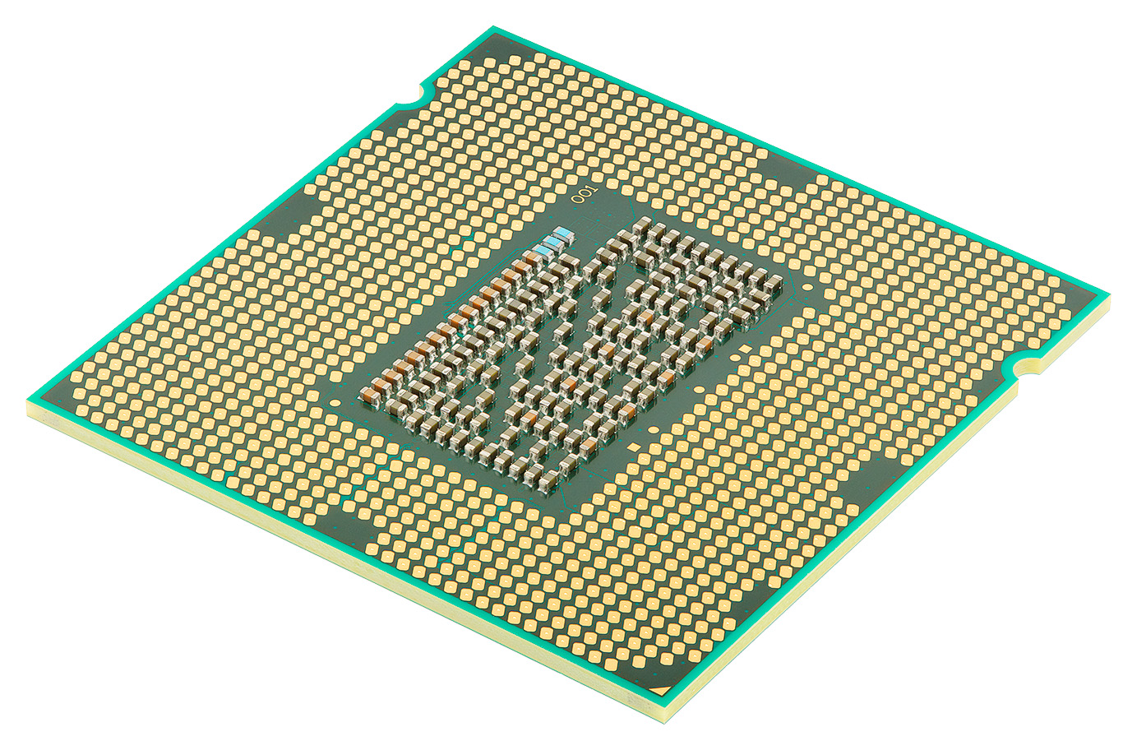
Digital Data
Recap from Unit 2: How do computer processors think/operate logically?

Slide 4
Compilers and Interpreters
When programs are written in high-level code, they must be compiled into low-level code so that a computer can understand it
The on/off or positive/negative states of computer processor transistors represent 0 and 1 – does this symbol look familiar?

Slide 5
Introducing Binary
Binary is a base 2 number system comprised of 0s and 1s
Everything a computer does to operate is based off this number system, so that they can base themselves off of logic gates (which we will explore in Unit 4)
Binary numbers can be translated into “normal” decimal values

Slide 6
Place Value
In number systems, a digit’s place value determines how much it contributes to the final total
With decimal numbers, we use base 10, with 10 values (0-9) for each digit
Base | 10² | 10¹ | 10⁰
Value | 100 | 10 | 1
Digit | X | Y | Z
x
Number = 100xX + 10xY + 1xZ

Slide 7
Place Value
In number systems, a digit’s place value determines how much it contributes to the final total
With binary, we use base 2, with 2 values (0 and 1) for each digit
Base | … | 2² | 2¹ | 2⁰
Value | … | 4 | 2 | 1
Digit | … | 1 | 0 | 1
x
Number = 4 + 1 = 5

Slide 8
The Binary Number System
Typically, binary numbers are represented as bytes
A bit is a single 0 or 1 digit
A byte is 8 bits
A nibble is 4 bits (half a byte)
Base | 2⁷ | 2⁶ | 2⁵ | 2⁴ | 2³ | 2² | 2¹ | 2⁰
Value | 128 | 64 | 32 | 16 | 8 | 4 | 2 | 1
Digit | 1 | 0 | 1 | 0 | 1 | 1 | 0 | 1
Work out the decimal value of this number

Slide 9
Converting from Binary to Decimal
Add up the numbers that are positive – this will give the denary value
10101101 = 128+32+8+4+1
= 173
Base | 2⁷ | 2⁶ | 2⁵ | 2⁴ | 2³ | 2² | 2¹ | 2⁰
Value | 128 | 64 | 32 | 16 | 8 | 4 | 2 | 1
Digit | 1 | 0 | 1 | 0 | 1 | 1 | 0 | 1

Slide 10
Converting from Decimal to Binary
We can use the binary table to convert backwards
Take the decimal – e.g. 43
Compare the decimal against each place value
If the decimal > place value, subtract place value from decimal
In this example, we start with 43-32 = 11, and work onwards with 11
Base | 2⁷ | 2⁶ | 2⁵ | 2⁴ | 2³ | 2² | 2¹ | 2⁰
Value | 128 | 64 | 32 | 16 | 8 | 4 | 2 | 1
Digit
Work out the binary value of 43

Slide 11
Now try these!
1011
1111
10101
100110
1011011
1001000
00101101
11010010
Remember the
place value rules!

Slide 12
Hexadecimal
Another number base you will need to learn is hexadecimal – base 16
What is significant about 16?

Slide 13
The Significance of 16
A nibble ( 4 bits ) has 16 different combinations
The Hexadecimal number system has sixteen values (0-F)
Therefore, we can represent binary/decimal values with 2 digits only!

Slide 14
The Hexadecimal Number System
The hex number system is base 16 – 16 values (0-F)
The place value tends to use the first 3 bases of 16
Dec | 0 | 1 | 2 | 3 | 4 | 5 | 6 | 7 | 8 | 9 | A | B | C | D | E | F
Hex | 0 | 1 | 2 | 3 | 4 | 5 | 6 | 7 | 8 | 9 | 10 | 11 | 12 | 13 | 14 | 15
Base | 16² | 16¹ | 16⁰
Value | 256 | 16 | 1
Digit

Slide 15
Convert 3C into a decimal number
Use a place value table
Base | 16¹ | 16⁰
Value | 16 | 1
Digit | 3 | C
16 x 3
+
1 x 12
=60

Slide 16
Converting from HEX to Binary
To convert from HEX to binary, we use two nibbles
Each digit is equal to one nibble (16 values), so we write them in and translate from there
E.g: Convert D6 into a binary value
8 | 4 | 2 | 1 | 8 | 4 | 2 | 1
D |  |  |  | 6
= 13 = 1 1 0 1 |  |  |  | = 6 = 0 1 1 0
11010110

Slide 17
Binary to HEX
Converting to HEX from Binary is the same principle
Use two nibbles, and convert the values into hex digits
E.g: 00101101
= 2D
8 | 4 | 2 | 1 | 8 | 4 | 2 | 1
0 | 0 | 1 | 0 | 1 | 1 | 0 | 1
=2 |  |  |  | =D

Slide 18
Converting between HEX and Decimal
Decimal to HEX is an easy process – HEX to Denary is considered not so easy
To convert a decimal value, simply write the digits out in a place value table and multiply
Example: Convert 45 into Hex
=16x4 + 1x5
=69
16 | 1
4 | 5

Slide 19
Now try these!
Convert from Denary to Hexadecimal
32
57
187
256
Convert from Binary to Hexadecimal
01100101
10101001
11011011

