Slide 1
Assessing non-financial performance (3)
Elkington’s Triple Bottom Line
The exam board like an essay where you can use this model, paper 1 (25 mark) essays in both 2017 and 2019 were linked to it.

Slide 2
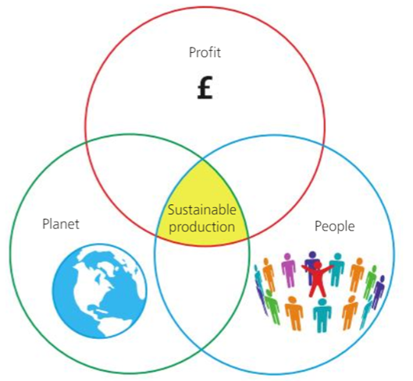
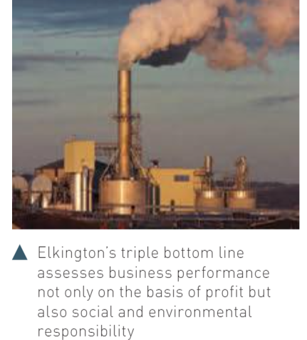
Elkington’s triple bottom line
What is the “Triple Bottom Line”?
The Triple Bottom Line is a concept that encourages the assessment of overall business performance based on three important areas:
Profit, People and Planet
it focuses on the belief that sustainable profitable business will only occur where all 3 elements are balanced.
As you go through the slideshow, make some notes about how the different firms are applying / using Elkington’s model.

Slide 3
How is Elkington different to Kaplan and Norton?
Kaplan and Norton links into SWOT analysis. It’s based on the internal working and information of the business. Looking at the strengths and weaknesses of the business, where there are opportunities and what factors might act as threats.
Elkington's model is based on the idea of sustainable business and links into 3.7.6 – social responsibility
This means the 2 models are looking at the business from different angles – one is about how the business can improve performance and the other is about the impact of the business on society and how the business can be ethical and sustainable (linking into 3.7.6)

Slide 4
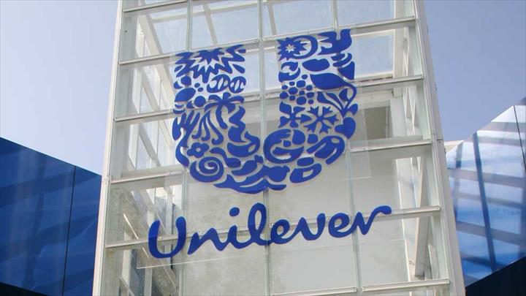
Which businesses use Elkington’s triple bottom line?
In theory, businesses which are more concerned about the environment and want to be seen as ‘green’.
Here’s Paul Polman, CEO of Unilever, talking about the importance of sustainability:
https://youtu.be/IzD1zfLVJnc
Don’t know what Unilever make? Click the image…

Slide 5
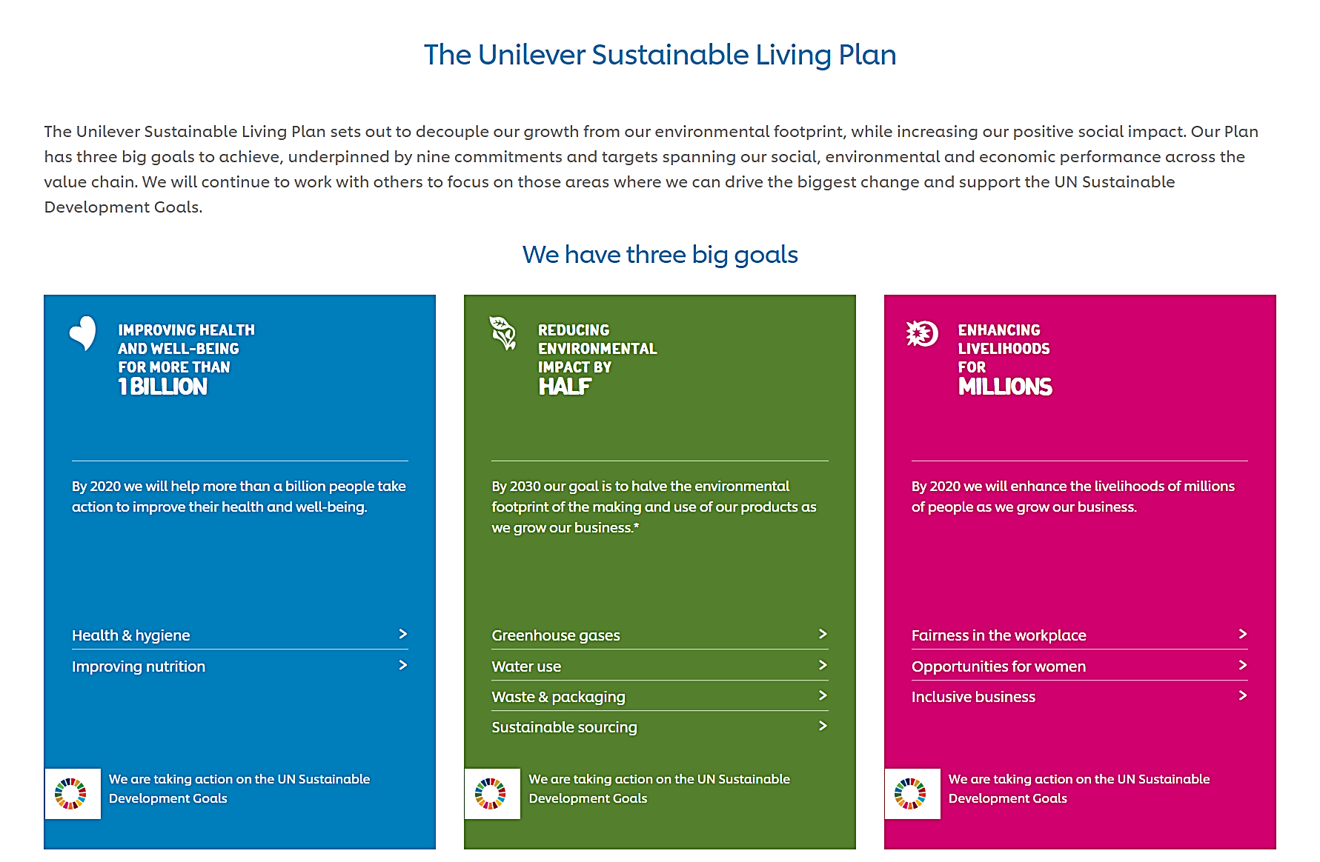
Unilever have embedded sustainability into their business and have developed their own sustainable living plan: have a look at what they do: https://www.Unilever.Co.Uk/sustainable-living/our-strategy/
Click the image, it’s a link…

Slide 6
Another business which uses this model is Ikea
Another business which uses this theory is IKEA:
https://www.ikea.com/gb/en/this-is-ikea/people-planet/
Here’s a video about their strategy:
https://www.ikea.com/gb/en/this-is-ikea/about-us/were-all-in-this-together-pubc8331c51
So, there are quite a lot of big businesses following this type of policy. Here’s an optional article you could come back to if you would like to read more:
https://www.theguardian.com/sustainable-business/2016/jan/02/billion-dollar-companies-sustainability-green-giants-tesla-chipotle-ikea-nike-toyota-whole-foods

Slide 7
What are the counter arguments – arguments against the TBL to measure performance?
Of course, the arguments about why a business would use the TBL are much easier than the arguments why you might not want to. Again you are in the position where you have to use theory from other parts of the syllabus to generate arguments against using the TBL.
Arguments on the other side could include:
Cost implications – availability of finance – financial objectives, profit budgets (3.5)
Stakeholder implications, conflict between stakeholders – maybe due to cost, dividend and profit implications but also training and planning implications (3.2)
Target market – maybe their customers are just not interested in sustainability – what does the firm do? Segmentation, targeting and positioning (3.3.2)
How competitive is the market – do they need to minimise costs to stay competitive? Is their demand price elastic? (marketing mix 3.3.3)
What are the firm’s values, mission and objectives? 3.7.1

Slide 8
Do you think all businesses can use the triple bottom line?
Complete the table below with ideas (with business examples) you could use to answer this question:
To what extent is it essential that all successful firms now use the Triple Bottom Line to measure their success?
Reasons why all firms could use the Triple Bottom Line | Reasons why some firms may choose not to use the Triple Bottom Line

Slide 9
Finally… a bit more information
Here is a link to a business called Conscious Creatives, it focusses on helping firms to become more conscious about how they do business, it’s only a tiny organisation but has big ambitions.
https://www.consciouscreatives.co.uk/business/5-steps-to-creating-a-conscious-organisation/
The work of Conscious creatives is based on the ideas of Economist Kate Raworth (sister of BBC newsreader Sophie Raworth), who has developed the idea of Doughnut economics.
Doughnut economics is not on the A level Business syllabus but it is interesting and good additional background. Kate’s an engaging speaker so if you’re interested in hearing about her theory she explains it really well here: https://youtu.be/1BHOflzxPjI

