Slide 1
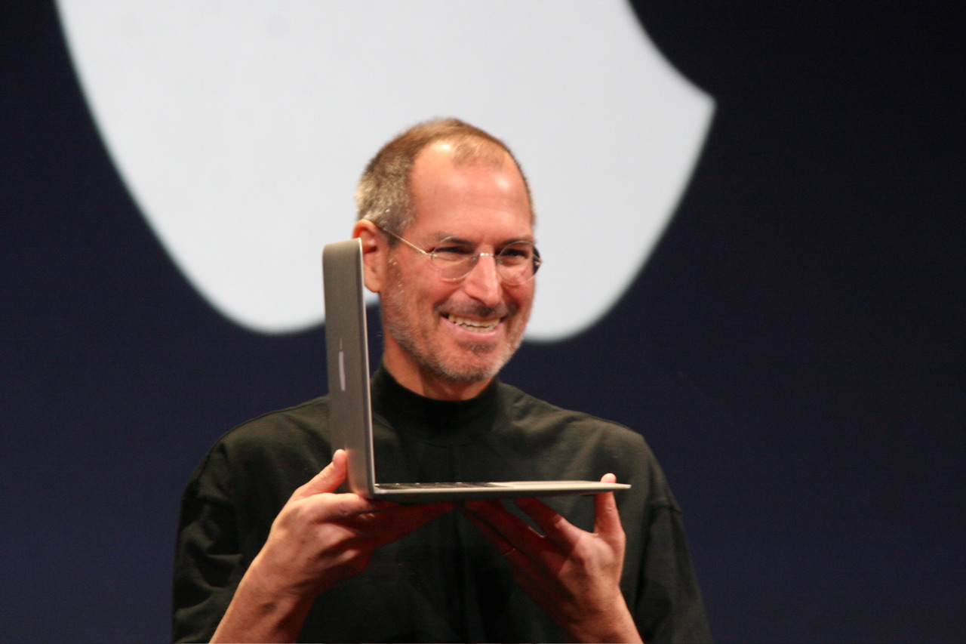
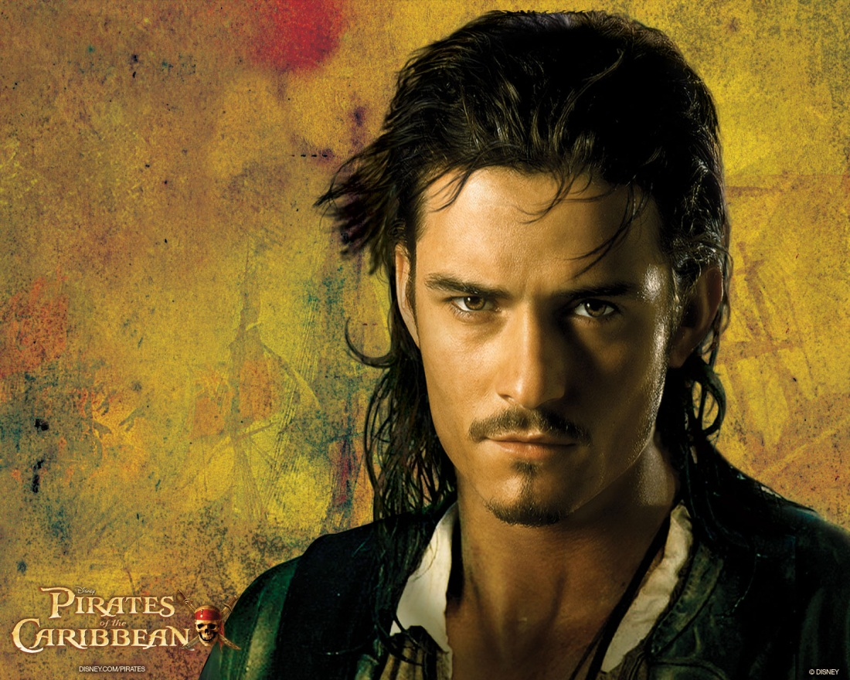
1
What’s the link?
3
4
Notes:
Image 1: Steve Jobs (founder of Apple); Image 2: Orlando Bloom; Image 3: Jennifer Lopez; Image 4: Tina Turner. The link is that they are all Buddhists.

Slide 2
1
Why have I chosen these people?
3
4
Notes:
Answer: To illustrate that not all Buddhists are monks and nuns/East Asian/wear orange robes, etc.

Slide 3
What we think we KNOW about Buddhism already.
What we WANT to KNOW about Buddhism (questions we have).
______________________________________
______________________________________
______________________________________
______________________________________
______________________________________
______________________________________
______________________________________
______________________________________
______________________________________
______________________________________
______________________________________
______________________________________
______________________________________
______________________________________
______________________________________
______________________________________
______________________________________
______________________________________
Notes:
Worksheet to be printed. Students to write down the things they think they know in the first column, including things which are incorrect. Their “facts” can then be given a tick or a cross depending on their accuracy.

Slide 4
Consider the quotes you have
Chose your favourite 2
Write them up
Explain why you have chosen these.

Slide 5
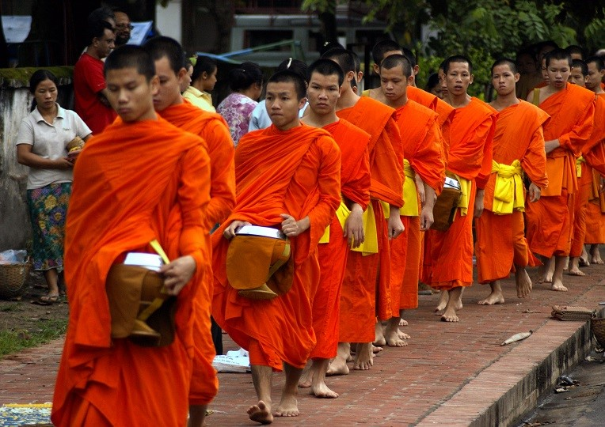
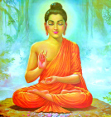
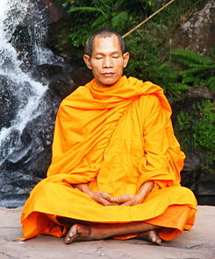
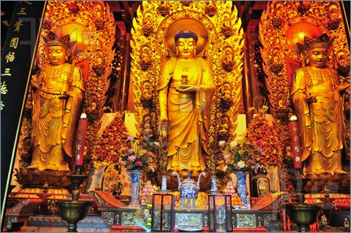
“All difficulties and suffering come from within”
“There is no birth, there is no death”
“All views are wrong views”

Slide 6
“You can search throughout the entire universe for someone who is more deserving of your love and affection than you are yourself, and that person is not to be found anywhere. You yourself, as much as anybody in the entire universe deserve your love and affection.”
“Like an archer, an arrow, the wise man steadies his trembling mind, a fickle and restless weapon.”
“There is no birth, there is no death”
“Holding on to anger is like grasping a hot coal with the intent of throwing it at someone else; you are the one who gets burned.”
“All difficulties and suffering come from within”
“The mind is everything”
“The secret of Buddhism is to remove all ideas, all concepts, in order for the truth to have a chance to penetrate, to reveal itself.”
“All views are wrong views”

Slide 7
Why Buddhism?
There are between 350–500 million Buddhists worldwide, making it the 4th largest religion in the world.

Slide 8
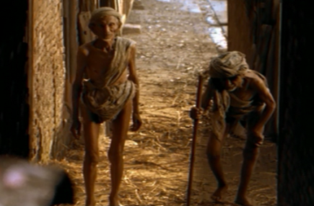
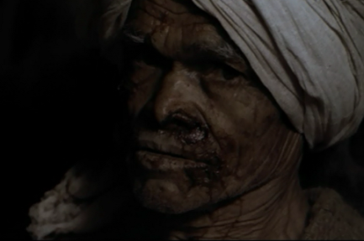
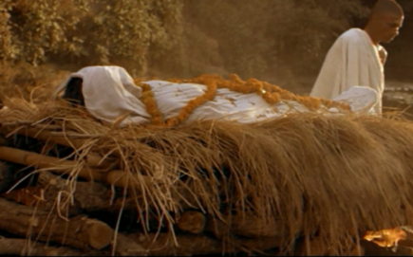
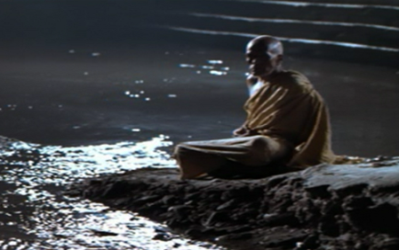
When Prince Siddhartha left his palace, he saw four sights:
1
2
DESCRIBE the four sights.
3
4
EXPLAIN why Prince Siddhartha chose to leave his palace life.
Notes:
Print as worksheet. Ask students to complete the first four boxes, but leave the box at the bottom for now.

Slide 10
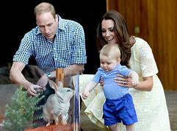
How did Buddhism begin?

Slide 11
When Prince Siddhartha left his palace, he saw four sights:
1
2
an old man;
a sick man;
DESCRIBE the four sights.
3
4
a dead man;
and a holy man.
EXPLAIN why Prince Siddhartha chose to leave his palace life.

Slide 12
When Prince Siddhartha left his palace, he saw four sights:
1
2
DESCRIBE the four sights.
3
4
Now complete this box.
EXPLAIN why Prince Siddhartha chose to leave his palace life.

Slide 13
Homework
Find out about 3 famous Buddhists and see if you can find out what they say about their own religious beliefs.

Slide 14
“Prince Siddhartha was wrong to leave his wife and child.”
Do you agree?
Why might someone disagree with you?

Slide 15
DESCRIBE the story of Prince Siddhartha
Notes:
Story board sheet to be printed. Images in the square boxes, accompanying text in the boxes underneath.

