Slide 1
Consensus and conflict theories

Slide 2
Consensus vs conflict theories and structural theories vs action theories

Slide 3
Consensus or Conflict?
Feminism
Marxism
Functionalism

Slide 4
Feminism definition?
Feminism sees society as and seeks to describe, explain and change the position of women in society. All feminists oppose women’s
but there are disagreements among them about is causes and how to overcome it.
male dominated
subordination

Slide 5
Different kinds of feminists you need to know about
Liberal / Reform
Radical
Marxist
Intersectional
Difference

Slide 6
Use pages 217-222 as you work through this powerpoint.
Also photocopy from the revision guide.

Slide 7
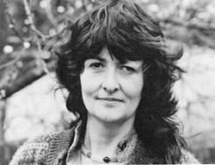
What do you know already about liberal feminism.
Think about sex / gender
Anne Oakley
Optimism
Have a read p217-218 and try to fill in the booklet

Slide 8
Liberal or reformist feminism
Concern with human rights and civil rights. Progress towards equal rights should come from gradual reforms.
Law and policies
Cultural change
Sex and gender Anne Oakley said there should be a differentiation between the 2 meaning that
Liberal feminists believe women can achieve equality this way eg laws about equality in education or employment
Prejudices and stereotypes get in the way of equality. They think cultural change can bring equality, for example if people stopped believing women are dominated by emotion and nurturing qualities
‘Sex’ refers to physical biological differences, gender is a socially constructed difference between ‘masculine’ and ‘feminine’ roles

Slide 9
Attitudes are
Overall liberal feminists are optimistic and believe in progress. They think that
Socially constructed and transmitted through socialisation so cultural change over time will bring gender equality
Change will come, society will become fair and gender will not matter

Slide 10
Comparison between functionalism and feminism?
Functionalists saw gender roles as being divided into instrumental roles (public) and expressive roles (private). Parsons saw men as and women as
Liberal feminists critique this and think that
Remember although liberal feminism critiques this functionalist view, it is the closest we get in feminism to ‘consensus’ theory. Why?
Intrumental
expressive
Men and women are equally capable of performing both roles. Traditional gender roles can prevent men and women from living fulfilling lives.
Recognises conflicts but focusses on a positive future from which women and men will gain. Eg an end of division of labour could create opportunities for men and women.

Slide 11
Evaluation of liberal feminism?
Studies are useful, they have documented extent of gender inequality.
Demonstrate that gender differences are not inborn but result of socialisation
BUT
They have been criticised for oversimplification. They ignore the possibility that there are bigger reasons for these inequalities
Marxist feminists and radical feminists argue that they are naïve to think that changes in law or attitudes will bring inequality as the problems are bigger than that

Slide 12
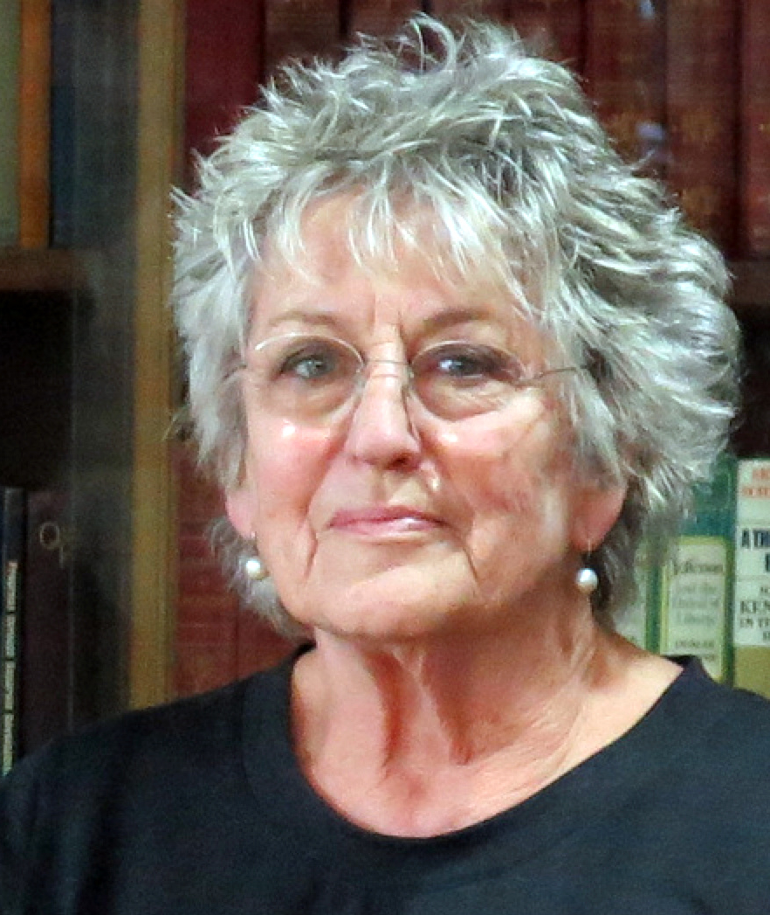
Radical feminism?
What can you remember?
Brownmiller?
Rich?
Greer?
Focus on patriarchy

Slide 13
Radical feminism
emerged in 1970s
Patriarchy is universal cause of inequality.
Men are women’s enemy.
All men oppress women and benefit from patriarchy

Slide 14
Solutions & theorists
Solutions include separatism (living apart from men) consciousness raising and political lesbianism.
Theorists are Susan Brownmiller (1976) who claims that fear of rape deters women from going out at night.
Adrienne Rich (1981) who claims that men force women into narrow and unsatisfying ‘compulsory heterosexuality’.
Germaine Greer (2000) argues for the creation of all female households.

Slide 15
Evaluation of radical feminism
Useful as it shows how relationships can involve dominion
Draws attention to the political dimension of areas like marriage, domestic labour, domestic violence, rape and pornography
Marxists would say that class not patriarchy is primary form of inequality
It does not explain why women’s experiences are different in different societies
Does not show how patriarchy will be abolished.
Somerville shows that heterosexual attraction means that the nuclear family will not be abolished and replaced by single sex households.
Patriarchy is in decline and liberal feminists would claim that life is getting better for women
What about violence against men and violence within lesbian relationships?

Slide 16
Marxist Feminism
Marxism Feminism reject liberal feminist view and radical view. Instead they believe that women’s subordination is rooted in
, although individual men benefit from women’s position, capitalism benefits the most. Women are unpaid homemakers so depend on the rest of the family. Cheap labour for employers (as there is an assumption they will depend on husband’s earnings. Reserve labour, reproduce workforce (nurture and socialise children to become workers), absorb anger Fran Ansley describes wives as ‘takers of shit’ – they soak up their husband’s frustration because of exploitation at work. Marxist feminists argue that if capitalism as overthrown then women’s lives would be better.
Capitalism

Slide 17
This may be developed further to look at ideology
Bartlett claims we should look at non-economic factors to understand women’s oppression. Looks at ideology which maintains women’s oppression. Ideology presents the nuclear family and the division of labour as natural and normal. Patriarchy is very deeply rooted in our consciousness.

Slide 18
Evaluation of Marxist Feminism
Economics is in all areas of life so Marxist feminists are right to emphasise the role of capitalism in the oppression of women.
BUT what about women’s subordination in non-capitalist societies?
Unpaid labour may be important for Capitalism but there is no explanation of why women do it and not men? Marxist feminism does not look enough at the ways that men oppress women (not just capitalism).
An alternative dual systems feminism looks at the economic system (capitalism) and the sex-gender system (patriarchy). Walby argues that capitalism and patriarchy are interrelated but the interests of the two are not the same so should be examined separately and capitalism is more powerful. Anna Pollert reminds us that patriarchy is just a descriptive term whereas capitalism is a system.

Slide 19
Intersectional feminism
Kimberlé Crenshaw, “a prism for seeing the way in which various forms of inequality often operate together and exacerbate each other,”
“All inequality is not created equal,”
“We tend to talk about race inequality as separate from inequality based on gender, class, sexuality or immigrant status. What’s often missing is how some people are subject to all of these, and the experience is not just the sum of its parts,” Crenshaw said.
Intersectional feminism centres the voices of those experiencing overlapping, oppression

Slide 20
Difference feminism
Women are not just one group. Different classes / races have different experiences of feminism. Essentialism is the idea that all women share the same essence and this may not be useful. We should instead be focussing on diversity.
Poststructural feminism eg Judith Butler are interested in discourse (different ways of thinking). By defining others in certain ways the users of discourse gain power. If we can understand different discourses this may give us an understanding of the power relationships.
Give some examples of different discourses which may affect women.
Religious / scientific / medical / artistic

Slide 21
Evaluation of difference and post-structural feminism
Walby argues that there are differences among women but that there are also similarities. They are all faced with patriarchy
Celebrating difference may unite women into many sub-groups weakening feminism as a movement for change

Slide 22
So to recap….
All feminists are concerned with oppression
Liberal feminists are optimistic and focus on sex / gender and cultural reasons for oppression. They are hopeful for change
Radical feminists see patriarchy in everything public and private spheres. Focus on a move to female households (matrilocal households preferred to heterosexual ones)
Marxist feminists look at link between capitalism and the oppression of women.
Difference / intersectional and post-structural feminists look at the complex picture of different experiences for different women also based on class, race etc.

