Slide 1
Binding Energy
Energy released Mass defect because of E=mc²
If you add up the mass of all of the parts in the nucleus then compare it to the mass of a nucleus itself then you will find that there is a difference between the two values. The mass of the nucleus is less than the mass of all the parts. This difference is called the mass defect.
Einstein’s equation E=mc² links mass and energy so when nucleons bind together the total mass is converted into energy and released.
When you pull apart the nucleus you need to put in energy, this energy you need to put in is equal to the energy that was released when the nucleus was formed.

Slide 2
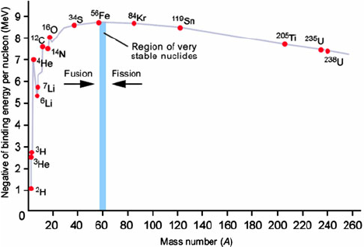
Binding energy per nucleon
A high average binding energy per nucleon number means more energy is needed to remove nucleons from the nucleus
Nuclear fusion of small nuclei and nuclear fission of large nuclei both increase the average binding energy
$$\text{Average} \text{binding} \text{energy} \text{per} \text{nucleon} \left(\text{MEV}\right)= \frac{Binding Energy (B)}{Nucleon Number (A_}$$

Slide 3
Fission
Large nuclei (>83 protons) can split into smaller nuclei by nuclear fission.
If fission happens itself it is called spontaneous fission, if it is caused by us we call it induced fission.
Energy is released during nuclear fission because the new smaller nuclei will have a higher binding energy per nucleon.
The larger a nucleon is, the more likely it is to undergo spontaneous fission.

Slide 4
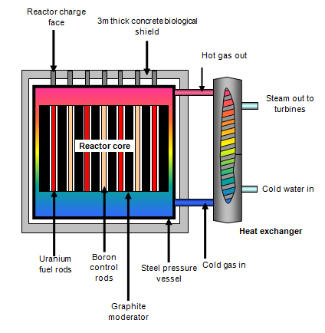
Nuclear Reactors
Nuclear reactors use induced fission to release energy.
Rods of uranium-235 are used as fuel for fission, U-238 is also used but this doesn’t undergo fission.
A thermal neutron is fired at the rod to induce fission.
The following fission reactions produce more neutrons (chain reaction)
These neutrons need to be slowed down and extra ones absorbed so that they can be captured by other U-235 nuclei. These slowed down neutrons are called thermal neutrons.
Control rods are also used to control the chain reaction. They can be lifted or lowered to absorb less or more neutrons to speed up or slow down the reaction.
Coolant needs to be used to remove heat produced by the fission reactions.

Slide 5
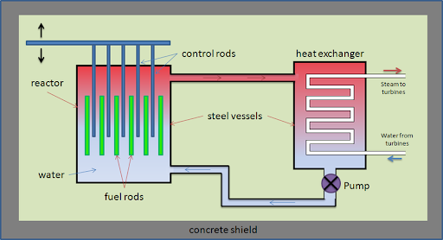
Reactor:
Concrete case shielding and prevents radiation escaping
Control rods absorbs neutrons (E.g. Boron)
Fuel rods with U-235
Water or graphene acts as a coolant to remove heat produced during reactions
Water can also act as a moderator to slow down fission neutrons to thermal neutrons.

Slide 6
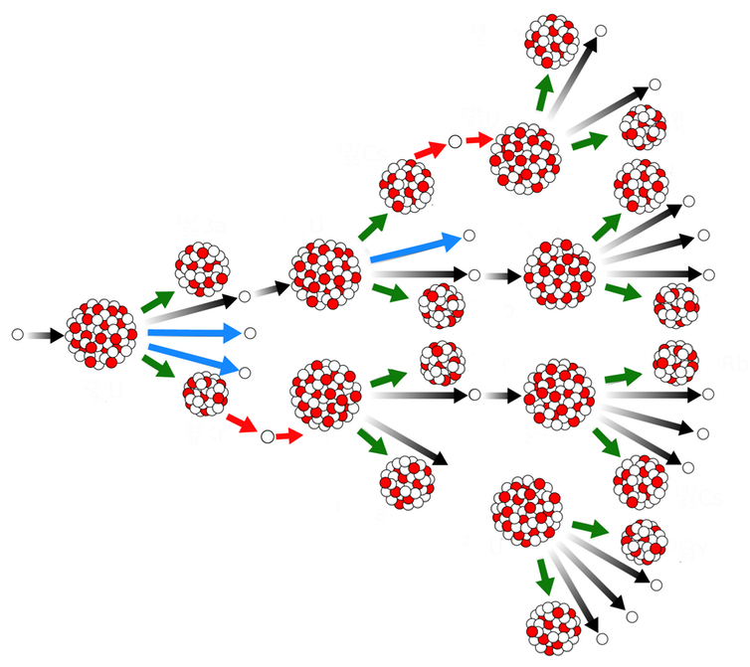
Mass of fuel
Sub-critical Mass
This is when the amount of fuel is smaller than the critical mass so the chain reaction will die out
Critical Mass
This is the amount of fuel needed to make the chain reaction continue at a steady rate
Supercritical Mass
This is more than the critical mass so each fission reaction sparks several further fission reactions – then the rate is controlled using control rods.

Slide 7
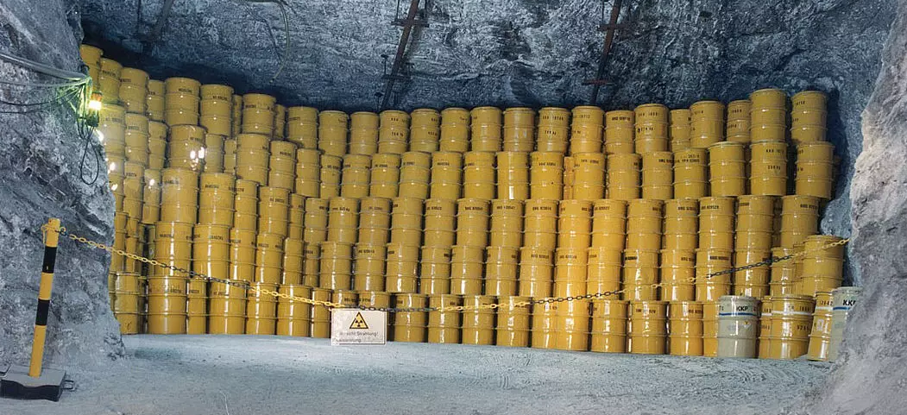
Waste products
3 levels of waste:
High level waste is highly radiative like spent fuel.
Initially the waste is very hot when it is removed from the power plant so it needs to be cooled in cooling ponds for many years until the temperature falls to a safe level.
It is then encased in glass before being buried in underground stores.
They are stored somewhere that will have minimum impact on animals and the environment.

Slide 8
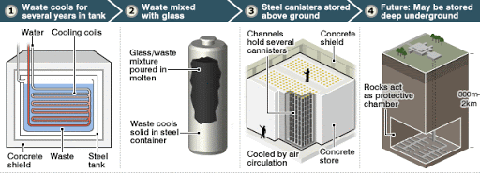
Intermediate waste is still radioactive, but not as hot as high level waste, so needs to be heavily shielded. This can be things like radioactive sources used in medicine.
Mixed with concrete and put into a stainless steel drum.
Low level waste has a lower radioactivity. It can include things like gloves/ laboratory glassware or clothing used near radioactive sources.
Put into sealed drums and surrounded by concrete and put into landfill sites.

Slide 9
Fusion
2 light nuclei can join together to form a single heavier nucleus.
The larger nucleus has a higher binding energy per nucleon so a lot of energy is released.
Fusion is not used for harvesting energy because it is difficult to do.
All nuclei are positively charged so they repel because of the electrostatic force.
The nuclei need to overcome this electrostatic force and get close enough for the strong interaction to attract the nuclei together.
This takes a very large amount of energy – (1MeV kinetic energy)

