Slide 1
Input and Output
Computer Science

Slide 2
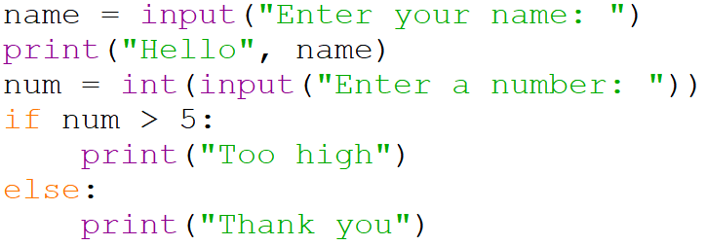
Starter
Explain what this program does:

Slide 3
Over to you…
At the prompt ask for an animal.
Input an animal.
Display an output that says My friend owns a [animal]
At the prompt ask for a food.
Input a food.
Display an output that says I hate [food] on a pizza
Display an output that says My friend’s [animal] likes to eat [food]

Slide 4
Pop Quiz
Which symbol is used for a whole number division?
Which symbol is used to find the remainder after a whole number division?
What word is used to ask the user to enter a value?
What word is used to display an output?
How to you separate the sections in a print statement ?

Slide 5
What of these are valid variable names?
✗
student name
x*y
num2
total!
45class
[number]
✗
✓
✗
✗
✗

Slide 6
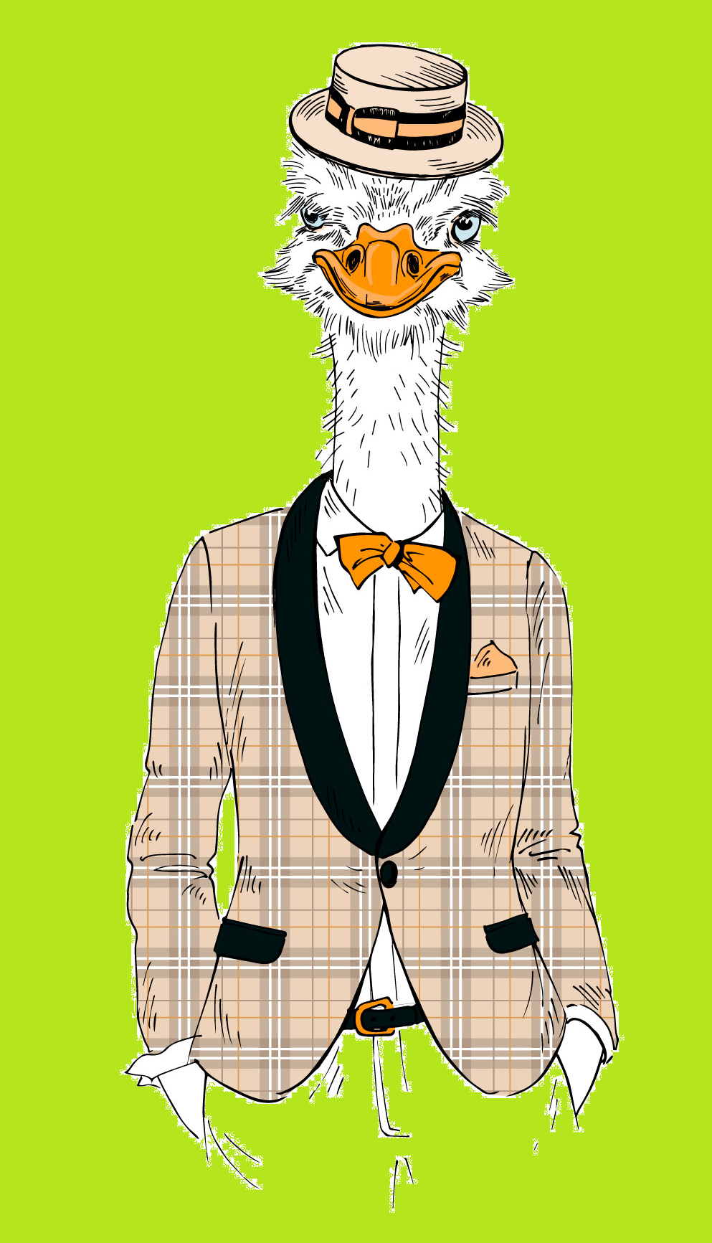
Pop Quiz
What is a variable?
What is a string?
What is an integer?
What is a floating-point number?

