Slide 1
Boolean Logic
Logic Gates

Slide 2
Binary
Recap: Binary is a base 2 number system comprising of 0s and 1s
A computer cannot understand the high-level languages we write in, so it does not understand commands such as print, input, FOR x in 1 TO y
Computer use binary for instructions, as computer processors can use electrical transistors to reflect binary logic (0 or 1)
This binary logic can be reflected through the use of logic gates

Slide 3
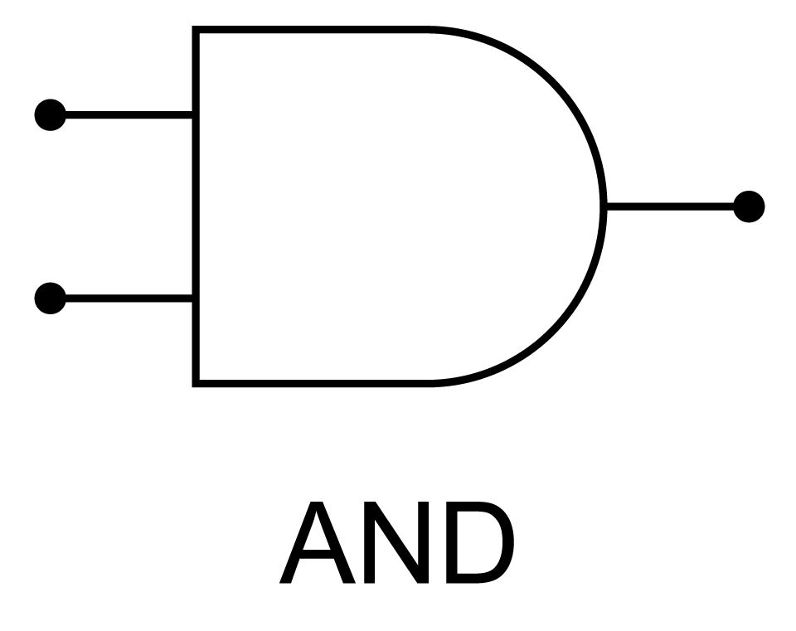
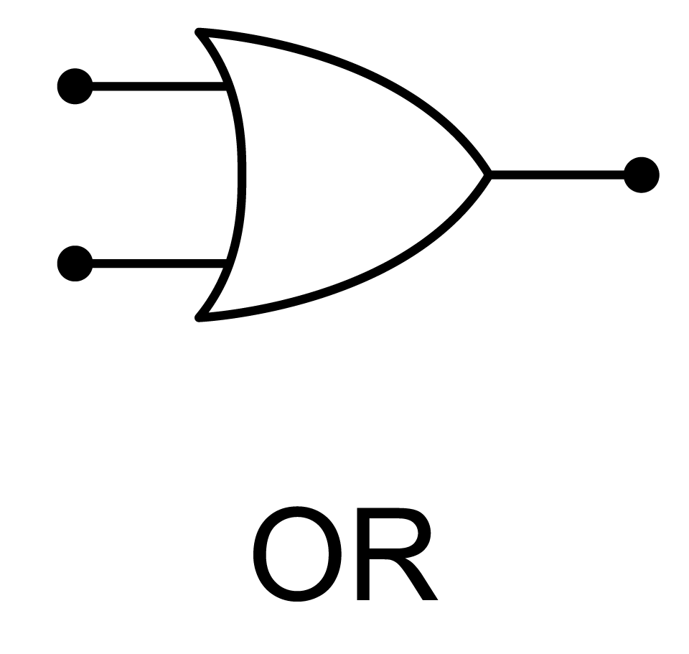
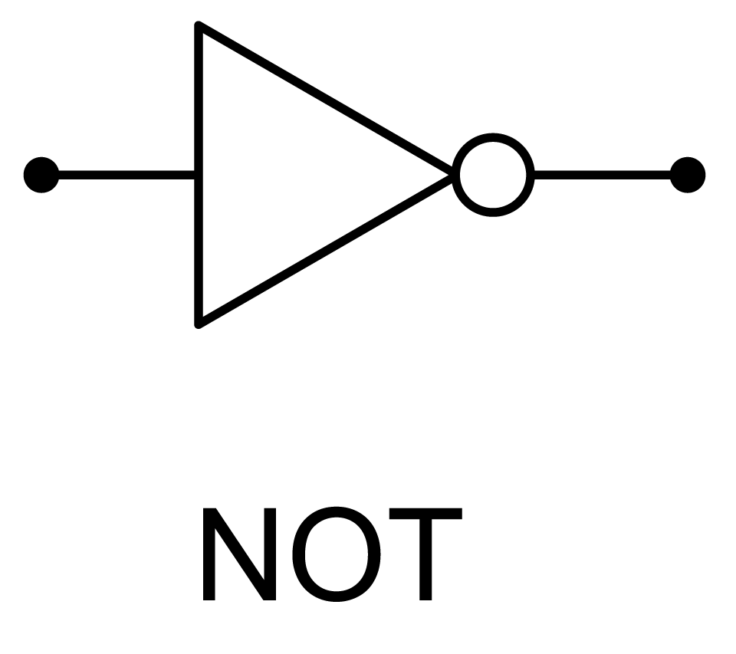
Logic Gates
Binary logic gates operate on inputs
There are three kinds of logic gate – NOT, AND & OR
These logic gates will remind you of the Boolean comparison operators used for selection and iterative programming constructs

Slide 4
NOT
The binary logic for NOT is that the output is not the input – i.e. the input is inverted
A
P
A | P
0 | 1
1 | 0
P=NOT(A)

Slide 5
AND
The binary logic for AND is that both inputs must be positive for a positive output
A | B | P
0 | 0 | 0
0 | 1 | 0
1 | 0 | 0
1 | 1 | 1
A
P
B
P=A AND B

Slide 6
OR
The binary logic for OR is that at least one input must be positive for a positive output
A | B | P
0 | 0 | 0
0 | 1 | 1
1 | 0 | 1
1 | 1 | 1
A
P
B
P=A OR B

