Slide 1
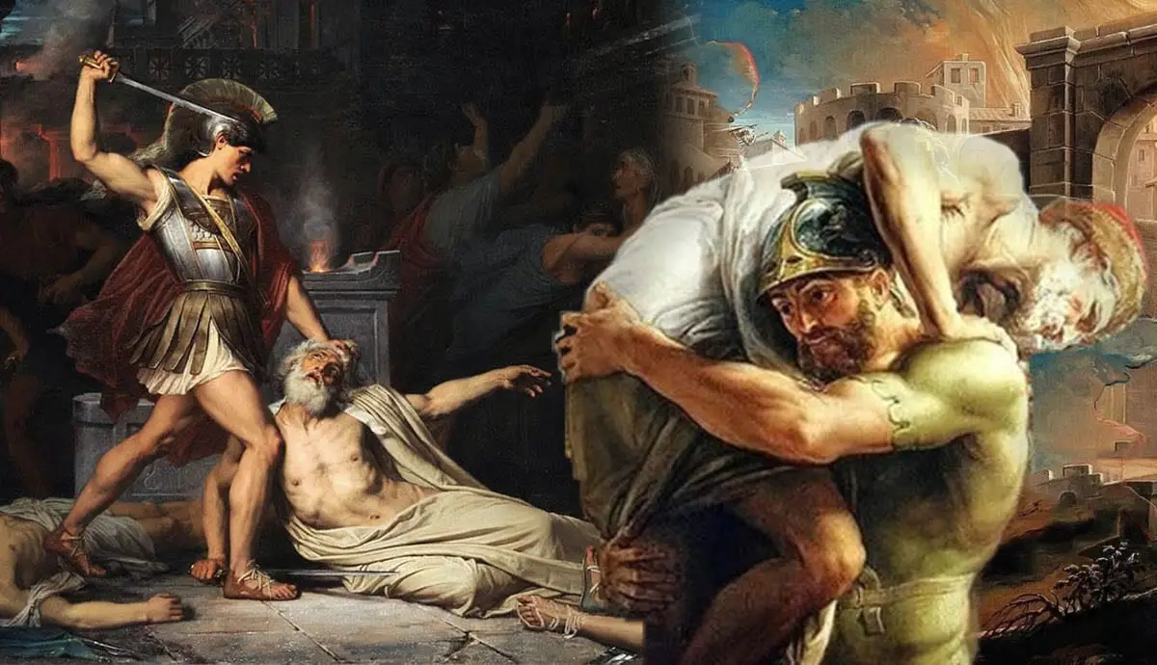
Who Said It?
See if you can match the following ten quotes to the ten characters you have been given:

Slide 2
Who Said It?
‘Look! We are eating even our tables!’

Slide 3
Who Said It?
‘So I am old and decayed and barren of truth and old age is taking me among warriors and kings and making a fool of me with false fears! Have a look at these!’

Slide 4
Who Said It?
‘It was the Caucasus that fathered you on its hard rocks and Hyrcanian tigers offered you their udders.’

Slide 5
Who Said It?
‘Here too there is just reward for merit, there are tears for suffering and men’s hearts are touched by what man has to bear.’

Slide 6
Who Said It?
‘I shall win rich renown today, either for stripping the corpse of the leader of my country’s enemies, or else for a glorious death. My father will bear the one fate as easily as the other.’

Slide 7
Who Said It?
‘You are the one who has been carried away by the empty winds of pride! You have taken to the slippery arts of your ancestors, but little good they will do you.’

Slide 8
Who Said It?
‘So the Aetolian Diomede and his city of Arpi will not help us. But Messapus will, and Tolumnius, blessed by the gods, and all the leaders who have come to us from so many peoples, and great will be the glory for the chosen men of Latium and the Laurentine hills. We have Camilla too.’

Slide 9
Who Said It?
‘So much for Aulestes! This is a better victim to offer to the great gods!’

Slide 10
Who Said It?
‘Your task, Roman, and don’t you forget it, will be to govern the peoples of the world in your empire. These will be your arts – and to impose a settled peace, to pardon the defeated and war down the proud.’

Slide 11
Who Said It?
‘I shall never go to a slave to any matron of Greece.’

Slide 12
Who Said It?
‘Look! We are eating even our tables!’
Ascanius

Slide 13
Who Said It?
‘So I am old and decayed and barren of truth and old age is taking me among warriors and kings and making a fool of me with false fears! Have a look at these!’
Allecto

Slide 14
Who Said It?
‘It was the Caucasus that fathered you on its hard rocks and Hyrcanian tigers offered you their udders.’
Dido

Slide 15
Who Said It?
‘Here too there is just reward for merit, there are tears for suffering and men’s hearts are touched by what man has to bear.’
Aeneas

Slide 16
Who Said It?
‘I shall win rich renown today, either for stripping the corpse of the leader of my country’s enemies, or else for a glorious death. My father will bear the one fate as easily as the other.’
Pallas

Slide 17
Who Said It?
‘You are the one who has been carried away by the empty winds of pride! You have taken to the slippery arts of your ancestors, but little good they will do you.’
Camilla

Slide 18
Who Said It?
‘So the Aetolian Diomede and his city of Arpi will not help us. But Messapus will, and Tolumnius, blessed by the gods, and all the leaders who have come to us from so many peoples, and great will be the glory for the chosen men of Latium and the Laurentine hills. We have Camilla too.’
Turnus

Slide 19
Who Said It?
‘So much for Aulestes! This is a better victim to offer to the great gods!’
Messapus

Slide 20
Who Said It?
‘Your task, Roman, and don’t you forget it, will be to govern the peoples of the world in your empire. These will be your arts – and to impose a settled peace, to pardon the defeated and war down the proud.’
Anchises

Slide 21
Who Said It?
‘I shall never go to a slave to any matron of Greece.’
Creusa

