Slide 1
Encoding, Capacity and Duration
 | DEFINITION | STM/LTM DIFFERENCES | SUPPORTING RESEARCH
CODING |  | STM =
 |  | LTM =
CAPACITY |  | STM =
 |  | LTM =
DURATION |  | STM =
 |  | LTM =

Slide 2
The MSM
ATTENTION
REHEARSAL LOOP
Place the keywords around the diagram into the correct place to show the major stores and processes associated with the MSM
Encoding: Phonological (acoustic)
RETRIEVAL
SHORT TERM MEMORY
MAINTENANCE REHEARSAL
Duration: less than ½ second
Capacity: 7+/-2 though can be increased via chunking
Capacity: Unlimited
PROLONGED REHEARSAL
DECAY
SENSORY REGISTER
Encoding: Dependent on data (through senses) though mainly ICONIC or ECHOIC
Duration: Unlimited
Duration: 18-30 seconds
LONG TERM MEMORY
Encoding: Semantic
Capacity: up to 10 items

Slide 3
The MSM Quick Quiz
Name the psychologist who investigated capacity of STM using a digit span task
Who developed MSM?
What is the name of the second store?
What is the name of the first store?
What is the name of the third store?
What term is used to describe the grouping together of letters/numbers I order to increase our STM capacity?
What word describes three random consonants grouped together to test STM duration?
What word means that you can recall items from a list in any order?
What type of memory is memory based upon meanings?
What word describes the tendency to recall words from the beginning of a list?
What word describes the tendency to recall words from the end of a list?
What is the capacity of STM?
What is the duration of SM?
What is the capacity of LTM?
What is the duration of STM?
What is the duration of LTM?
How is information in sensory memory encoded?
How is information in LTM encoded?
How is information in STM encoded?
Name the psychologists who investigated duration of STM using trigrams
Name a type of forgetting from the STM store
What process causes information to remain in STM?
Name the process by which information is transferred from STM to LTM
Name the process by which information is transferred from LTM to STM
Name the process by which information is transferred from SM to STM
What other name is given to Glanzer and Cunitz’s primacy-recency effect?
Name the psychologist who found that chunking increases the capacity of STM
Who supported the idea that LTM and STM encode information in different ways?
Which psychologist investigated the capacity of STM using a digit-span task?
Which psychologist investigated encoding of STM and LTM?

Slide 4
Evaluating the MSM (make comparisons with WMM)

Slide 5
Evaluating the MSM Quick Quiz
Peterson and Peterson investigated the ___ of STM using trigrams.
The psychologist who conducted a digit span task to prove the capacity of STM
The psychologist who investigated the types of encoding used by STM and LTM
A criticism of artificial experiments into memory; low ____
The effect investigated by Glanzer and Cunitz also known as the serial position effect/curve which proves that there are separate STM and LTM stores
A clinical case study which proves the existence of separate STM and LTM stores as the MSM proposed
A criticism of the MSM for failing to consider various types of LTM
LTM has been shown to have various types including episodic, semantic and ___
A model which proves that STM is not a simple store as MSM suggested but is divided into more complex structures such as the central executive, visuospatial scratchpad and phonological loop.
A type of rehearsal which is proposed by the MSM but which is basic and based upon verbal repetition without more complex thought.
A type of rehearsal not used by the MSM but which is considered to lead to better types of memory.
The MSM has been criticised for focusing upon the structures of memory rather than the ___ which is better explained by the levels of processing model.
The MSM has been criticised for being passive, one-way and ___

Slide 6
The WMM
STRENGTHS
WEAKNESSES

Slide 7
Correct the Ten Mistakes
Baddeley and Snitch: the Working Memory Model (WMM)
Deals with visual based information
The controller of the system
VISUOSPATIAL SCRATCHPAD
VISUOSPATIAL SCRATCHPAD
PHONOLOGICAL STORE
Also known as the inner ear
It rehearses information verbally
ARTICULATORY SYSTEM
Deals with sound based information
Information is received from either the eyes or LTM
Also known as the inner voice
It receives information from either the ears or LTM
PHONOLOGICAL LOOP
EPIC BUFFER
A recent addition to the model
It prepares memories for storage in episodic LTM
Is affected by word length
Have a large memory capacity
All stores -

Slide 8
The MSM and WMM Timed Challenge
Challenge 1 | Challenge 2
How many stores are there in MSM? | What name is given to the controller within WMM?
Name one study that supported the WMM | Name one study that supported the MSM
What is the duration of STM and LTM in MSM? | What two components make up the phonological loop?
Name the new addition to the WMM to help explain how information goes from STM to LTM | Name all three stores in MSM
What name is given to the idea that we remember information from the beginning and end of a word list rather than in the middle? | What component of WMM would deal with verbal information?
Name the component in WMM that deals with colours and shapes. | What is the capacity of STM and LTM in MSM?
Name two reasons why information can be lost from the STM in MSM | What name is given to an experiment in which Ps are asked to do more than one activity at a time?
What component of WMM would deal with acoustic information? | Why is it that a person can remember words at the beginning of a list (the primacy effect)?
Name one strength of MSM | Name one strength of WMM
Name one limitation of WMM | Name one limitation of MSM

Slide 9
Evaluating the WMM (make comparisons with MSM)

Slide 10
Multiple choice quiz 1
Coding is acoustic, capacity is limited and duration is between 18-30 seconds. Which memory store is being described?
The term coding refers to:
Which one of the following best describes LTM?
Peterson and Peterson investigated:
Sensory register
LTM
STM
Procedural memory
The format in which information is stored in memory
The length of time information is stored for in memory
The amount of information that can be stored in memory at any one time
The transfer of information from one memory store to another
Memory store with limited capacity and acoustic coding
Permanent memory store with semantic coding
Temporary memory store with visual coding
Memory store with semantic coding and limited capacity
The capacity of STM
The duration of STM
The coding of STM
The duration of LTM
Which of the following are features of the sensory register?
The MSM describes which of the following memory stores?
The process by which information is held in STM by repeating it over and over again refers to:
The case of HM supports the MSM because he:
It has a capacity of 7±2 items
Memories in the register can last up to a lifetime
The capacity is very large
Coding is semantic
STM and LTM only
Sensory register, LTM and STM
Episodic memory, semantic memory and procedural memory
STM only
Retrieval
Consolidation
Elaborative rehearsal
Maintenance rehearsal
Had a poor LTM and a poor STM
Had a good immediate memory span but could not remember whom he had spoken to one hour earlier
Could never learn a new skill or remember practising it
Had a good STM span for digits but a poor one for letters

Slide 11
Types of LTM
 | EPISODIC | SEMANTIC | PROCEDURAL
DESCRIPTION
EVALUATIVE POINTS

Slide 12
Multiple choice quiz 2
Which of the following are most likely to be stored in episodic LTM?
Cohen and Squire disagree with Tulving’s three types of LTM and state instead that we should examine:
“Time stamped and needs to be consciously searched” is a description of which type of LTM?
Which specific area of the brain is important in recalling both semantic and episodic memories?
Memories for facts such as Loftus is a psychologist
Memories for events that have happened to us at various times involving other people and places
Our knowledge of what words mean
Memories of our skilled actions such as playing the guitar
Declarative memory and procedural memory
STM and LTM
Episodic and semantic memory
Sensory memory and iconic memory
Very long term memory
Procedural memory
Episodic memory
Semantic memory
The hippocampus
The cerebral cortex
The prefrontal cortex
The amygdala
Which component of WMM brings together different types of information into a single memory?
The case of KF supports the WMM because he had:
The phonological loop of WMM is divided into two components. These are:
Which component of WMM links working memory with LTM?
Central executive
Episodic buffer
Phonological loop
Visuospatial scratchpad
A poor STM but intact LTM
Poor STM for verbal material but near normal STM for visual material
A near-normal STM but could not recall events from long ago
No ability to learn new skills
The central executive and LTM
The phonological store and articulatory loop
The visuospatial scratchpad and episodic buffer
The phonological store and episodic buffer
Central executive
Episodic buffer
Phonological loop
Visuospatial scratchpad

Slide 13
Explanations for forgetting 1: Interference
DEFINITION
PROACTIVE INTERFERENCE (INCLUDING AN EXAMPLE)
RETROACTIVE INTERFERENCE (INCLUDING AN EXAMPLE)
EMPIRICAL EVIDENCE
POINT
EXPAND
EVIDENCE
LINK
POINT
EXPAND
EVIDENCE
LINK
POINT
EXPAND
EVIDENCE
LINK

Slide 14
Explanations for forgetting 2: Retrieval failure
DEFINITION
CONTEXT DEPENDENT FOREGTTING (INCLUDING AN EXAMPLE)
STATE DEPENDENT FORGETTING (INCLUDING AN EXAMPLE)
EMPIRICAL EVIDENCE
POINT
EXPAND
EVIDENCE
LINK
POINT
EXPAND
EVIDENCE
LINK
POINT
EXPAND
EVIDENCE
LINK

Slide 15
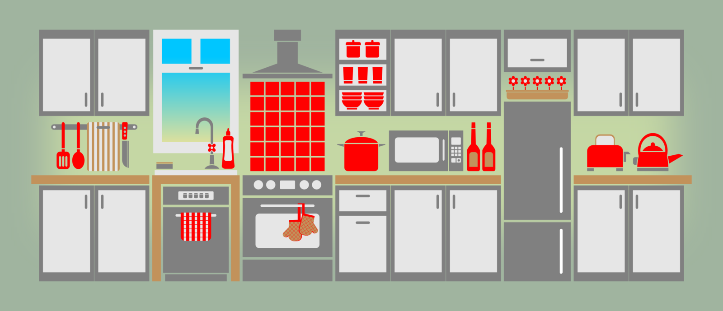
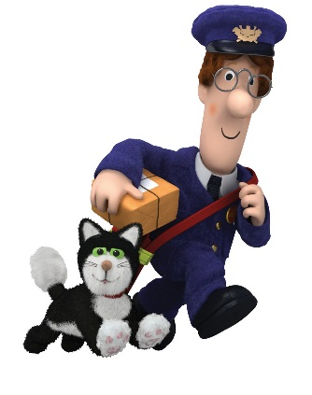
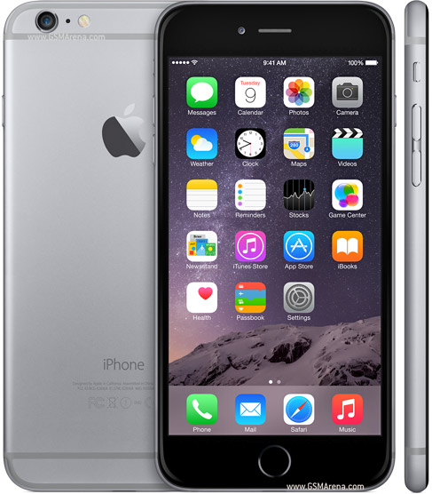
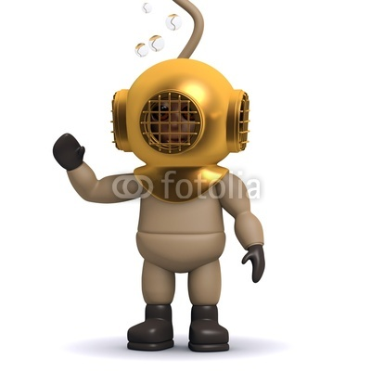
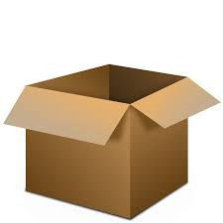
Interference or Retrieval failure
???
???
???

Slide 16
Multiple choice quiz 3
Interference is an explanation for forgetting from which memory store?
Proactive interference occurs when:
Which of the following situations makes interference less likely?
Which of the following is the best example of retroactive interference?
Sensory register
Iconic memory
Echoic memory
LTM
Newer memories cause forgetting of older ones
Memories fade over time
Older memories cause forgetting of newer ones
We don’t have the right cues to trigger memories.
When two instances of learning are similar
When two instances of learning are meaningful
When two instances of learning are different
When the time between two instances of learning is short
A student revises for her Spanish exam, then her French and has trouble recalling her Spanish
A student revises for her Spanish exam, then her French and has trouble recalling her French
You have a new mobile phone but keep telling people your old one
You accidentally call your new boyfriend by your old one’s name
Retrieval failure occurs when:
Being drunk when you learn something and when you recall it is an example of which kind of cue?
Godden and Baddeley found lower levels of recall when:
Tulving’s encoding specificity principle states that forgetting is likely when:
Information disappears from memory and is no longer available
Information was never encoded in LTM in the first place
We don’t have the right cues to recall a memory
New information pushes out older information
State-related
Context-related
Mood-related
Memory-related
Learning and recall both took place underwater
Learning and recall both took place on land
Recall took place only a short time after learning
Learning took place on land and recall took place underwater
A cue present when we learn something is also present when we try to retrieve it
A cue present when we learn something is absent when we try to retrieve it
Retrieving information happens very soon after we learn it
Two sets of information are very different

Slide 17
Accuracy of EWT 1: Misleading information
Leading question:
Evidence in support of leading questions:
Response-bias explanation:
Substitution explanation:
Evidence in support of post-event discussion
Post-event discussion:

Slide 18
Misleading information keyword challenge
Complete the keywords by reading the clues and definitions below. If you get stuck, use the word bank at the bottom.
Suggests that the wording of the question has no real effect upon the participants’ memories but just influences how they decide to answer.
A problem posed by Loftus’s use of video footage of car accidents rather than real-life events
Occurs when there is more than one witness to an event as they may discuss what they have seen with co-witnesses or with other people.
A study which asked Ps to estimate the speeds of two crashing vehicles with different verbs given to different experimental groups.
A study which tested the substitution explanation by asking Ps if they had seen the broken headlight when this had never existed.
The wording of a question actually changes the participant’s memory.
A question which, because of the way it is phrased, suggests a certain answer
Wright’s study into post-event discussion found this percentage of pairs agreeing on content of which only one person had witnessed.
A real-life case study which suggests that leading questions do not necessarily have the negative effect upon recall which experimental research has shown.
A problem with Loftus and Palmer’s study given the experimental design used and nature of the task.
A technique which has been developed for use by the police to avoid the negative effects of leading questions.
COGNITIVE INTERVIEW INDIVIDUAL DIFFERENCES LACKS MUNDANE REALISM LEADING QUESTION LOFTUS AND PALMER LOFTUS AND ZANNI POST-EVENT DISCUSSION RESPONSE BIAS EXPLANATION SUBSTITUTION EXPLANATION YUILLE AND CUTSHALL 79

Slide 19
Evaluating the effects of misleading information on EWT

Slide 20
Post-event contamination quick questions
32% of those in Loftus and Palmer’s study who had been given the verb “smashed” reported seeing broken glass but what was the percentage for the hit condition?
All of the questions below relate to research conducted into EWT. See how many you can answer.
Which verb in Loftus and Palmer’s study led to the highest speed estimate?
Name a psychologist that investigated the effects of leading questions
How many participants took place in Loftus and Palmer’s study and what age were they?
What name is given to a question which, because of the way it is phrased, suggests a certain answer?
Name a psychologist that investigated the effects of post-event discussion.

Slide 21
Give an example of a leading question
Which explanation suggests that the wording of the question has no real effect upon the participants’ memories but just influences how they decide to answer
Which psychologist found alternative evidence that leading questions don’t necessarily have an effect on EWT?
In Wright et al.’s study, what was the story about on the storyboard that Ps observed?
What experimental design did Loftus and Palmer use in their study?
After how many months did witnesses in Yuille and Cutshall’s study show continued accuracy in recall?
Where was Yuille and Cutshall’s case study based?
What is post-event discussion?

Slide 22
What is an economic implication of Loftus’s research into EWT?
What did participants watch in Loftus and Palmer’s study?
By how much variation was there in Loftus and Palmer’s study of speed estimates between the two contrasting verb conditions?
What type of police interviewing technique has developed since psychological research to ensure that leading questions do not affect the reliability of EWT?
What were Ps asked a week after the first experiment?
Give one reason why Loftus’s research lacks mundane realism.
In what way could individual differences have affected the results of Loftus and Palmer’s study?
What term is used to describe the way in which Ps respond in ways to be helpful which may have been the case in Loftus’s study?

Slide 23
What percentage of pairs agreed with each other’s testimony in Wright et al.’s study even though one member of the pair hadn’t seen this information?
What were the two variations of question that Loftus and Zanni asked?
Why should we probably be more aware of Yuille and Cutshall’s study than Loftus’s?
By how much more were Ps likely to report having seen a broken headlight in Loftus and Zanni’s study when a leading question was posed?
What type of details are most likely to be affected by leading questions?
Upon which theory of forgetting is the cognitive interview based?
Which explanation did Loftus argue saw the wording of a question actually change the participant’s memory ?
Which psychologist found that the cognitive interview was a more reliable method?

Slide 24
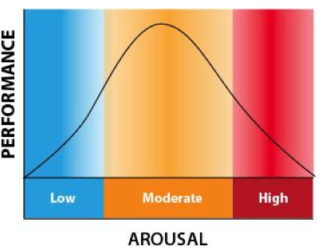
Accuracy of EWT 2: Anxiety
Anxiety can have a negative effect on EWT because…
ANXIETY
Anxiety can have a positive effect on EWT because…
Empirical evidence in support
Empirical evidence in support
The Yerkes-Dodson law says that…

Slide 25
Evaluating the effects of anxiety on EWT

Slide 26
EWT study jumble
This was a case study of a robbery at a petrol station in Vancouver, Canada in which 2 people were shot, one of whom died. 21 witnesses were interviewed by police, 13 of which were re-interviewed 5 months later by researchers. During the interviews, researchers attempted to insert 2 misleading questions but these had no effect. | The study proves that memory for events can be contaminated by discussions that witnesses have with other people. This means that there is real world application as the police will be able to utilise this knowledge to separate witnesses after an event so that recall remains intact, increasing the reliability of any statements that they collect. | The study utilised an independent groups design which means that differences in the outcome may have been the result of individual differences between the participants. The study relies upon Ps having good estimates of speed which may vary based upon individual experiences such as driving.
The study aimed to investigate the effect of post-event discussion between witnesses on recall of an event. Ps were shown a storyboard about a man having his wallet stolen by a woman. In one condition, the woman was shown to be acting alone whilst in the other condition, she had an accomplice. | The study concluded that post-event contamination can occur from simple variations within the wording of questions. This is important due to the real world application of police techniques with witnesses. Knowing this, police can be trained sufficiently so that distortions to recall do not occur. | This study has been criticised for lacking ecological validity. As the participants were waiting in the reception area, they may have anticipated that something was going to happen, which could have affected the accuracy of their judgements. They may have also been more prone to demand characteristics given that they knew this was an experiment and may have tried to respond in ways to please the experimenters.
This study has helped to show the effects of weapon focus (more specifically, anxiety induced from seeing a weapon) and how this reduces the reliability of eyewitness testimony. | The study involved Ps having to estimate the speeds of cars in video footage of an accident. The Ps were given different verbs in the question to see how it impacted upon recall as well as being given leading questions such as “did you see the broken light?”. | The study aimed to investigate if anxiety affects the accuracy of eyewitness testimony. It involved Ps being invited to a laboratory where they were told to wait in the reception area when an individual holding either a pen with hands covered in grease or a bloodied letter opener walked past them. The Ps were later asked to identify the man they’d seen.
As the study was naturally occurring, it has high ecological validity. It contradicts laboratory experiments such as those of Loftus as it showed that the insertion of misleading questions doesn’t necessarily have a negative effect on recall. The most distressed individuals were actually the most superior for recall. | The study is said to lack generalisability as it was a one-off incident. Even the researchers have suggested that this may be a case of a flashbulb memory. This suggests that certain events are remembered in more detail and more permanently, explaining how those who were more involved in the event remembered more. | Some have argued that the misinformation presented to Ps only biases the way that they respond to questions but the original memory is actually intact. This is known as the response bias hypothesis. It is also the case that where information is quite obviously false, recollection of the event is not affected, despite discussion.
LOFTUS AND PALMER
JOHNSON AND SCOTT
WRIGHT
YUILLE AND CUTSHALL

Slide 27
Multiple choice quiz 4
Which of the following statements is the best definition of EWT?
Which of the following is the best example of a leading question?
Which of the following sequence of verbs did Loftus and Palmer use in their study?
The task in Loftus and Palmer’s study was artificial because it:
Our ability to remember things such as facts and figures
How people remember the details of events they have observed themselves such as crimes and accidents
Our memories for people’s names and faces
Memories that last for weeks, months or years.
Did you see a broken headlight?
Did you see anything afterwards?
Can you recount the events in a different order?
Did you see the knife?
Contacted, pranged, hit, collided, smashed
Touched, bumped, hit, collided, smashed
Contacted, bumped, hit, collided, smashed
Contacted, bumped, hit, walloped, smashed
Lacked the emotional impact of a real-life accident
Took place in a lab
Is unethical to show film clips of accidents
Resembled a real-life accident
What did Johnson and Scott investigate?
The tunnel theory of the relationship between EWT and anxiety states that:
Real-life studies of anxiety and EWT have found that:
An advantage of Yuille and Cutshall’s study was:
EWT for natural disasters
The inverted U theory
The weapon focus effect
A real-life case of EWT
We are unable to recall the details of many aspects of an event
Our attention narrows to concentrate on one aspect of a situation
A high level of anxiety is related to a high level of recall
Most people experience anxiety when witnessing crimes and accidents
High levels of anxiety are associated with low levels of recall
High levels of anxiety are associated with high levels of recall
Anxiety and recall are not related
The findings from lab studies are correct
It allowed a high degree of control over variables
It overcame all possible ethical objections
It investigated anxiety in real-life eyewitness situations
The findings are very easy to analyse

Slide 28
The Cognitive Interview
DEFINITION
TECHNIQUE | EXAMPLE QUESTION | REASON
1.
2.
3.
4.
SUPPORTING EVIDENCE
POINT
EXPAND
EVIDENCE
LINK
POINT
EXPAND
EVIDENCE
LINK
POINT
EXPAND
EVIDENCE
LINK

Slide 29
Multiple choice quiz 5 (plus Stella design your own)
Two of the main techniques of the cognitive interview are:
The enhanced cognitive interview uses the four techniques of the CI. It also:
Two of the main techniques of the CI are based on:
A significant limitation of the CI is:
Change perspective and reinstate the context
Change perspective and change opinion
Report everything and use retrieval cues
Reverse the order and answer the interviewer’s questions
Is a lot quicker
Is more widely used
Gets the witness to speak slowly
Is nearly as effective as the CI
Tulving’s encoding specificity principle
Miller’s research into the capacity of STM
The MSM
Baddeley’s research into coding in memory
It is time-consuming for the police to use
It is less effective than the standard police interview
Some aspects of it are more useful than others
It is not supported by the bulk of psychological research into how memory works

Slide 30
EWT study jumble
This was a case study of a robbery at a petrol station in Vancouver, Canada in which 2 people were shot, one of whom died. 21 witnesses were interviewed by police, 13 of which were re-interviewed 5 months later by researchers. During the interviews, researchers attempted to insert 2 misleading questions but these had no effect. | The study proves that memory for events can be contaminated by discussions that witnesses have with other people. This means that there is real world application as the police will be able to utilise this knowledge to separate witnesses after an event so that recall remains intact, increasing the reliability of any statements that they collect. | The study utilised an independent groups design which means that differences in the outcome may have been the result of individual differences between the participants. The study relies upon Ps having good estimates of speed which may vary based upon individual experiences such as driving.
The study aimed to investigate the effect of post-event discussion between witnesses on recall of an event. Ps were shown a storyboard about a man having his wallet stolen by a woman. In one condition, the woman was shown to be acting alone whilst in the other condition, she had an accomplice. | The study concluded that post-event contamination can occur from simple variations within the wording of questions. This is important due to the real world application of police techniques with witnesses. Knowing this, police can be trained sufficiently so that distortions to recall do not occur. | This study has been criticised for lacking ecological validity. As the participants were waiting in the reception area, they may have anticipated that something was going to happen, which could have affected the accuracy of their judgements. They may have also been more prone to demand characteristics given that they knew this was an experiment and may have tried to respond in ways to please the experimenters.
This study has helped to show the effects of weapon focus (more specifically, anxiety induced from seeing a weapon) and how this reduces the reliability of eyewitness testimony. | The study involved Ps having to estimate the speeds of cars in video footage of an accident. The Ps were given different verbs in the question to see how it impacted upon recall as well as being given leading questions such as “did you see the broken light?”. | The study aimed to investigate if anxiety affects the accuracy of eyewitness testimony. It involved Ps being invited to a laboratory where they were told to wait in the reception area when an individual holding either a pen with hands covered in grease or a bloodied letter opener walked past them. The Ps were later asked to identify the man they’d seen.
As the study was naturally occurring, it has high ecological validity. It contradicts laboratory experiments such as those of Loftus as it showed that the insertion of misleading questions doesn’t necessarily have a negative effect on recall. The most distressed individuals were actually the most superior for recall. | The study is said to lack generalisability as it was a one-off incident. Even the researchers have suggested that this may be a case of a flashbulb memory. This suggests that certain events are remembered in more detail and more permanently, explaining how those who were more involved in the event remembered more. | Some have argued that the misinformation presented to Ps only biases the way that they respond to questions but the original memory is actually intact. This is known as the response bias hypothesis. It is also the case that where information is quite obviously false, recollection of the event is not affected, despite discussion.
LOFTUS AND PALMER
JOHNSON AND SCOTT
WRIGHT
YUILLE AND CUTSHALL

