Slide 1
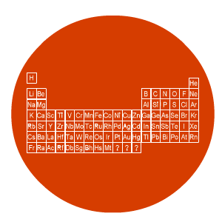
Chemistry
Formula

Slide 2
Lesson objectives
Understand the structure of formula

Slide 3
Chemical formula
Chemical formula
- shows the type and ratio of atoms in a compound

Slide 4
Chemical formula - example
carbon dioxide
carbon atom = 1
CO₂
formula =
oxygen atoms = 2
Total atoms = 3

Slide 5
Chemical formula - task
water
hydrogen atoms = 2
H₂O
formula =
oxygen atom = 1
Total atoms = 3

