Slide 1
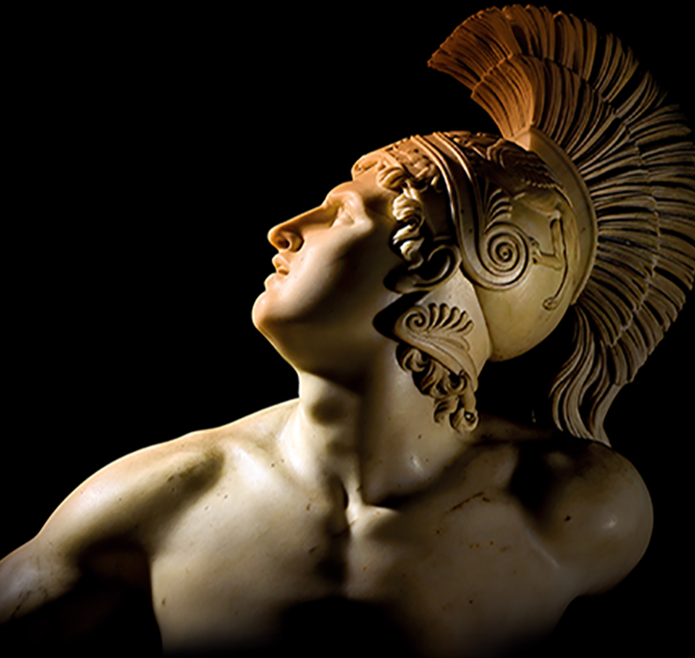
Iliad Revision Books 1-10
Work out the original word by looking at it with the vowels removed.
The first person to solve it unlocks questions for improving their score.
If you’re not answering, pay attention! You may be able to still compete.

Slide 2
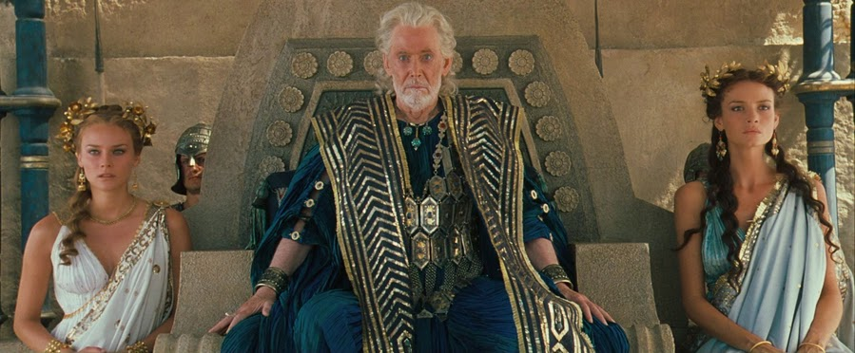
Category 1 - Character

Slide 3
CHLLS
Achilles

Slide 4
Questions on Achilles
Answer the following questions. You get five points for each correct answer but only have 10 seconds per question. If you get it wrong, your opponent gets 5 seconds to steal the points.
1) Who was Achilles’ father?
Answer: Peleus
2) Where does Achilles come from?
Answer: Phthia
3) What town did Achilles capture when he killed Andromache’s father and brothers?
Answer: Thebe

Slide 5
DSSS
Odysseus

Slide 6
Questions on Odysseus
Answer the following questions. You get five points for each correct answer but only have 10 seconds per question. If you get it wrong, your opponent gets 5 seconds to steal the points.
1) Which of Priam’s advisors had Odysseus previously impressed?
Answer: Antenor
2) What was Odysseus chosen to do in Book 9?
Answer: Join the embassy to Achilles
3) What was the name of the oath Odysseus had all the suitors of Helen swear, which required their participation in the Trojan War?
Answer: The Oath of Tyndareus

Slide 7
PRM
Priam

Slide 8
Challenge: Priam’s Family
You have 30 seconds to complete the following family tree. If you get any wrong, your opponent has 10 seconds to fill in the gaps. Any they answer correctly reduces your score by one. You will get the following points:
A) 3 correct = 5 points
B) 5 correct = 10 points
C) 7 correct = 15 points
Priam
?
Hecuba
Helen
Paris
Deiphobus
Helenus
Hector
Andromache
?
Cassandra
?
?
Astyanax
?

Slide 9
BRSS
Briseis

Slide 10
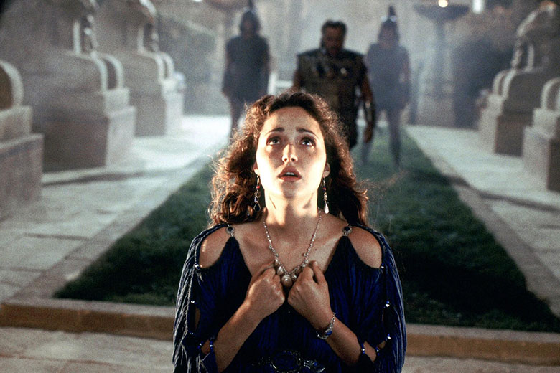
Challenge: Women in the Iliad
You have 30 seconds to name ten female mortal characters named in the Iliad. If you are short, your opponent will get 10 seconds to name any you missed. Any they add reduces your score by one. You will get the following points:
A) 5 correct = 5 points
B) 7 correct = 10 points
C) 10 correct = 15 points

Slide 11
GMMNN
Agamemnon

Slide 12
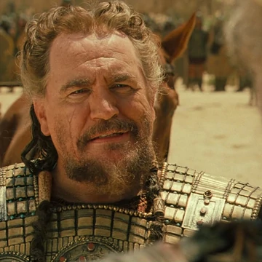
Challenge: Agamemnon’s Relationships
You have 30 seconds to match ten characters to their relationship with Agamemnon. If any are incorrect, your opponent will get 10 seconds to match any you missed. Any they add reduces your score by one. You will get the following points:
A) 5 correct = 5 points
B) 7 correct = 10 points
C) 10 correct = 15 points
https://learningapps.org/watch?v=psazs6i2322

Slide 13
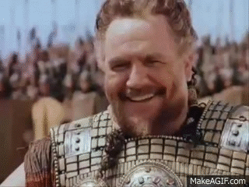

Slide 14
NTNR
Antenor

Slide 15
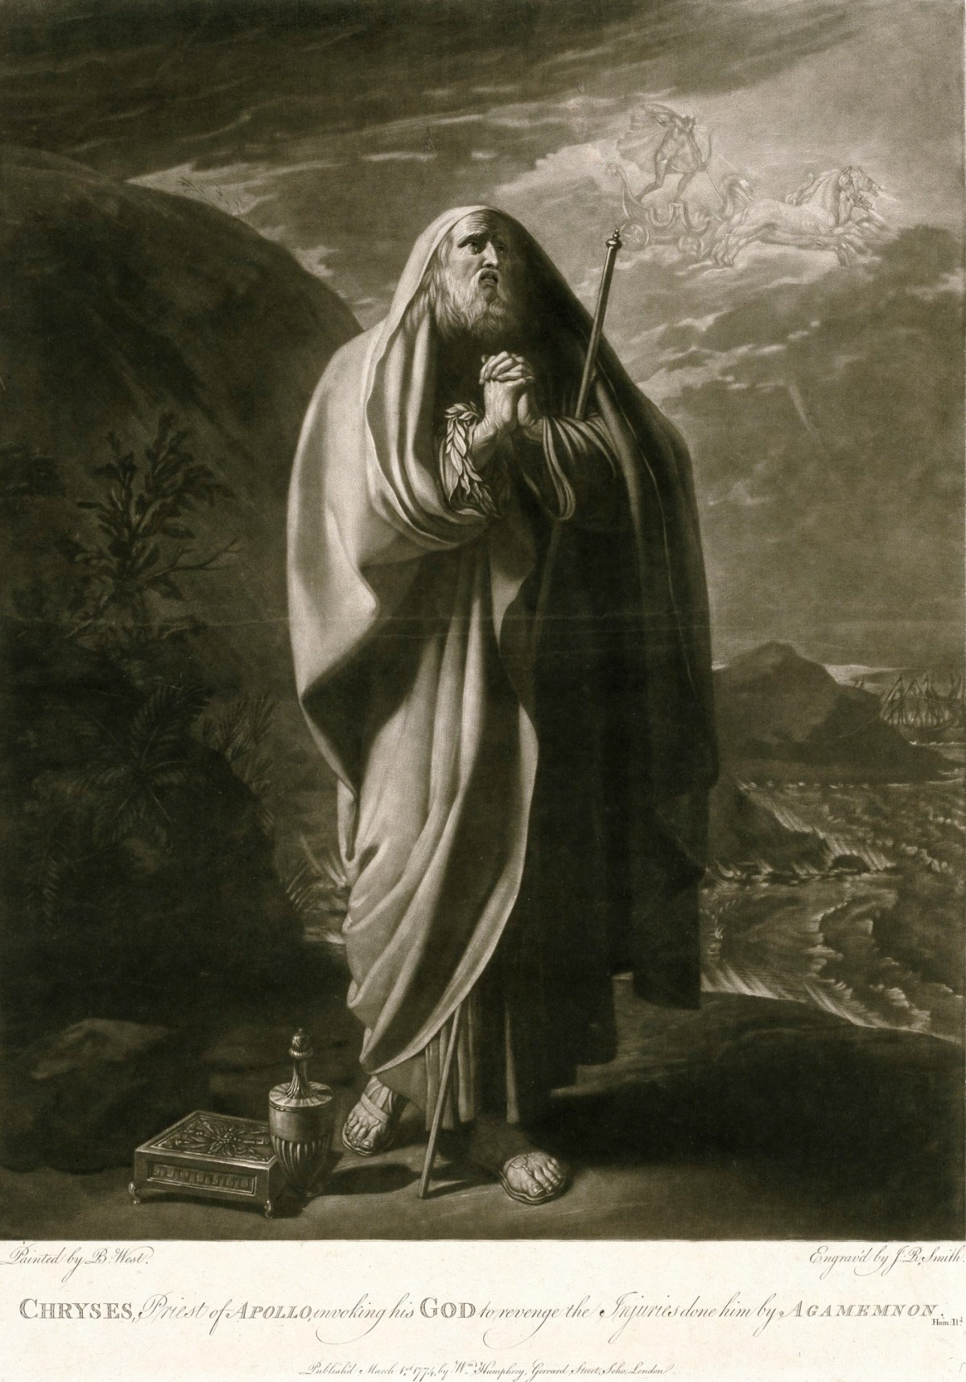
Challenge: Cameos
You have 30 seconds to place ten characters into the only book they appear in (by the end of book 10). If any are incorrect, your opponent will get 10 seconds to match any you missed. Any they add reduces your score by one. You will get the following points:
A) 5 correct = 5 points
B) 7 correct = 10 points
C) 10 correct = 15 points
https://learningapps.org/watch?v=panvpssrj22

Slide 16
MRNS
Meriones

Slide 17
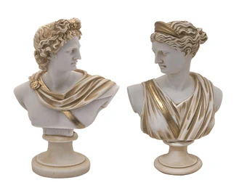
Challenge: Pairs
You have 30 seconds to sort the characters into ten pairs (often found together or associated with one another). If any are incorrect, your opponent will get 10 seconds to match any you missed. Any they add reduces your score by one. You will get the following points:
A) 5 correct = 5 points
B) 7 correct = 10 points
C) 10 correct = 15 points
https://learningapps.org/watch?v=p3e3zcwi322

Slide 18
STHNLS
Sthenelus

Slide 19
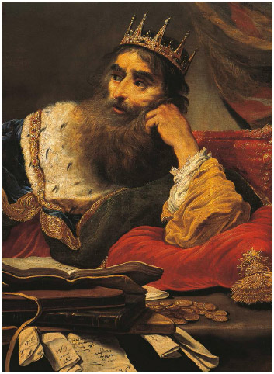
Challenge: Kings
You have 30 seconds to name as many kings in the Iliad as possible. Your opponent will also make a list. Any they have that you do not reduces your score by one. You will get the following points:
A) 5 correct = 5 points
B) 7 correct = 10 points
C) 10 correct = 15 points

Slide 20
MCHN
Machaon

Slide 21
Questions on Injuries
Answer the following questions. You get five points for each correct answer but only have 10 seconds per question. If you get it wrong, your opponent gets 5 seconds to steal the points.
1) Which Achaean managed to successfully wound two deities?
Answer: Diomedes
2) Who manages to draw blood by stabbing Hector in Book 7?
Answer: Ajax
3) Who wounded Menelaus with an arrow, causing Agamemnon to panic?
Answer: Pandarus

Slide 22
LT
Litae

Slide 23
Questions on Lesser Deities
Answer the following questions. You get five points for each correct answer but only have 10 seconds per question. If you get it wrong, your opponent gets 5 seconds to steal the points.
1) Which nymph was the mother of Achilles?
Answer: Thetis
2) Who is the goddess of Blind Folly?
Answer: Ate
3) Can you name any of the Muses?
Answer: Calliope (epic poetry); Clio (history); Euterpe (flutes and music); Thalia (comedy and pastoral poetry); Melpomene (tragedy); Terpsichore (dance); Erato (love poetry and lyric poetry); Polyhymnia (sacred poetry); Urania (astronomy)

Slide 24
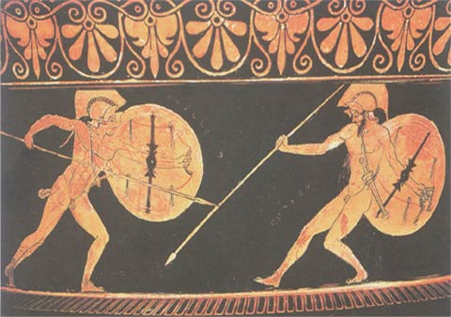
Category 2 – Key Terms

Slide 25
xn
Xenia

Slide 26
KLS
Kleos

Slide 27
RST
Aristeia

Slide 28
PTHS
Pathos

Slide 29
TM
Time

Slide 30
HBRS
Hubris

Slide 31
SPPLCTN
Supplication

Slide 32
MTS
Metis

Slide 33
TPS
Topos

Slide 34
T
Ate

Slide 35
Category 3 – Homer’s Favourite Literary Devices

Slide 36
HMRC SML
Homeric Simile

Slide 37
VVD
Vivid

Slide 38
RTRDTN
Retardation

Slide 39
FRML
Formula

Slide 40
BCK STR
Back Story

Slide 41
PRSNFCTN
Personification

Slide 42
PTHT
Epithet

Slide 43
PSTRPH
Apostrophe

Slide 44
RHTRCL QSTN
Rhetorical Question

Slide 45
RNG CMPSTN
Ring Composition

