Slide 1
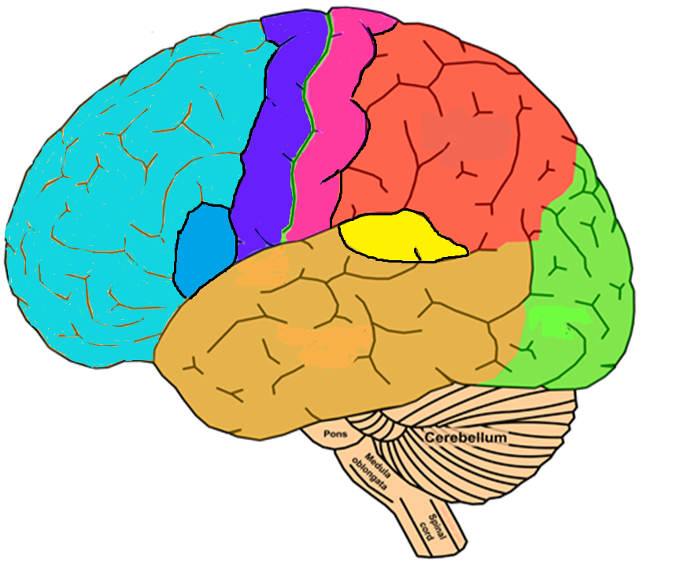
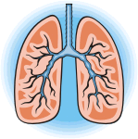
The Functions of the Brain

Slide 2
Methods of measuring localisation of function within the brain
NAME
DESCRIPTION
IMAGE
STRENGTHS
LIMITATIONS

Slide 3
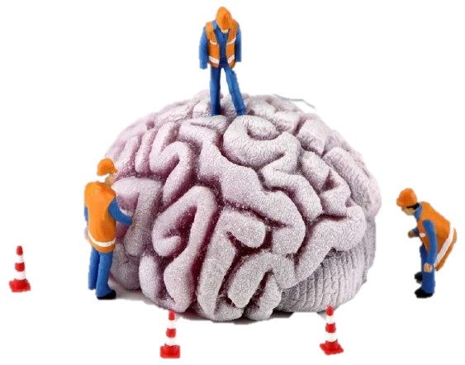
Localisation of function and ways of investigating the brain multiple choice
The theory that all parts of the brain are involved in the processing of thought and action is called:
Broca’s area is located in the:
Damage to which area of the brain may result in a loss of control of fine movements?
Most of the damage to Phineas Gage’s brain was sustained in the:
Holistic theory
Localisation theory
Plasticity
Law of equipotentiality
Left parietal lobe
Right occipital lobe
Left frontal lobe
Left temporal lobe
The somatosensory area
The motor area
The auditory area
Wernicke’s area
Frontal lobe
Parietal lobe
Temporal lobe
Occipital lobe
A method of detecting changes in blood oxygenation and flow that occur as a result of neural activity best describes what?
Which of the following is most likely to measure ‘global’ (whole) brain activity rather than specific areas of activity/damage?
Which of the following uses a statistical averaging technique to remove extraneous scan data?
Which of the following describes a post-mortem investigation?
fMRI
EEG
ERP
Post-mortem
fMRI
EEG
ERP
Post-mortem
fMRI
EEG
ERP
Post-mortem
Removal of the frontal lobe
Microscopic removal of brain cells
Cutting the brain down the middle to separate hemispheres
Examining a brain after death

Slide 4
Biopsychology Letter Tiles
KEYWORD
DEFINITION
A’S A
SIA
BROC
PHA
OF FU
SATION
NCTION
LOCALI
FUNC
OVERY
AL REC
TION
AL CO
EBR
RTEX
CER
SATION
HEMISP
ATERALI
HERIC L
CITY
NEU
ASTI
ROPL
EVENT
NTIALS
RELAT
ED POTE
T BRA
SPLI
ENTS
IN PATI

Slide 5
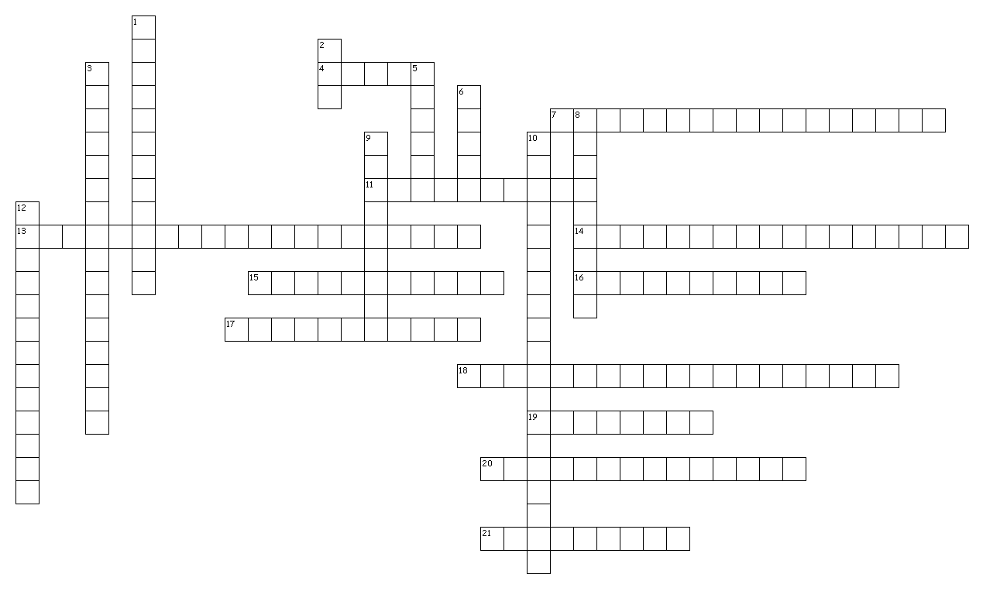
Circadian Rhythms Crossword
Down
1. A group of people who are likely to experience disruption to their circadian rhythms. (5,7)
2. A tiny bundle of nerve cells located in the hypothalamus that is one of the primary endogenous pacemakers involved in maintaining circadian rhythms such as the sleep/wake cycle. (1,1,1)
3. Research into circadian rhythms has provided more knowledge about this area of drug treatments. (16)
5. A case study of a man who stayed in a cave for 2 months (and later 6 months). (6)
6. An example of an important exogenous zeitgeber. (5)
8. A type of biological rhythm with a frequency of less than one in 24 hours. (9)
9. A type of biological rhythm with a frequency of more than one cycle in 24 hours. (9)
10. External cues that may affect or entrain our biological rhythms. (9,10)
12. A problem with studies such as Siffre is that they may not be considered to be this. (13)
Across
4. The location of many studies into free-running as they prevent exposure to natural light. (5)
7. Distinct patterns of changes in body activity that conform to cyclical time periods. (10,7)
11. Most people are generally found to have a circadian rhythm of just over this number of hours. (6,4)
13. Internal body clocks that regulate many of our biological rhythms. (10,10)
14. Adverse consequences that can occur as a result of disruption to circadian rhythms. (17)
15. The process that activates or provides a timing cue for a biological rhythm. (11)
16. This type of light may also have an impact upon circadian rhythms as shown by Czeisler which would question research findings such as Siffre’s. (11)
17. The impact upon the sleep/wake cycle in the absence of external stimuli such as light. (4-7)
18. An example of a biological rhythm other than the sleep/wake cycle. (4,4,11)
19. Teenagers’ circadian rhythms typically begin this amount of time after those of adults showing evidence for individual differences. (3,5)
20. The way in which we feel drowsy and alert at different points within the day. (5-4,5)
21. A type of biological rhythm, subject to a 24 hour cycle. (9)

Slide 6
A case study of a man who stayed in a cave for 2 months (and later 6 months).
A group of people who are likely to experience disruption to their circadian rhythms.
A problem with studies such as Siffre is that they may not be considered to be this.
A type of biological rhythm with a frequency of less than one in 24 hours.
A type of biological rhythm with a frequency of more than one cycle in 24 hours.
A type of biological rhythm, subject to a 24 hour cycle.
Adverse consequences that can occur as a result of disruption to circadian rhythms.
An example of an important exogenous zeitgeber.
Distinct patterns of changes in body activity that conform to cyclical time periods.
Duffy found that people could be categorised according to these headings which would describe different preferences for sleeping patterns.
External cues that may affect or entrain our biological rhythms.
Folkard said that we need to be careful of doing this with results about external stimuli into circadian rhythms.
Internal body clocks that regulate many of our biological rhythms
Most people are generally found to have a circadian rhythm of between this number of hours.
Research into circadian rhythms has provided more knowledge about this area of drug treatments.
Teenagers’ circadian rhythms typically begin this amount of time after those of adults.
The amount of change within our core body temperature during the day.
The impact upon the sleep/wake cycle in the absence of external stimuli such as light.
The location of many studies into free-running as they prevent exposure to natural light.
The peak time for our core body temperature when it reaches around 38°C.
The process that activates or provides a timing cue for a biological rhythm.
The way in which we feel drowsy and alert at different points within the day.
This factor prevents generalisation based upon circadian rhythm research as it suggests that each person is different.
This may also have an impact upon circadian rhythms as shown by Czeisler which would question research findings such as Siffre’s.
24-25 hours
6pm
Artificial light
Biological rhythms
Caves
Circadian rhythms
Desynchronisation
Endogenous pacemakers
Entrainment
Exogenous zeitgebers
Free-running
Generalisable
Individual differences
Infradian rhythms
Larks and owls
Light
Overgeneralising
Pharmacokinetics
Shift workers
Siffre
Sleep/wake cycle
Two degrees
Two hours
Ultradian rhythms
Circadian Rhythms Quiz

Slide 7
Circadian Rhythms PEEL

Slide 8
THE CONTROL OF CIRCADIAN, ULTRADIAN AND
EXCEPTIONAL CIRCUMSTANCES ARE ENDOGENOUS PACEMAKERS FREE-RUNNING. IN FACT, TO ISOLATE THE
ENDOGENOUS PACEMAKERS (E.G. THE
INTERNAL BODYCLOCKS KNOWN AS
SUPRACHIASMATIC NUCLEUS) AND
EXTERNAL CUES FROM THE ENVIRONMENT (SUCH AS
EFFECTS OF EXOGENOUS ZEITGEBERS (AS SIFFRE DID) CREATES ARTIFICIAL CONDITIONS WHICH CAN BE ARGUED TO LACK ECOLOGICAL VALIDITY.
WORK WITHOUT EXTERNAL CUES, IT IS SAID TO BE
ATTEMPT TO RE-SET THE INTERNAL SYSTEM IN A PROCESS KNOWN AS
EXOGENOUS ZEITGEBERS. IF THE RHYTHM CAN
ENTRAINMENT. IN REALITY THOUGH,
HIGHLY REDUCTIONIST TO ONLY CONSIDER ONE ELEMENT AS ONLY IN
BIOLOGICAL RHYTHMS SUCH AS THE SLEEP/WAKE CYCLE (WHICH IS AN EXAMPLE OF A
CIRCADIAN RHYTHM) RELY ON BOTH ENDOGNEOUS PACEMAKERS AND EXOGENOUS ZEITGEBERS IN WHAT IS
FREE-RUNNING. BY CONTRAST, EXTERNAL CUES MAY
INFRADIAN CYCLES CAN BE INFLUENCED BY
KNOWN AS A BLENDED SYSTEM. IT COULD THEREFORE BE ARGUED TO BE
LIGHT AND SOCIAL CUES) KNOWN AS

Slide 9
Endogenous pacemakers and exogenous zeitgebers word puzzle
Rhythm lasting less than 24 hours
Can disrupt bodily rhythms
Answer the clues and find the words in the word search. The remaining letters read left to right to provide a key phrase for a conclusion to an essay on this topic.
The main endogenous pacemaker
M | E | N | S | T | R | U | A | L | C | Y | C | L | E
I | M | N | R | E | A | S | L | I | T | S | Y | O | L
U | E | R | B | I | O | H | L | O | C | G | I | C | C
U | L | T | R | A | D | I | A | N | I | A | L | R | Y
H | A | Y | T | H | M | F | S | A | R | R | E | C | C
O | T | L | I | G | H | T | N | T | C | R | O | L | G
L | O | E | D | B | Y | W | B | O | A | T | H | E | N
N | N | D | O | G | E | O | N | O | D | U | S | P | I
A | I | C | E | M | A | R | K | E | I | R | S | A | P
N | N | D | E | X | O | K | G | E | A | N | O | U | E
S | Z | N | A | I | D | A | R | F | N | I | E | I | E
T | G | E | B | E | R | S | I | N | A | B | L | E | L
N | D | E | D | S | Y | S | T | E | M | X | Y | Z | S
Rhythm lasting about 24 hours
The main exogenous zeitgeber
Hormone responsible for rhythmic changes in the sleep/wake cycle
Rhythm lasting more than 24 hours
An example of an infradian rhythm
An example of an ultradian rhythm

Slide 10
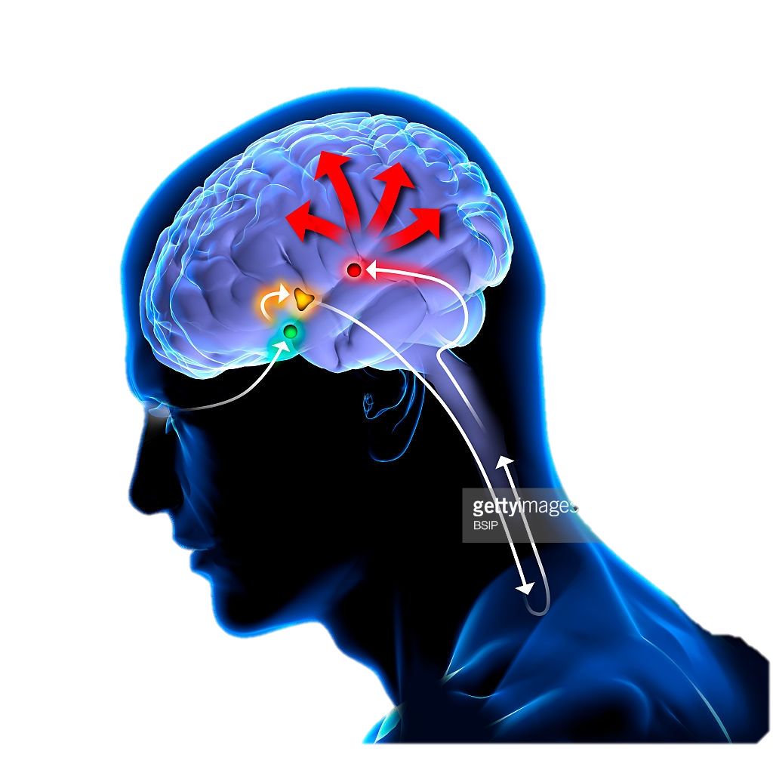
Endogenous Pacemakers: the SCN

Slide 11
Endogenous Pacemakers and Exogenous Zeitgebers
GLOSSARY
AO1 INTRODUCTION AND AO3 CONCLUSION

Slide 12
Endogenous Pacemakers and Exogenous Zeitgebers Evaluation Colour Sort
 | POINT | EXPLAIN | ELABORATE/HOWEVER
Animal studies into the role of the SCN | Much of the research looking at endogenous pacemakers and exogenous zeitgebers influence on the sleep wake cycle is case study or studies using very small samples, such as Siffre cave study and Aschcoff and Wevers Bunker study. | Burgess found that exposure to bright light following an east-west flight decreased the time needed to readjust to local time on arrival. Three groups of volunteers were exposed to either continuous bright light, intermittent bright light or dim light. They found participants in the continuous bright light group shifted their circadian rhythm back 2.1 hours, intermittent bright light 1.5 hours and dim light 0.6 hours. | However, may psychologists would argue that this study is an example of an exceptional circumstance; and that for most people there is an interaction between our internal pacemaker and exogenous zeitgebers that sets our circadian rhythm. Isolating each factor and investigating each separately may tell us very little about how our circadian rhythms are set in real life and actually, we need to consider a blended system.
Reductionism: The role of peripheral oscillators | . Jetlag can be a severe condition causing sleep, appetite and mood disturbance. So by understanding the role exogenous zeitgebers have on our sleep we can decrease the impacts jetlag has on our sleep wake cycles. | This is shown through a case study by Miles (1977) of a young man blind from birth with a circadian rhythm of 24.9 hours, whose sleep wake cycle could not be adjusted regardless of changes to social cues. He required medication to allow him to sleep and wake up every day at the appropriate times. | However, there are many methodological limitations to Campbell and Murphy’s original research, and other psychologists have suggested that the participants may have had some limited light exposure to their eyes. Also, they only isolated light in this experiment, and did not control for the influence of other exogenous zeitgebers such as the time that meals were taken as well as ambient temperature on the sleep wake cycle.
Role of exogenous zeitgebers may be overstated | The suprachiasmatic nucleus role in the sleep wake cycle can be demonstrated with animals through lesion studies and cellular implantation. | Consequently, it is impossible to generalise these results to whole populations of people, as there may be some individual differences in the research sample that makes these participants respond to the changes the sleep/wake cycle in atypical ways. For example, Siffre noted that when he went into the cave at 60 years, his body responded very differently with his body clock following more of a 48 hour cycle. And Czeisler has found evidence that cycles can vary by as much as 13-65 hours. | The strengths of both of these animal studies is that manipulation of the SCN (IV) was conducted under controlled conditions so the results can be replicated, and show a clear cause and effect relationship; i.e. damage/change to the SCN alters sleep wake cycle. However, there are issues in generalising these findings to much higher order species like humans who also have many complex social cues which may alter sleep wake patterns. Moreover these studies can be considered unethical as the rodents were exposed to extreme harm; and it could be argued that the findings from this research do not justify the means of obtaining them.
Issues with case study evidence to support the role of endogenous pacemakers | The role of exogenous zeitgebers may have been exaggerated, as there is evidence that although external environmental cues may vary, some individual’s pacemakers are set to withstand their influence. | Research has demonstrated that there are many peripheral oscillators found in many other organs of the body including the adrenal gland , oesophagus, lungs, liver, pancreas and skin that not only function in combination with the SCN, they also have the ability to work independently. Damiola (2000) demonstrated that changing the feeding patterns in mice could alter the circadian rhythm of liver cells by up to 12 hours. Furthermore Campbell and Murphy demonstrated that light may be detected by skin receptor cells even when the same information is not received by the eyes. Fifteen patients were woken at various times of the night and light was shone onto the back of their knees. In some cases the researchers managed to alter the sleep wake cycle of these participants by three hours. This suggests that light need not enter the eyes and stimulate the SCN in order to exert an effect on the sleep wake cycle. | As a result, those in the continuous bright light group felt sleepier 2 hours earlier in the evening and woke up two hours earlier in the morning, closer to the local time conditions they would find themselves in after an east-west flight. This research demonstrates that we can entrain our circadian rhythms to fit into changing time zones to reduce the impact of jetlag. This also has implications on the economy, as individuals who must take long haul flights for business can improve their productivity and concentration upon landing at their destinations and get on with their jobs more rapidly.
Practical application: Using Light exposure to avoid jet lag | It may be too simplistic to suggest that the suprachiasmatic nucleus is the only endogenous pacemaker responsible for regulating the sleep wake cycle. | DeCoursay destroyed the SCN connections in 30 chipmunks and returned them to their natural habitat for 80 days. She noted that many of them were killed by predation not long after, as they had ventured out of their nests at the wrong time of day, suggesting their normal sleep wake cycle had been impaired. Furthermore, Ralph implanted SCN cells from mutant hamsters who had a sleep wake cycle of 20 hours into the SCN hamsters with a normal cycle. He discovered that for the hamsters who received the transplant their cycles changed to that of their mutant donors. Both these studies provide support for the importance of the SCN in regulating the sleep wake cycle. | This suggests that results cannot be generalised from these small samples onto everyone, as factors such as age and gender may have significant impacts on our circadian rhythms.

Slide 13
Circadian and Infradian Rhythms Multiple Choice
Which of the following is an example of the circadian rhythm?
In Siffre’s cave study and Aschoff and Wever’s bunker study, the biological clock is not influenced by exogenous zeitgebers such as light. Within these studies, it is described as:
Core body temperature varies by approximately how many degrees over a 24 hour period?
Research into circadian rhythms has contributed to our understanding of chronotherapeutics which is the study of:
The menstrual cycle
Seasonal affective disorder
The sleep/wake cycle
The stages of sleep
Free-wheeling
Free-trading
Free-flowing
Free-running
1 degree C
2 degrees C
3 degrees C
5 degrees C
The timing of drug dosing
How circadian and infradian rhythms interact
How endogenous pacemakers are detected by skin receptors
The effects of disruption of circadian rhythms (including shift work and jet lag)
The Stern and McClintock study investigated the influence of which chemicals?
Rapid eye movement (REM) occurs in which phase of the sleep cycle?
Melatonin is secreted by the:
Which pattern of brainwave activity is not a feature of the sleep cycle?
Hormones
Pheromones
Phonemes
Drugs
Stages 1 and 2
Stages 3 and 4
Stage 5
It is not part of the sleep cycle
Adrenal gland
Thyroid gland
Pituitary gland
Pineal gland
Alpha waves
Beta waves
Delta waves
Theta waves

Slide 14
Describe and discuss research into circadian rhythms (16 marks)
WHAT TO INCLUDE:
Paragraph 1 – Introduction: Keep brief, explain that a circadian rhythm is one type of biological rhythm which has a periodicity of 24 hours eg: The sleep/wake cycle, Core Body Temperature and hormone production
Paragraph 2 – Theory: Explain that biological rhythms are thought to be controlled by endogenous pacemakers and exogenous zeitgebers. Explain the meaning of each of these terms and describe the biological processes and the influence of external zeitgebers on endogenous pacemakers but keep it related to Circadian Rhythms for this essay
Paragraph 3 – Evidence-Research or Anecdotal: Discuss research evidence here that has been carried out on circadian rhythms (sleep wake cycle) eg: Siffre, Ashcroft and Weaver, Folkard etc: Then discuss research evidence for and against core body temp and hormones.
Paragraph 4 – Criticisms/Evaluation of Evidence/and or Theories: Positive and negative criticisms of the findings from research or theory (if not done above) and the methodologies used for research into this area. These can be general (relevant to the nature of research in this area or specific to each piece of research) Remember to be synoptic and look at your toolkit to see what areas you can include to show your knowledge of approaches, issues and debates within psychology – but remember to make these relevant to the topic under discussion.
Paragraph 5 – Conclusion: A brief conclusion that sums up the strengths and/or limitations of the overall evidence, and discusses importance to our scientific knowledge, and real life application. Do not introduce new studies or material here.

Slide 15
Exam technique: application to stem in essays
THE QUESTION:
WHAT TO INCLUDE:
Robert suffered a stroke at the age of 55. After the stroke he was paralysed down his right side, though he could move his left arm and leg easily. Robert could clearly understand what was said to him, but was unable to produce any speech.
Discuss how knowledge of hemispheric lateralisation and language centres in the brain has helped our understanding of cases such as Robert’s. Refer to Robert’s case in your answer.
Possible content
Systematic research from Wernicke and Broca onwards has demonstrated that in most people language centres are lateralised to the left hemisphere
Wernicke’s area seems to be responsible for the interpretation of speech – damage leads to receptive or sensory aphasia
Broca’s area was thought to be responsible for the production of speech this is now thought to involve a wider network than just Broca’s area – damage leads to production (expressive) or motor aphasia
Possible application
The presence of a right sided paralysis confirms that in cases such as Robert’s there is lateralised damage to the left hemisphere
Robert, can understand speech so we conclude that he does not have Wernicke’s, receptive, aphasia; caused by damage to Wernicke’s area in the left hemisphere.
Robert cannot produce speech so we conclude that Broca’s area has been damaged leading to Broca’s, production or expressive aphasia.
Possible discussion
As language centres are lateralised they can be impaired by damage to the left hemisphere, not to the right. The left hemisphere also controls the muscles of the right side of the body therefore, when brain damage leads to speech problems combined with paralysis of body muscles, it is usually a right sided paralysis
Damage to Broca’s area can lead to production/expressive aphasia combined with right sided paralysis
Damage to Broca’s and Wernicke’s areas may lead to global aphasia (inability to understand or to produce speech), combined with right sided paralysis
Use of research evidence to support explanation
Problems associated with different types of research evidence

Slide 16
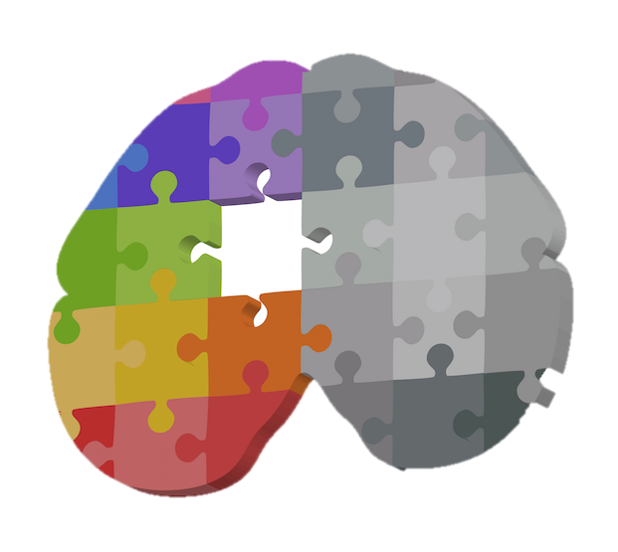
 | A form of plasticity following damage to the brain through trauma. It describes the brain’s ability to redistribute or transfer functions usually performed by a damaged area(s) to other undamaged area(s).
 | A part of the brain which Mechelli found was larger in people who were bilingual compared to those who were monolingual.
 | A psychologist who imaged the brains of medical students before and after their final exams which showed learning induced changes of the posterior hippocampus and parietal cortex.
 | An example of an event which may cause trauma and potentially lead to a person displaying functional recovery.
 | Changing functionality to a similar area on the opposite side of the brain to perform a specific task e.g. damage to Broca’s area on the left side of the brain causing the right equivalent side to resume its function.
 | Links between different neurons that meet at a synapse. The number of these reaches its maximum at 2-3 when there are about 15,000.
 | Routes that would not normally be involved in performing a particular function that become activated to enable functioning to continue as before.
 | The continued experience of sensations in a limb that has been amputated as though the missing limb is still there. It occurs in about 60-80% of amputees.
 | The deletion of rarely used synaptic connections and the strengthening of those that are more frequently used.
 | The growth of new nerve endings which connect with other undamaged nerve cells to form new neuronal pathways.
 | The part of the brain that showed greater amounts of grey matter in London taxi drivers compared with a control group.
 | The psychologist who investigated neuroplasticity in London black cab drivers.
 | This describes the brain’s tendency to change and adapt (functionally and physically) as a result of experience and new learning.
 | When physical, cognitive and communication deficits may improve on their own e.g. after a stroke as the brain heals, often in the first few days, weeks or months after the trauma.
 | Where the neuron is killed and all connections associated with the neuron are also eliminated.
Plasticity and functional recovery of the brain after trauma mix and match
Apoptosis * Axonal sprouting * Draganski * Functional recovery * Hippocampus * Maguire * Parietal cortex * Phantom limb syndrome * Plasticity * Recruitment of homologous areas * Secondary neural pathways * Spontaneous recovery * Stroke * Synaptic connections * Synaptic pruning

Slide 17
Positive or negative? Plasticity or functional recovery?
Alzheimer's
Alzheimer’s patients have been found to eat less which has been explained by visual deficits which means that they find it harder to see the food.
Medical students
Draganski showed that studying can lead to changes in the brain with the posterior hippocampus and parietal cortex showing visible changes following an MRI after a 3 month period studying for exams
Depression
Depressed patients have been found to have reduced hippocampal volume which varies with the number of episodes and duration of the illness
Epilepsy
Jody Miller provided an example of how plasticity can allow normal everyday functioning even with the loss of the right hemisphere
Stroke
Patients have been found to display spontaneous recovery in the weeks following trauma (though intervention through movement therapy and electrical stimulation may also be required)
Visuospatial changes
The posterior hippocampus of London taxi drivers is larger than London bus drivers following learning of the London map (Maguire)
Coma recovery
A case study of Terry Willis who suffered a brain injury that led to him being in a coma for 19 years showed that when he awoke, his brain created new neural connections and re-wired differently to a normal brain which allowed him to maintain function
Phantom limb
A type of maladaptive plasticity which is experienced by approximately 60-80% of amputees in which they experience phantom sensations in their missing limb. It is assumed to be the result of maladaptive changes in the primary sensory cortex after amputation
Drug use
Drug addiction can have a maladaptive effect upon the brain. This is because addiction means that certain brain pathways are repeated and therefore become stronger.
Meditation
Prolonged periods of meditation have been shown to have an effect upon the brain, changing both its structure and function with meditators having a thicker cortex than non-meditators particularly in areas related to attention and sensory processing.

Slide 18
Plasticity Multiple Choice
Which of the following refers to the activation of secondary neural pathways to carry out new functions?
In the Maguire et al. study of London taxi drivers, which area was seen to have undergone learning-induced changes?
What is the term used to describe the dying off of neurons?
What is the term that is used to refer to when connections within the brain are either removed or strengthened?
Revealing
Unmasking
Unearthing
Renewing
Posterior hippocampus
Anterior hypothalamus
Interior gyrus
Temporal lobe
Pruning
Depression
Apoptosis
Regeneration
Neuroplasticity
Synaptic pruning
Traumatic brain injury
Spontaneous recovery
Which of the following age groups would have the greatest amount of neural plasticity with respect to recovery from brain damage?
Neural plasticity would be least important for which of the following?
True or false? The number of neurons in the brain is set by early childhood and declines throughout life
What is another term for brain plasticity?
A. 1-10 years B. 11-20 years C. 21-30 years D. 60-70 years
A. recovering mental functions lost due to brain damage B. learning a new fact about biology C. forming a memory of what you did last night D. Neural plasticity would be equally important for all the above.
TRUE
FALSE
Neuroplasticity
Neuron plasticity
Neural plasticity
Cognitive plasticity

Slide 19
Split Brain Patients
Situation | Explain what would happen in split brain patients… | Explain why that would happen
An object is presented in the left visual field and the patient is asked to pick the object up with their left hand.
An object is placed in the left hand and the patient is asked to name it
A word is presented to the right visual field and the patient is asked to name it
Two different words are shown to the left (key) and right (ring) visual field. They are asked to draw an object and say what they have been drawing.
A picture of a nude is presented amongst geometric shapes to the left visual field and the P is asked to describe what they saw.
The patient is shown a split face with the left half being a man and the right half being a woman. The P then has to find the matching face from a set of faces
A patient was shown an object to the left visual field and asked to draw it with the right hand.
A patient was shown an object to the left visual field and asked to describe it.
Two different words are shown to the left (Ball) and right (Pen) visual field. They are asked to name one and draw the other.
The patient is shown a split face with the left half being the image of a man and the right half being a woman and the P has to describe the face

Slide 20
Evaluating split-brain research
Gazzaniga (1998) suggests that some of the early discoveries from split-brain research have been disconfirmed by more recent discoveries. E.g. split-brain research had suggested that the right hemisphere was unable to handle even the most rudimentary language. Damage to the left hemisphere was found to be far more detrimental to language function than was damage to the right. However, case studies have demonstrated that this was not necessarily the case. One patient, known as JW, developed the capacity to speak out of the right hemisphere, with the result that JW can now speak about information presented to the left or to the right brain (Turk et al 2002).
Sperry’s (and later Gazzaniga’s) pioneering work into the split-brain phenomenon has produced an impressive and sizeable body of research findings, the main conclusion of which appears to be that the left hemisphere’s function is predominantly analytical and verbal tasks whilst the right is more adept at performing spatial tasks and music. The right hemisphere can only produce rudimentary words and phrases but contributes emotional and holistic content to language. Overall, research suggests that the left hemisphere is the analyser whilst the right hemisphere is the synthesiser and this has provided a key contribution to our understanding of brain processes.
Sperry’s research was very well designed and employed well thought through standardised procedures. As he made use of presenting information to one eye for just 1/10 of a second, it prevented both visual fields from seeing the same information meaning that he had high control over which hemisphere was being exposed. He also designed a procedure which could be replicated so his findings could be validated.
One perhaps unfortunate legacy of work into lateralisation of function is the growing amount of pop-psychology literature concerning the functional distinction between the left and right hemispheres. Such work often oversimplifies and over emphasises the differences. In truth the differences and relationships between the two hemispheres are acknowledged to be a lot more intricate. Far from working in isolation the two hemispheres form a highly integrated system and are both involved in most everyday tasks. In addition, research into functional recovery and neuroplasticity has revealed that behaviours typically associated with one hemisphere can effectively be performed by the other when the situation requires it.
Lateralisation of function appears to change throughout an individual’s lifetime with normal ageing. Across many types of tasks and many brain areas, lateralised patterns found in younger individuals tend to switch to bilateral patterns in healthy older adults. Szaflarski et al (2006) found that language became more lateralised to the left hemisphere with increasing age in children and adolescents, but after the age of 25, lateralisation decreased with each decade of life. It is difficult to know why this is the case. One possibility is that using the extra processing resources of the other hemisphere may in some way compensate for age-related declines in function. This implies that a lateralised brain is in fact only a feature of young adults and not true for everyone.
One of the problems with Sperry’s research is that split-brain patients constitute an unusual sample of people. In Sperry’s study, the sample size was just 11, all of whom had a history of epileptic seizures. It has been argued that this may have caused unique changes in the brain that may have influenced the findings It was also the case that some Ps had experienced more disconnection of the two hemispheres as part of their surgical procedure than others. Finally, the control group that Sperry used, made up of 11 people with no history of epilepsy, may not have been appropriate. Overall, this prevents generalisation to people who have not had their corpus callosum severed.
Research into lateralisation of function, especially of split-brain research, has prompted a considerable amount of theoretical debate. Whilst this has not always supported Sperry’s findings, it has nevertheless fuelled new lines of enquiry into the topic. Roland and Pucetti, for example, have suggested that the two hemispheres are so functionally different that they represent a form of duality in the brain- that in effect we are two minds (and that this is a situation that is only emphasised and not caused in the split brain patient).

Slide 21
Endogenous pacemakers, exogenous zeitgebers and split brain multiple choice
The SCN is located within which part of the brain?
The mutant hamsters in the Ralph et al. study were bred to have circadian rhythms of how long?
Campbell and Murphy’s participants had light shone:
DPSD stands for:
Hypothalamus
Hippocampus
Amygdala
Corpus callosum
28 days
28 hours
24 hours
20 hours
On the back of their necks
On the soles of their feet
On the backs of their knees
Up their noses
Deep sleep phase disease
Dream sequence placement detector
Dedicated serotonin producing drug
Delayed sleep phase disorder
The fact that language is controlled by the left hemisphere in most people is known as:
If an object was shown to the left visual field of one of Sperry’s patients, they would report:
Which of the following is specialised in the right hemisphere in most people?
What would happen if the right visual field of a split-brain patient sees TOAD and the left visual field sees STOOL?
Lateralisation
Aphasia
Holism
Plasticity
That they had seen the object
That there was nothing there
That they saw two objects
That they saw a different object
Musical ability
Analytic tasks
Verbal ability
Right hand
Say Toad and draw Stool
Say stool and draw toad
Draw stool only
Draw a toadstool

Slide 22
The Functions of the Brain
Motor area
Somatosensory cortex
Located in the parietal lobe, it processes sensory information such as touch, heat, cold, pressure. It is separated by the motor area by the central sulcus.
Parietal Lobe
A region in the frontal lobe involved in regulating movement.
Assists with the interpretation of touch.
Helps with the understanding of objects, shapes and space
Frontal lobe
The location for awareness of what we are doing within our environment (our consciousness). It predicts the consequences of actions.
Occipital lobe
Processes and makes sense of visual information. It contains the visual area which receives and processes visual information
Broca’s Area
An area of the frontal lobe of the brain in the left hemisphere (in most people) responsible for speech production.
Wernicke’s Area
An area of the temporal lobe in the left hemisphere (in most people) responsible for language comprehension
Temporal lobe
The location for auditory ability and memory acquisition. It contains the auditory area which is concerned with the analysis of speech-based information
Brain stem
Cerebellum
Plays a role in automatic functions such as heartbeat and breathing
Plays a major role in balance and voluntary motor skills

Slide 23
Methods of measuring localisation of function within the brain
NAME
DESCRIPTION
IMAGE
STRENGTHS
LIMITATIONS
Functional magnetic resonance imaging (fMRI)
A method used to measure brain activity while a person is performing a task that uses MRI technology (detecting radio waves from changing magnetic fields). This enables researchers to detect which regions of the brain are rich in oxygen (as a result of the haemodynamic response) and thus are active. It produces three-dimensional images known as activation maps.
Unlike other scanning techniques such as PET, it does not rely on the use of radiation. If administered correctly it is virtually risk free, non-invasive and straightforward to use.
It is expensive compared to other neuroimaging techniques and can only capture a clear image if the person stays perfectly still.
It produces images that have very high spatial resolution, depicting detail by the millimetre, and providing a clear picture of her brain activity as localised. This helps us to understand localisation of function.
It has poor temporal resolution because there is around a five second time lag behind the image on screen and the initial firing of neuronal activity. Finally, it can only measure blood flow in the brain, it cannot home in on the activity of individual neurons and so it can be difficult to tell exactly what kind of brain activity is being represented on screen.
Electroencephalogram (EEG)
A record of the tiny electrical impulses produced by the brain's activity via electrodes that are fixed to an individual's scalp using a skull cap. By measuring characteristic wave patterns, it can produce an overall account of brain activity meaning that the EEG can help diagnose certain conditions of the brain as unusual arrhythmic patterns of activity can indicate neurological abnormalities such as epilepsy, tumours or disorders of sleep.
This technique has proved invaluable in the diagnosis of conditions such as epilepsy, a disorder characterised by random bursts of activity in the brain that can easily be detected on screen. Similarly, it has contributed much to our understanding of the stages involved in sleep such as ultradian rhythms.
Poor spatial resolution as they are unable to specify the exact location from which electrical impulses are originating.
It has extremely high temporal resolution with today's technology accurately detecting brain activity at a resolution of a single millisecond (and even less in some cases).
Limited anatomical specificity meaning that they can only detect when groups of neurons are firing, and not precisely where.
Event-related potentials (ERPs)
The brain's electrophysiological response to a specific sensory, cognitive, or motor event can be isolated through statistical analysis of EEG data. Using a statistical averaging technique, all extraneous brain activity from the original EEG recording is filtered out leaving only those responses that relate to, say, the presentation of a specific stimulus or performance of a specific task. What remains are event-related potentials: types of brainwave that are triggered by particular events. These are linked to cognitive processes such as attention and perception.
These bring much more specificity to the measurement of neural processes than could ever be achieved using EEG data.
There is a lack of standardisation in methodology between different research studies which makes it difficult to confirm findings.
As they are derived from EEG measurements, they have excellent temporal resolution, especially when compared to neuroimaging techniques such as fMRI. They have had widespread use in the measurement of cognitive functions and deficits e.g. the P300 component is thought to be involved in the allocation of attention all resources and the maintenance of working memory.
A further issue is that, in order to establish pure data, background noise and extraneous material must be completely eliminated and this may not always be easy to achieve.
Post mortem examinations
The brain is analysed after death to determine whether certain observed behaviours during the patient's lifetime can be linked to abnormalities in the brain. This may involve comparison with a neurotypical brain in my rider to ascertain the extent of the difference.
This was vital in providing a foundation for early understanding of key processes in the brain. Broca and Wernicke both relied on these studies in establishing links between language, brain and behaviour decades before neuroimaging ever became a possibility.
Causation is an issue with these investigations. Observed damage to the brain may not be linked to the deficits under review but to some other unrelated trauma or decay.
The studies improve medical knowledge and help generate hypotheses for further study.
The studies raise ethical issues of consent from the patient before death. Patients may not be able to provide informed consent, for example in the case of HM who lost his ability to form memories was not able to provide such consent - nevertheless research has been conducted on his brain following his death.

Slide 24
Localisation of function and ways of investigating the brain multiple choice
The theory that all parts of the brain are involved in the processing of thought and action is called:
Broca’s area is located in the:
Damage to which area of the brain may result in a loss of control of fine movements?
Most of the damage to Phineas Gage’s brain was sustained in the:
Holistic theory
Localisation theory
Plasticity
Law of equipotentiality
Left parietal lobe
Right occipital lobe
Left frontal lobe
Left temporal lobe
The somatosensory area
The motor area
The auditory area
Wernicke’s area
Frontal lobe
Parietal lobe
Temporal lobe
Occipital lobe
A method of detecting changes in blood oxygenation and flow that occur as a result of neural activity best describes what?
Which of the following is most likely to measure ‘global’ (whole) brain activity rather than specific areas of activity/damage?
Which of the following uses a statistical averaging technique to remove extraneous scan data?
Which of the following describes a post-mortem investigation?
fMRI
EEG
ERP
Post-mortem
fMRI
EEG
ERP
Post-mortem
fMRI
EEG
ERP
Post-mortem
Removal of the frontal lobe
Microscopic removal of brain cells
Cutting the brain down the middle to separate hemispheres
Examining a brain after death

Slide 25
Biopsychology Letter Tiles
A’S A
SIA
BROC
PHA
BROCA’S APHASIA
OF FU
SATION
NCTION
LOCALI
LOCALISATION OF FUNCTION
FUNC
OVERY
AL REC
TION
FUNCTIONAL RECOVERY
AL CO
EBR
RTEX
CER
CEREBRAL CORTEX
SATION
HEMISP
ATERALI
HERIC L
HEMISPHERIC LATERALISATION
CITY
NEU
ASTI
ROPL
NEUROPLASTICITY
EVENT
NTIALS
RELAT
ED POTE
EVENT RELATED POTENTIALS
T BRA
SPLI
ENTS
IN PATI
SPLIT BRAIN PATIENTS

Slide 26
A case study of a man who stayed in a cave for 2 months (and later 6 months). | Siffre
A group of people who are likely to experience disruption to their circadian rhythms. | Shift workers
A problem with studies such as Siffre is that they may not be considered to be this. | Generalisable
A type of biological rhythm with a frequency of less than one in 24 hours. | Infradian rhythms
A type of biological rhythm with a frequency of more than one cycle in 24 hours. | Ultradian rhythms
A type of biological rhythm, subject to a 24 hour cycle. | Circadian rhythms
Adverse consequences that can occur as a result of disruption to circadian rhythms. | Desynchronisation
An example of an important exogenous zeitgeber. | Light
Distinct patterns of changes in body activity that conform to cyclical time periods. | Biological rhythms
Duffy found that people could be categorised according to these headings which would describe different preferences for sleeping patterns. | Larks and owls
External cues that may affect or entrain our biological rhythms. | Exogenous zeitgebers
Folkard said that we need to be careful of doing this with results about external stimuli into circadian rhythms. | Overgeneralising
Internal body clocks that regulate many of our biological rhythms | Endogenous pacemakers
Most people are generally found to have a circadian rhythm of between this number of hours. | 24-25 hours
Research into circadian rhythms has provided more knowledge about this area of drug treatments. | Pharmacokinetics
Teenagers’ circadian rhythms typically begin this amount of time after those of adults. | Two hours
The amount of change within our core body temperature during the day. | Two degrees
The impact upon the sleep/wake cycle in the absence of external stimuli such as light. | Free-running
The location of many studies into free-running as they prevent exposure to natural light. | Caves
The peak time for our core body temperature when it reaches around 38°C. | 6pm
The process that activates or provides a timing cue for a biological rhythm. | Entrainment
The way in which we feel drowsy and alert at different points within the day. | Sleep/wake cycle
This factor prevents generalisation based upon circadian rhythm research as it suggests that each person is different. | Individual differences
This may also have an impact upon circadian rhythms as shown by Czeisler which would question research findings such as Siffre’s. | Artificial light
24-25 hours
6pm
Artificial light
Biological rhythms
Caves
Circadian rhythms
Desynchronisation
Endogenous pacemakers
Entrainment
Exogenous zeitgebers
Free-running
Generalisable
Individual differences
Infradian rhythms
Larks and owls
Light
Overgeneralising
Pharmacokinetics
Shift workers
Siffre
Sleep/wake cycle
Two degrees
Two hours
Ultradian rhythms
Circadian Rhythms Quiz

Slide 27
THE CONTROL OF CIRCADIAN, ULTRADIAN AND
INFRADIAN CYCLES CAN BE INFLUENCED BY
INTERNAL BODYCLOCKS KNOWN AS
ENDOGENOUS PACEMAKERS (E.G. THE
SUPRACHIASMATIC NUCLEUS) AND
EXTERNAL CUES FROM THE ENVIRONMENT (SUCH AS
LIGHT AND SOCIAL CUES) KNOWN AS
EXOGENOUS ZEITGEBERS. IF THE RHYTHM CAN
WORK WITHOUT EXTERNAL CUES, IT IS SAID TO BE
FREE-RUNNING. BY CONTRAST, EXTERNAL CUES MAY
ATTEMPT TO RE-SET THE INTERNAL SYSTEM IN A PROCESS KNOWN AS
ENTRAINMENT. IN REALITY THOUGH,
BIOLOGICAL RHYTHMS SUCH AS THE SLEEP/WAKE CYCLE (WHICH IS AN EXAMPLE OF A
CIRCADIAN RHYTHM) RELY ON BOTH ENDOGNEOUS PACEMAKERS AND EXOGENOUS ZEITGEBERS IN WHAT IS
KNOWN AS A BLENDED SYSTEM. IT COULD THEREFORE BE ARGUED TO BE
HIGHLY REDUCTIONIST TO ONLY CONSIDER ONE ELEMENT AS ONLY IN
EXCEPTIONAL CIRCUMSTANCES ARE ENDOGENOUS PACEMAKERS FREE-RUNNING. IN FACT, TO ISOLATE THE
EFFECTS OF EXOGENOUS ZEITGEBERS (AS SIFFRE DID) CREATES ARTIFICIAL CONDITIONS WHICH CAN BE ARGUED TO LACK ECOLOGICAL VALIDITY.

Slide 28
Endogenous pacemakers and exogenous zeitgebers word puzzle
Rhythm lasting less than 24 hours
ULTRADIAN
Can disrupt bodily rhythms
SHIFT WORK
Answer the clues and find the words in the word search. The remaining letters read left to right to provide a key phrase for a conclusion to an essay on this topic.
The main endogenous pacemaker
SCN
M | E | N | S | T | R | U | A | L | C | Y | C | L | E
I | M | N | R | E | A | S | L | I | T | S | Y | O | L
U | E | R | B | I | O | H | L | O | C | G | I | C | C
U | L | T | R | A | D | I | A | N | I | A | L | R | Y
H | A | Y | T | H | M | F | S | A | R | R | E | C | C
O | T | L | I | G | H | T | N | T | C | R | O | L | G
L | O | E | D | B | Y | W | B | O | A | T | H | E | N
N | N | D | O | G | E | O | N | O | D | U | S | P | I
A | I | C | E | M | A | R | K | E | I | R | S | A | P
N | N | D | E | X | O | K | G | E | A | N | O | U | E
S | Z | N | A | I | D | A | R | F | N | I | E | I | E
T | G | E | B | E | R | S | I | N | A | B | L | E | L
N | D | E | D | S | Y | S | T | E | M | X | Y | Z | S
Rhythm lasting about 24 hours
CIRCADIAN
The main exogenous zeitgeber
LIGHT
Hormone responsible for rhythmic changes in the sleep/wake cycle
MELATONIN
Rhythm lasting more than 24 hours
INFRADIAN
An example of an infradian rhythm
MENSTRUAL CYCLE
An example of an ultradian rhythm
SLEEPING CYCLE

Slide 29
Endogenous Pacemakers: the SCN
Light enters the eye and signals are sent from the retina to the brain’s visual centre and suprachiasmatic nucleus (SCN).
During the night, the pineal gland increases production of melatonin, a chemical that induces sleep and that is inhibited during periods of wakefulness.
Melatonin
Pineal gland
SCN
The SCN is an example of an endogenous pacemaker. It is a tiny bundle of nerve cells located in the hypothalamus, just above the optic chiasm (where nerve fibres connected to the eye cross over).
Information about day length and light is passed from the SCN to the pineal gland (a pea-like structure in the brain just behind the hypothalamus).
The SCN receives information about light directly from the optic chiasm, even when our eyes are closed, enabling the biological clock to adjust to changing patterns of daylight whilst we are asleep.

Slide 30
Endogenous Pacemakers and Exogenous Zeitgebers Evaluation Colour Sort
 | POINT | EXPLAIN | ELABORATE/HOWEVER
Animal studies into the role of the SCN | Much of the research looking at endogenous pacemakers and exogenous zeitgebers influence on the sleep wake cycle is case study or studies using very small samples, such as Siffre cave study and Aschcoff and Wevers Bunker study. | Burgess found that exposure to bright light following an east-west flight decreased the time needed to readjust to local time on arrival. Three groups of volunteers were exposed to either continuous bright light, intermittent bright light or dim light. They found participants in the continuous bright light group shifted their circadian rhythm back 2.1 hours, intermittent bright light 1.5 hours and dim light 0.6 hours. | However, may psychologists would argue that this study is an example of an exceptional circumstance; and that for most people there is an interaction between our internal pacemaker and exogenous zeitgebers that sets our circadian rhythm. Isolating each factor and investigating each separately may tell us very little about how our circadian rhythms are set in real life and actually, we need to consider a blended system.
Reductionism: The role of peripheral oscillators | . Jetlag can be a severe condition causing sleep, appetite and mood disturbance. So by understanding the role exogenous zeitgebers have on our sleep we can decrease the impacts jetlag has on our sleep wake cycles. | This is shown through a case study by Miles (1977) of a young man blind from birth with a circadian rhythm of 24.9 hours, whose sleep wake cycle could not be adjusted regardless of changes to social cues. He required medication to allow him to sleep and wake up every day at the appropriate times. | However, there are many methodological limitations to Campbell and Murphy’s original research, and other psychologists have suggested that the participants may have had some limited light exposure to their eyes. Also, they only isolated light in this experiment, and did not control for the influence of other exogenous zeitgebers such as the time that meals were taken as well as ambient temperature on the sleep wake cycle.
Role of exogenous zeitgebers may be overstated | The suprachiasmatic nucleus role in the sleep wake cycle can be demonstrated with animals through lesion studies and cellular implantation. | Consequently, it is impossible to generalise these results to whole populations of people, as there may be some individual differences in the research sample that makes these participants respond to the changes the sleep/wake cycle in atypical ways. For example, Siffre noted that when he went into the cave at 60 years, his body responded very differently with his body clock following more of a 48 hour cycle. And Czeisler has found evidence that cycles can vary by as much as 13-65 hours. | The strengths of both of these animal studies is that manipulation of the SCN (IV) was conducted under controlled conditions so the results can be replicated, and show a clear cause and effect relationship; i.e. damage/change to the SCN alters sleep wake cycle. However, there are issues in generalising these findings to much higher order species like humans who also have many complex social cues which may alter sleep wake patterns. Moreover these studies can be considered unethical as the rodents were exposed to extreme harm; and it could be argued that the findings from this research do not justify the means of obtaining them.
Issues with case study evidence to support the role of endogenous pacemakers | The role of exogenous zeitgebers may have been exaggerated, as there is evidence that although external environmental cues may vary, some individual’s pacemakers are set to withstand their influence. | Research has demonstrated that there are many peripheral oscillators found in many other organs of the body including the adrenal gland , oesophagus, lungs, liver, pancreas and skin that not only function in combination with the SCN, they also have the ability to work independently. Damiola (2000) demonstrated that changing the feeding patterns in mice could alter the circadian rhythm of liver cells by up to 12 hours. Furthermore Campbell and Murphy demonstrated that light may be detected by skin receptor cells even when the same information is not received by the eyes. Fifteen patients were woken at various times of the night and light was shone onto the back of their knees. In some cases the researchers managed to alter the sleep wake cycle of these participants by three hours. This suggests that light need not enter the eyes and stimulate the SCN in order to exert an effect on the sleep wake cycle. | As a result, those in the continuous bright light group felt sleepier 2 hours earlier in the evening and woke up two hours earlier in the morning, closer to the local time conditions they would find themselves in after an east-west flight. This research demonstrates that we can entrain our circadian rhythms to fit into changing time zones to reduce the impact of jetlag. This also has implications on the economy, as individuals who must take long haul flights for business can improve their productivity and concentration upon landing at their destinations and get on with their jobs more rapidly.
Practical application: Using Light exposure to avoid jet lag | It may be too simplistic to suggest that the suprachiasmatic nucleus is the only endogenous pacemaker responsible for regulating the sleep wake cycle. | DeCoursay destroyed the SCN connections in 30 chipmunks and returned them to their natural habitat for 80 days. She noted that many of them were killed by predation not long after, as they had ventured out of their nests at the wrong time of day, suggesting their normal sleep wake cycle had been impaired. Furthermore, Ralph implanted SCN cells from mutant hamsters who had a sleep wake cycle of 20 hours into the SCN hamsters with a normal cycle. He discovered that for the hamsters who received the transplant their cycles changed to that of their mutant donors. Both these studies provide support for the importance of the SCN in regulating the sleep wake cycle. | This suggests that results cannot be generalised from these small samples onto everyone, as factors such as age and gender may have significant impacts on our circadian rhythms.

Slide 31
Circadian and Infradian Rhythms Multiple Choice
Which of the following is an example of the circadian rhythm?
In Siffre’s cave study and Aschoff and Wever’s bunker study, the biological clock is not influenced by exogenous zeitgebers such as light. Within these studies, it is described as:
Core body temperature varies by approximately how many degrees over a 24 hour period?
Research into circadian rhythms has contributed to our understanding of chronotherapeutics which is the study of:
The menstrual cycle
Seasonal affective disorder
The sleep/wake cycle
The stages of sleep
Free-wheeling
Free-trading
Free-flowing
Free-running
1 degree C
2 degrees C
3 degrees C
5 degrees C
The timing of drug dosing
How circadian and infradian rhythms interact
How endogenous pacemakers are detected by skin receptors
The effects of disruption of circadian rhythms (including shift work and jet lag)
The Stern and McClintock study investigated the influence of which chemicals?
Rapid eye movement (REM) occurs in which phase of the sleep cycle?
Melatonin is secreted by the:
Which pattern of brainwave activity is not a feature of the sleep cycle?
Hormones
Pheromones
Phonemes
Drugs
Stages 1 and 2
Stages 3 and 4
Stage 5
It is not part of the sleep cycle
Adrenal gland
Thyroid gland
Pituitary gland
Pineal gland
Alpha waves
Beta waves
Delta waves
Theta waves

Slide 32
Plasticity Multiple Choice
Which of the following refers to the activation of secondary neural pathways to carry out new functions?
In the Maguire et al. study of London taxi drivers, which area was seen to have undergone learning-induced changes?
What is the term used to describe the dying off of neurons?
What is the term that is used to refer to when connections within the brain are either removed or strengthened?
Revealing
Unmasking
Unearthing
Renewing
Posterior hippocampus
Anterior hypothalamus
Interior gyrus
Temporal lobe
Pruning
Depression
Apoptosis
Regeneration
Neuroplasticity
Synaptic pruning
Traumatic brain injury
Spontaneous recovery
Which of the following age groups would have the greatest amount of neural plasticity with respect to recovery from brain damage?
Neural plasticity would be least important for which of the following?
True or false? The number of neurons in the brain is set by early childhood and declines throughout life
What is another term for brain plasticity?
1-10 years
11-20 years
21-30 years
60-70 years
A. recovering mental functions lost due to brain damage B. learning a new fact about biology C. forming a memory of what you did last night D. Neural plasticity would be equally important for all the above.
TRUE
FALSE – brain plasticity shows that mental exercise and stimulation can produce new neurons
Neuroplasticity
Neuron plasticity
Neural plasticity
Cognitive plasticity

Slide 33
Functional recovery | A form of plasticity following damage to the brain through trauma. It describes the brain’s ability to redistribute or transfer functions usually performed by a damaged area(s) to other undamaged area(s).
Parietal cortex | A part of the brain which Mechelli found was larger in people who were bilingual compared to those who were monolingual.
Draganski | A psychologist who imaged the brains of medical students before and after their final exams which showed learning induced changes of the posterior hippocampus and parietal cortex.
Stroke | An example of an event which may cause trauma and potentially lead to a person displaying functional recovery.
Recruitment of homologous areas | Changing functionality to a similar area on the opposite side of the brain to perform a specific task e.g. damage to Broca’s area on the left side of the brain causing the right equivalent side to resume its function.
Synaptic connections | Links between different neurons that meet at a synapse. The number of these reaches its maximum at 2-3 when there are about 15,000.
Secondary neural pathways | Routes that would not normally be involved in performing a particular function that become activated to enable functioning to continue as before.
Phantom limb syndrome | The continued experience of sensations in a limb that has been amputated as though the missing limb is still there. It occurs in about 60-80% of amputees.
Synaptic pruning | The deletion of rarely used synaptic connections and the strengthening of those that are more frequently used.
Axonal sprouting | The growth of new nerve endings which connect with other undamaged nerve cells to form new neuronal pathways.
Hippocampus | The part of the brain that showed greater amounts of grey matter in London taxi drivers compared with a control group.
Maguire | The psychologist who investigated neuroplasticity in London black cab drivers.
Plasticity | This describes the brain’s tendency to change and adapt (functionally and physically) as a result of experience and new learning.
Spontaneous recovery | When physical, cognitive and communication deficits may improve on their own e.g. after a stroke as the brain heals, often in the first few days, weeks or months after the trauma.
Apoptosis | Where the neuron is killed and all connections associated with the neuron are also eliminated.
Plasticity and functional recovery of the brain after trauma mix and match
Apoptosis * Axonal sprouting * Draganski * Functional recovery * Hippocampus * Maguire * Parietal cortex * Phantom limb syndrome * Plasticity * Recruitment of homologous areas * Secondary neural pathways * Spontaneous recovery * Stroke * Synaptic connections * Synaptic pruning

Slide 34
Split Brain Patients
Situation | Explain what would happen in split brain patients… | Explain why that would happen
An object is presented in the left visual field and the patient is asked to pick the object up with their left hand. | The P could point to a matching object on the table but would insist that nothing was seen. | The right hemisphere is unable to speak, hence why the brain thinks that nothing has been seen. It can, however, process visual information which is why it is able to select the matching object.
An object is placed in the left hand and the patient is asked to name it | Ps could not attach verbal labels to the object projected in the left visual field and seemed unaware of the object in their hand, but could draw, point or select the object by touch. | The left side of the body is controlled by the right hemisphere. As the right side of the brain deals with visuospatial information and not language, it is unable to communicate what has been seen but can reproduce it visually.
A word is presented to the right visual field and the patient is asked to name it | Ps could describe it in speech and writing | The right visual field is processed by the left hemisphere which deals with language. This explains why the person is able to use language to describe the word (both spoken and written).
Two different words are shown to the left (key) and right (ring) visual field. They are asked to draw an object and say what they have been drawing. | Ps would draw a key but say that they have drawn a ring. | The two halves of the brain are not able to communicate with each other. The right hemisphere deals with visual based information (hence the drawing of a key) but the left hemisphere is language based (hence saying the word ring).
A picture of a nude is presented amongst geometric shapes to the left visual field and the P is asked to describe what they saw. | The patient produces giggling and blushing but has no awareness of seeing the picture. | The brain has processed the visual information through the right hemisphere which explains the blushing and giggling, yet the language centre is operated by the left hemisphere which is why the image could not be described.
The patient is shown a split face with the left half being a man and the right half being a woman. The P then has to find the matching face from a set of faces | The patient would identify the face of a man. | The right hemisphere is dominant for visual based information so when asked to match an image, the face presented to the right hemisphere is selected whilst the face presented to the right visual field (left hemisphere) is ignored.
A patient was shown an object to the left visual field and asked to draw it with the right hand. | Ps could not draw the object well. | The left visual field is found in the right hemisphere which controls the left side of the body. The right hand though is controlled by the left hemisphere. The right hand is therefore unable to draw what the right hemisphere has seen.
A patient was shown an object to the left visual field and asked to describe it. | Ps tend to report that there was nothing there. | The left visual field is processed by the right hemisphere which is unable to deal with language. This explains why the person is unable to use language to describe the word.
Two different words are shown to the left (Ball) and right (Pen) visual field. They are asked to name one and draw the other. | Ps would draw what was on the left half of the screen (ball) but say that they had drawn what was on the right side of the screen (pen) | The left visual field (right hemisphere) is visual based information (hence the drawing of the ball) but the right visual field (left hemisphere) is language based (hence saying the word pen).
The patient is shown a split face with the left half being the image of a man and the right half being a woman and the P has to describe the face | The patient would describe a female. | The left hemisphere dominates for verbal description so the person would describe the information presented to their right visual field.

Slide 35
Evaluating split-brain research
Gazzaniga (1998) suggests that some of the early discoveries from split-brain research have been disconfirmed by more recent discoveries. E.g. split-brain research had suggested that the right hemisphere was unable to handle even the most rudimentary language. Damage to the left hemisphere was found to be far more detrimental to language function than was damage to the right. However, case studies have demonstrated that this was not necessarily the case. One patient, known as JW, developed the capacity to speak out of the right hemisphere, with the result that JW can now speak about information presented to the left or to the right brain (Turk et al 2002).
Sperry’s (and later Gazzaniga’s) pioneering work into the split-brain phenomenon has produced an impressive and sizeable body of research findings, the main conclusion of which appears to be that the left hemisphere’s function is predominantly analytical and verbal tasks whilst the right is more adept at performing spatial tasks and music. The right hemisphere can only produce rudimentary words and phrases but contributes emotional and holistic content to language. Overall, research suggests that the left hemisphere is the analyser whilst the right hemisphere is the synthesiser and this has provided a key contribution to our understanding of brain processes.
Sperry’s research was very well designed and employed well thought through standardised procedures. As he made use of presenting information to one eye for just 1/10 of a second, it prevented both visual fields from seeing the same information meaning that he had high control over which hemisphere was being exposed. He also designed a procedure which could be replicated so his findings could be validated.
One perhaps unfortunate legacy of work into lateralisation of function is the growing amount of pop-psychology literature concerning the functional distinction between the left and right hemispheres. Such work often oversimplifies and over emphasises the differences. In truth the differences and relationships between the two hemispheres are acknowledged to be a lot more intricate. Far from working in isolation the two hemispheres form a highly integrated system and are both involved in most everyday tasks. In addition, research into functional recovery and neuroplasticity has revealed that behaviours typically associated with one hemisphere can effectively be performed by the other when the situation requires it.
Lateralisation of function appears to change throughout an individual’s lifetime with normal ageing. Across many types of tasks and many brain areas, lateralised patterns found in younger individuals tend to switch to bilateral patterns in healthy older adults. Szaflarski et al (2006) found that language became more lateralised to the left hemisphere with increasing age in children and adolescents, but after the age of 25, lateralisation decreased with each decade of life. It is difficult to know why this is the case. One possibility is that using the extra processing resources of the other hemisphere may in some way compensate for age-related declines in function. This implies that a lateralised brain is in fact only a feature of young adults and not true for everyone.
One of the problems with Sperry’s research is that split-brain patients constitute an unusual sample of people. In Sperry’s study, the sample size was just 11, all of whom had a history of epileptic seizures. It has been argued that this may have caused unique changes in the brain that may have influenced the findings It was also the case that some Ps had experienced more disconnection of the two hemispheres as part of their surgical procedure than others. Finally, the control group that Sperry used, made up of 11 people with no history of epilepsy, may not have been appropriate. Overall, this prevents generalisation to people who have not had their corpus callosum severed.
Research into lateralisation of function, especially of split-brain research, has prompted a considerable amount of theoretical debate. Whilst this has not always supported Sperry’s findings, it has nevertheless fuelled new lines of enquiry into the topic. Roland and Pucetti, for example, have suggested that the two hemispheres are so functionally different that they represent a form of duality in the brain- that in effect we are two minds (and that this is a situation that is only emphasised and not caused in the split brain patient).

Slide 36
Endogenous pacemakers, exogenous zeitgebers and split brain multiple choice
The SCN is located within which part of the brain?
The mutant hamsters in the Ralph et al. study were bred to have circadian rhythms of how long?
Campbell and Murphy’s participants had light shone:
DPSD stands for:
Hypothalamus
Hippocampus
Amygdala
Corpus callosum
28 days
28 hours
24 hours
20 hours
On the back of their necks
On the soles of their feet
On the backs of their knees
Up their noses
Deep sleep phase disease
Dream sequence placement detector
Dedicated serotonin producing drug
Delayed sleep phase disorder
The fact that language is controlled by the left hemisphere in most people is known as:
If an object was shown to the left visual field of one of Sperry’s patients, they would report:
Which of the following is specialised in the right hemisphere in most people?
What would happen if the right visual field of a split-brain patient sees TOAD and the left visual field sees STOOL?
Lateralisation
Aphasia
Holism
Plasticity
That they had seen the object
That there was nothing there
That they saw two objects
That they saw a different object
Musical ability
Analytic tasks
Verbal ability
Right hand
Say Toad and draw Stool
Say stool and draw toad
Draw stool only
Draw a toadstool

