Slide 1
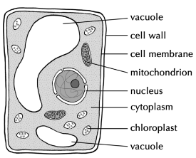
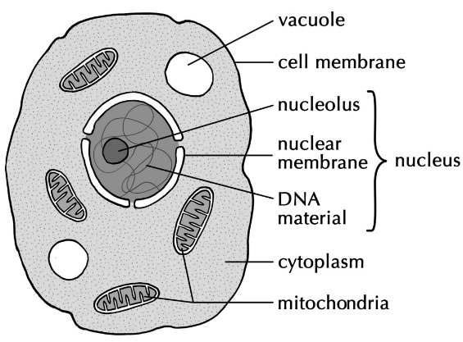
PLANT CELL
ANIMAL CELL
X
X
LABEL THE PLANT CELL AND ANIMAL CELL. CHOOSE FROM THE FOLLOWING:
(Note: labels can be used more than once. You do not need the label for the structures labelled X on the animal cell.)
Cell membrane, cell wall, chloroplast, cytoplasm, nucleus, DNA, mitochondria, vacuole

Slide 2
NAME OF STRUCTURE | FUNCTION (job) | ANIMAL CELL | PLANT CELL | BOTH
Nucleus
Cytoplasm
Cell membrane
Cell wall
Mitochondrion
Vacuole
Chloroplast

