Slide 1
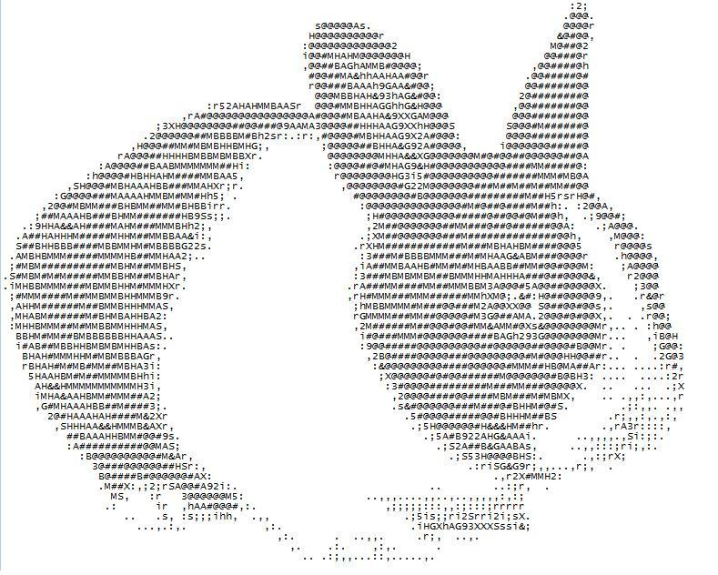
The ASCII Alphanumeric Code
What is it?
Why use it?
How do we use it?

Slide 3
What is it?
ASCII code represents alphanumeric data in most computers.
“American Standard Code for Information Interchange”
It works like any other code. One thing represents another.
In ASCII, binary is used to represent our numbers, letters and symbols.
ASCII includes definitions for 128 characters:
33 are non-printing control characters (many now obsolete) that affect how text and space is processed and 95 printable characters, including space.
Notes:
The control characters in ASCII still in common use include:
0 (null, NUL, \0, ^@), originally intended to be an ignored character, but now used by many programming languages to mark the end of a string.
7 (bell, BEL, \a, ^G), which may cause the device receiving it to emit a warning of some kind (usually audible).
8 (backspace, BS, \b, ^H), used either to erase the last character printed or to overprint it.
9 (horizontal tab, HT, \t, ^I), moves the printing position some spaces to the right.
10 (line feed, LF, \n, ^J), used as the end of line marker in most UNIX systems and variants.
12 (form feed, FF, \f, ^L), to cause a printer to eject paper to the top of the next page, or a video terminal to clear the screen.
13 (carriage return, CR, \r, ^M), used as the end of line marker in Mac OS, OS-9, FLEX (and variants). A carriage return/line feed pair is used by CP/M-80 and its derivatives including DOS and Windows, and by Application Layer protocols such as HTTP.
27 (escape, ESC, \e [GCC only], ^[).
127 (delete, DEL, ^?), originally intended to be an ignored character, but now used in some systems to erase a character.

Slide 4
Why do we use it?
At a very basic level we use ASCII because computers store all information in binary.
Therefore we need some way to encode numbers, letters and symbols in binary.
At first many different character sets were used, so on one system the code 0100001 would represent A, but on another it could be P, or Y!!!

Slide 5
Why do we use it?
Obviously this situation was far from ideal.
A standard character set was needed so that consistency between systems could be achieved.
Almost all character sets in use, now begin with the 128 ASCII characters.

Slide 6
How do we use it?
Each character (or command) is represented as a number from 0 to 127.
This is stored as a binary value in 7 bits.

Slide 7
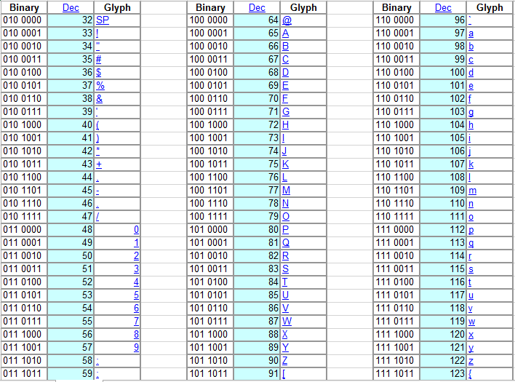
Notes:
Numbers can be encoded, but are stored as a text character (like a string in a database), so can not be used in calculations.

