Slide 1
Chemistry
Diffusion - R

Slide 2
Lesson objectives
Understand that particles in gases and liquids are able to move around in random directions

Slide 3
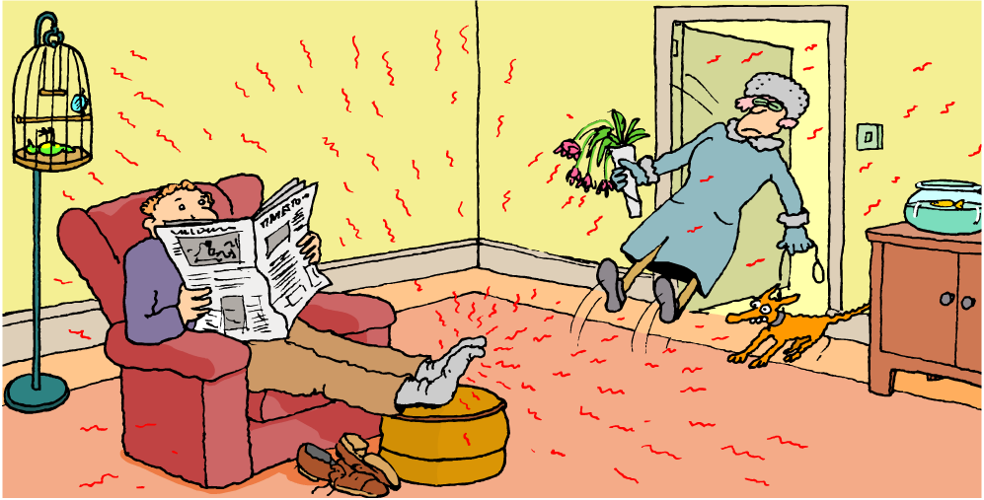
How do smells spread out?

Slide 4
What is diffusion?
Diffusion is the random movement of particles. When particles diffuse, they spread out and mix with other particles.
For example, the smell of aftershave or perfume can be detected by people on the other side of a room because the perfume particles diffuse in the air.
Can you think of some more everyday examples of diffusion?
Notes:
Photo credit: © 2008 Jupiterimages Corporation

Slide 5
Diffusion definition
Diffusion is the random movement of particles from an area of high concentration to low concentration

Slide 6
Fill in the gaps in these sentences, using words from the box. You may need to use some words more than once.
The colour in the beaker spreads out by ________________ .
The water ______________ are moving around all the time.
They bump into _________________ from the coloured crystal, and __________ them around. The colour gradually _____________ out through the ___________ .
diffusion moves particles spreads water

Slide 7
Fill in the gaps in these sentences, using words from the box. You may need to use some words more than once.
The colour in the beaker spreads out by diffusion.
The water particles are moving around all the time.
They bump into particles from the coloured crystal, and moves them around. The colour gradually spreads out through the water.
diffusion moves particles spreads water

Slide 8
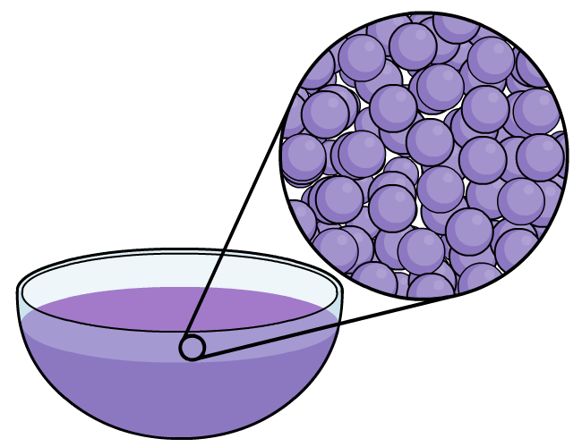
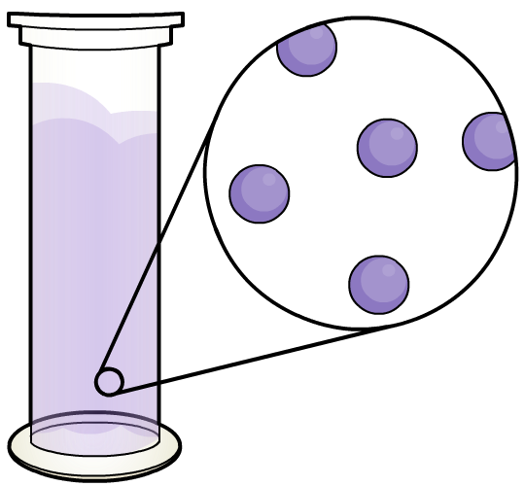
Diffusion in liquids and gases
Which will diffuse faster, a gas or a liquid?
The particles of a gas will diffuse faster. Why?
The gas particles are moving around faster than the particles in a liquid because they have more energy. This means that the gas particles will spread out more quickly.

Slide 9
Diffusion in solids
The particles in liquids and gases diffuse easily because they are free to move around. However, it is possible for solids to diffuse as well.
Scientists have found that if they put two metals next to each other and leave them for a long time, eventually a few particles of one metal will diffuse into the other.
This is because the particles in a solid vibrate, and some of them have enough energy to move around a little bit as well. Eventually, a few particles move around enough to diffuse into the other metal.
Notes:
Photo credit: Sophie Collin

Slide 10
Diffusion
Use the particle model to explain these facts about diffusion:
Diffusion occurs in liquids and gases but not in solids.
Diffusion happens more quickly for gases than for liquids.
Diffusion happens more quickly at warm temperatures than at cooler temperatures.
Here are some key words that might help:
particles movement kinetic energy

