Slide 1
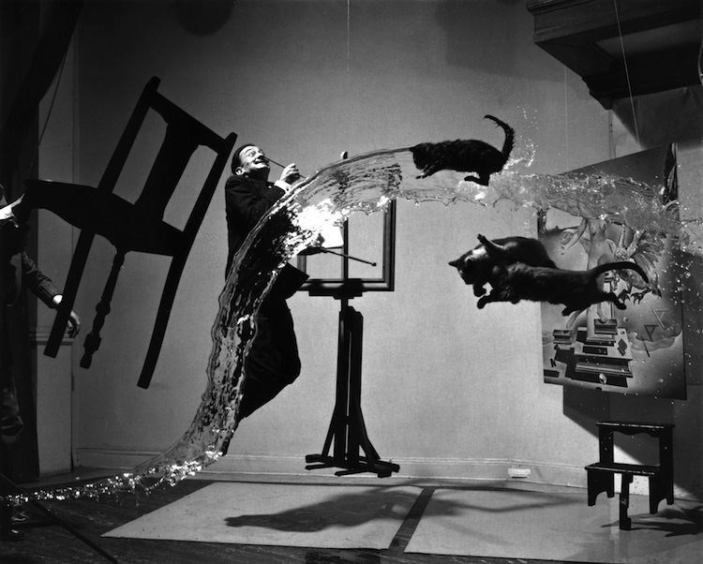
What is in the picture? Describe it in detail.
Where has the photograph been taken? Describe the setting or scene.
What message do you think the photographer wants to communicate to you? What is the work about?
What kind of colours are in the picture? What do they make you think about?
What formal elements can you talk about in this picture? Can you describe the lighting/ composition/ viewpoints/ pattern/ textures?
What mood or atmosphere is created in the picture? How does it make you feel and why?
Salvador Dali - ‘Dali A (Dali Atomicus)’
What ideas could you take from this photographer to inspire your own photography?
What is your opinion of this photograph? Be specific and explain yourself fully.

