Slide 1
Chemistry
Changing states of matter - R

Slide 2
Lesson objectives
Name the changes of the states of matter
Understand how the particle arrangement changes with increasing temperature

Slide 3
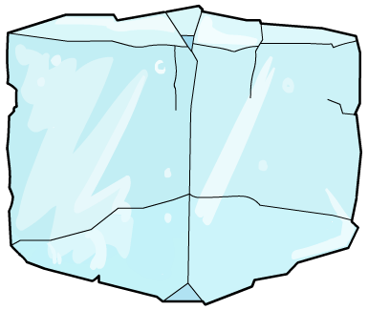
Changes of state
Each change of state has a special name:
melting
evaporating or boiling
ice
water
steam
freezing
condensing

Slide 4
Changing state
melting
evaporating
liquid
freezing
condensing
2
3
particles stay the same size
particle arrangement changes
solid
gas
energy of particles changes

Slide 5
Heating – melting & boiling
energy is being used to push the particles further apart
Temp/^{O}C
150
100
50
0
-50
gas
boiling
point
energy is being used to break particles apart
liquid
melting
point
Time/s
solid

Slide 6
Changing state
As the temperature increases and a solid changes to a liquid then a gas, what happens to?
the attraction between them
the energy of the particles
the movement of the particles

